Slide 1
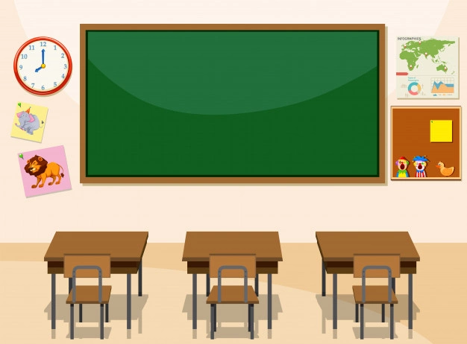
Hello everyone !!!

Slide 2
* WARM-UP
BRAINSTORMING
List as many adverbs of frequency as possible
always
usually
often
sometimes
rarely
never
……………

Slide 3
Unit
8
SHOPPING
LESSON 3: A closer look 2
* Grammar
1. ADVERBS OF FREQUENCY
2. SIMPLE PRESENT FOR FUTURE EVENTS
1

Slide 4
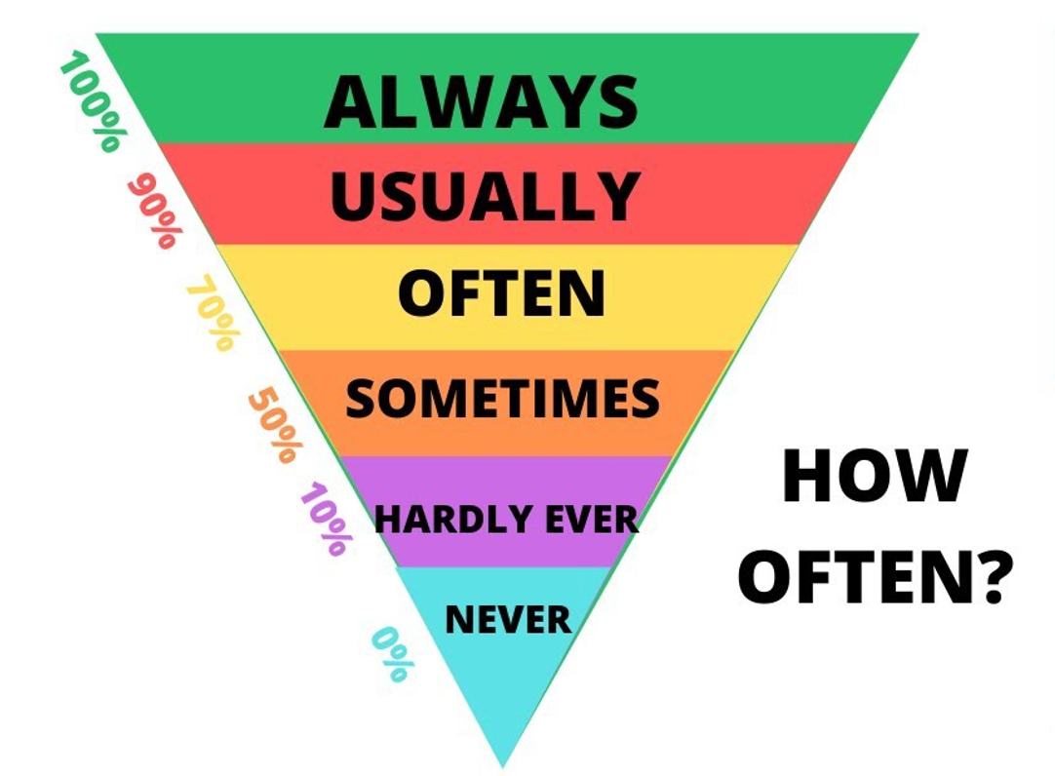
1. ADVERBS OF FREQUENCY
+ Notes: Trạng từ chỉ tần suất
1. Đứng trước động từ thường
My sister usually writes to me.
2. Đứng sau động từ tobe
They’re always slower than other teams

Slide 5
* PRACTICE
1
Complete the sentences with the adverbs of frequency from the box.
always
often
sometimes
rarely
never
1. My mother________ shops at the supermarket. She never shops anywhere else.
2. I ________ buy things online, just once or twice a year. I prefer to shop at the shopping mall.
3. You can _______ bargain at a supermarket because the prices are fixed.
4. How ______ do you return things you buy online?
5. I don’t often buy things at the dollar store. My mother only takes me there __________.
Game

Slide 6
* PRACTICE
1
Complete the sentences with the adverbs of frequency from the box.
1
2
3
4
5

Slide 7
* PRACTICE
1
Complete the sentences with the adverbs of frequency from the box.
always
often
sometimes
rarely
never
1. My mother________ shops at the supermarket. She never shops anywhere else.
always

Slide 8
* PRACTICE
1
Complete the sentences with the adverbs of frequency from the box.
always
often
sometimes
rarely
never
2. I ________ buy things online, just once or twice a year. I prefer to shop at the shopping mall.
rarely

Slide 9
* PRACTICE
1
Complete the sentences with the adverbs of frequency from the box.
always
often
sometimes
rarely
never
3. You can _______ bargain at a supermarket because the prices are fixed.
never

Slide 10
* PRACTICE
1
Complete the sentences with the adverbs of frequency from the box.
always
often
sometimes
rarely
never
4. How ______ do you return things you buy online?
often

Slide 11
* PRACTICE
1
Complete the sentences with the adverbs of frequency from the box.
always
often
sometimes
rarely
never
5. I don’t often buy things at the dollar store. My mother only takes me there __________.
sometimes

Slide 12
* PRACTICE
1
Complete the sentences with the adverbs of frequency from the box.
always
often
sometimes
rarely
never
1. My mother________ shops at the supermarket. She never shops anywhere else.
2. I ________ buy things online, just once or twice a year. I prefer to shop at the shopping mall.
3. You can _______ bargain at a supermarket because the prices are fixed.
4. How ______ do you return things you buy online?
5. I don’t often buy things at the dollar store. My mother only takes me there __________.

Slide 13
2
Read the schedule for the grade 8 field trip tomorrow, and underline the verbs in the sentences. Then answer the questions.
Field trip to the Double Dragon Chocolate Factory. 30 February
9:00 | The bus leaves.
10:00 | Students arrive at the factory
10:10 | Students watch a documentary introducing the factory.
10:30 | The tour of the factory starts.
12:10 | Students return to school to write the trip reports.
Present simple
What tense are the verbs in the sentences?
Are the sentences about habits or future activities?
Future activities

Slide 14
2. SIMPLE PRESENT FOR FUTURE EVENTS
USES
- Facts
- Habitual actions
- Future events

Slide 16
3
Write A next to a sentence if it relates to a timetable, schedule or plan, and B if it is an unplanned future action.
1. We’ll go to Costco to return this suitcase.
2. Look! We have a whole afternoon for shopping on the second day of our tour.
3. The summer sales end next Sunday.
4. Listen to the announcement. The train doesn’t leave till 12:00.
5. I’m too busy today, so we’ll go shopping on Tuesday.
B
A
A
A
B

Slide 17
4
Choose the correct answer to complete each sentence.
1. The supermarket in my neighbourhood opens / will open longer hours than the one in yours.
2. Don’t worry. I make / will make a shopping list, and you just give it to the shop owner.
3. We don’t buy / won’t buy a birthday cake this year. We can bake one at home.
4. The bus schedule says that there is / will be a bus to Aeon at 10:05.
5. Look at the advertisement. Does / Will the big sale start next Friday?

Slide 18
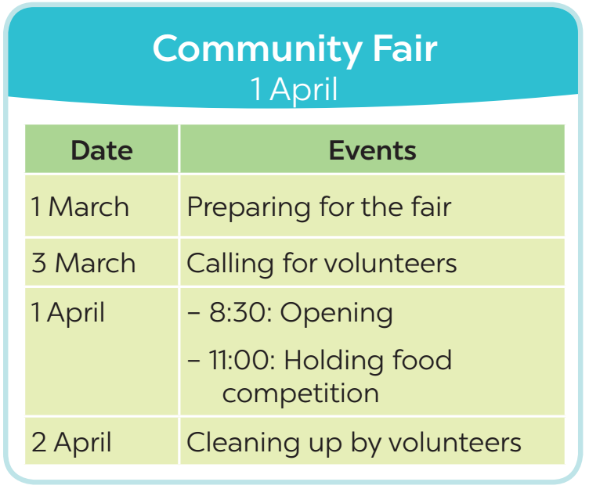
5
Work in pairs. Ask and answer to check planned events for the community fair next month.
Example:
A: When do we start preparing for the fair?
B: We start on the first of March.

Slide 19
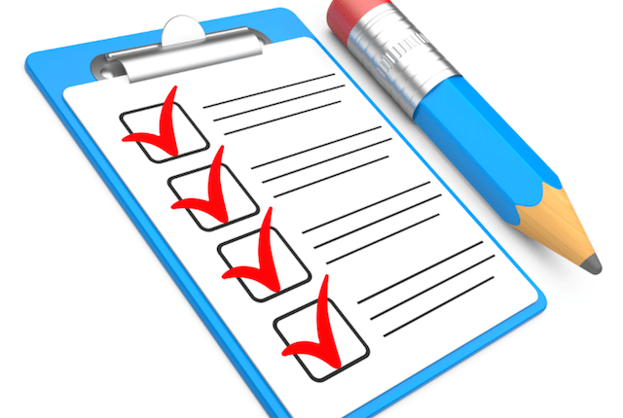
CONSOLIDATION
What have we learnt in this lesson?
Recall adverbs of frequency
Present simple for future uses

Slide 20
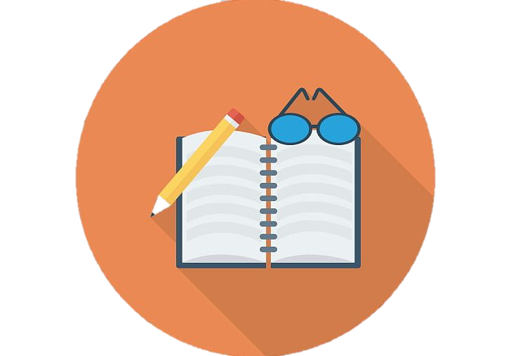
* Homework
Learn the use of adverbs of frequency by heart.
Make 5 sentences of the simple present for future meaning
Do exercise in the Workbook

