Slide 1


Slide 2



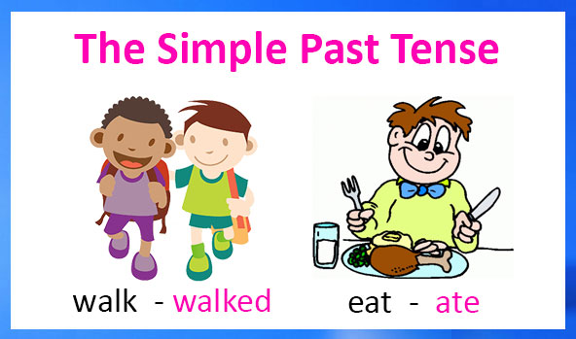
Unit
3
COMMUNITY SERVICE
https://wordwall.net/resource/61693950
LESSON 3: A CLOSER LOOK 2

Slide 3
LESSON 3: A CLOSER LOOK 2
IRREGULAR VERBS
REGULAR VERBS
V_{1 →} V _{2 ( S. P)}
V₁ → V-ed
grow → grew
Collect → collected
make → made
Reuse → reused
Send → sent
Join → joined
Teach → taught
Help → helped
Take → took
Plant → planted
Buy → bought
Pick → picked
See → saw
Read → read
Volunteer → volunteered

Slide 4

WARM-UP
https://wordwall.net/resource/61981247/copy-of-present-continuous-past-simple
What did you do last weekend?
What did you watch yesterday?
Who did you meet two days ago?

Slide 5
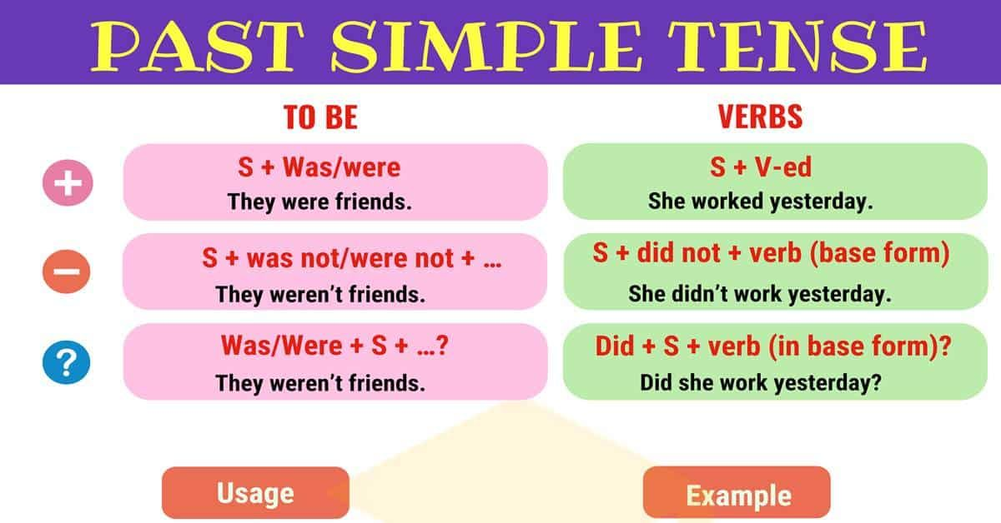
Yesterday, last, ago, this morning, in 2022, 2021,… ; in the past,

Slide 6
PRACTICE
1
Circle the correct answer A, B, or C to complete each sentence.
1. Green School ______ vegetables for an orphanage last spring.
A. is growing B. grew C. grows
2. Children ______ plastic bottles for recycling a month ago.
A. are collecting B. collect C. collected
3. We ______ English to children in a primary school last summer.
A. are teaching B. taught C. teach

Slide 7
PRACTICE
1
Circle the correct answer A, B, or C to complete each sentence.
4. Our school club ______ gloves for old people in nursing homes last winter.
A. made B. is making C. make
5. We ______ bottles to help the environment last month.
A. are reusing B. reuse C. reused

Slide 8
PRACTICE
https://wordwall.net/resource/26872691
2
Complete the sentences the the past simple form of the given verbs.
took
1. Care for Animals (take) _______ care of thousands of homeless dogs and cats last year.
2. ___________ teenagers (join) ___________ Lending Hand in 2015?
3. We (help) ___________ the elderly in a village last summer.
4. Last year, we (send) ___________ textbooks to help children in a rural village.
5. Tom (volunteer) ______________ to teach English in our village last winter.
Did
join
helped
sent
volunteered

Slide 9
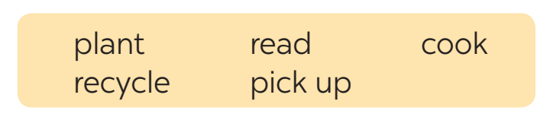
PRACTICE
https://wordwall.net/resource/21751774
3
Complete the sentences with the correct forms of the verbs from the box.
1. The club members _____________ food for patients every Sunday.
2. ________ you _____________ those trees in the playground last month?
3. Nick and his friends _________________ rubbish on the beach now.
4. Tom ______________ the plastic bottles, and now he has some nice vases.
5. We often ____________ books to old people in a nursing home.
cook
Did
plant
are picking up
recycled
read

Slide 10
PRACTICE
4
Write complete sentences from the prompts.
1. last year / our club / donate / books / children in rural areas.
_____________________________________________________
2. children / send / you thank-you cards / a week ago?
_____________________________________________________
3. I / teach / two children in grade 2 / last summer.
_____________________________________________________
4. Last spring / we / help / the elderly / nursing home.
_____________________________________________________
5. How / you / help / people / in flooded areas / last year?
_____________________________________________________
Last year, our club donated books to children in rural areas.
Did children send you thank-you cards a week ago?
I taught two children in grade 2 last summer.
Last spring, we helped the elderly in a nursing home.
How did you help the people in flooded areas last year?

Slide 11

CONSOLIDATION
2
HOMEWORK
Complete exercises in the Workbook.

Slide 12

Website: sachmem.vn
Fanpage: facebook.com/sachmem.vn/

