Slide 1
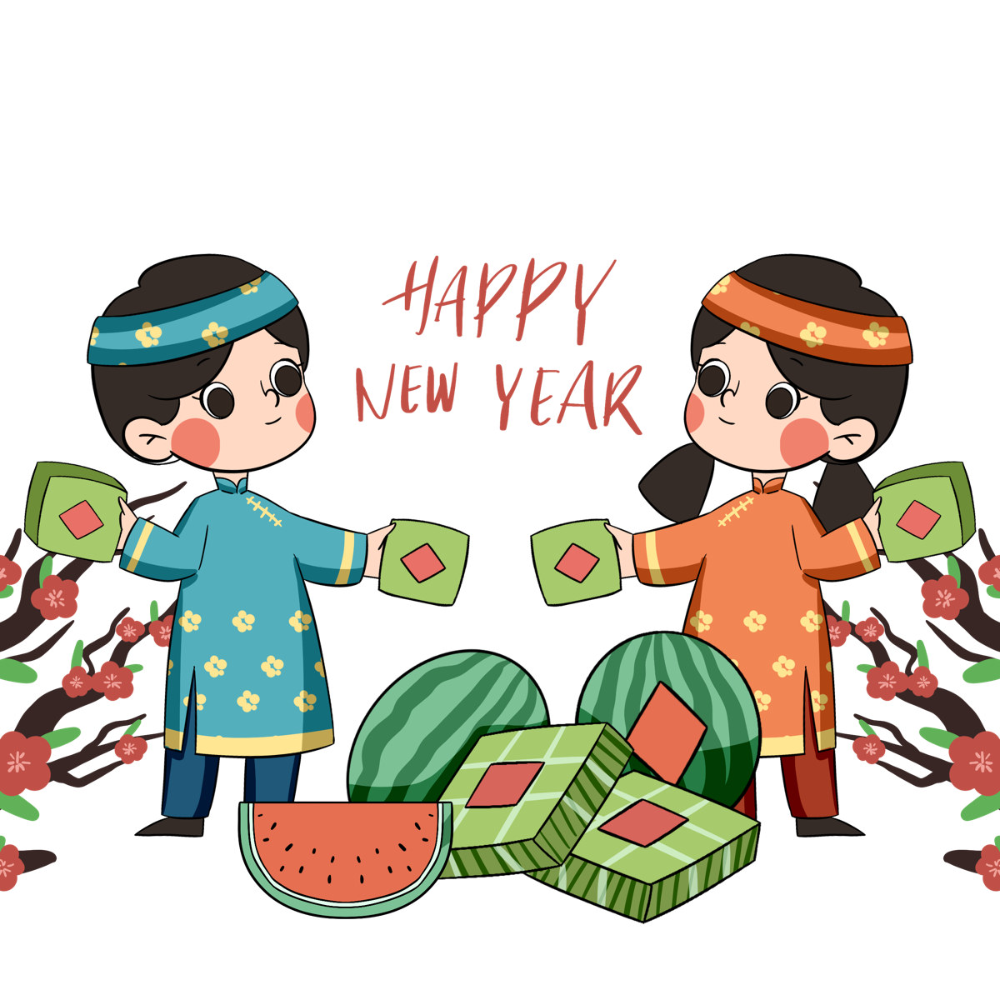
Unit 6. our tet holiday
COMMUNICATION

Slide 3
EVERYDAY ENGLISH
Saying New Years' wish

Slide 6
The USA
Russia
Japan
Thailand
They go to Time Square to watch the New Year’s Eve Ball drop
They bathe in an ice hole
They eat mocha rice cakes.
They throw water on other people

Slide 8
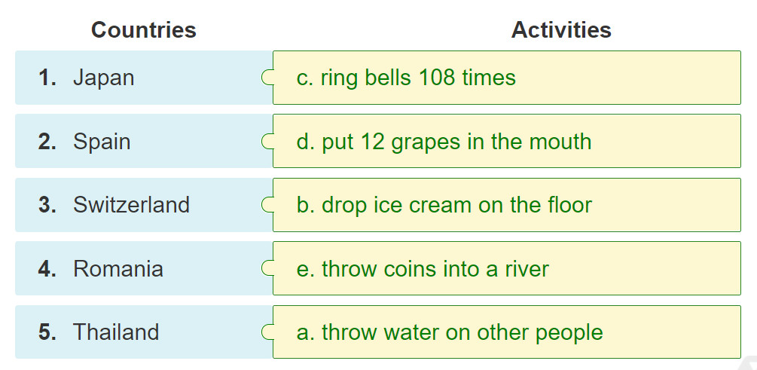

Slide 9
5
Work in groups. Each student chooses one activity from 4. Take turns to say them aloud. The group says which country he / she is talking about.
Example: – They throw water on other people. – It's in Thailand.

Slide 10
5
Work in groups. Each student chooses one activity from 4. Take turns to say them aloud. The group says which country he / she is talking about.
- They put 12 grapes in the mouth. (Họ cho 12 quả nho vào miệng.)
- It’s Spain. (Đó là Tây Ban Nha.)
- They ring bells 108 times. (Họ rung chuông 108 lần.)
- It’s Japan. (Đó là Nhật Bản.)
- They throw coins into a river. (Họ ném đồng xu xuống sông.)
- It’s Romania. (Đó là Romania.)
- They drop ice cream on the floor. (Họ làm rơi kem xuống sàn.)
- It’s Switzerland. (Đó là Thụy Sĩ.)

Slide 12
To find the answers to the questions click on the clock image on the bottom right-hand corner of each slide.

Slide 13
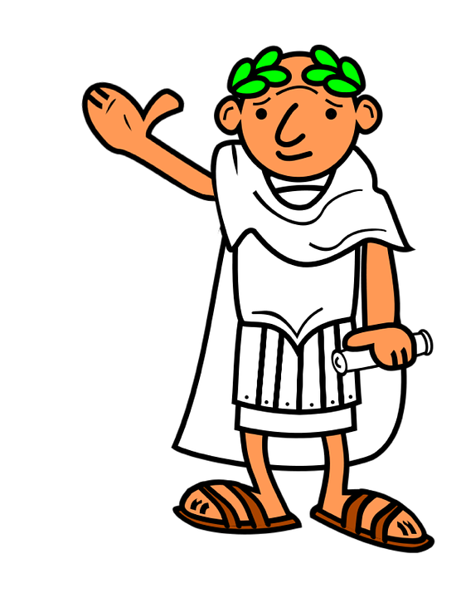
1. Who introduced the Julian Calendar in 45BC and made January 1st the beginning of the New Year?
The New Year will now begin on the 1st of January.
The Egyptians
The Romans
The Armenians

Slide 14
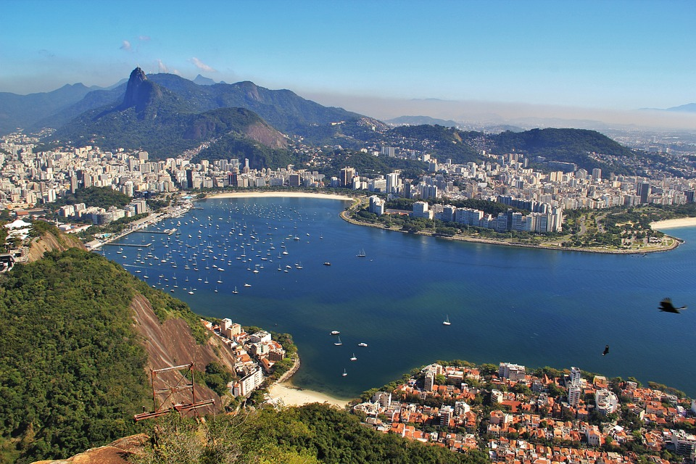
2. The River of Januarywas discovered by the Portuguese on 1st January 1502. What is the River of January known as?
Rio de la Plata
Rio de Janeiro
Rio Grande

Slide 15
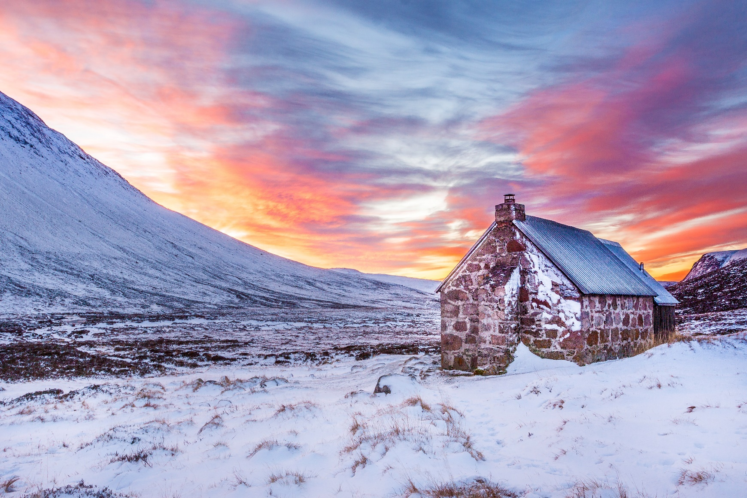
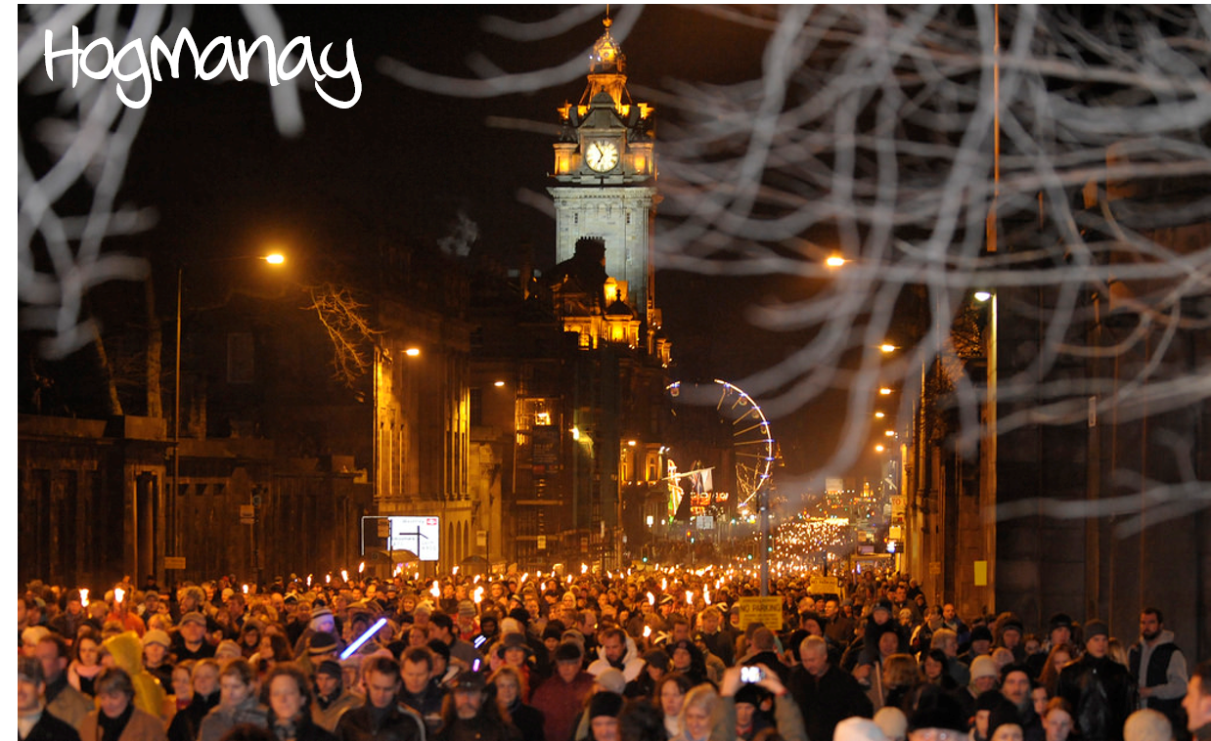
3. What is New Year known as in Scotland?
Hagmoney
Hogmanay
First Night
Notes:
https://www.flickr.com/photos/126452848@N08/21299891288/sizes/l
https://www.goodfreephotos.com/albums/scotland/other-scotland/dusk-sky-and-clouds-with-house-in-scotland.jpg

Slide 16
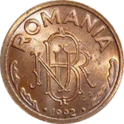
4. In Romania what is traditionally thrown into rivers at New Year?
corn
coins
branches
Notes:
Coins https://hy.wikipedia.org/wiki/%D5%8A%D5%A1%D5%BF%D5%AF%D5%A5%D6%80:1leu1992b.png

Slide 17
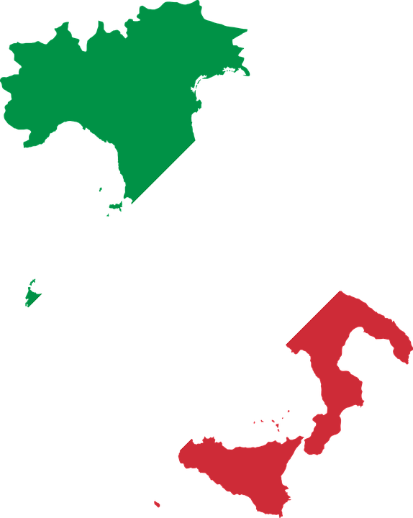
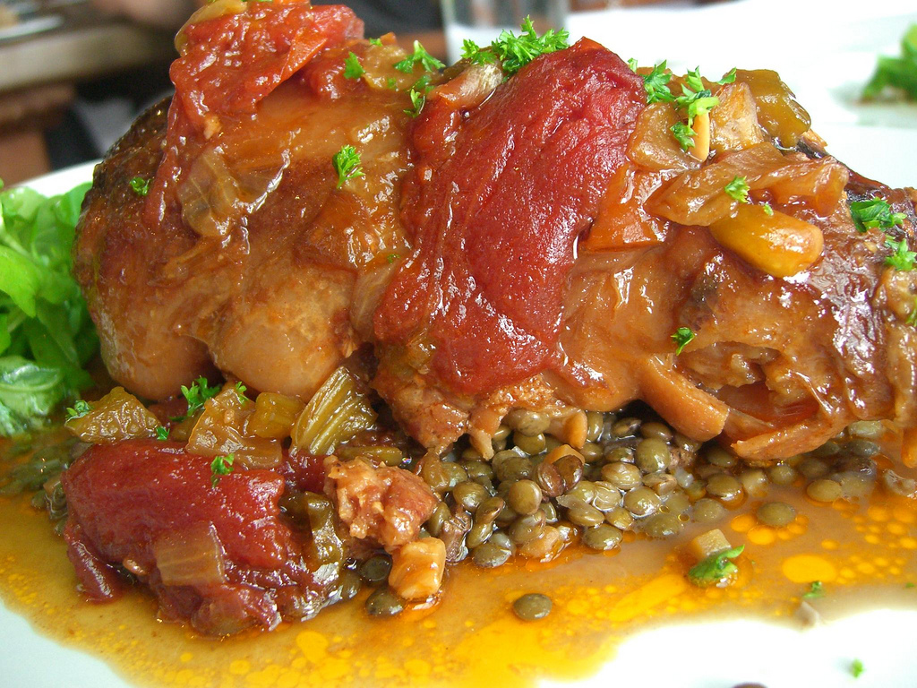
5. Where is it a custom to eat pig’s trotters and lentils on New Year’s Day to bring good luck in the coming year?
England
Italy
Spain
Notes:
https://www.flickr.com/photos/avlxyz/4951349104/sizes/l

Slide 18
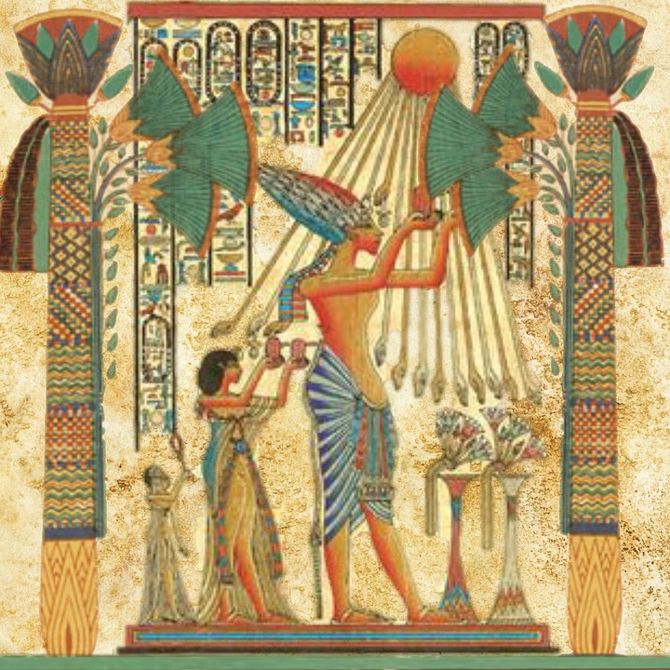
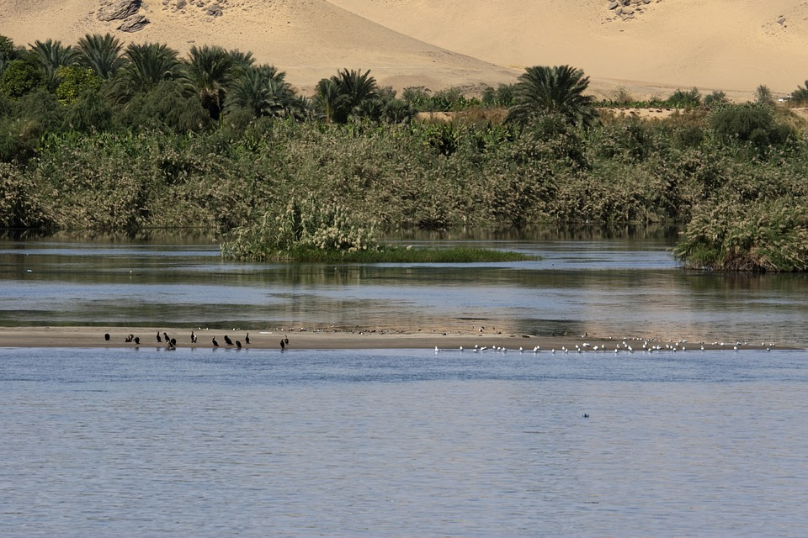
6. In Ancient Egypt what event decided the date of the New Year?
the alignment of stars
lunar eclipse
flooding of the Nile

Slide 19
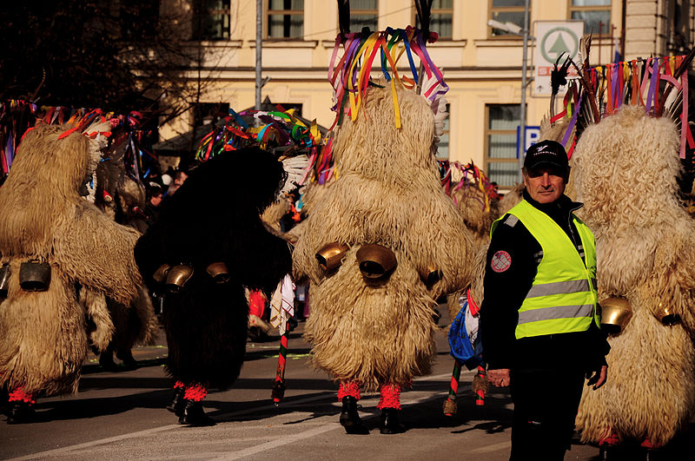
7. In which country do people put on bear costumes and dance in order to scare away evil spirits at New Year?
Peru
Slovenia
Slovenia
Poland
Notes:
https://commons.wikimedia.org/wiki/File:Kurents,_Carnival_in_Kranj,_Slovenia_2009_(3312680197).jpg
https://en.wikipedia.org/wiki/File:Flag-map_of_Slovenia.svg

Slide 20
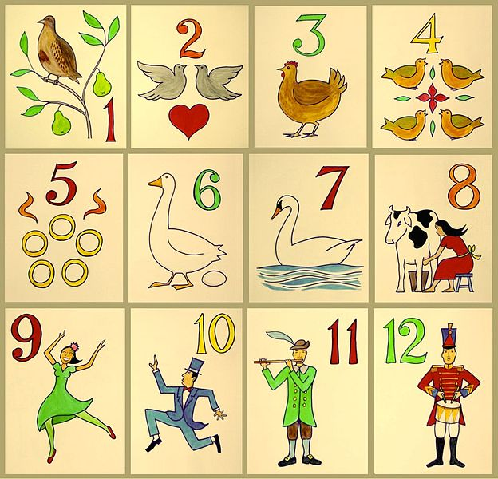
8. On which day of Christmas is January 1st?
sixth
seventh
eighth

Slide 21
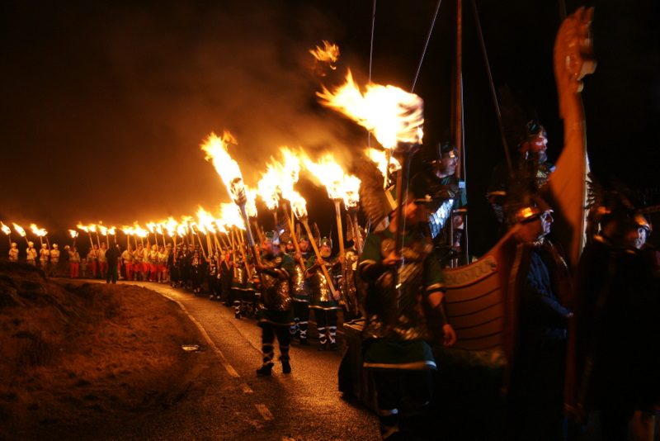
9. Where do people take part in a ceremony at New Year that involves the swinging of large balls of fire?
Scotland
Norway
Iceland
Notes:
https://commons.wikimedia.org/wiki/File:Procession_at_Uyeasound_Up_Helly_Aa_-_geograph.org.uk_-_1706007.jpg

Slide 22
10. Where is it a custom for people to throw old furniture out of windows on New Year’s Eve?
Cuba
https://youtu.be/Yp5lvaqQrkc
South Africa
Portugal

Slide 23
HOMEWORK

