Slide 1

Unit 2: MY FRIENDS AND I
Lesson 1.2
Page 35

Slide 2

WARM-UP

Slide 3
Listen and choose. Then say.

Slide 4


Listen and choose
slowly
fast
badly
A
B
C

Slide 5
Listen and choose
well
fast
badly
A
B
C

Slide 6
Listen and choose
well
fast
hard
A
B
C

Slide 7
Listen and choose
well
fast
badly
A
B
C

Slide 8
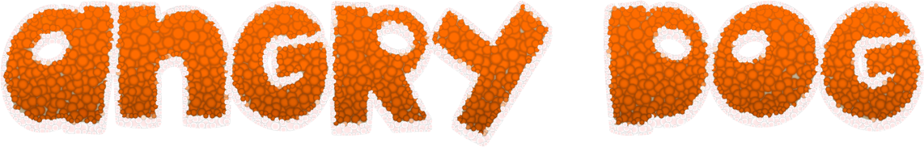
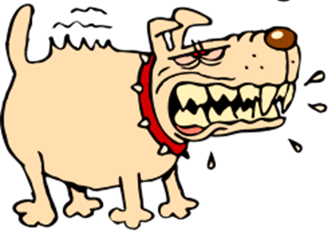


GAME
GAME ON ADVERBS OF MANNER
Notes:
8

Slide 9
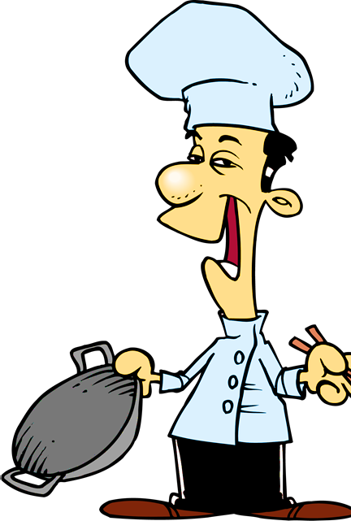

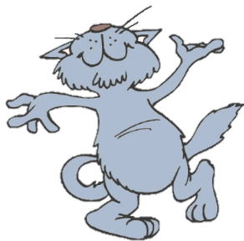
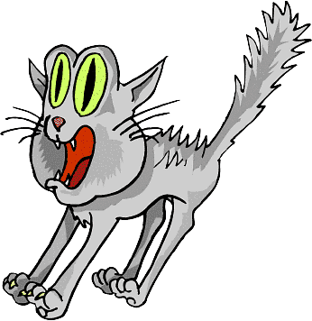

He sings ____________.
You got it!
badly
bad
NEXT
Notes:
9

Slide 10
She sings beautifully.
She is a _________ singer.
You got it!
good
well
NEXT

Slide 11
This bus is too _______ .
We will be late for school.
You got it!
slow
slowly
NEXT
Notes:
11

Slide 12
They are fantastic dancers.
They dance really _______.
You got it!
well
badly
NEXT
Notes:
12

Slide 13
I don’t want to go with him.
He drives too ________ .
You got it!
fast
slow
END

Slide 14
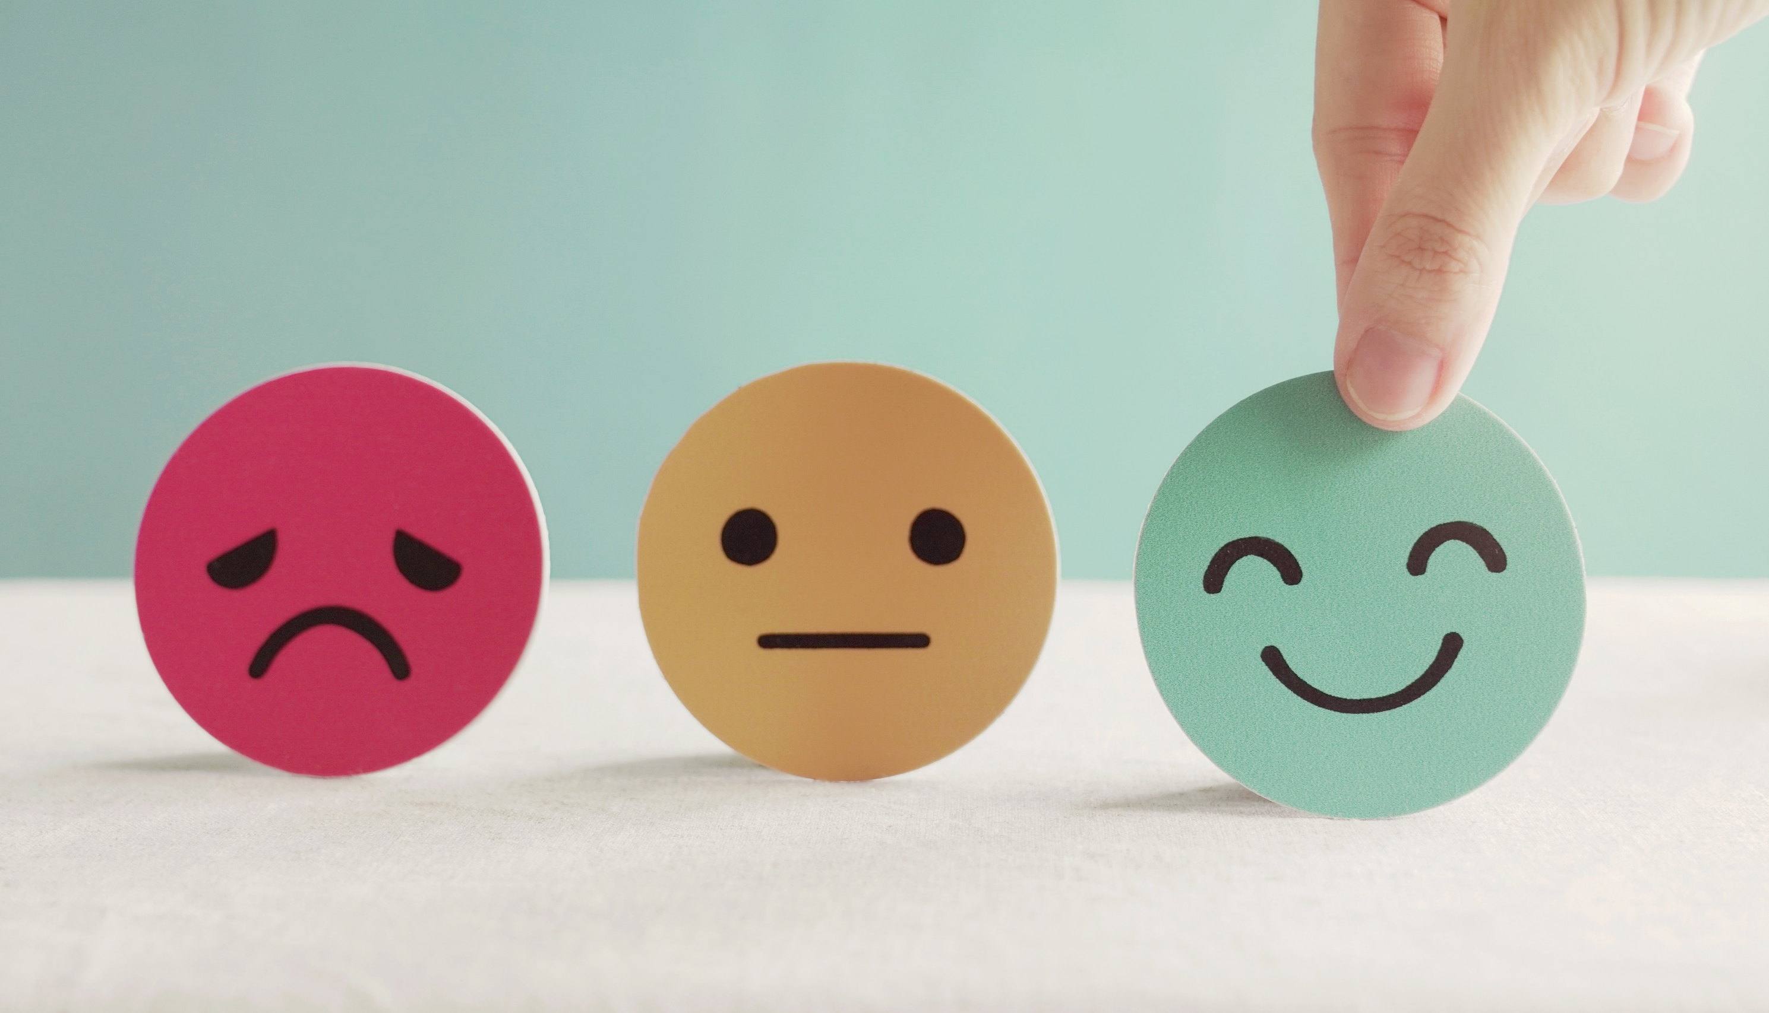
Lesson 3
Stay positive and have a nice day!

