Slide 1

Unit 3: MY FRIENDS AND I
Culture - Lesson 2
Page 44

Slide 2
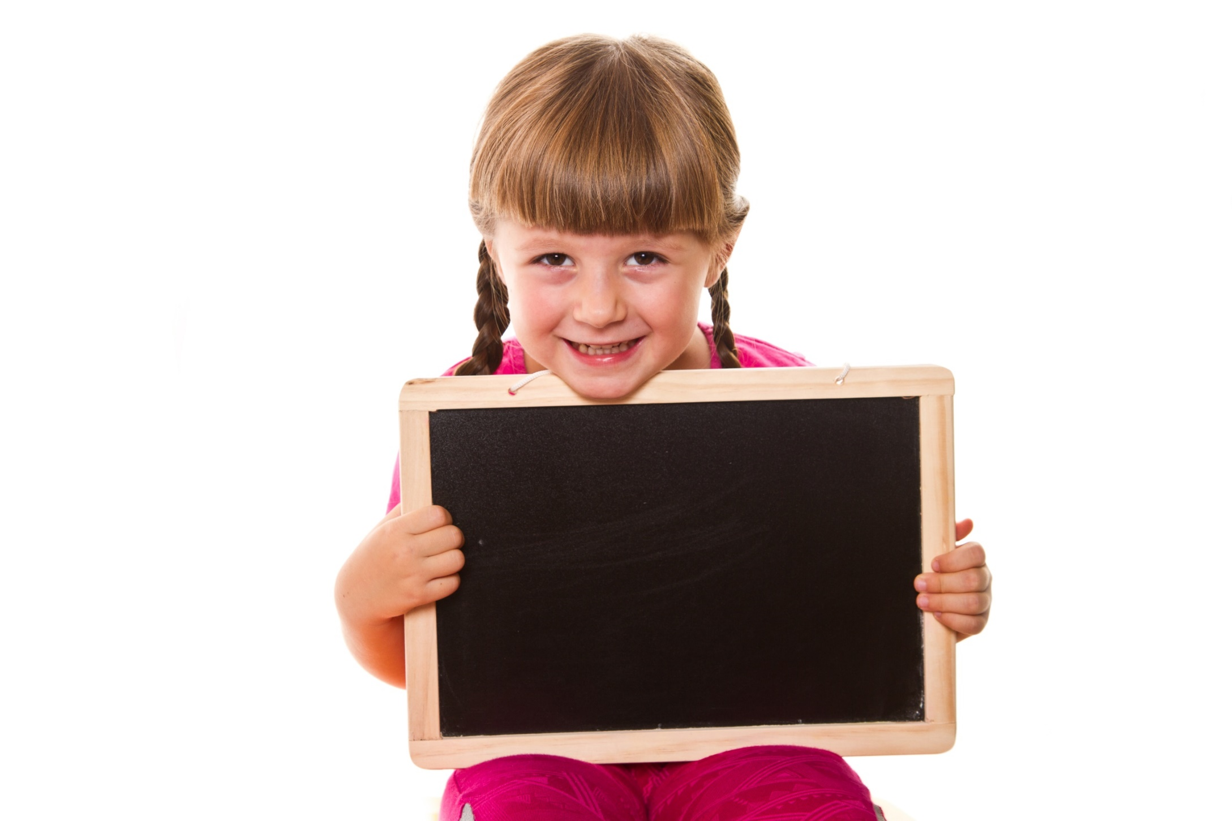
Lead-in

Slide 3
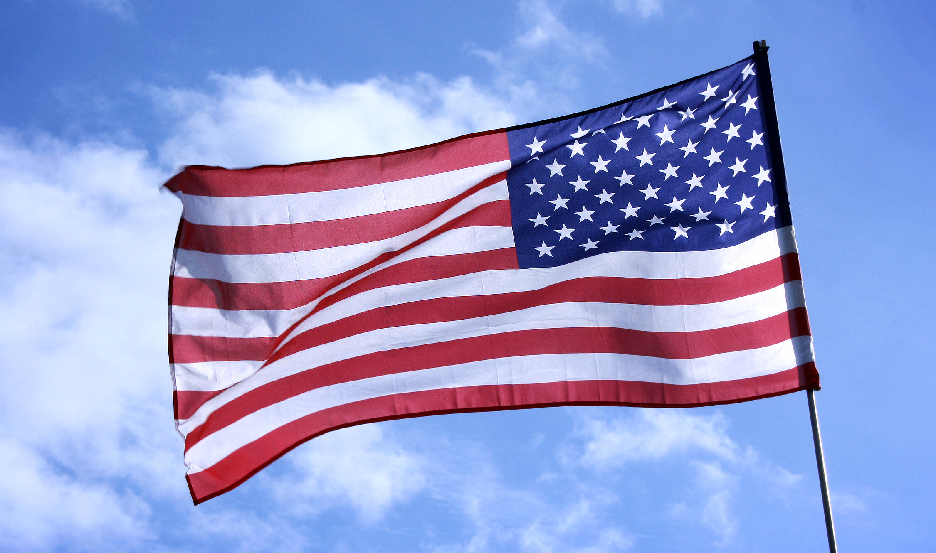
WHAT COUNTRY IS IT?
The U.S.A.
Its capital is Washington, D.C.
It is the world’s third largest country in size.

Slide 4
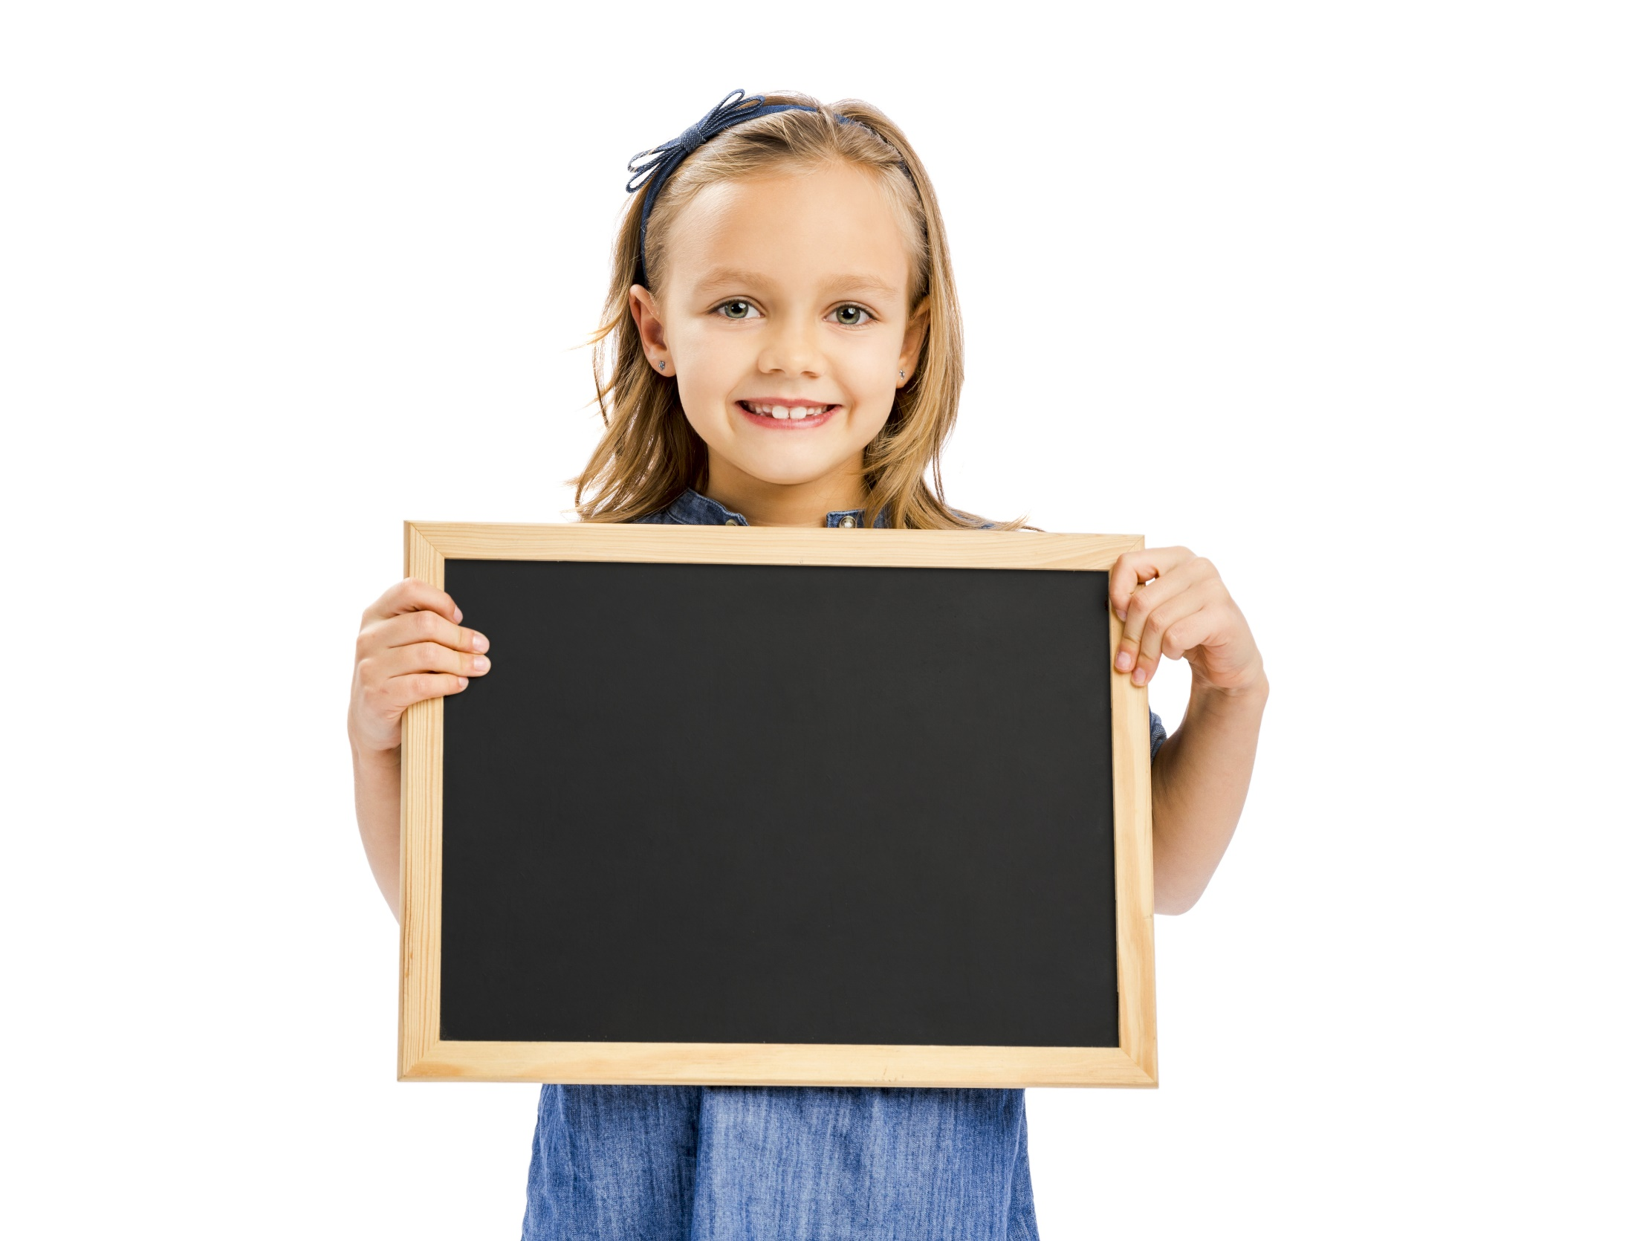
Reading

Slide 5
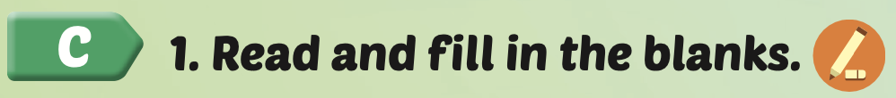
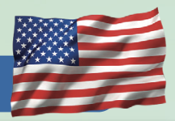

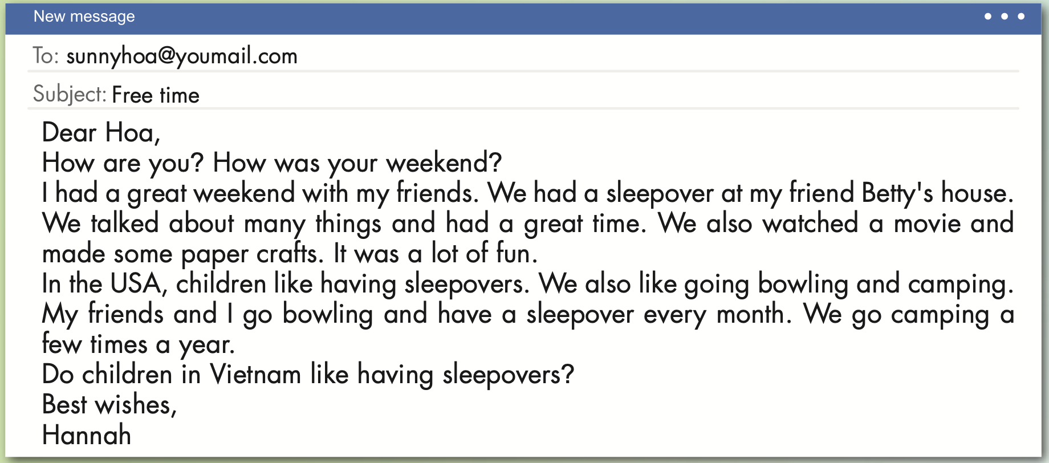

Slide 6
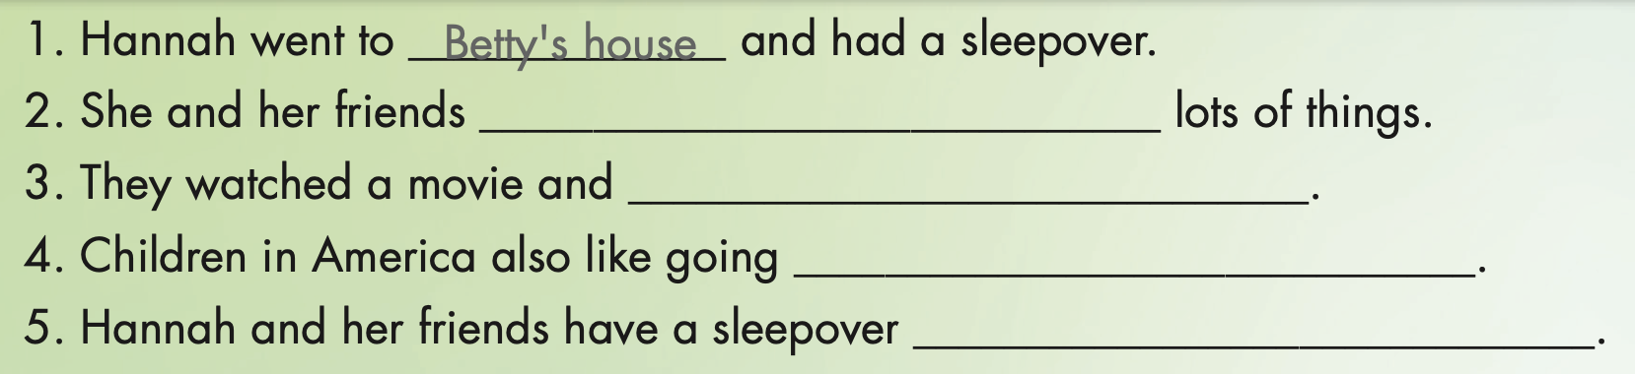
talked about
made some paper crafts
bowling and camping
every month

Slide 7

NO
YES or NO
YES
START

Slide 8
Hoa had a sleepover at her friend Betty’s house.
NO
YES

Slide 9
Hannah had a great weekend with her feiends.
NO
YES

Slide 10
Hannah lives in the USA.
NO
YES

Slide 11
In the USA, children don’t like going camping.
NO
YES

Slide 12
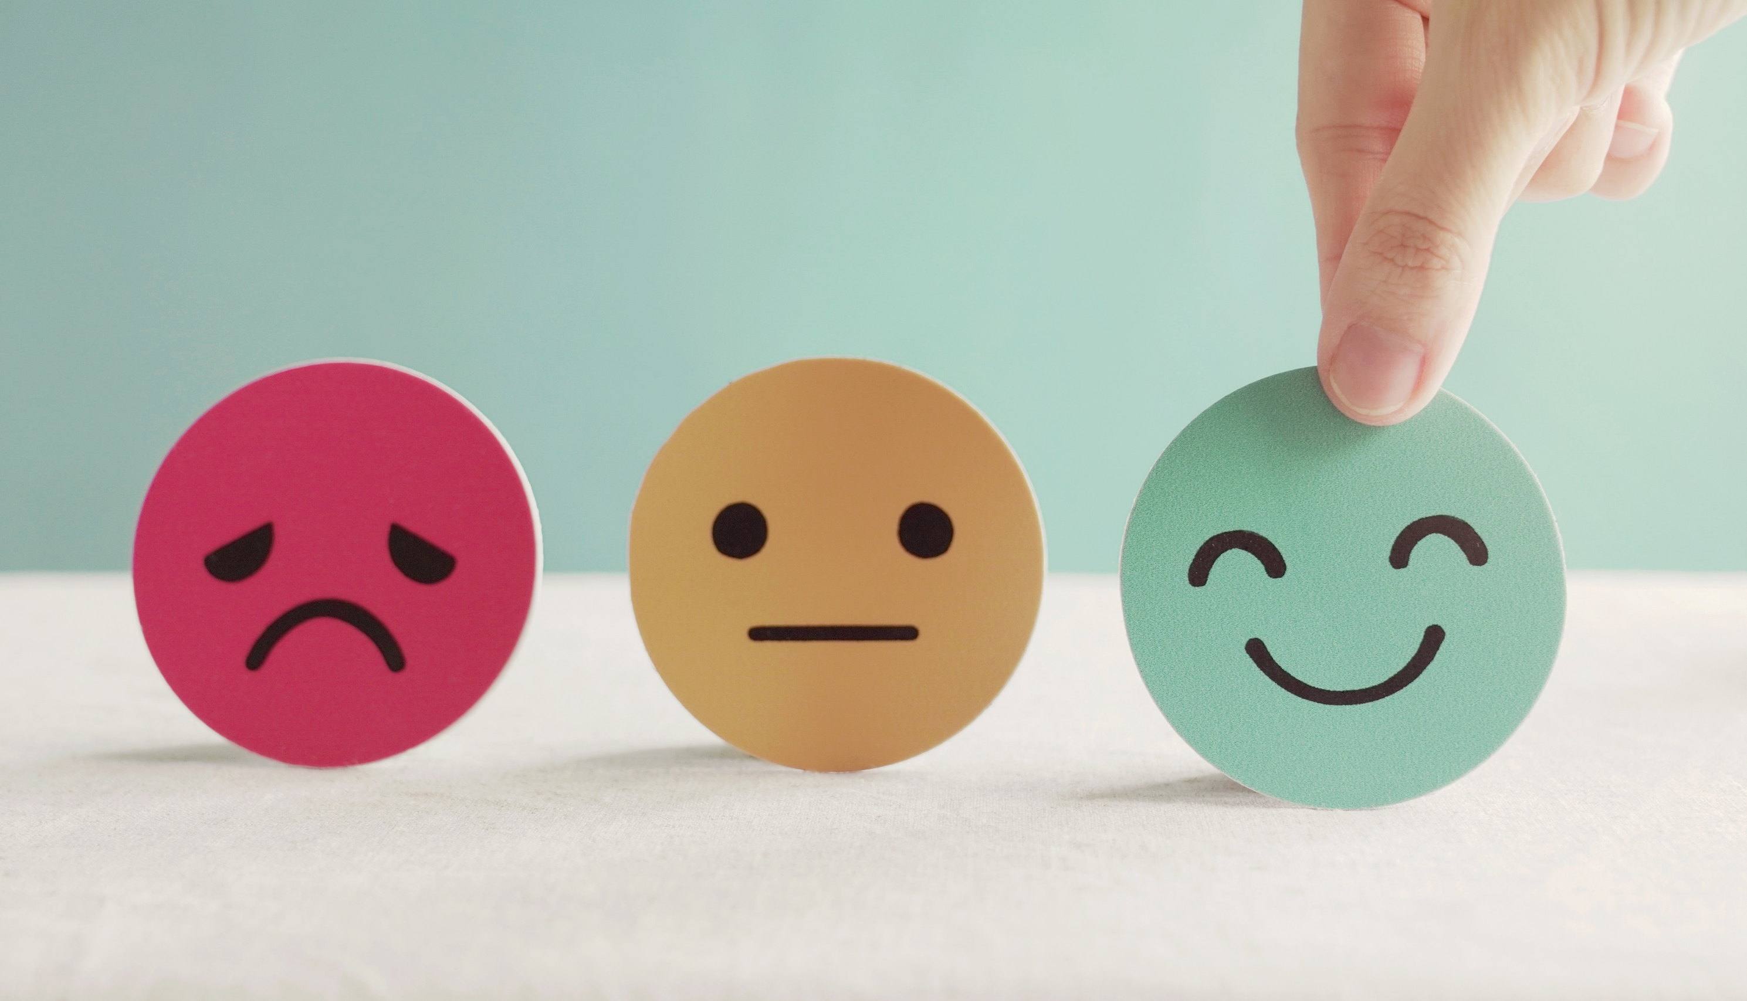
Lesson 3
Stay positive and have a nice day!

