Slide 1

Unit 3: School
Review 2
Page 51

Slide 2
Lesson Outline
Warm-up
Speaking
Consolidation
Wrap-up

Slide 3
Objectives
By the end of this lesson, students will be able to review asking who owns different school supplies, asking what subjects people like, and talking about their school timetables.

Slide 4

WARM UP

Slide 5

Let’s play!
Hot seat

Slide 6

It’s time to learn …

Slide 7

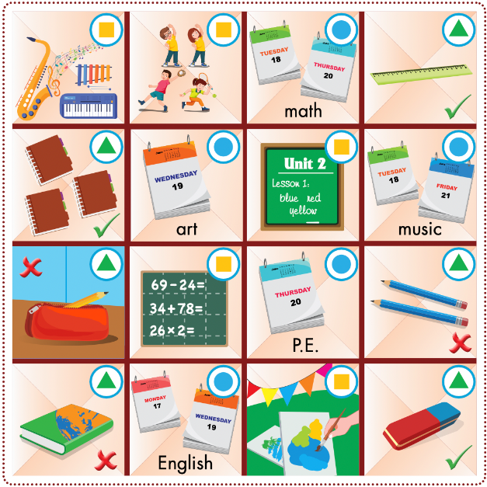

Slide 8

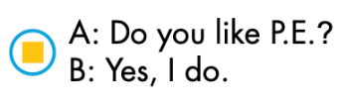

Example:

Slide 9


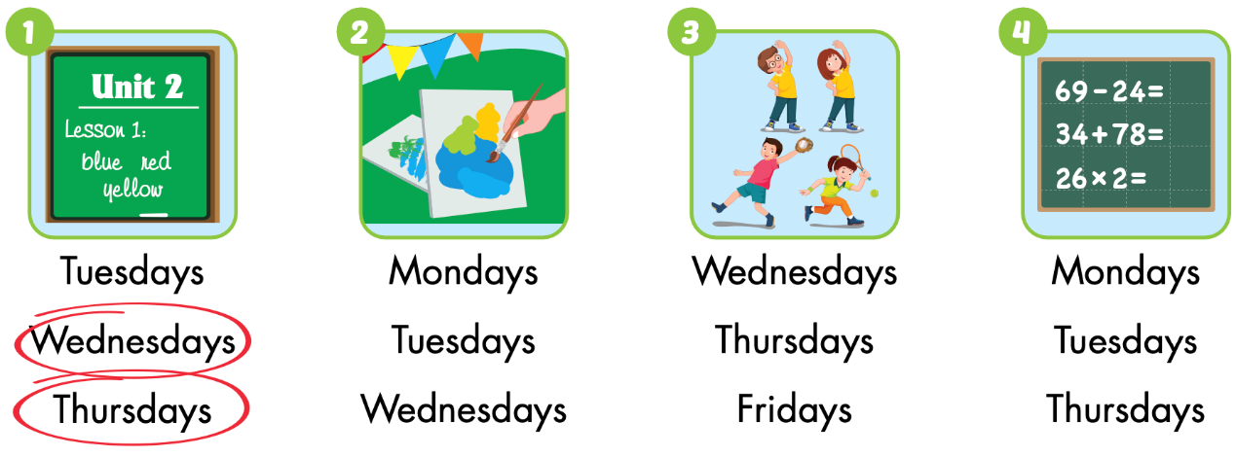
Extra Practice
WB p. 37

Slide 10
Top
5
QUIZ

Slide 11
# 1

Slide 12
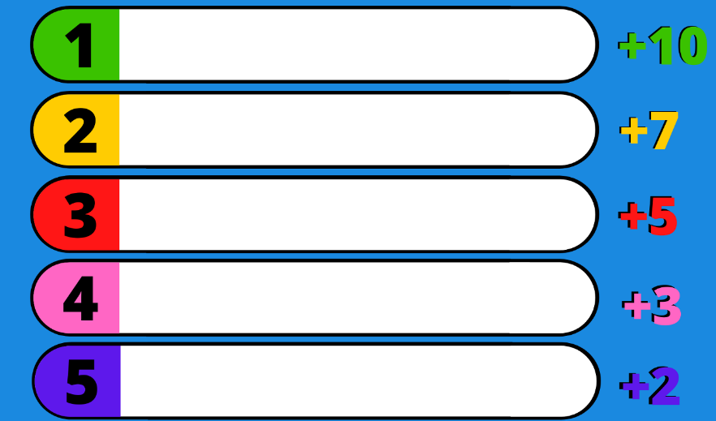
Name a school thing.
eraser
notebook
ruler
pencil case
book

Slide 13
# 2

Slide 14
Name a color.
green
orange
red
pink
purple

Slide 15
# 3

Slide 16
Name a day.
Sunday
Tuesday
Friday
Thursday
Monday

Slide 17
# 4

Slide 18
Name a school subject.
Math
English
music
art
P.E.

Slide 19

CONSOLIDATION

Slide 20
Let’s play!

Slide 21

game
Word Jumble Race

Slide 22



Slide 23

WRAP-UP

Slide 24
Lesson 3
Today’s lesson
Vocabulary:
Monday, Tuesday, Wednesday, Thursday, Friday, Saturday, Sunday
math, art, English, music, P.E.
pencil, ruler, notebook, eraser
Structures/ Sentence patterns
When do you have math?
I have math on Monday.

Slide 25
Lesson 3
Homework
Review all vocabularies and structures. Make sentences using them.
Do the exercises on page 37 WB
Prepare the next lesson (page 52 SB)

Slide 26
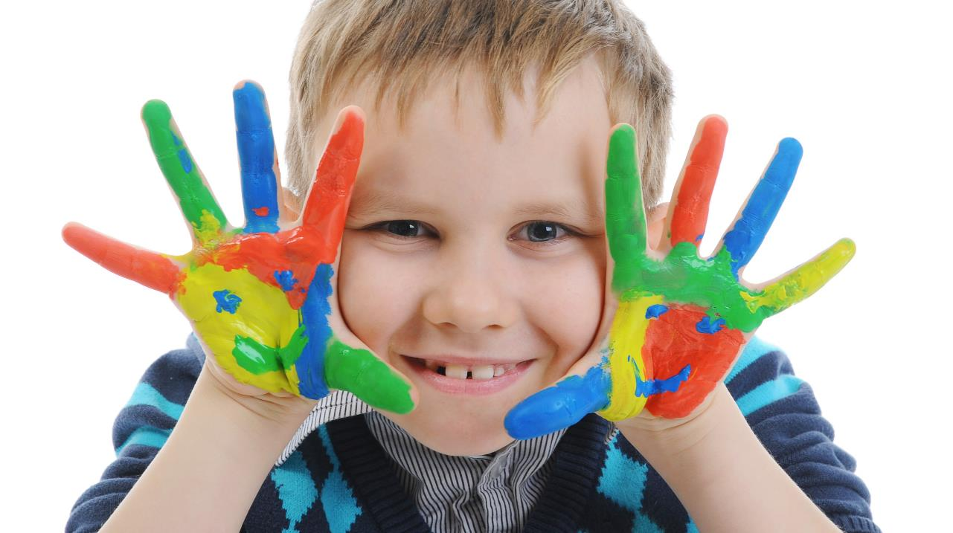
Enjoy your day!

Slide 27

Lesson 3
Stay positive and have a nice day!

