Slide 1
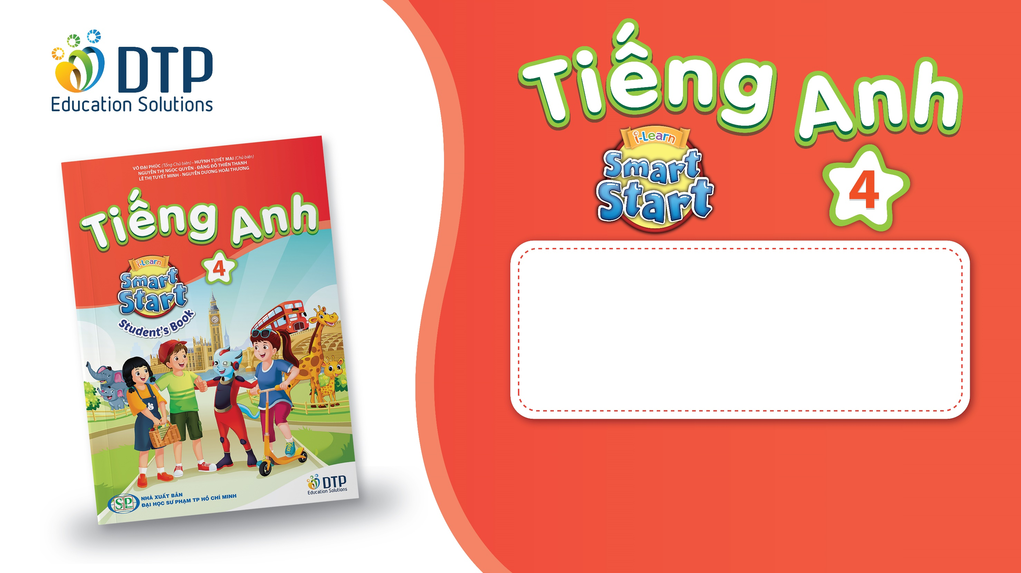
Unit 4: ACTIVITIES
Lesson 1.1
Page 48

Slide 2
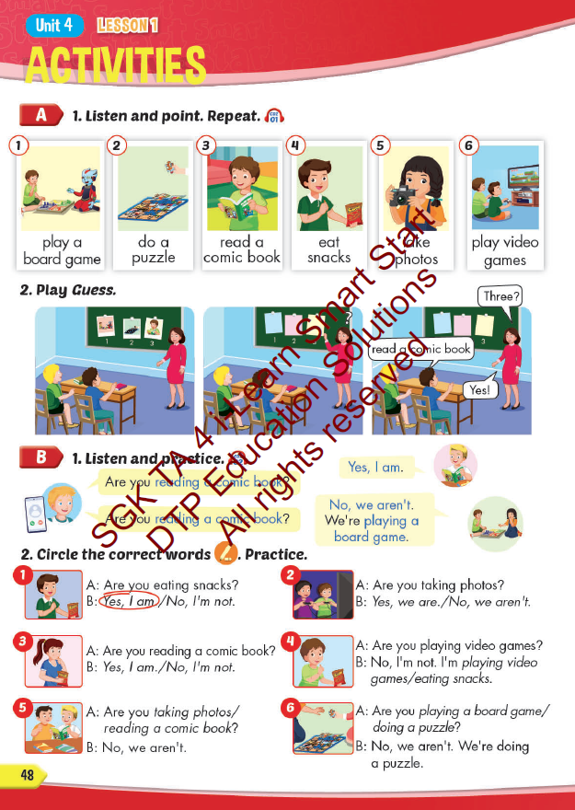
Lesson Outline
Warm-up
Vocabulary
Structure
Consolidation
Wrap-up

Slide 3
Objectives
By the end of this lesson, students will be able to learn and use ….
Vocabulary: play a board game, do a puzzle, read a comic book, eat snacks, and play video games.
Structure:
Are you reading a comic book?
- Yes, I am.
Are you read a comic book?
- No, we aren’t. We’re playing a board game.

Slide 4

WARM UP

Slide 5
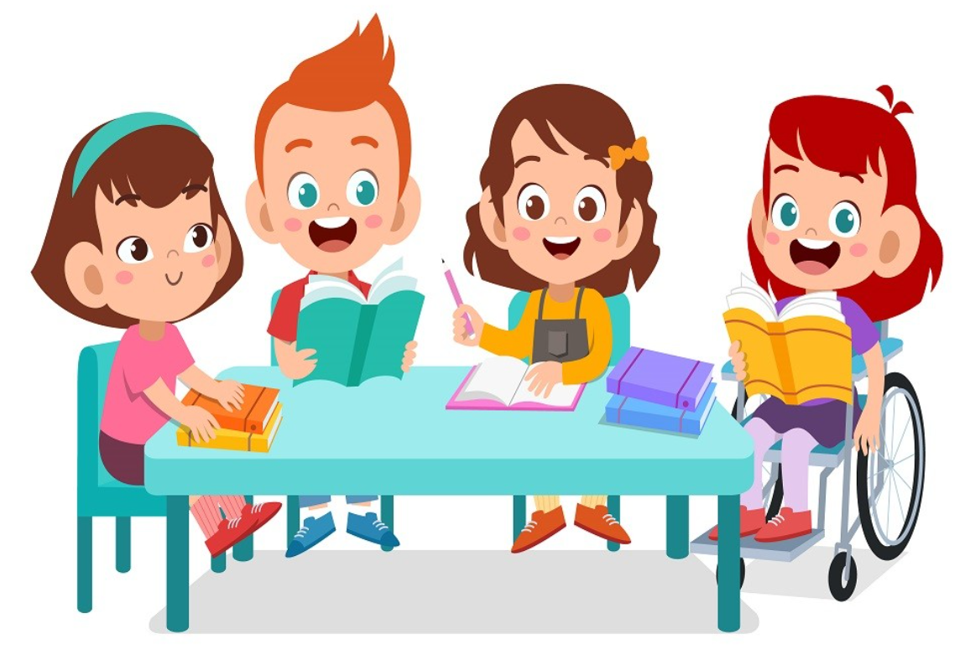
It’s time to learn …

Slide 6

New words
play a board game
do a puzzle
read a comic book
eat snacks
take photos

Slide 7

Presentation

Slide 8

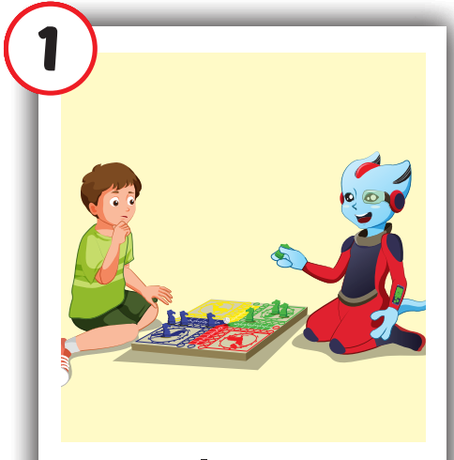
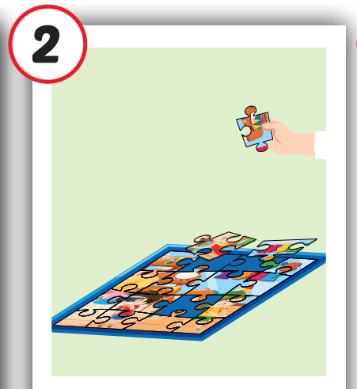
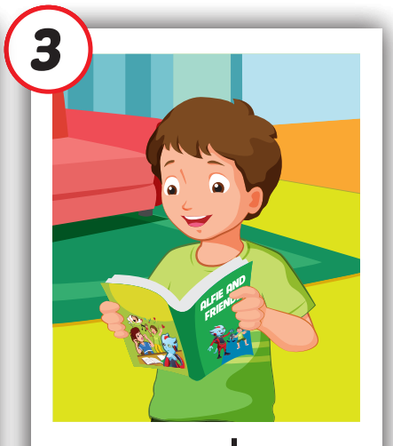

Click each English word to hear the sound.
play a board
game
do
a puzzle
read a comic book
/pleɪ ə ˈbɔːrd ˌɡeɪm/
chơi trò chơi có bàn cờ
/duː ə ˈpʌzl /
trò chơi xếp hình
/riːd ə ˈkɑːmɪk bʊk/ đọc truyện tranh

Slide 9
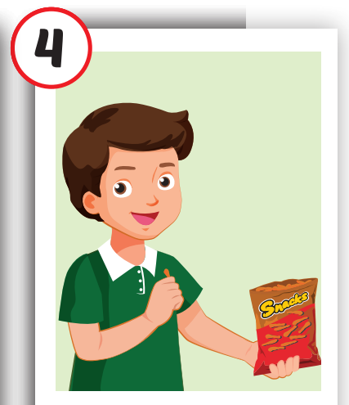
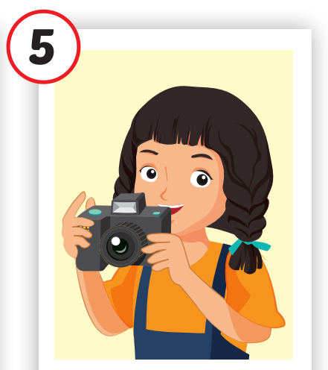
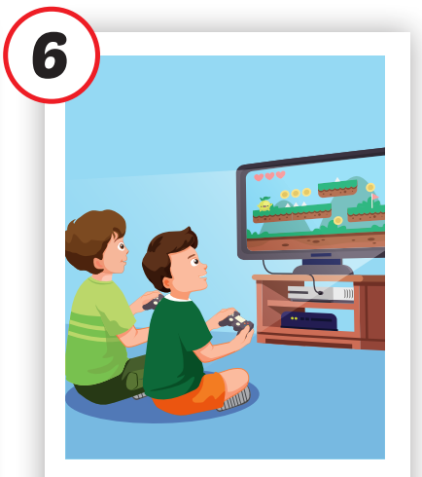
play
video games
eat snacks
take photos
/iːt snæk/ ăn vặt
/teɪk ˈfoʊtoʊz /
chụp ảnh
/ˈplei ˈvɪdioʊ ɡeɪmz/ chơi trò chơi điện tử

Slide 10

Practice

Slide 11
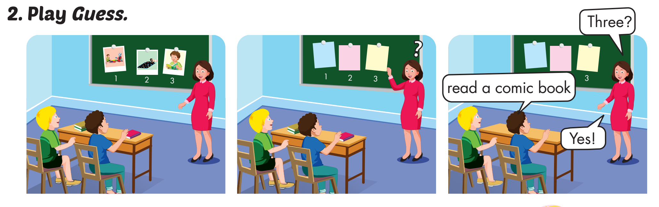

Slide 12
WHAT’S MISSING?
play a board game
eat snacks
read a comic book
take photos
take photos
Do a puzzle
Do a puzzle
Do a puzzle
eat snacks
take photos
read a comic book
read a comic book
play a board game
Do a puzzle
eat snacks
Do a puzzle
eat snacks
take photos
play a board game
take photos
read a comic book
play a board game
read a comic book

Slide 13
Structures
Are you reading a comic book? - Yes, I am.
Are you reading a comic book?
No, we aren’t. We are playing a board game.

Slide 14
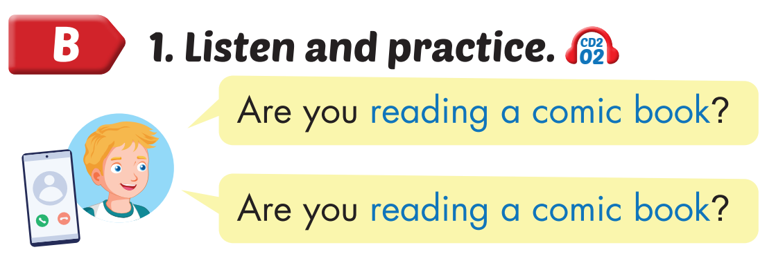
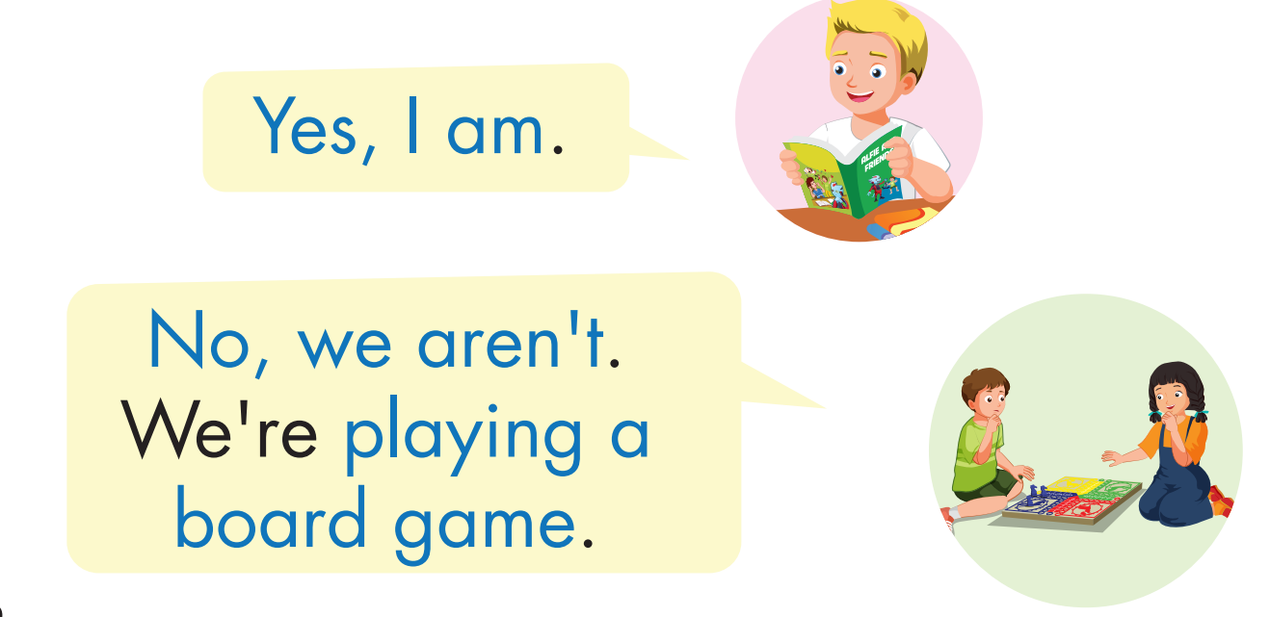
Click on the headphone icon to hear the sound.

Slide 15

Practice

Slide 16

CONSOLIDATION

Slide 17
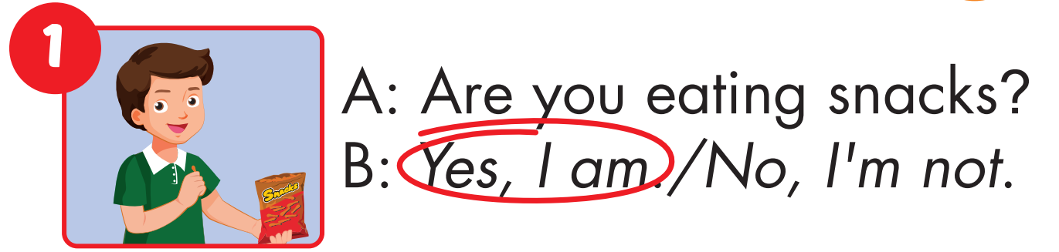
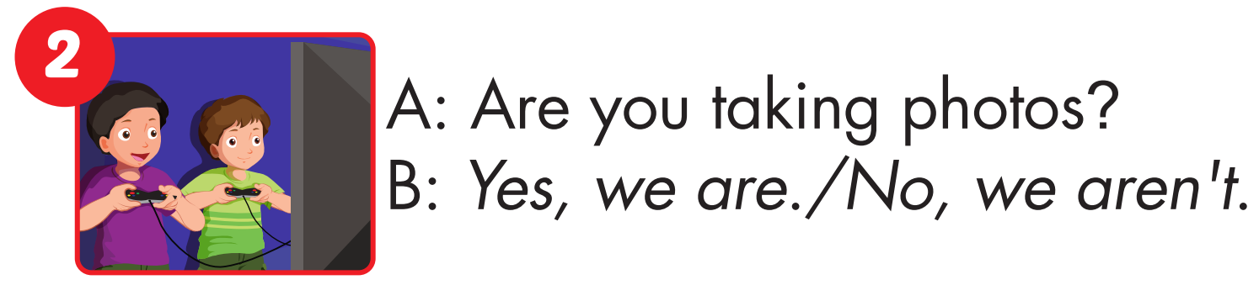

Slide 18
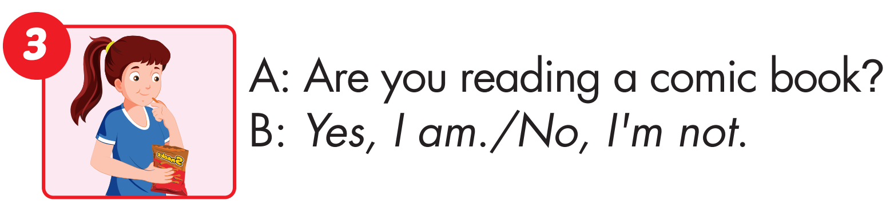
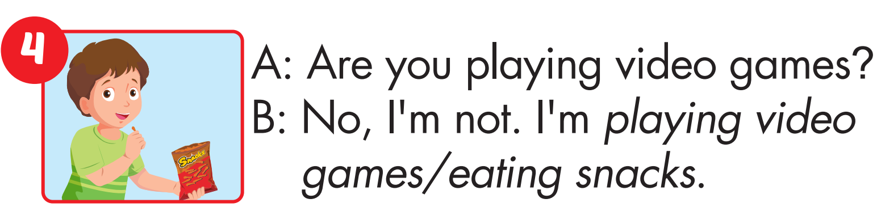

Slide 19
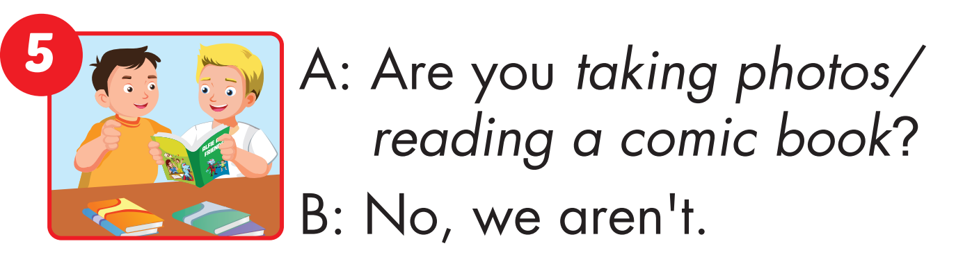
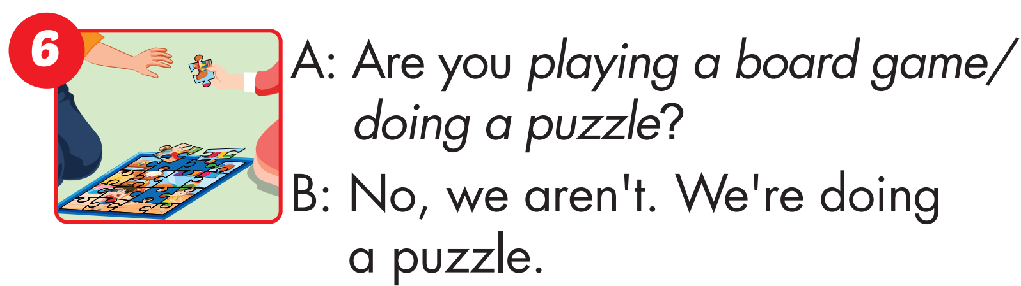

Slide 20
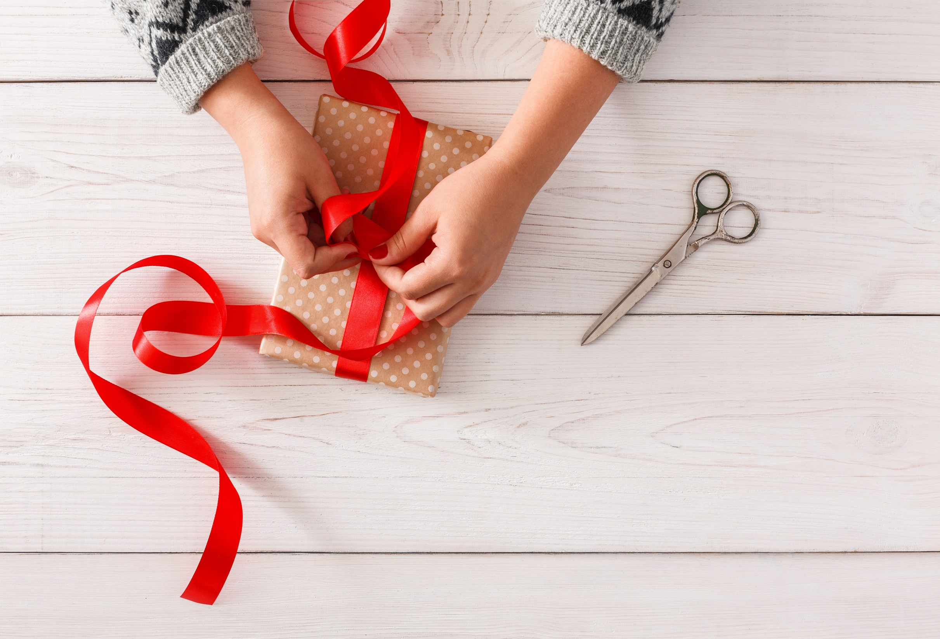
WRAP-UP

Slide 21
Today’s lesson
Vocabulary
play a board game, do a puzzle, read a comic book, eat snacks, play video games.
Structures/ Sentence patterns
Are you reading a comic book?
– Yes, I am.
Are you read a comic book?
- No, we aren’t. We’re playing a board game.

Slide 22
Homework
Practice the vocabularies and structure, and make sentences using them.
Prepare the next lesson (page 49 SB).

Slide 23
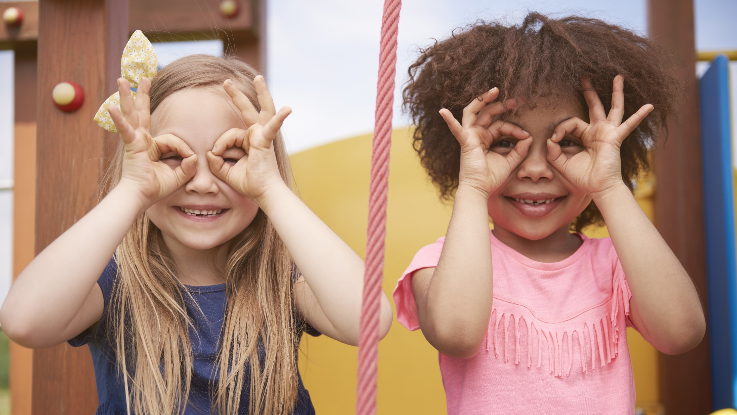
Enjoy your day!

