Slide 1

Unit 3: WEATHER
Lesson 4.2
Page 44

Slide 2
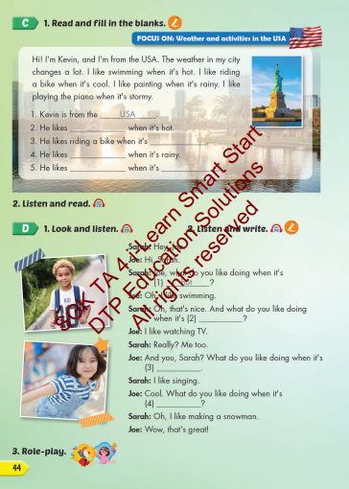
Lesson Outline
Warm-up
Listening
Consolidation
Wrap-up

Slide 3
Objectives
By the end of this lesson, students will be able to the weather like today.
Vocabulary: Cold, Hot, Warm, Freezing, Cool, Stormy
Structure: What do you like doing when it's hot?
I like swimming.

Slide 4

WARM UP

Slide 5

It’s time to learn …

Slide 6

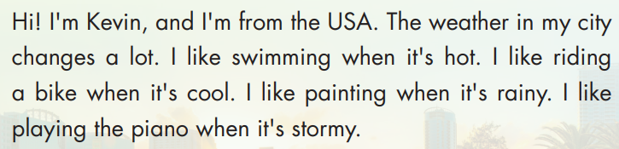
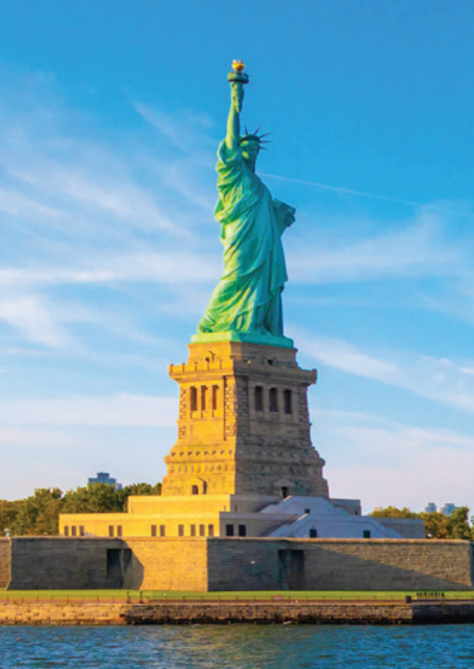
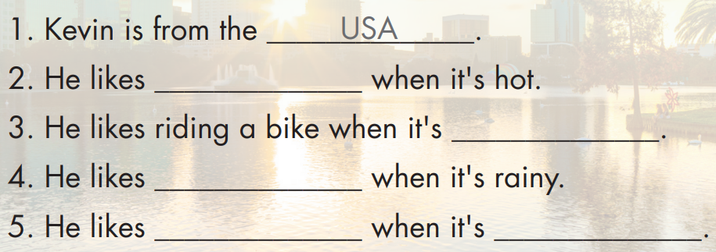
swimming
cool
painting
playing the piano
stormy

Slide 7


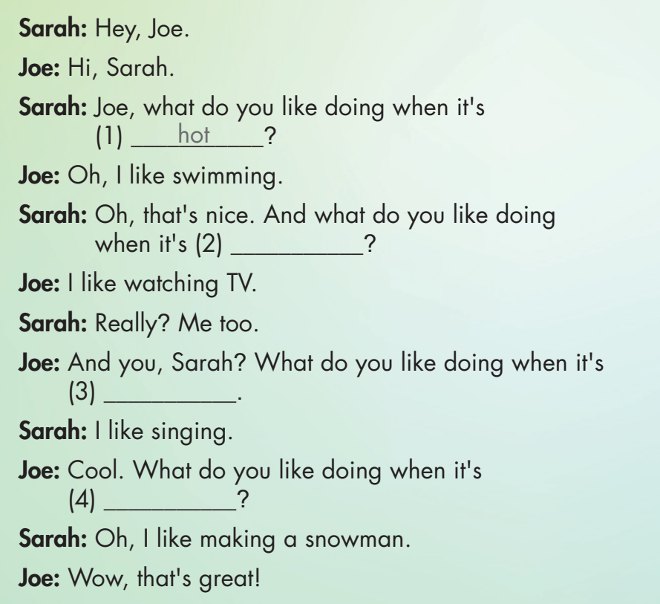

Slide 8


rainy
stormy
freezing

Slide 9

Practice

Slide 10

CONSOLIDATION

Slide 11

WRAP-UP

Slide 12
Today’s lesson
Vocabulary
Hot
Cold
Warm
Cool
Freezing
Stormy
Structures/ Sentence patterns
What do you like doing when it's hot?
I like swimming.

Slide 13
Homework
Practice the vocabularies and structure; and make sentences using them.
Prepare the next lesson (page 45 SB).

Slide 14
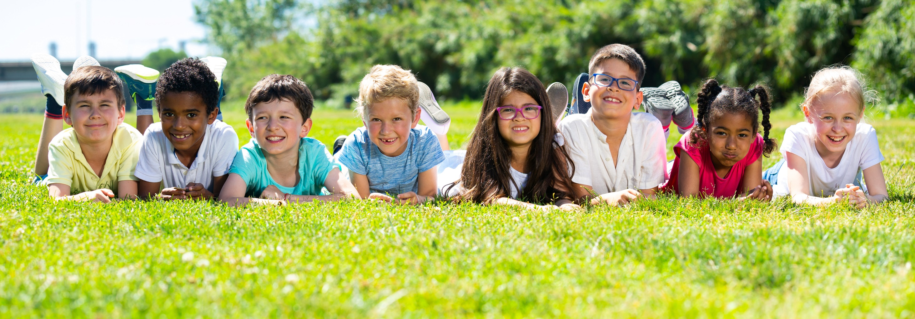
Have a nice day!

