Slide 1

Unit 4: HOME
Lesson 3.2
Page 59

Slide 2
Objectives
By the end of this lesson, students will be able to ask where things are.
Vocabulary: Revision
mirror, picture, sofa, table, box, house.
Structure: Revision
Is the picture in the living room? Yes, it is.
Is the cat in the house? No, it isn’t.

Slide 3

WARM UP

Slide 4

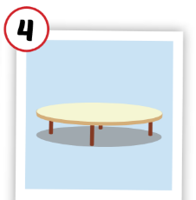
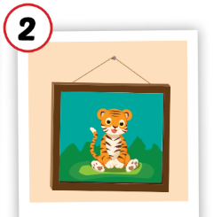
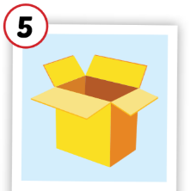
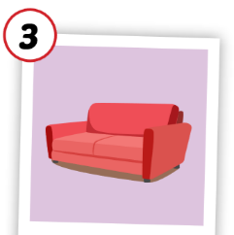
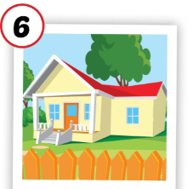
1
4
6
1
2
5
SPIN
5
2
3
4
3
6

Slide 5

It’s time to learn …

Slide 6

Listening

Slide 7

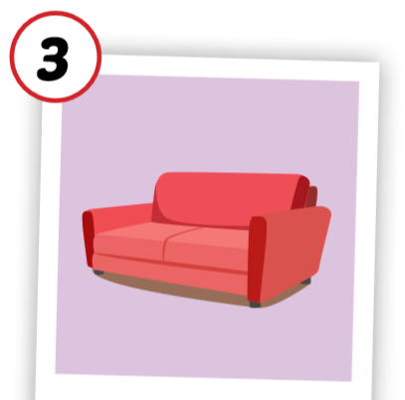
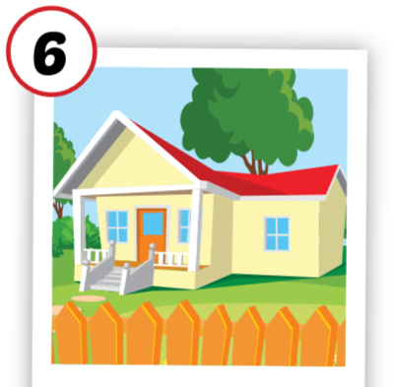

C. 1. Listen and repeat.
1
2
sofa
house

Slide 8


C. 2. Chant.
Click on the earphone to practice the chant.
/əʊ/, /aʊ/, /əʊ/
sofa
/əʊ/, /aʊ/, /əʊ/
house
/əʊ/, /aʊ/, /əʊ/

Slide 9

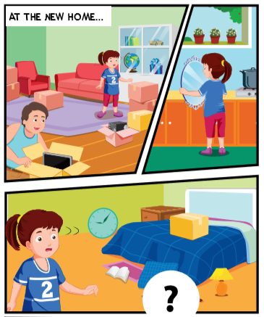
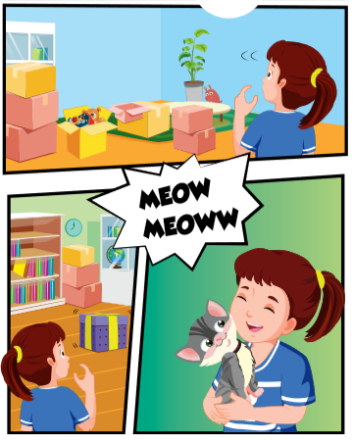

Slide 10


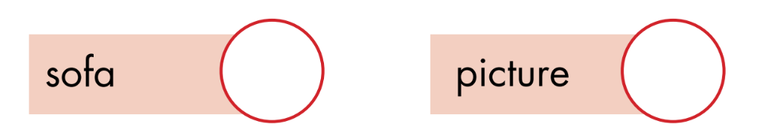
1
4
3
2

Slide 11


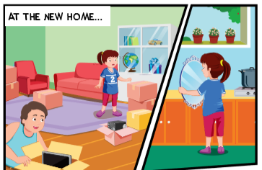
Can I help you, Daddy?
Yes, please, Lucy. Can you help me find some things?
Sure, Daddy.
Is the in the kitchen, Lucy ?
mirror
Yes, it is. Here you are ?

Slide 12
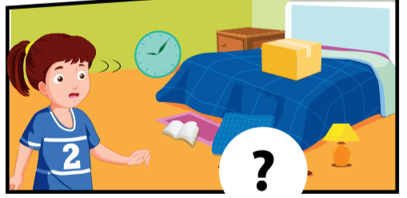
Is the in the bedroom ?
picture
Let me see. Yes, it is.
That’s great.

Slide 13
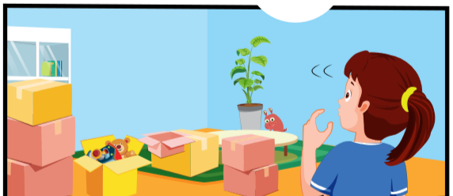
Is the in the living room ?
sofa
Oh, no, it isn’t.
That’s OK. We can find it later.

Slide 14
Is the in the living room ?
table
No, it isn’t.
OK. Do you see a box?
Yes.
Look in the box, Lucy.
Wow! Daddy! There’s a little cat.
It’s for you! Welcome to our new house!

Slide 15

Lucy: Can I help you, Daddy?
Mr. Brown: Yes, please, Lucy. Can you help me find some things?
Lucy: Sure, Daddy.
Mr. Brown: Is the mirror in the kitchen, Lucy?
Lucy: Yes, it is. Here you are.

Slide 16
Mr. Brown: Is the picture in the bedroom?
Lucy: Let me see. Yes, it is.
Mr. Brown: That’s great.

Slide 17
Mr. Brown: Is the sofa in the living room?
Lucy: Oh, no, it isn’t.
Mr. Brown: That’s OK. We can find it later.

Slide 18
Mr. Brown: Is the table in the living room?
Lucy: No, it isn’t.
Mr. Brown: OK. Do you see a box?
Lucy: Yes.
Mr. Brown: Look in the box, Lucy.
Lucy: Wow! Daddy! There’s a little cat!
Mr. Brown: It’s for you! Welcome to our new 2 house!

Slide 19

CONSOLIDATION

Slide 20

WRAP-UP

Slide 21
Lesson 3
Today’s lesson
Structures/ Sentence patterns
Revision
Is the picture in the living room? Yes, it is.
Is the cat in the house?
No, it isn’t.
Vocabulary
Revision
mirror, picture, sofa, table, box, house.

Slide 22
Homework
Review the vocabularies and sentence patterns.
Make sentences using them.
Do the exercise C on page 43 (WB)
Prepare the next lesson (page 60 SB)

Slide 23
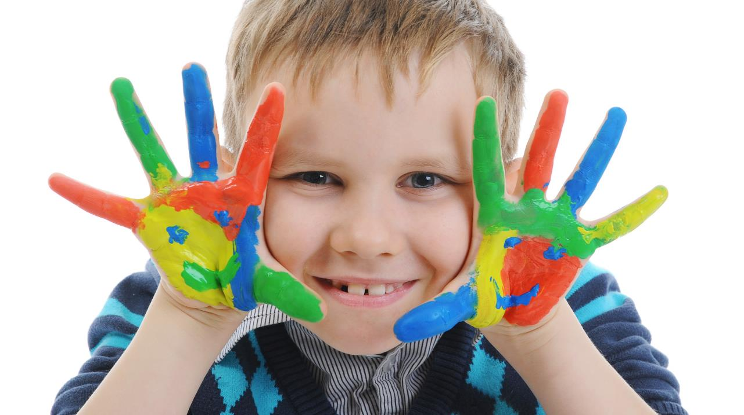
Enjoy your day!

Slide 24
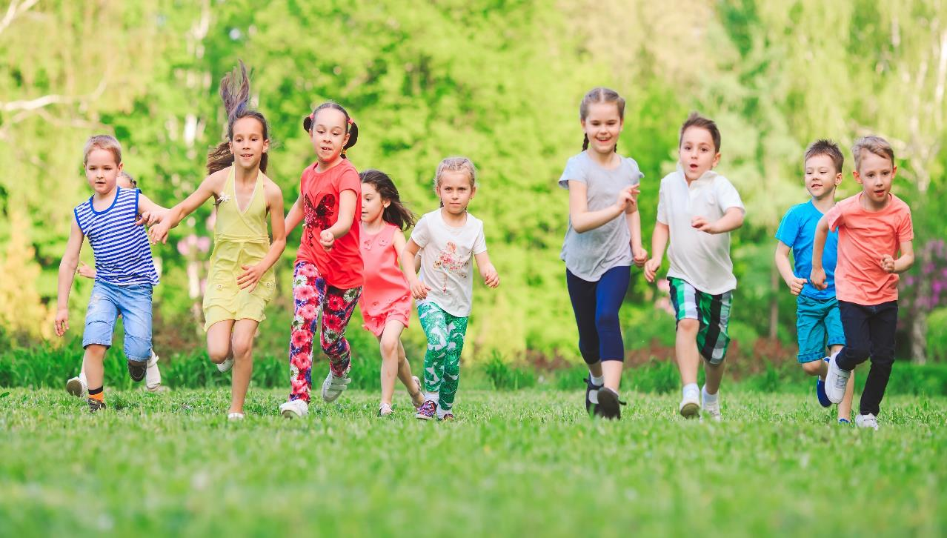
Have a nice day!

