Slide 1






















Notes:
Để nguyên trang bìa như này, chỉ thay đổi tên bài trong quá trình làm. Logo của sách Wonderful World

Slide 2





Unit: 4
FREE TIME
Lesson 2: Part 4, 5, 6

Slide 3




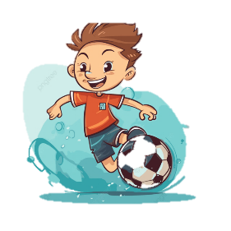




Table of contents
01
02
Warm-up
Presentation
04
Production
03
Practice
05
Wrap-up & Assessment

Slide 4
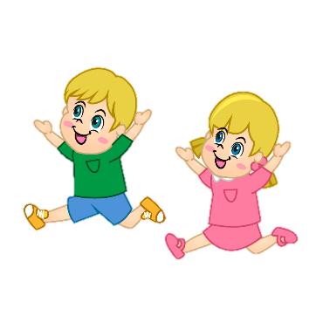



Warm-up
01
Let’s play a game:
“FREEZE”

Slide 5
Presentation
02

Slide 6






Grammar: can and can’t
“Can” is a modal auxiliary which is used for:
1. ability
  Example:
I can go to the bookshop.
S + can/can’t + V infinitive + …
2. polite requests
She can’t swim well.
Can + S + V infinitive +…?
✓ Yes, S + can.
x No, S + can’t.
= cannot.
Can we go on a ride?
Yes, we can.
x No, we can’t.

Slide 7








Practice speaking
Mini-game:
Lucky the colors

Slide 8
Practice
03

Slide 9






6 Write the correct questions to ask for your mother’s permission.
go to the park go to the bookshop go to the museum
go to the cinema play the piano

Slide 10
Production
04

Slide 11
Wrap-up & Assessment
05

Slide 12



Wrap-up
Vocabulary review:
go to the park
go to the cinema
go to the bookstore
play the piano
go to the museum
Grammar:
can /can’t
Unit 4: Free time
Lesson 2 – Part 4,5,6
What have we learnt today?

