Slide 1










Unit 5: Leisure time
Lesson 1: Task 1, 2, 3

Slide 2

1
Warm up
Guess “ Weather“
Guess “ Weather“
Notes:
Play a small game “ Guess weather”
The teacher asks SS to listen the sound and guess what weather it is.
T calls Ss to answer and check their answers.
T asks Ss to repeat names of weather.

Slide 3
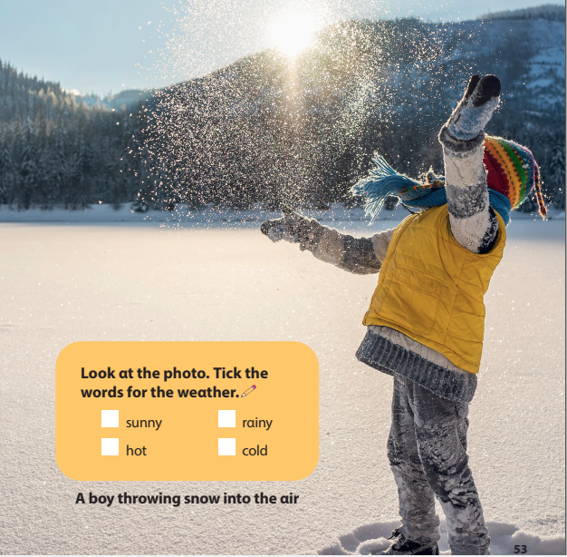
✓
✓
Notes:
Lead in: Photo time!
-T shows the picture about a boy throwing the snow into the air and gives students some questions: What can you see? What is he wearing? Is it sunny/ rainy/cold/ hot?
- T calls SS to answer and check their answers.
- T introduces that they will learn about “ Weathe” today.
- Write on the board “Leisure time” and introduce the lesson.

Slide 4

2
Presentation

Slide 5






1. Listen and point. Repeat
Notes:
- Play track 5.1 for the students to listen to, point to, and repeat the words in chorus and groups.

Slide 6
3
Practice

Slide 7




2. Listen and read. Tick.
Jane: What’s the weather like today, Tom?
Tom: It’s cold and snowy. Look! Mum and Dad are making a snowman in the playground.
Jane: That’s interesting. Let’s go out!
The weather is _______.
cold hot windy snowy
Notes:
Task 2: Listen and read. Tick.
- Ask SS to identify names of charaters in the dialogue.
- play track 5.2 and let Sts listen to the dialogue, then repeat each sentences.
Note:each click can listen each sentence. Click on the speaker to listen whole dialogue.

Slide 8



3. Look and say.
It’s snowy.
It’s cloudy.
Notes:
Task 3: Look and say :
- Look at the picture and let SS write the sentences and say these sentences like the example.
- Call SS to say aloud in front of the class.

Slide 9

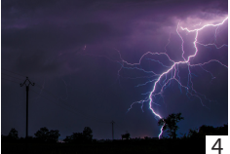
3. Look and say.
It’s windy.
It’s stormy.
Notes:
Task 3: Look and say :
- Look at the picture and let SS write the sentences and say these sentences like the example.
- Call SS to say aloud in front of the class.

Slide 10
UNIT 5: LEISURE TIME
LESSON 1 – PERIOD 1
What we learnt today
Vocabulary
cloudy
windy
stormy
snowy
What’s the weather like?
It’s cloudy.
Structure

