Slide 1







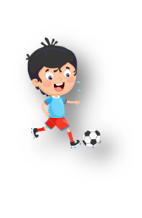

Unit 5: Leisure time
Lesson 2: Task 1, 2, 3

Slide 2

1
Presentation

Slide 3

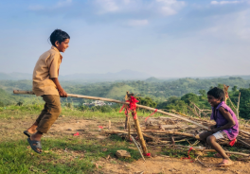
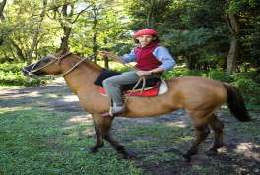

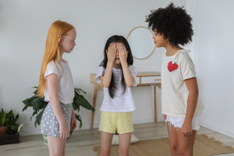
Look and match
1
jump rope
play on the seesaw
2
ride a horse
3
4
play hide – and - seek
Notes:
Checking vocabulary: Look and match.
- T asks SS to look at the pictures and words, then match them together.
- T calls SS to match and say the words again.

Slide 4





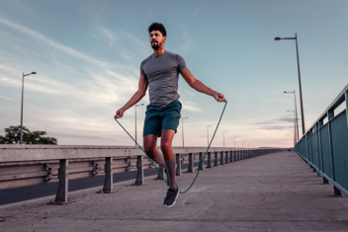



1. Listen and point. Repeat.
jump rope
play
hide – and - seek
play on
the seesaw
ride
a horse
Notes:
- Play track 5.4 for the students to listen to, point to, and repeat the words in chorus and groups.

Slide 5
2
Practice

Slide 6


Jack: Hi, Joe. What is Susan doing?
Joe: She’s jumping rope in the garden.
Jack: How about her sisters?
Joe: They’re playing hide-and-seek with me. Do you see them?
Jack: No, I don’t. Good luck with your game!
Susan is ____________________________ in the garden.
Joe is _____________________________ with Susan’s sisters.
jumping rope
playing hide-and-seek
Notes:
- Ask SS to identify names of charaters in the dialogue.
- Play track 5.5 and let SS listen to the dialogue, then repeat each sentences.
- Ask SS to and read again, then write the correct answers.
- Let Sts read the dialogue by Role-play “Jack and Joe” to practice the words and the sentences.

Slide 7
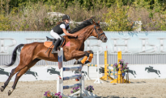

3. Look and say.
1. She’s riding a horse.
1. she/ ride a horse
What is she/he doing?
She’s/ He’s + V-ing.
2. She’s jumping rope.
2. she/ jump rope
Notes:
Task 3: Look and say :
- Look at the picture and let SS write the sentences and say these sentences like the example.
- Call SS to say aloud in front of the class.
- Help Ss identify the questions and answers in general.
- Call SS to work in pairs and use these structures, then call them to present in front of the class.

Slide 8


3. Look and say.
3. They are playing hide-and-seek.
3. they/ play hide-and-seek
What are you/they doing?
We/they... + are + V-ing.
4. we/ play on the seesaw
4. We are playing on the seesaw.
Notes:
Task 3: Look and say :
- Look at the picture and let SS write the sentences and say these sentences like the example.
- Call SS to say aloud in front of the class.

Slide 9
3
Production

Slide 10



are
What
doing ?
they
Notes:
- Work in groups.
- Ask SS to work in groups and look at the board and reorder the words to make a sentence, then answer the questions if it is a question or make a question if it is an answer.
- Call SS to answer then ask and answer in front of the class.
- Check and give feedback.

Slide 11


Joe
What
doing?
is

Slide 12
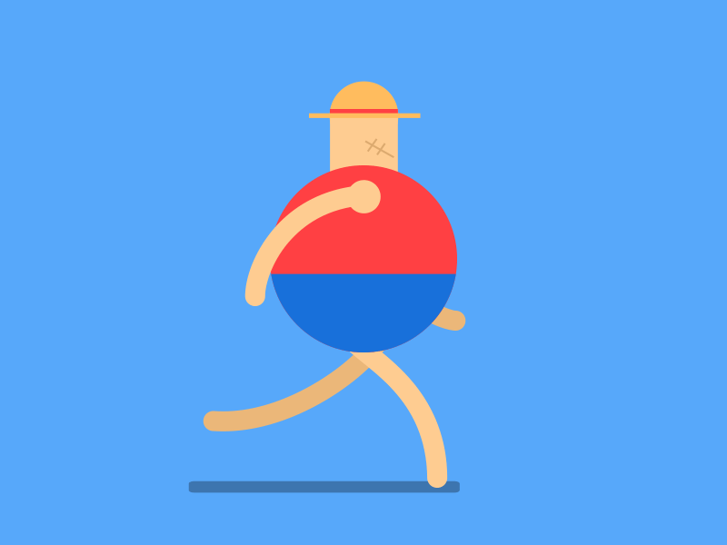

She’s
riding
a
horse.

Slide 13


the seesaw.
playing
We’re
on

Slide 14
4
Assessment

Slide 15
4. Look and circle.
weatplayhideandseekher
wiplayontheseesawndy
clorideahorseudy
storjumpropemy
swhatisshedoingwy
Notes:
-Ask sts to do the assessment.
- Check with the class.

Slide 16
UNIT 5: LEISURE TIME
LESSON 2 – PERIOD 1
What we learnt today
ride a horse
play on the seesaw
Vocabulary
play hide-and-seek
jump rope
What is he/she doing?
He’s/she’s + V-ing.
What are you/they doing?
We/They + are + V-ing.
Structure

