Slide 1





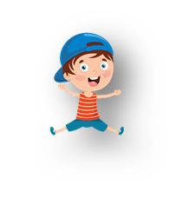

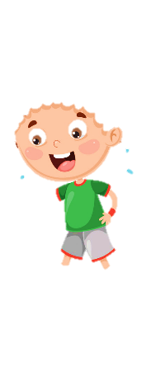









UNIT 6: OUTDOOR ACTIVITIES
Lesson 1
Period 2 – Task 4,5,6 (P.65)

Slide 2

01
WARM-UP

Slide 3
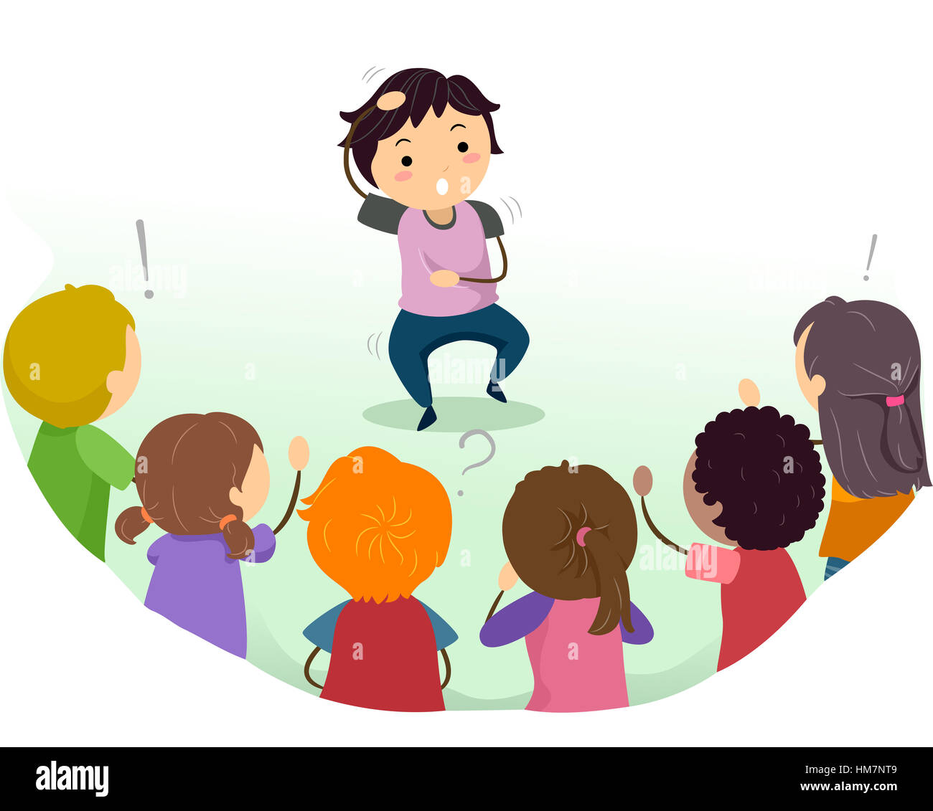
CHARADE

Slide 4
02
PRESENTATION

Slide 5


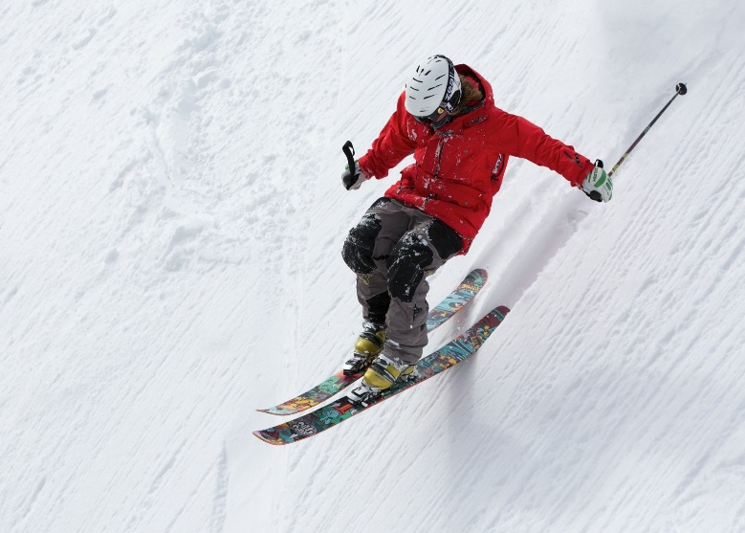
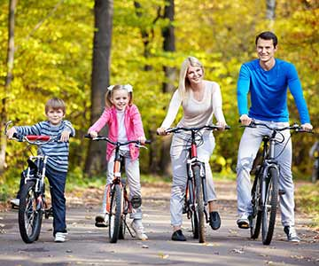
4. Listen and repeat
(page 65)
1
2
What can we do on the mountain?
What can we do in the park?
We can ski on the mountain.
We can ride a bike in the park.

Slide 6
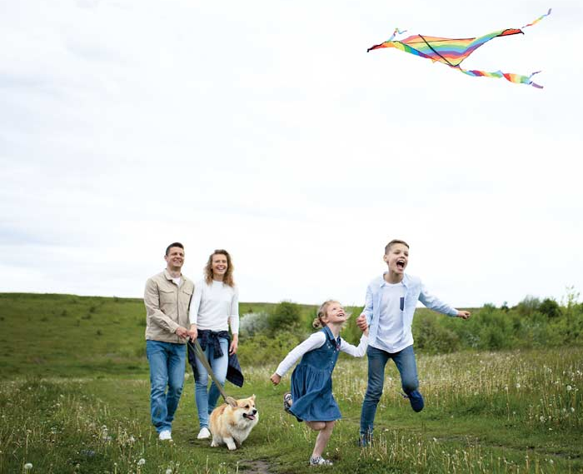
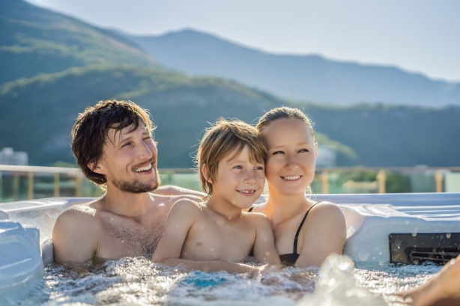
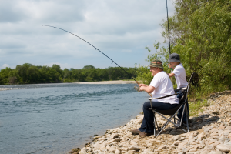
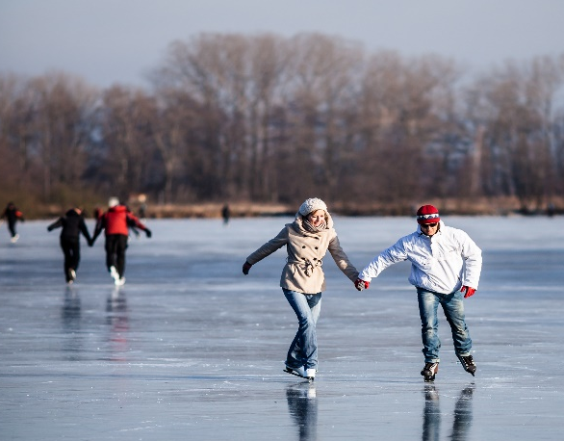
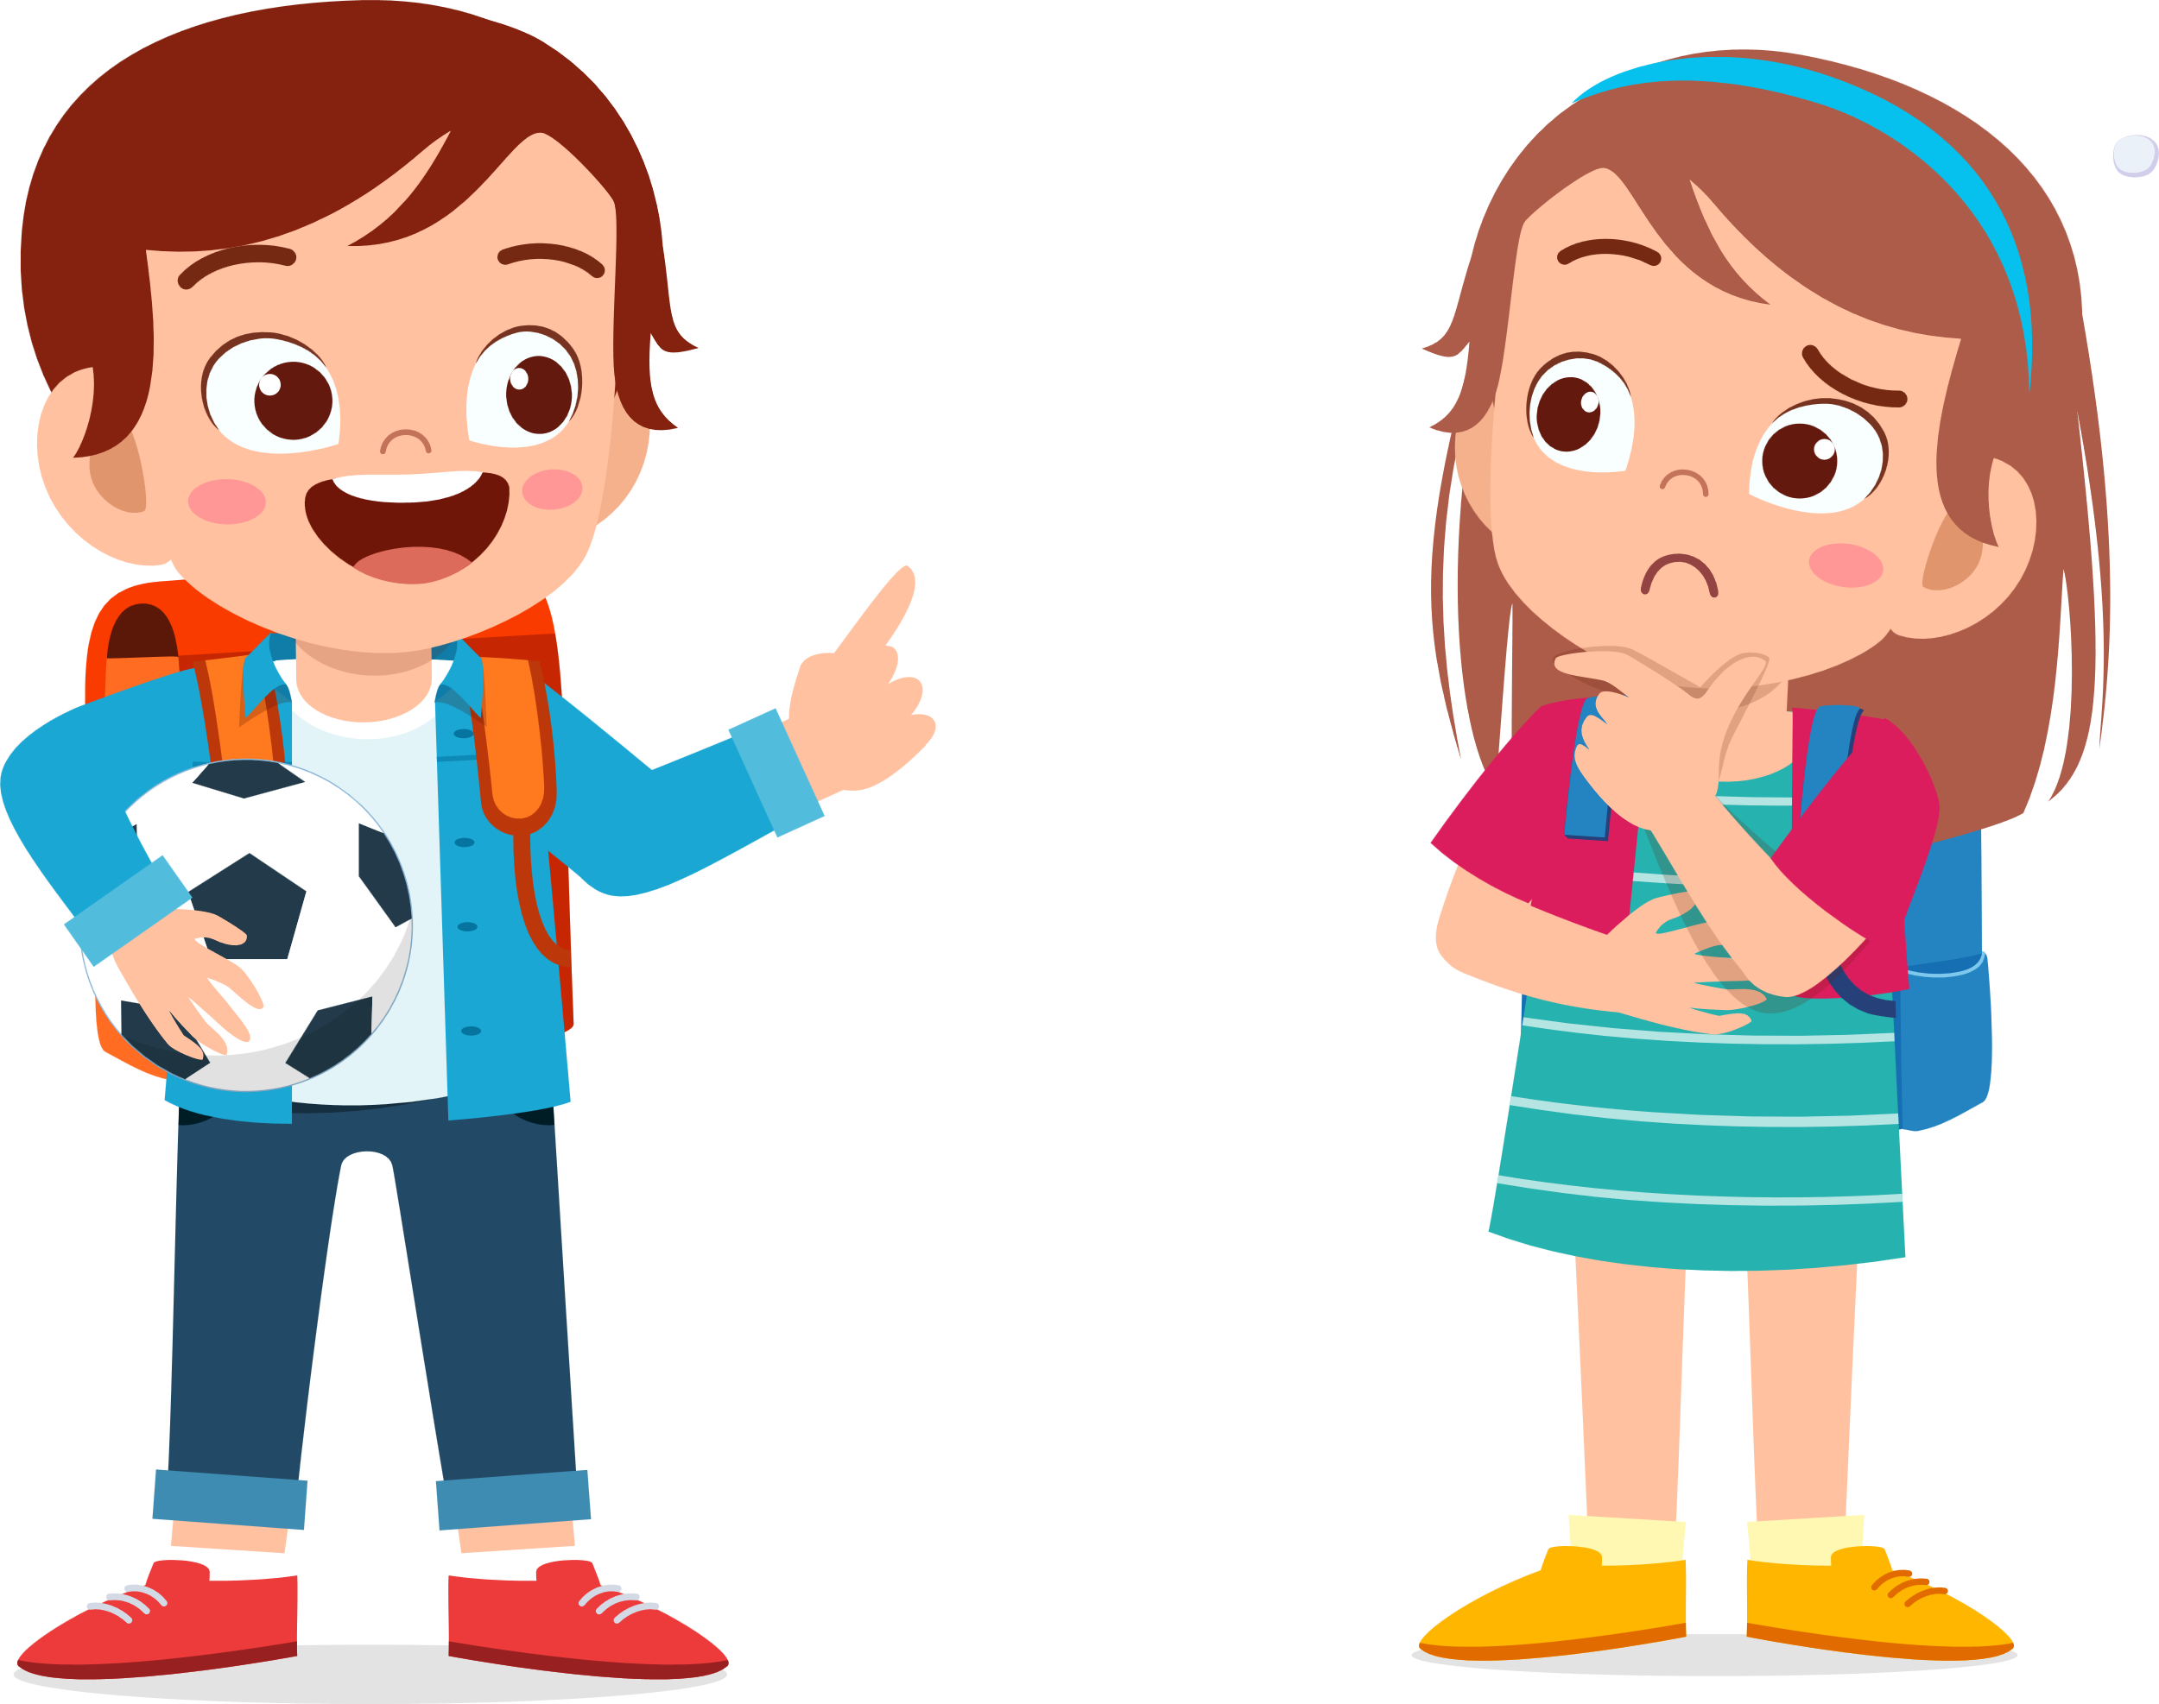
5. Look and say
(page 65)
What can we do in the field?
fly a kite/
in the field
swim/
in the pool
1
2
We can fly a kite in the field.
go fishing/
by the river
ice-skate/
on the lake
3
4

Slide 7
03
PRACTICE

Slide 8

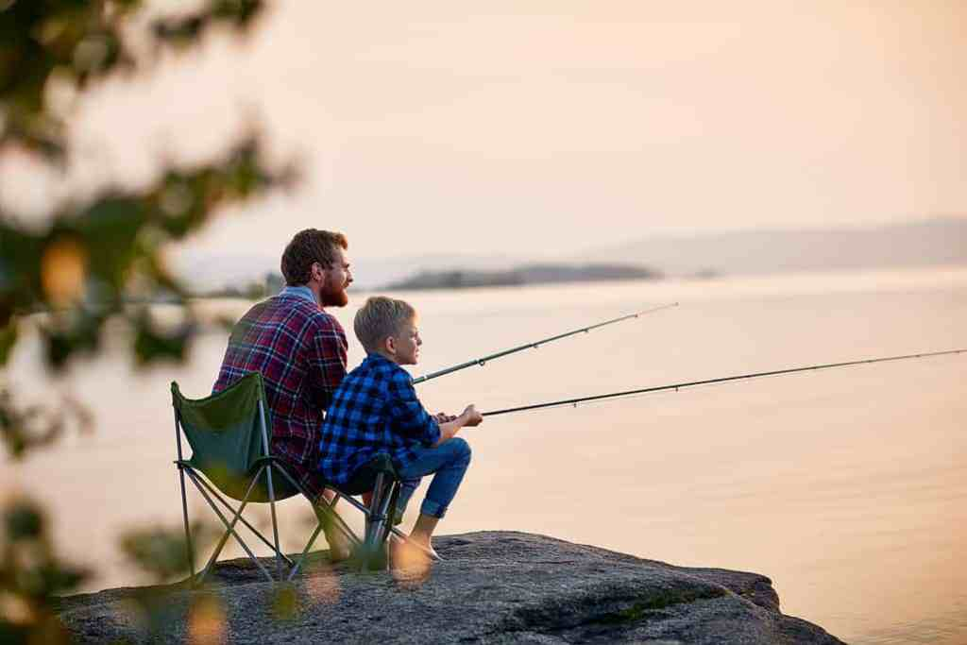
What can we do by the river?
A. We can jump rope.
B. We can go fishing.
C. We can sing a song.
D. We can dance.
GO HOME

Slide 9
What can we do in the pool?
A. We can swim.
B. We can play tennis.
C. We can go fishing.
D. We can ice-skate.
GO HOME

Slide 10




Thank you & goodbye!

