Slide 1










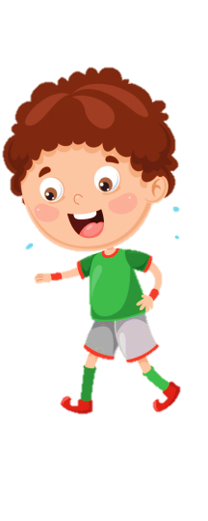












Slide 2

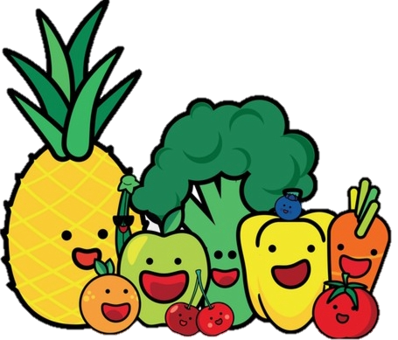
Unit 9:
My Favourite Food
Lesson 3 – Task 1, 2, 3

Slide 3
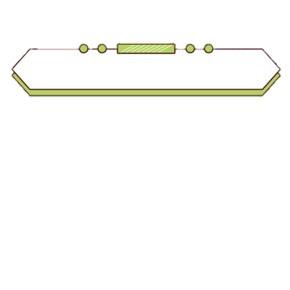

PRESENTATION
Task 1 Listen and point. Repeat.

Slide 4

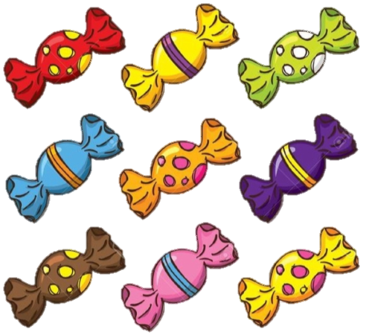
New words
sweets

Slide 5
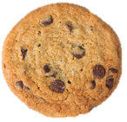
New words
biscuit

Slide 6

New words
ice cream

Slide 7
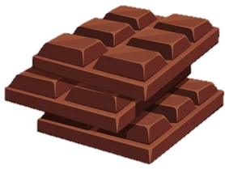
New words
chocolate

Slide 8
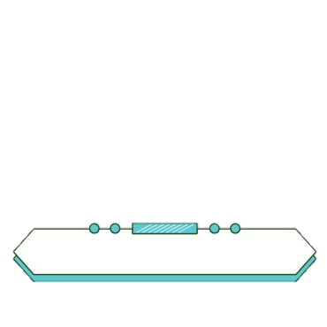

PRACTICE
Task 2 Listen and tick.

Slide 9
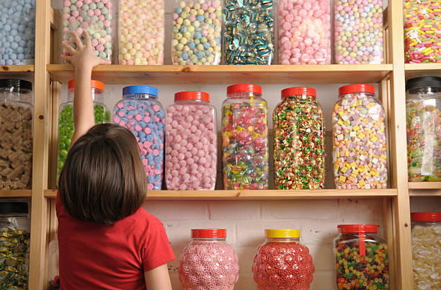
Grandpa: Come on, Leo. Let’s go to the sweet shop!
Leo: Look, Grandpa. There are a lot of apple sweets, and there is a lot of chocolate, too.
Grandpa: Let’s get some sweets.
Leo: Are there biscuits?
Grandpa: Yes, they’re in the box. Let’s get some!
✓
1 There are a lot of ______ apple sweets banana sweets in the shop.
✓
2 There are __________ biscuits sweets in the box.

Slide 10


3 PRACTICE
Task 3 Look and say.

Slide 11
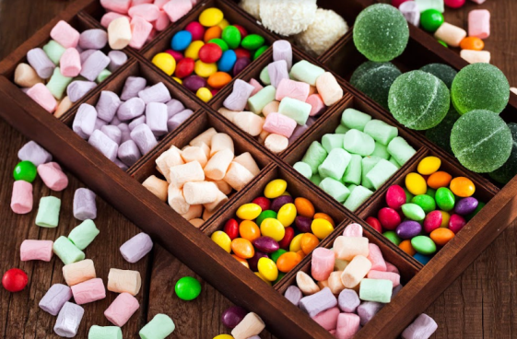
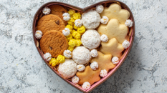
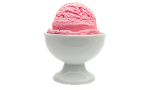
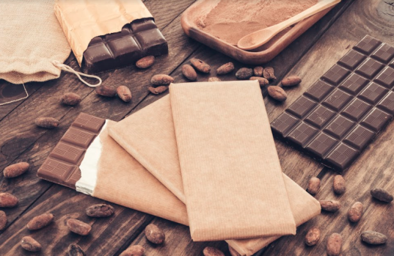
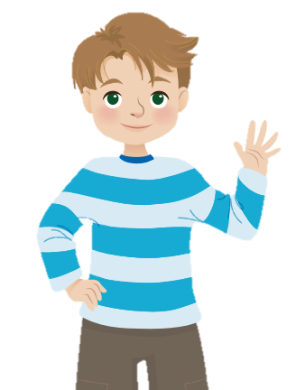
1 There are ....
2 There are ....
3 There is ....
4 There is ....
There is a lot of chocolate.
Let’s get some!
There are a lot of biscuits in the box.
Let’s get some!
There are a lot of sweets in the box.
Let’s get some!
There is a cup of ice cream.
Let’s get some!
Notes:
Ask Ss to look at 4 pictures and identify names of them.
- Introduce the structures “ There is/ there are...” again. Then ask Ss to look at the example and say.
- Work in pairs and talk about 4 pictures.
- Call some pairs to prensent in front of the class.
- Give them feedback.

Slide 12
4 PRODUCTION
Game “What is it?”
Notes:
(Teacher calls pairs of SS from the differen groups. One of them chooses a piece of paper and uses their language to describe the word. The other has to guess the word in 20 seconds.)

Slide 13

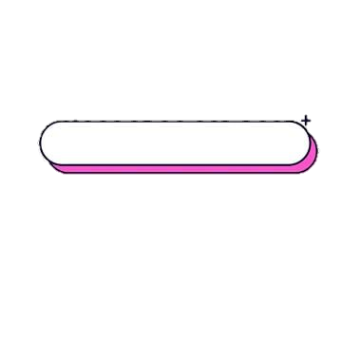
Example
What is it?
It’s round. It’s small and brown. What is it?
It’s a biscuit.
biscuit

Slide 14
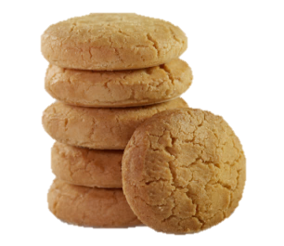



5 ASSESSMENT
Look, match and fill in the blanks.
1
sw_ _ ts
ee
2
_iscuit_
b s
3
ice cr_ _ m
ea
4
ch_ col_ te
o a

