Slide 1











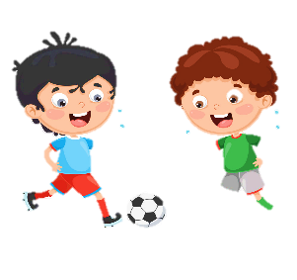


Unit 1:
MY FAMILY
AND FRIENDS
Lesson 2 - Task 1, 2, 3

Slide 2

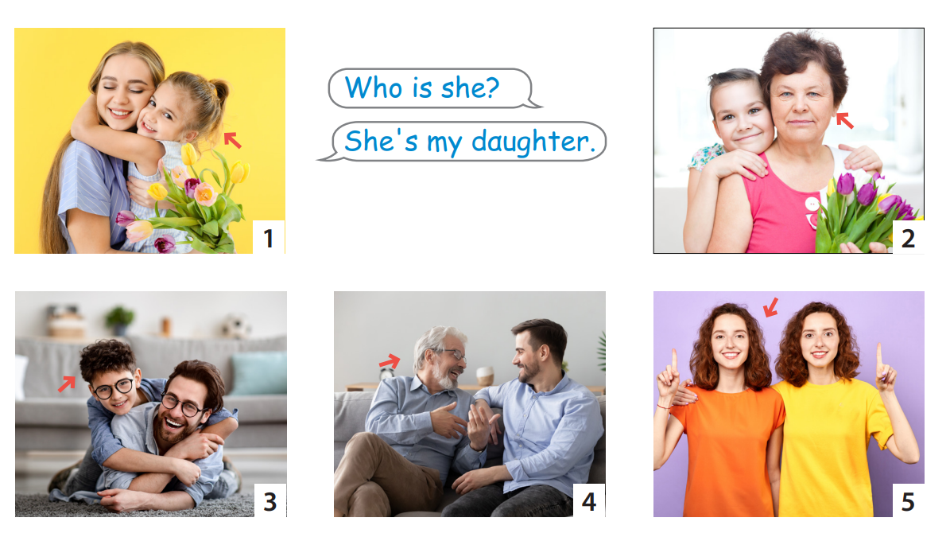

Review

Slide 3

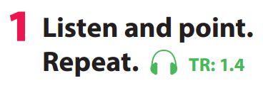

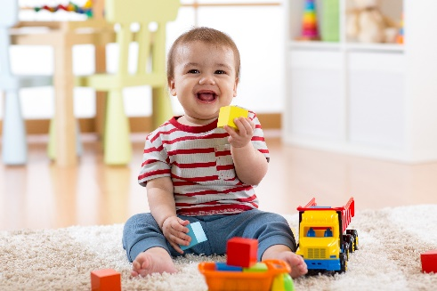

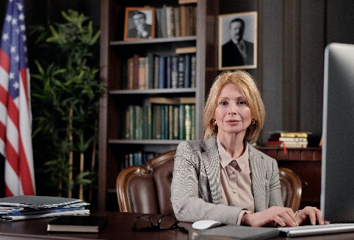
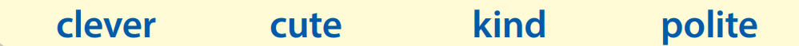

Notes:
Task 1: Listen and point. Repeat. (Track 1.4)
- Use flashcards to introduce the vocabulary and structure of lesson.
- Say the words for students to repeat in chorus.
- Play the recording for the students to listen to, point to, and repeat the words.
- Read out the new picture words in the vocabulary box in random order and ask students to point to the correct pictures.
- Read out the word clever. Explain the meaning. Then say a student’s name, e.g. Lan’s clever! and ask students to repeat. Ask volunteers to stand at the front and do the same with any name they like.

Slide 4
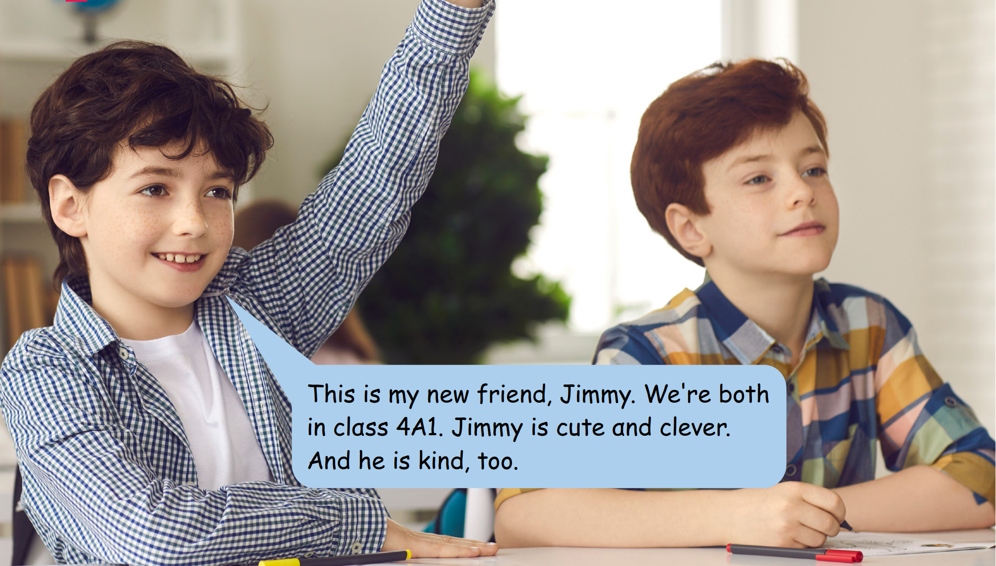
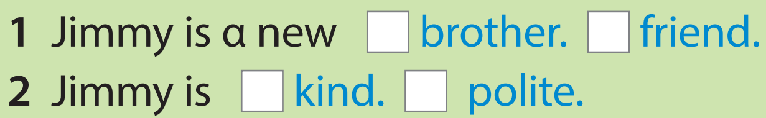
Listen and read. Tick.
✔
✔
Notes:
Task 2: Listen and tick. (Track 1.5) - Ask students to look at the photo of 2 friends - Point to the name in the text. Read them out and ask students to repeat. - Play the recording. Tell students to look at the picture and follow the text with their fingers. - Play the recording again, pause after each sentence and ask students to repeat. - Ask students to practice reading out the text individually and in pairs. Ask some volunteers to read it out in front of the whole class. - Tell students to look at the photo and ask them tick the right answer in the box.Ask students to read the text again to find out information to make sure that they have the right answer. Check answers as the whole class.

Slide 5
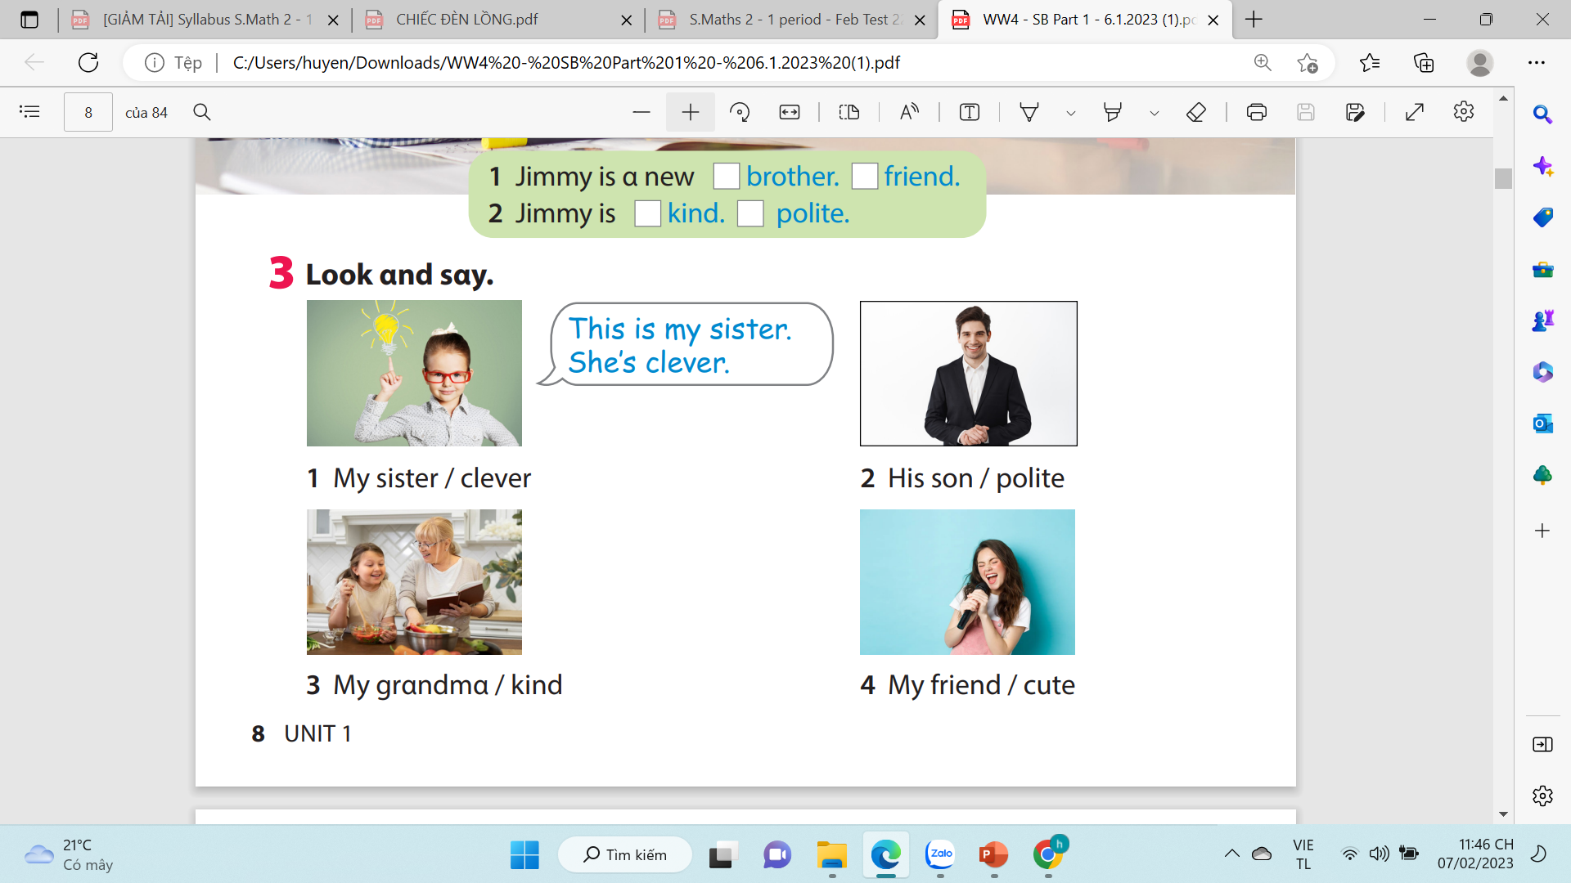
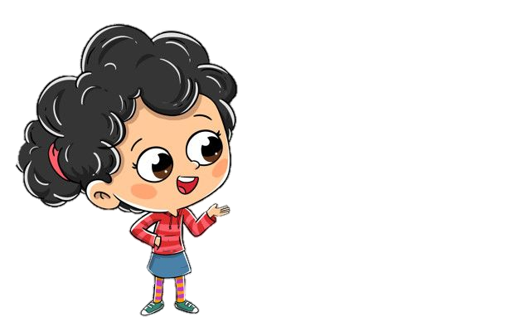
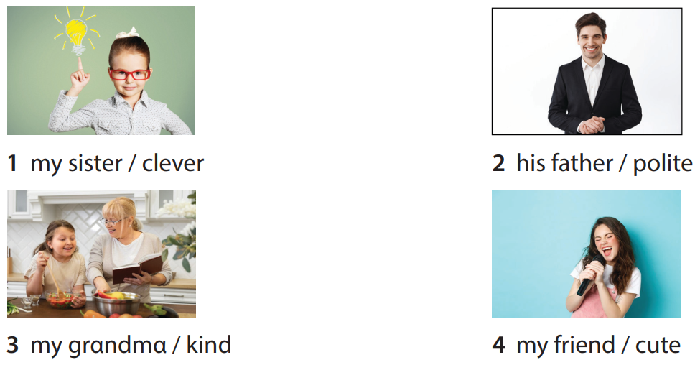
Notes:
Task 3: Point and say.
- Ask students to work pairs. Tell them they are going to say sentences based on the photo in Activity 2.
- Ask students to look back at the photo in Activity 2 and the sample sentences in Activity 3.

Slide 6




Thank you & goodbye!

