Slide 1

Unit 4: HOME
Lesson 2.1
Page 55

Slide 2
Lesson Outline
Warm-up
Vocabulary
Structure
Consolidation
Wrap-up

Slide 3
Objectives
By the end of this lesson, students will be able to ask what people are doing.
Vocabulary: cleaning, playing, eating, sleeping, cooking.
Structure: What’s he doing? He’s sleeping.

Slide 4

WARM UP

Slide 5
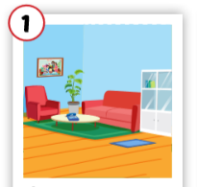
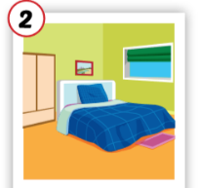
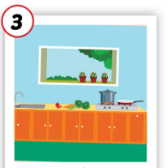
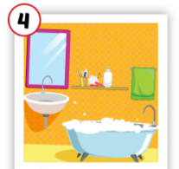
Crossword puzzles
3
k
1
l
i
o
b
r
4
2
e
Notes:
Students play the crossword puzzles. They practice spelling.

Slide 6
Crossword puzzles
3
k
1
l
i
v
i
n
g
r
o
o
m
b
r
4
2
e

Slide 7
Crossword puzzles
3
k
1
l
i
v
i
n
g
r
o
o
m
b
r
4
2
b
e
d
r
o
o
m

Slide 8
Crossword puzzles
3
k
1
l
i
v
i
n
g
r
o
o
m
b
t
r
4
c
h
2
b
e
d
r
o
o
m
n

Slide 9
Crossword puzzles
3
k
1
l
i
v
i
n
g
r
o
o
m
b
a
t
h
r
o
o
m
4
c
h
2
b
e
d
r
o
o
m
n

Slide 10

It’s time to learn …

Slide 11

New words
cleaning, playing,
eating,
sleeping, cooking.

Slide 12

Presentation

Slide 13

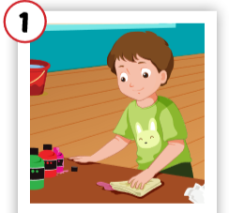
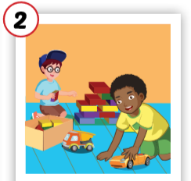
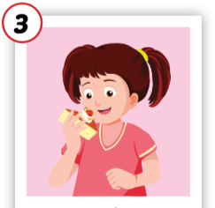
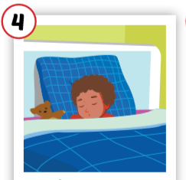
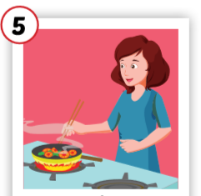
Click each English word to hear the sound.
cleaning
playing
eating
sleeping
cooking
/kliːnɪŋ/
đang lau chùi
/pleɪɪŋ/
đang chơi
/iːt ɪŋ /
đang ăn
/sliːp ɪŋ /
đang ngủ
/ˈkʊk ɪŋ /
đang nấu nướng

Slide 14
Click each English word to hear the sound.
cleaning
/kliːnɪŋ/
đang lau chùi

Slide 15
Click each English word to hear the sound.
playing
/pleɪɪŋ/
đang chơi

Slide 16
Click each English word to hear the sound.
eating
/iːt ɪŋ /
đang ăn

Slide 17
Click each English word to hear the sound.
sleeping
/sliːp ɪŋ /
đang ngủ

Slide 18
Click each English word to hear the sound.
cooking
/ˈkʊk ɪŋ /
đang nấu nướng

Slide 19

Practice

Slide 20
Click each English word to hear the sound.
cleaning
playing
eating
sleeping
cooking
/kliːnɪŋ/
đang lau chùi
/pleɪɪŋ/
đang chơi
/iːt ɪŋ /
đang ăn
/sliːp ɪŋ /
đang ngủ
/ˈkʊk ɪŋ /
đang nấu nướng

Slide 21
Slap the board

Slide 22

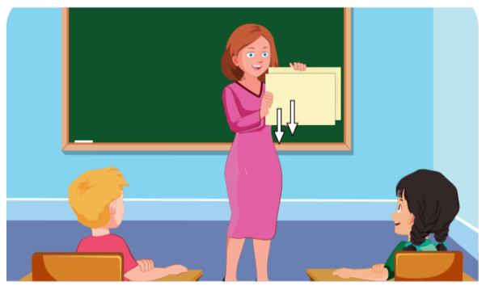
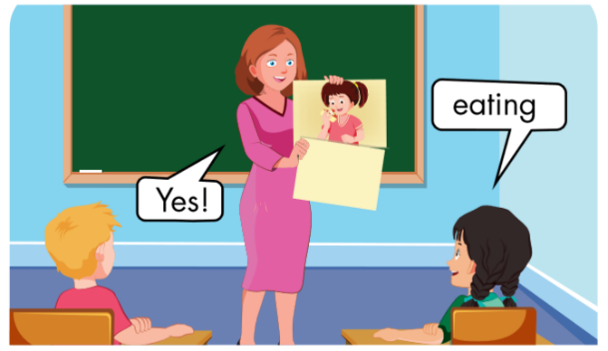

Slide 23

Yes!
cleaning
playing
No!

Slide 24

cleaning

Slide 25

sleeping

Slide 26

Yes!
cooking
cooking
eating
No!

Slide 27

Structures
What’s he doing? He’s sleeping.

Slide 28
Presentation

Slide 29





Slide 30
Practice

Slide 31

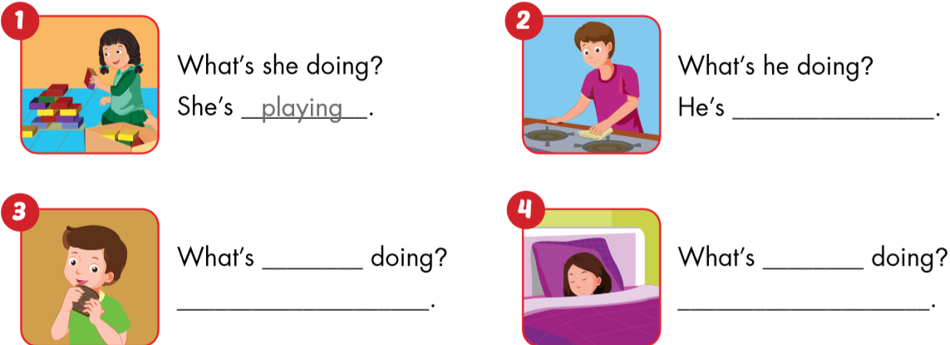
playing.
cleaning.
he
she
He’s eating.
She’s sleeping.

Slide 32
Ask and answer.
What’s he doing?
What’s she doing?
What’s she doing?
He’s sleeping.
She’s eating.
She’s cooking.
Notes:
Giáo viên có thể thay chủ ngữ bằng tên người (ở số ít)

Slide 33

Workbook
p. 40

Slide 34

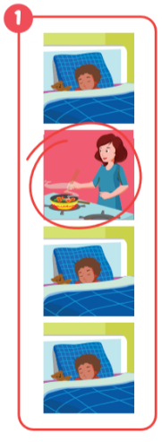
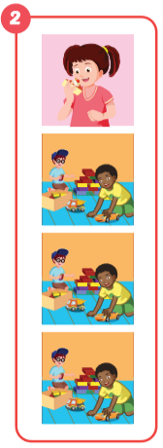
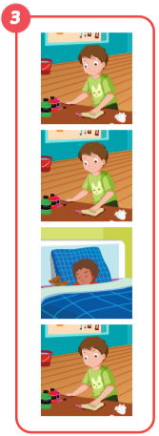
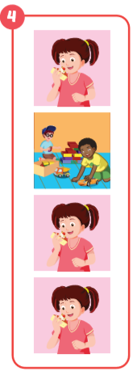
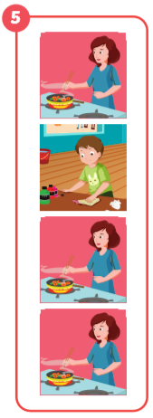
cooking
eating
sleeping
playing
cleaning

Slide 35

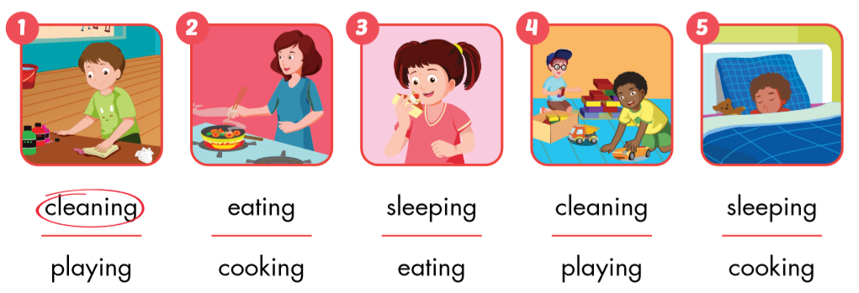

Slide 36
Early
Production

Slide 37




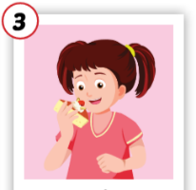
1
4
4
1
2
What’s he/she doing?
SPIN
5
2
He’s / she’s …………
3
4
3
5

Slide 38

CONSOLIDATION

Slide 39
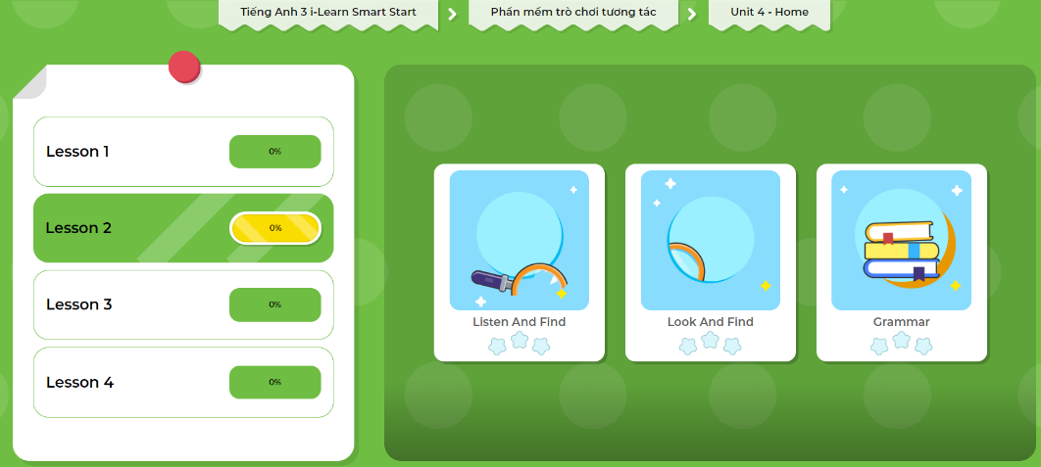
Extra Practice
DHA App
Let’s play!
Click here to play the game

Slide 40
o g
s e ping
cooking
sleeping
ea g
eating
la ing
cleaning
playing
c a g

Slide 41
Click each English word to hear the sound.
cleaning
playing
eating
sleeping
cooking
/kliːnɪŋ/
đang lau chùi
/pleɪɪŋ/
đang chơi
/iːt ɪŋ /
đang ăn
/sliːp ɪŋ /
đang ngủ
/ˈkʊk ɪŋ /
đang nấu nướng

Slide 42
Make sentences.
sleeping
eating
cooking
He’s sleeping.
She’s eating.
She’s cooking.
Notes:
Giáo viên có thể thay chủ ngữ bằng tên người (ở số ít)

Slide 43

WRAP-UP

Slide 44
Lesson 3
Today’s lesson
Vocabularies
cleaning, playing,
eating,
sleeping, cooking.
Structures/ Sentence patterns
What’s he doing?
He’s sleeping.

Slide 45
Homework
Review the vocabularies and sentence patterns. Make sentences using them.
Do the exercises on page 40 (WB)
Prepare the next lesson (page 56 SB)
Play consolidation games in Tiếng Anh 3 i-Learn Smart Start DHA App on www.eduhome.com.vn
Do the exercise in Tiếng Anh 3 i-Learn Smart Start Notebook (page 29)

Slide 46

Enjoy your day!

