Slide 1

Unit 2
WHAT I CAN DO
CULTURE LESSON 3
PAGE 31

Slide 2
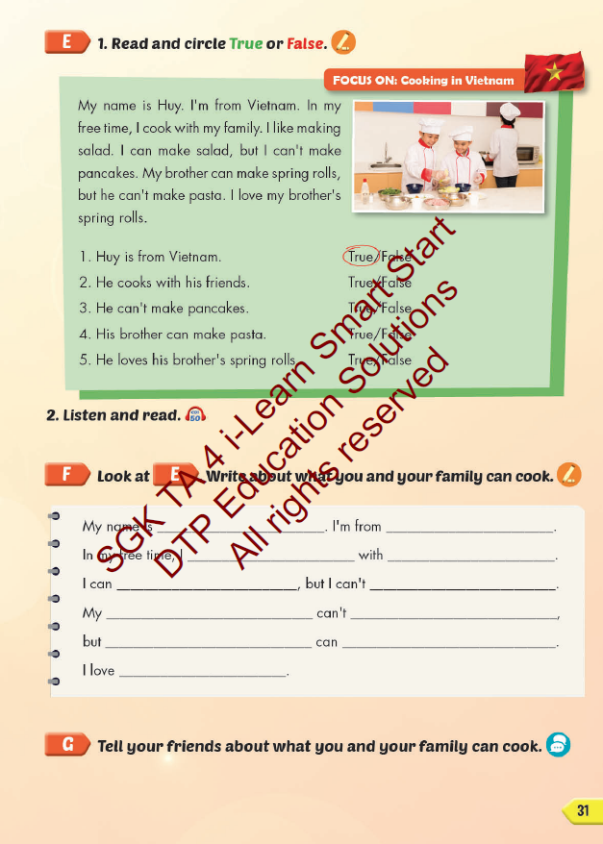
Lesson Outline
Warm-up
Reading
Writing
Consolidation
Wrap-up

Slide 3
Objectives
By the end of this lesson, students will be able to read, listen, write and talk about cooking in Vietnam.
Vocabulary: salad, pasta, pancakes, spring rolls, soup
Structure: I can make pasta, but I can't make soup.

Slide 4

WARM UP

Slide 5



LISTEN AND CHOOSE

Slide 6
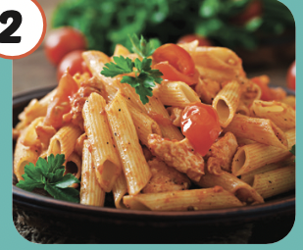
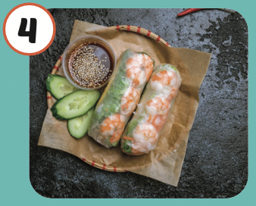
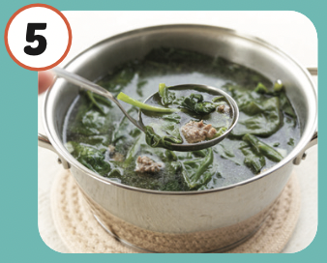
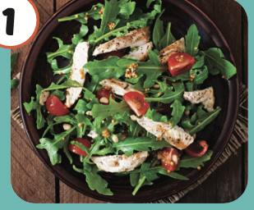
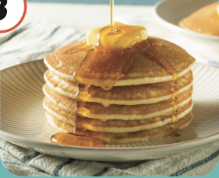


Slide 9

It’s time to learn …

Slide 10

Reading

Slide 11
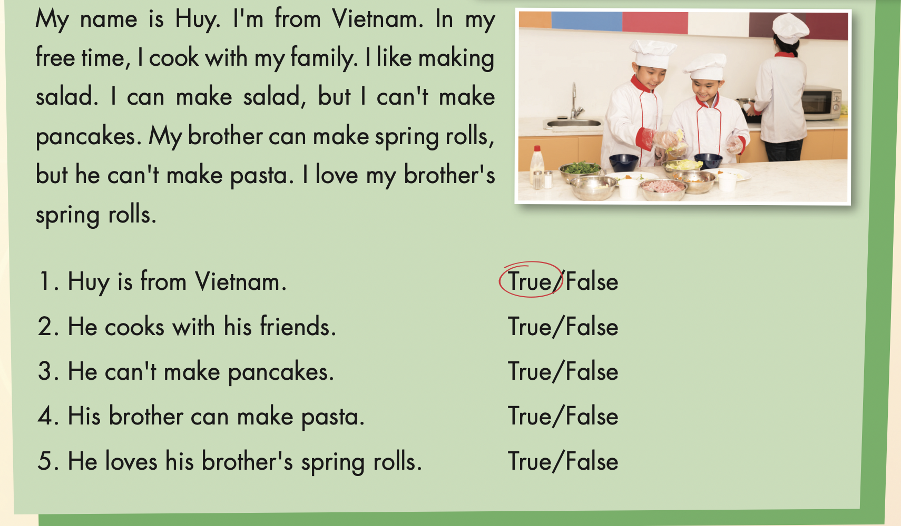
LOOK AT THE PICTURE AND ANSWER THESE QUESTIONS
Where are they from?
What are they doing?

Slide 12



Slide 13
WHERE IS MY SKATEBOARD?
START

Slide 14

Huy is from Vietnam.
TRUE
FALSE

Slide 15
He cooks with his friends.
TRUE
FALSE

Slide 16
He can’t make pancakes.
TRUE
FALSE

Slide 17
His brother can make pasta.
TRUE
FALSE

Slide 18
He loves his brother’s spring rolls.
TRUE
FALSE

Slide 19


Slide 20

Writing

Slide 21
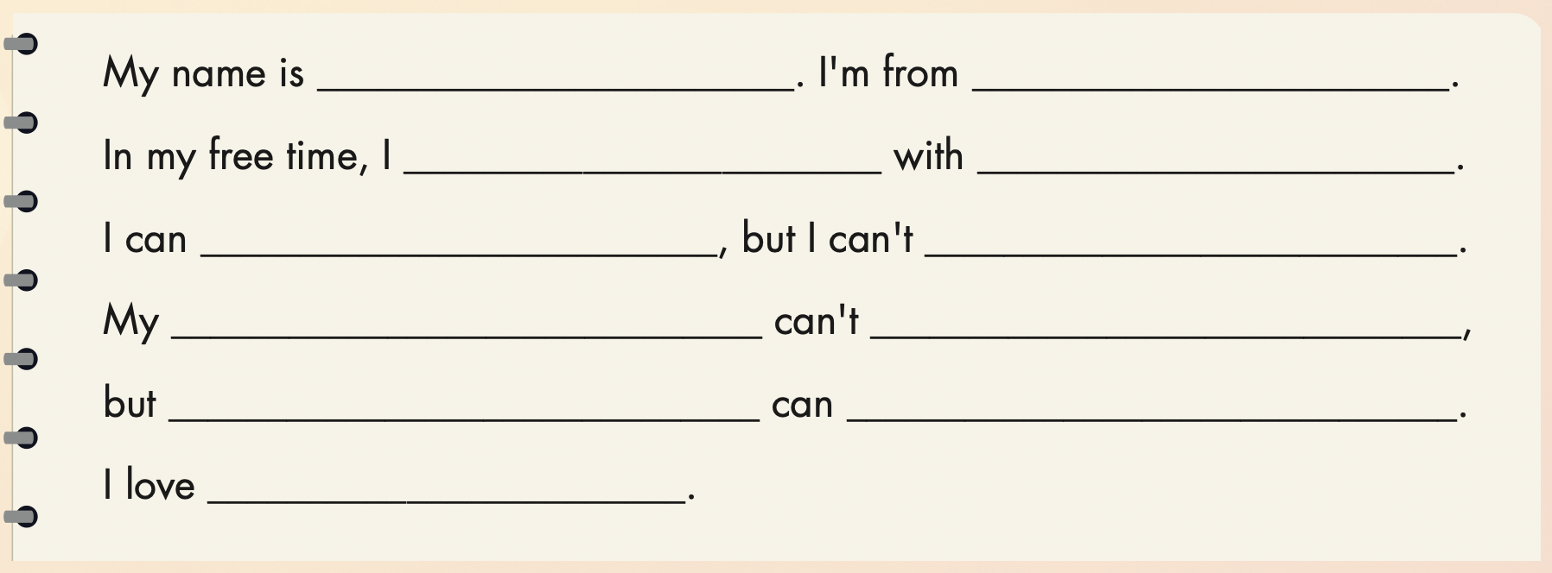

Slide 22

Speaking

Slide 23


Slide 24

CONSOLIDATION

Slide 25

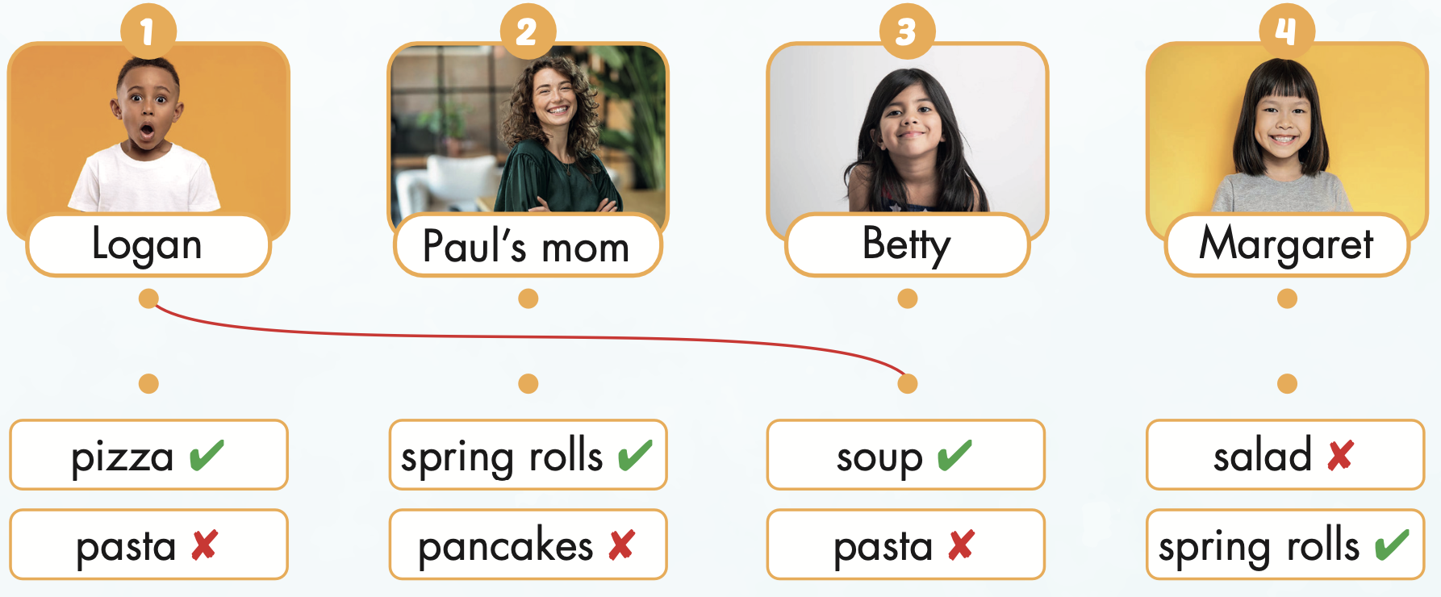
Extra Practice
WB, page 19

Slide 26

WRAP-UP

Slide 27
Today’s lesson
Vocabularies
salad,
pasta,
pancakes,
spring rolls,
soup
Structures/ Sentence patterns
I can make pasta, but I can't make soup.

Slide 28
Homework
Practice the vocabularies and structure; and make sentences using them.
Do the exercises in Tiếng Anh 4 i-Learn Smart Start WB (page 19)
Do the exercises in Tiếng Anh 4 i-Learn Smart Start Notebook (page 13)
Prepare the next lesson (page 32 SB)
Play the consolidation games in Tiếng Anh 4 i-Learn Smart Start DHA App on www.eduhome.com.vn

Slide 29

Enjoy your day!

