Slide 1
Unit 3: School
Review 1
SB p 50
WB p 36 (A)

Slide 2
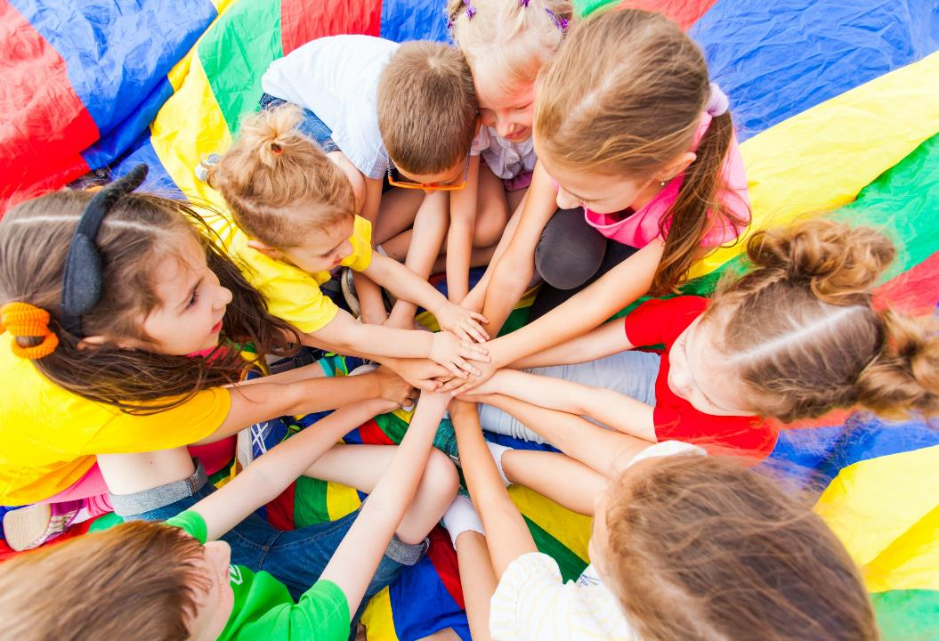
WARM UP

Slide 3
It’s time to learn …

Slide 4
Look at the table and call out the days and subjects.

Slide 5
math
math
art
English
music
English

Slide 6
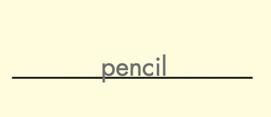

Slide 7
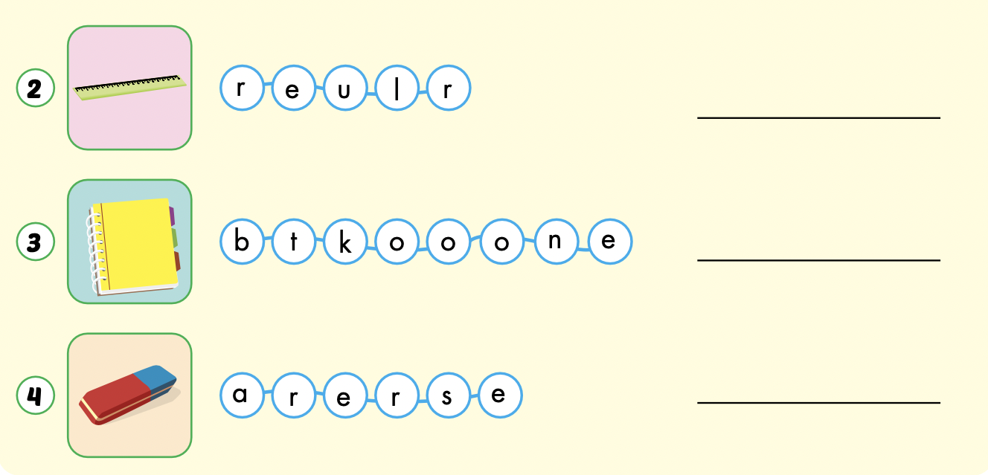
ruler
notebook
eraser

Slide 8
MYSTERY Box Game
Keep / Give The Box?

Slide 9
HOW TO PLAY:
Make 2 teams
Pick a letter and answer the question
Then you must choose:
KEEP THE BOX
or
GIVE THE BOX to the other team

Slide 10
BE CAREFUL!
The points in the box can be GOOD or BAD

Slide 11
ARE YOU READY?

Slide 12
A
B
C
D
E
F
G
H
I
J
K

Slide 13
What is this?

Slide 15
+100

Slide 16
What are these?

Slide 18
-100

Slide 19
What color is this?

Slide 21
+1000

Slide 22
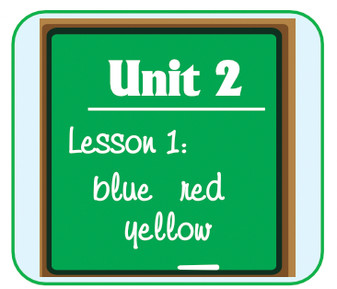
What subject is this?

Slide 24
-500

Slide 25
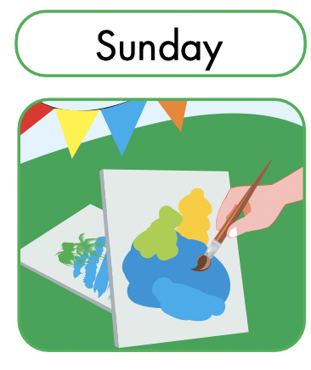
When do you have art?

Slide 27
+1

Slide 28
Do you like purple?

Slide 30
-200

Slide 31
Red and blue make…
?
?

Slide 33
+300

Slide 34
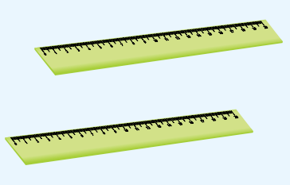
Are these your rulers?

Slide 36
+50

Slide 37
What color is it?

Slide 39
+600

Slide 40
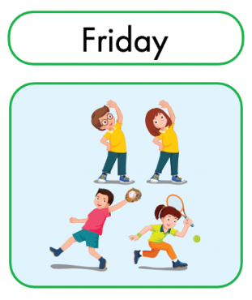
When do you have P.E?.

Slide 42
-1000

Slide 43
Extra Practice
WB p. 36

Slide 44
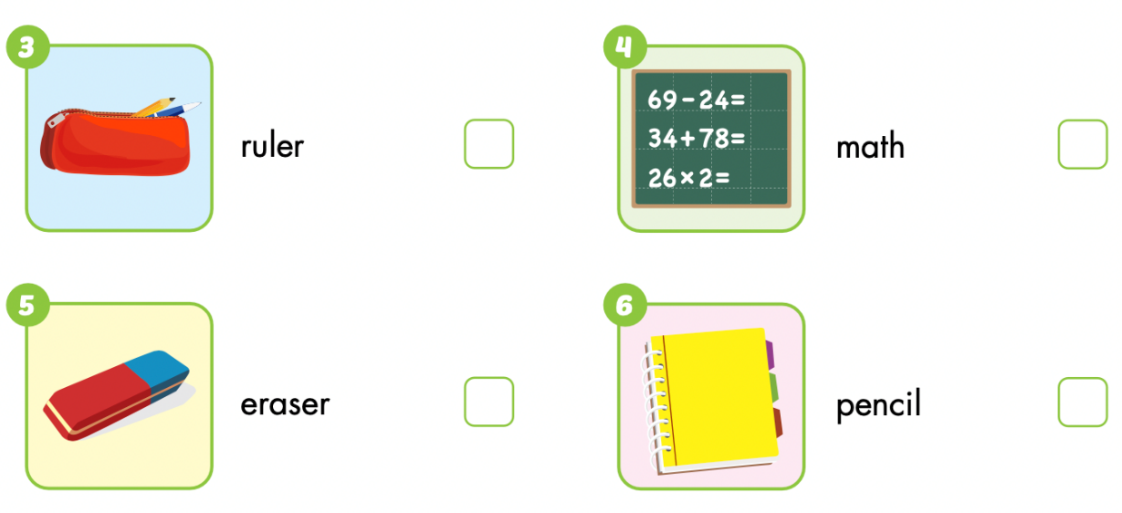

Slide 45
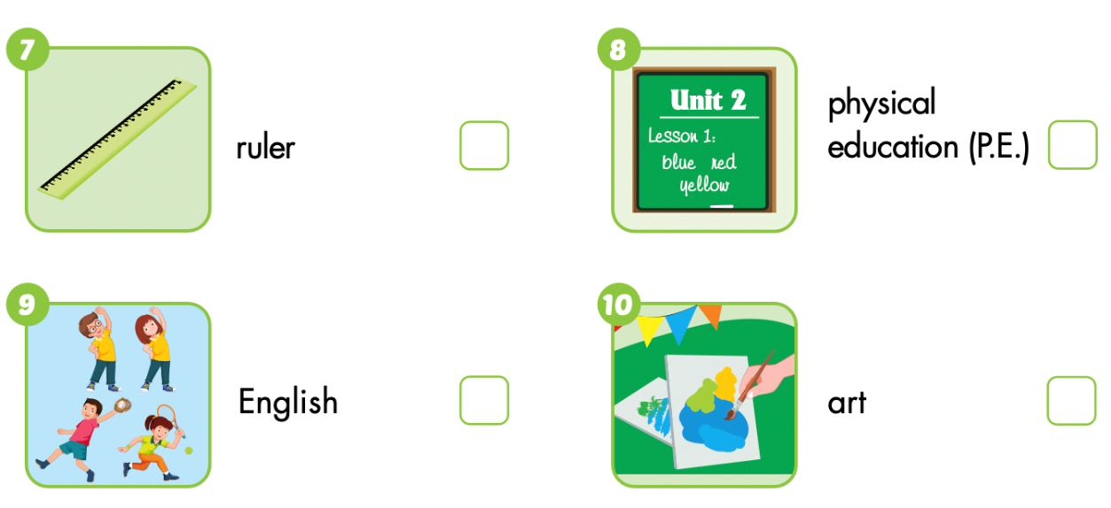

Slide 46
Lesson 3
Today’s lesson
Vocabularies:
Monday, Tuesday, Wednesday, Thursday, Friday, Saturday, Sunday
math, art, English, music, P.E.
Pencil, ruler, notebook, eraser
Structures/ Sentence patterns
When do you have math?
I have math on Monday.

