Slide 1
Unit 4: HOME
Lesson 2.1
SB p55
WB p40 (A,B)

Slide 2
WARM UP

Slide 3
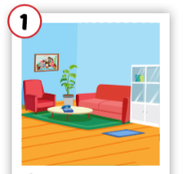
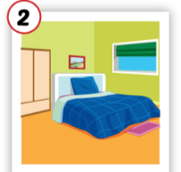
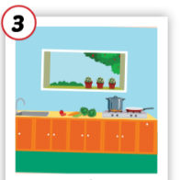
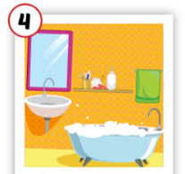
Crossword puzzles
3
k
1
l
i
o
b
r
4
2
e
Notes:
Students play the crossword puzzles. They practice spelling.

Slide 4
Crossword puzzles
3
k
1
l
i
v
i
n
g
r
o
o
m
b
r
4
2
e

Slide 5
Crossword puzzles
3
k
1
l
i
v
i
n
g
r
o
o
m
b
r
4
2
b
e
d
r
o
o
m

Slide 6
Crossword puzzles
3
k
1
l
i
v
i
n
g
r
o
o
m
b
t
r
4
c
h
2
b
e
d
r
o
o
m
n

Slide 7
Crossword puzzles
3
k
1
l
i
v
i
n
g
r
o
o
m
b
a
t
h
r
o
o
m
4
c
h
2
b
e
d
r
o
o
m
n

Slide 8
It’s time to learn …

Slide 9
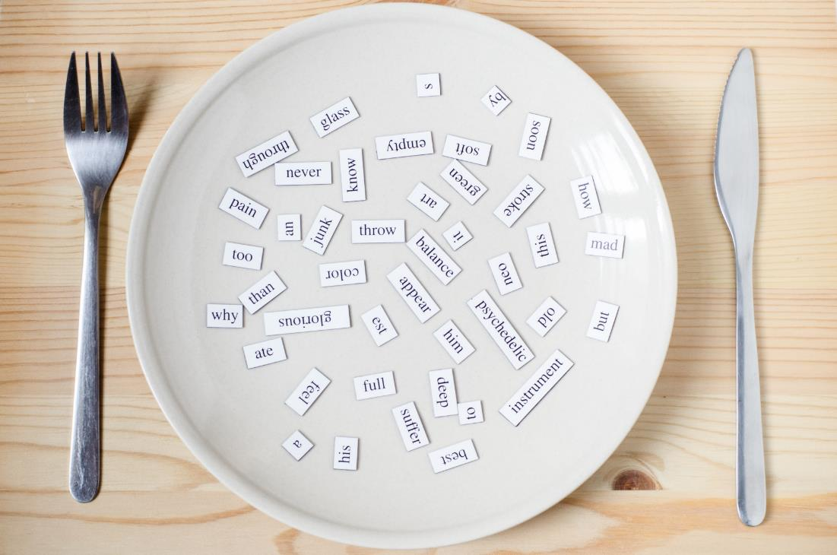
New words
cleaning, playing,
eating,
sleeping, cooking.

Slide 10
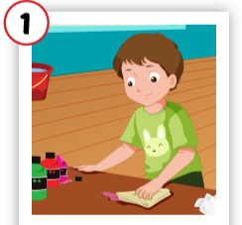
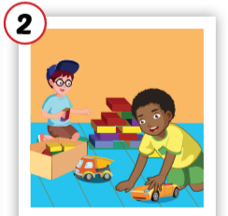
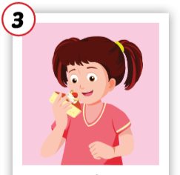
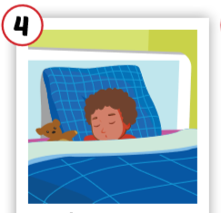
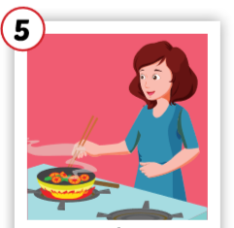
Click each English word to hear the sound.
cleaning
playing
eating
sleeping
cooking
/kliːnɪŋ/
đang lau chùi
/pleɪɪŋ/
đang chơi
/iːt ɪŋ /
đang ăn
/sliːp ɪŋ /
đang ngủ
/ˈkʊk ɪŋ /
đang nấu nướng

Slide 11
Slap the board

Slide 12
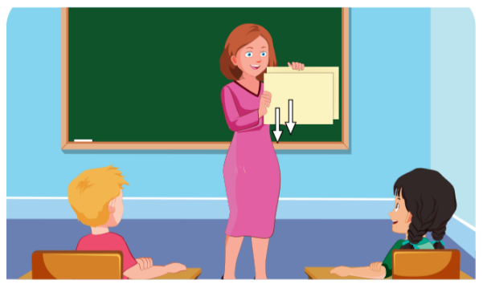
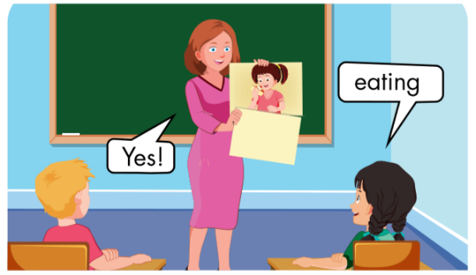

Slide 13
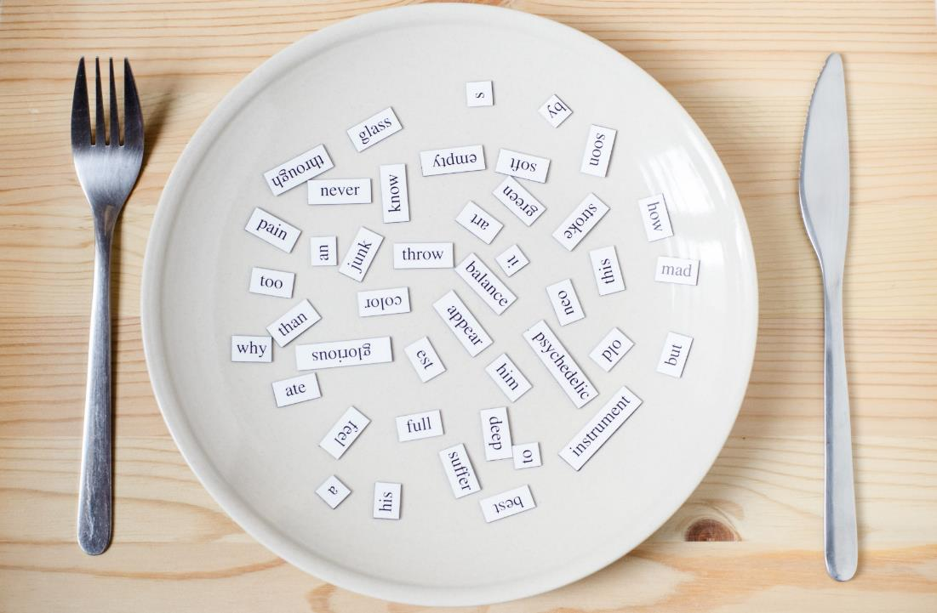
Structures
What’s he doing? He’s sleeping.

Slide 14
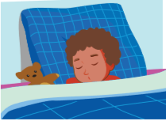
Click English word to hear the sound.

Slide 15
Ask and answer
What’s he doing?
What’s she doing?
He’s ____.
1
She’s _____.
4
2
3
Notes:
Giáo viên có thể thay chủ ngữ bằng tên người (ở số ít)

Slide 16
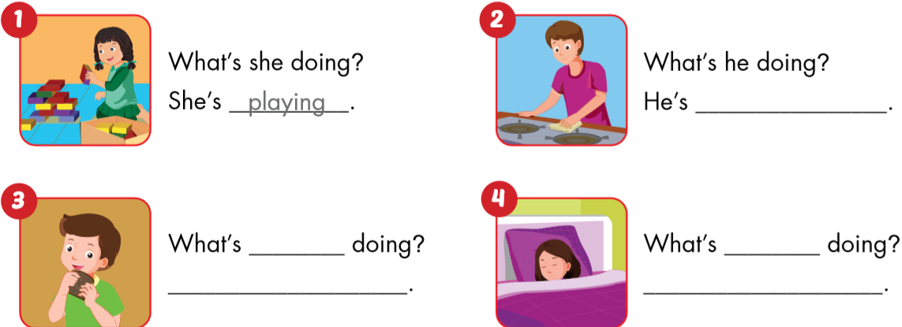
playing.
cleaning.
he
she
He’s eating.
She’s sleeping.

Slide 17
Workbook
p. 40

Slide 18
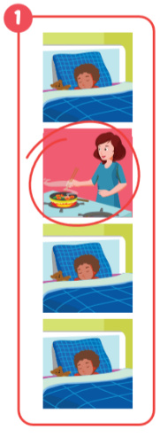
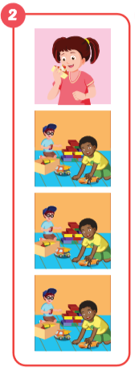
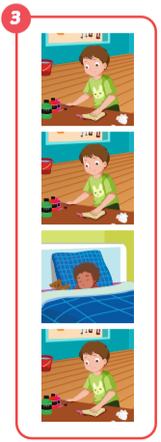
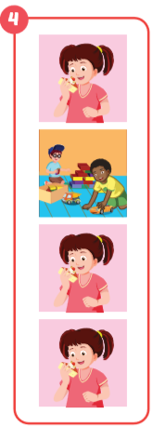
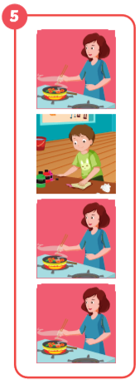
cooking
eating
sleeping
playing
cleaning

Slide 19
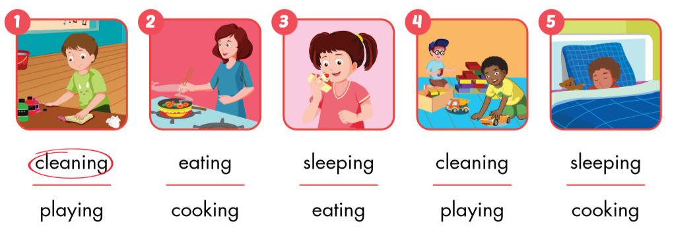

Slide 20
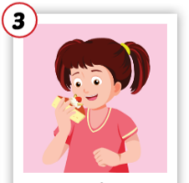
1
4
4
1
2
What’s he/she doing?
SPIN
5
2
He’s / she’s …………
3
4
3
5

Slide 21
o g
s e ping
cooking
sleeping
ea g
eating
la ing
cleaning
playing
c a g

Slide 22
Lesson 3
Today’s lesson
Vocabularies
cleaning, playing,
eating,
sleeping, cooking.
Structures/ Sentence patterns
What’s he doing?
He’s sleeping.

