Slide 1
Unit 4: HOME
Lesson 3.1
Page 58

Slide 2
WARM UP

Slide 3
In pairs, ask what people are doing.
What are they doing?
They are reading books.

Slide 4
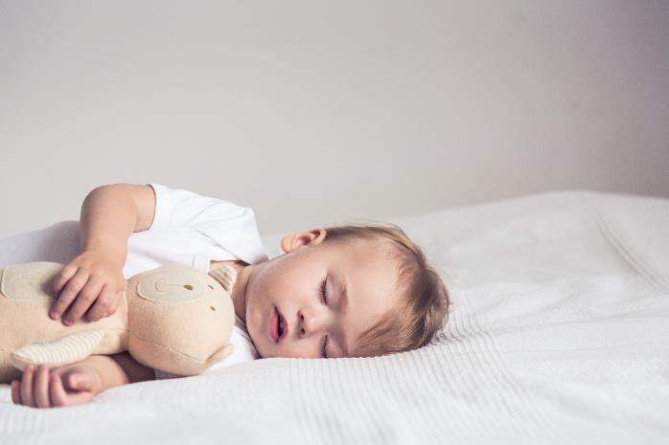
In pairs, ask what people are doing.
Where’s he?
He’s in the bedroom.
What’s he doing?
He’s sleeping.

Slide 5
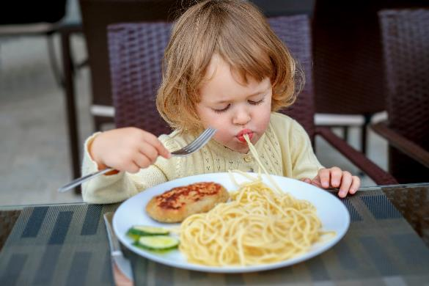
In pairs, ask what people are doing.
What’s she doing?
She’s eating.

Slide 6
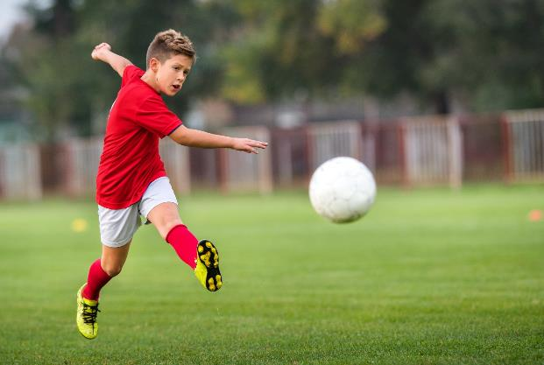
In pairs, ask what people are doing.
What’s he doing?
He’s playing football.

Slide 7
It’s time to learn …

Slide 8
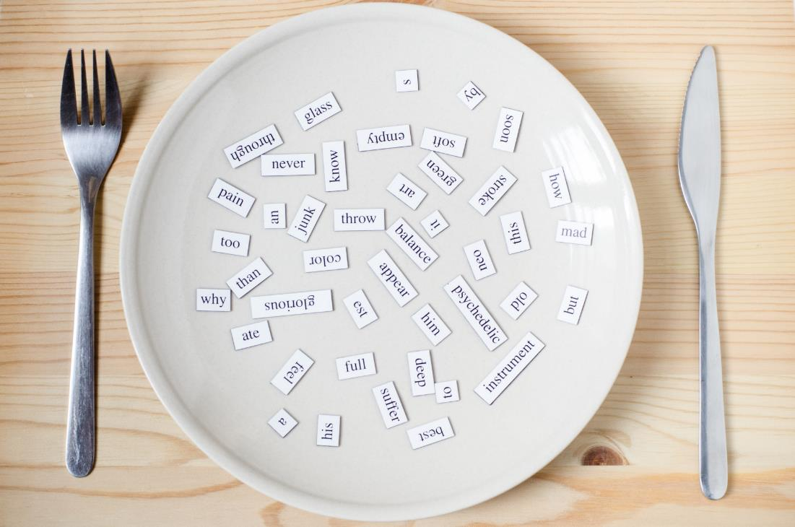
New words
mirror,
picture,
sofa,
table,
box,
house.

Slide 9
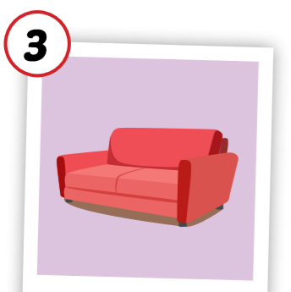
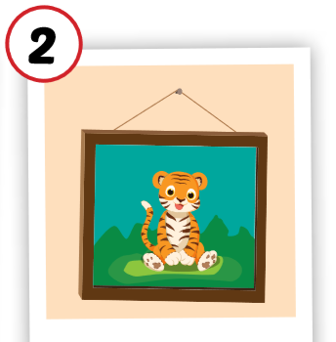
Click each English word to hear the sound.
mirror
picture
sofa
/ˈmɪrər/
cái gương
/ˈpɪktʃər/
bức tranh
/ˈsəʊfə/
ghế sô-pha

Slide 10
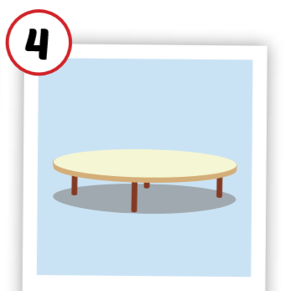
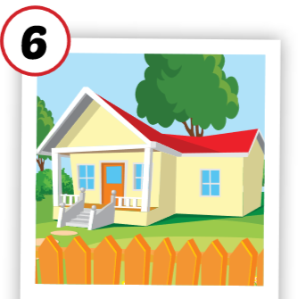
Click each English word to hear the sound.
table
box
house
/ˈteɪbl/
cái bàn
/bɑːks/
cái hộp
/haʊs/
ngôi nhà

Slide 11
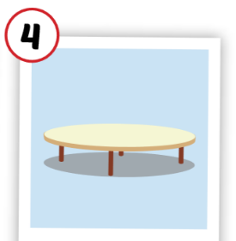
What’s missing.

Slide 12
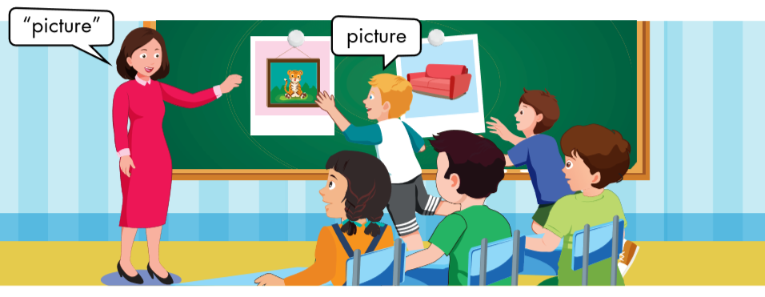
Sofa
Sofa

Slide 13
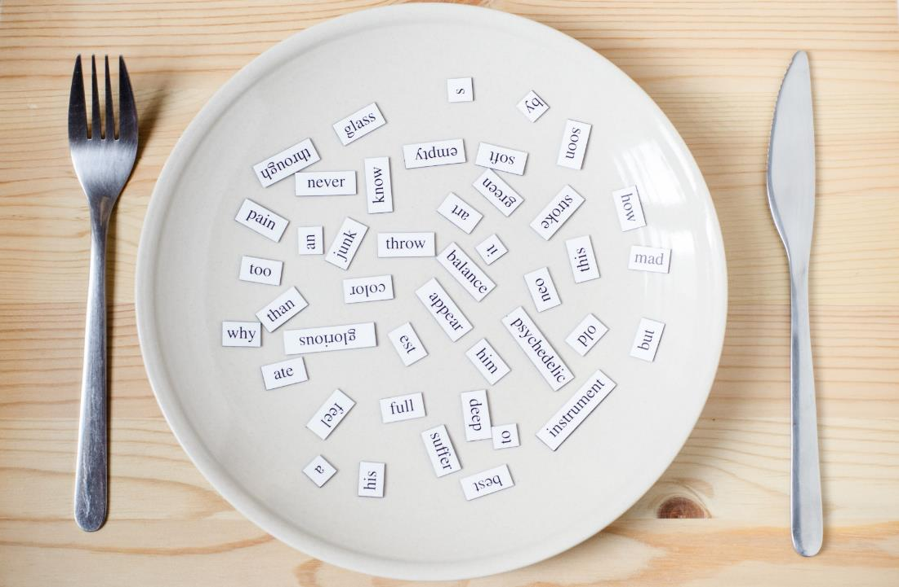
Structures

Slide 14
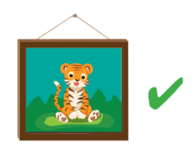
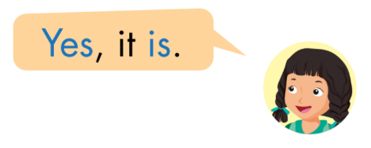

Slide 15
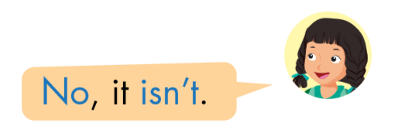

Slide 16
Which picture?
Is the ____ in the living room?
Yes, it is.
No, it isn’t.
1
2

Slide 17
sofa
Yes
isn’t.

Slide 18
Workbook
p. 42

Slide 19
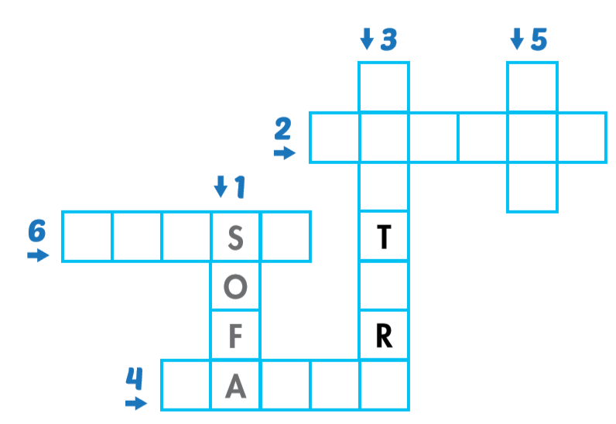
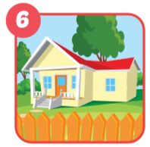
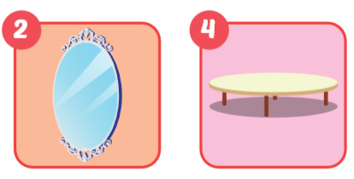
P
c
u
e
b
x
m i r r o r
h o u e
t b l

Slide 20
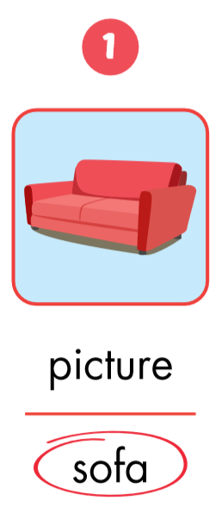
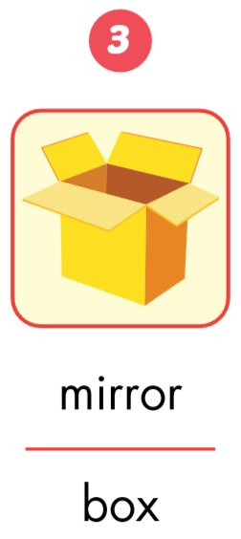
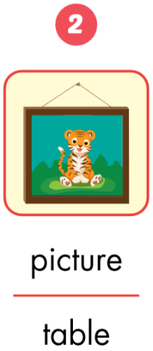

Slide 21
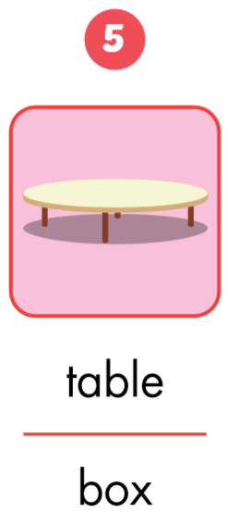
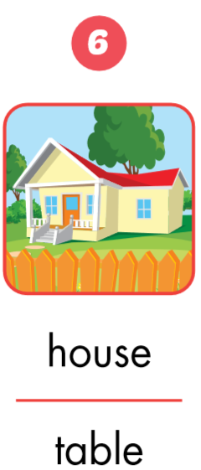
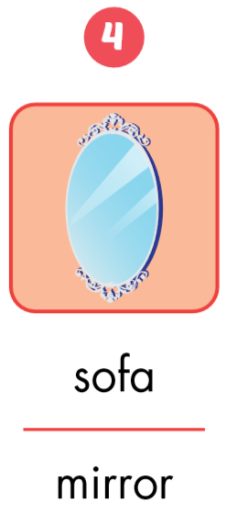

Slide 22
Lesson 3
Today’s lesson
Structures/ Sentence patterns
Is the picture in the living room?
Yes, it is.
Is the cat in the house?
No, it isn’t.
Vocabularies
mirror, picture,
sofa,
table,
box,
house.

