Slide 1
Unit 4: HOME
Lesson 4.3
Page 63

Slide 2
WARM UP

Slide 3
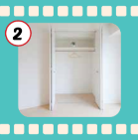
Guessing game.
Where is a bed ?
Notes:
Choose which safe to get the right answer. E.g.: (Where is a bed? It’s in the brown safe.) That’s right. What color is it? It’s blue.

Slide 4
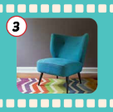
Guessing game.
Where is a chair ?

Slide 5
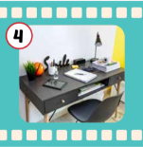
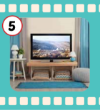
Guessing game.
Where is a TV ?

Slide 6
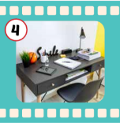
Guessing game.
Where is a desk?

Slide 7
It’s time to learn …

Slide 9
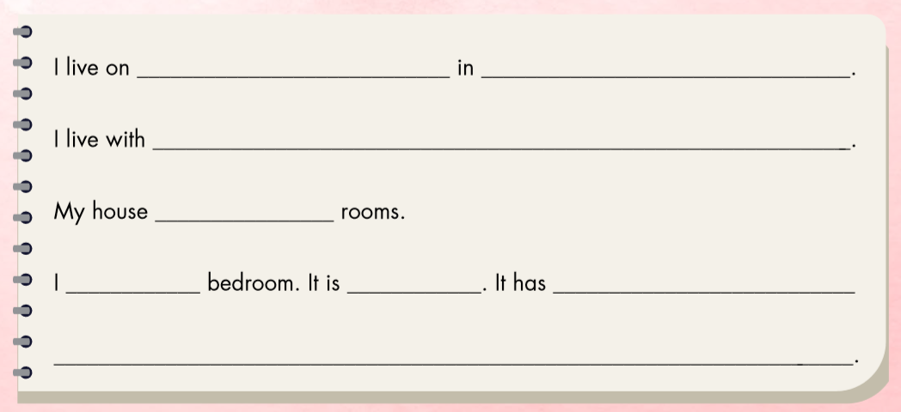

Slide 10
Ngoc Lam Street
Long Bien, Hanoi
my mother and father.
has four
love my
blue
a bed, a desk, and a closet.

Slide 11
Workbook
p. 43
(E)

Slide 12
E. Write about your home. Write 10–20 words.

Slide 13
Use the suggested words to complete the task.
I/Hàng Bài Street/Hanoi.
I/live/my mother/my father/my sister.
My house/ five/ rooms.
I/love/my living room. It/blue. It/TV/picture/sofa.

Slide 14
Use the suggested words to complete the task.
I live on Hàng Bài Street in Hanoi.
I live with my mother, my father, and my sister.
My house has five rooms.
I love my living room. It is blue. It has a TV, a picture, and a sofa.

Slide 15
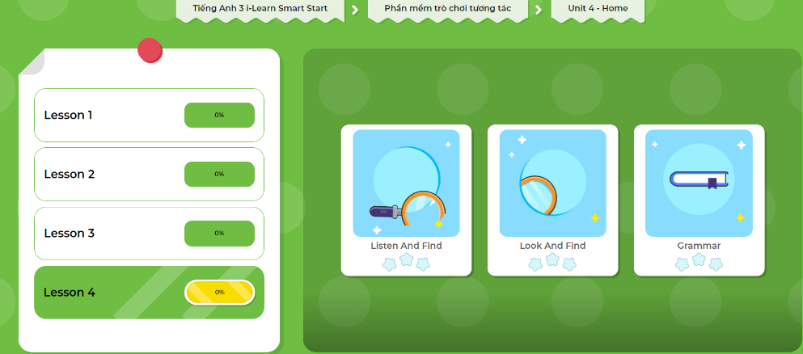
LET’S PLAY!
Click here to play the games!

