Slide 1
Unit 4: HOME
Lesson 4.2 Review and practice
SB Page 65
WB p. 47

Slide 2
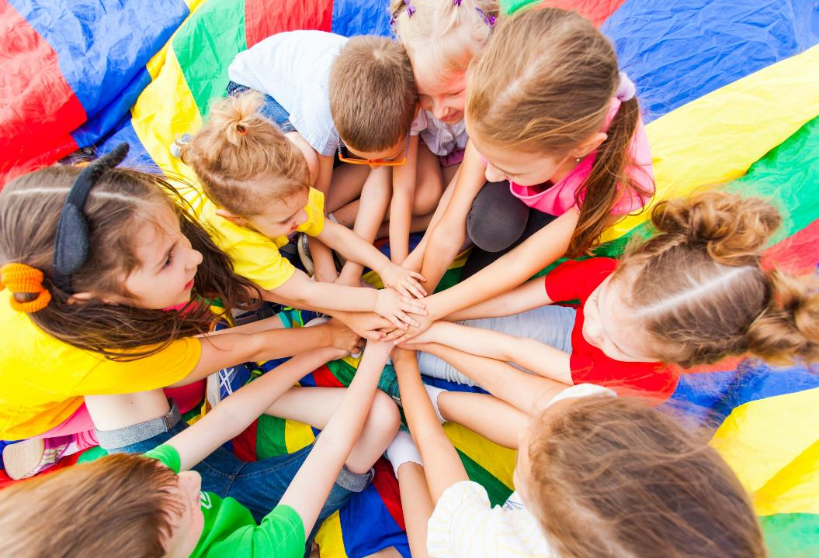
WARM UP

Slide 3
WHAT’S NEXT?
Bo__
Box
Ta__ __ __
Table
Be__
Bed
De__ __
Desk
Mi__ __ __ __
Mirror
Cl__ __ __ __
Closet

Slide 4
WHAT’S NEXT?
Pic__ __ __ __
Picture
Ba__ __ __ __ __ __
Bathroom
Ki__ __ __ __ __
Kitchen
Be__ __ __ __ __
Bedroom
Ya__ __
Yard
Cha__ __
Chair

Slide 5
It’s time to learn …

Slide 6
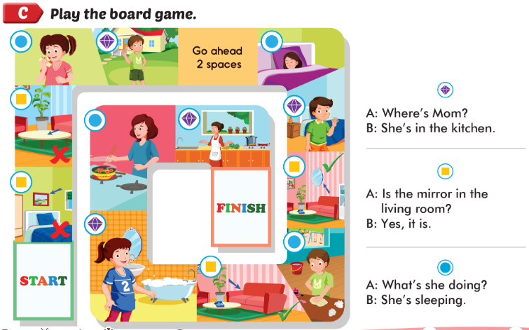

Slide 7
Workbook
p. 47
(C)

Slide 8
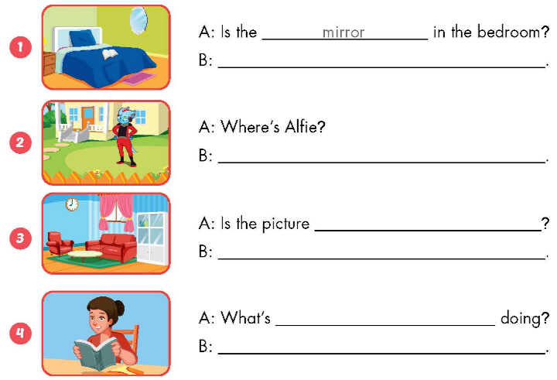
Yes, it is.
He’s in the yard.
in the living room
No, it isn’t.
she
She’s reading

