Slide 1
Unit 4: HOME
Lesson 3.3
Page 60

Slide 2
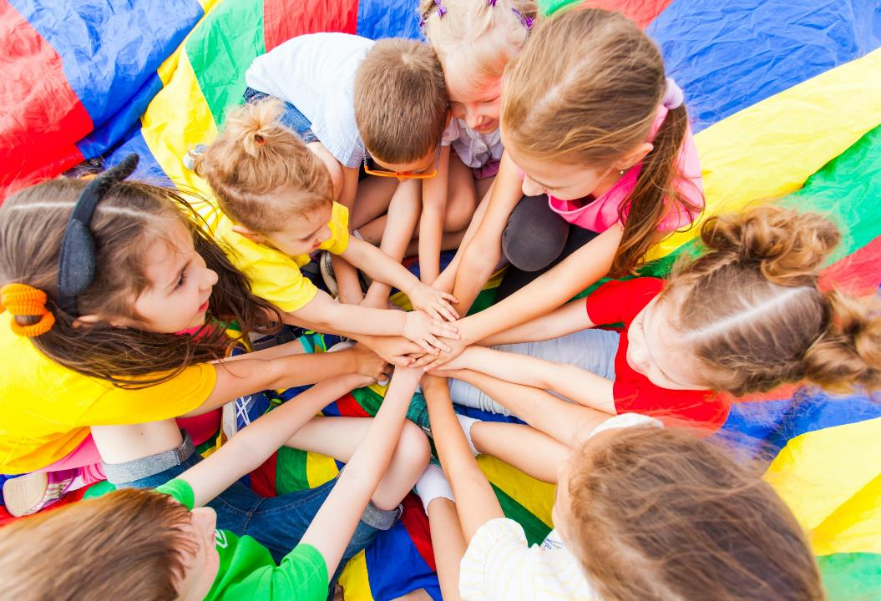
WARM UP

Slide 3
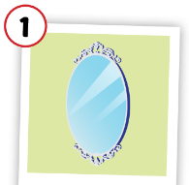
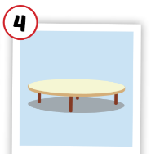
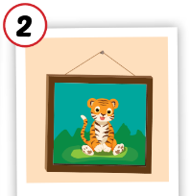
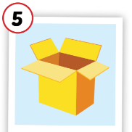
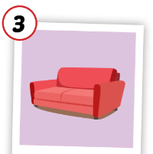
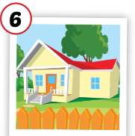
Matching the picture with its meaning.
table
picture
house
mirror
sofa
box

Slide 4
It’s time to learn …

Slide 5
Is the table in the living room?
Yes, it is.

Slide 6
Is the mirror in the living room?
No, it isn’t.

Slide 7
Is the box in the living room?
Yes, it is.

Slide 8
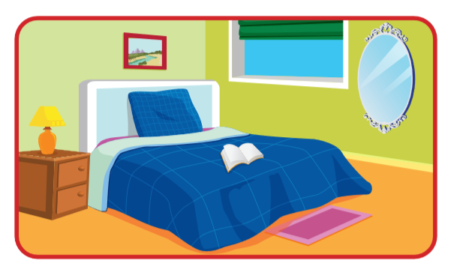
Is the mirror in the living room?
Yes, it is.

Slide 9
Is the picture in the bedroom?
Yes, it is.

Slide 10
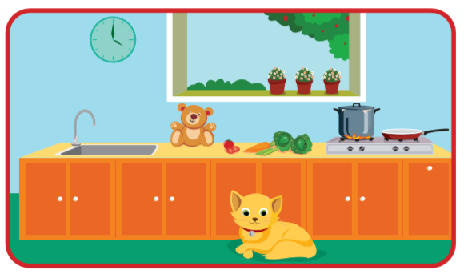
Is the cat in the kitchen?
Yes, it is.

Slide 11
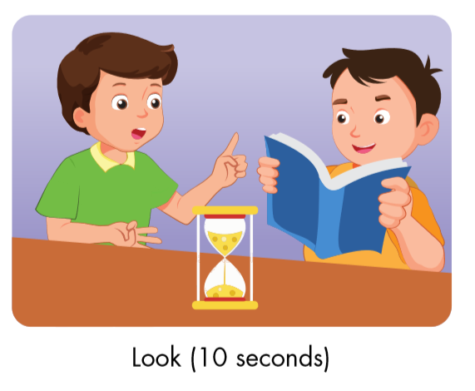
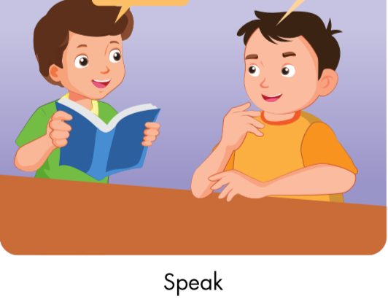
Is the cat in the bedroom?
No, it isn’t.
Correct.

Slide 12
Is the table in the living room?
Yes, it is.
Correct.

Slide 13
Is the picture in the living room?
Yes, it is.
Correct.

Slide 14
Is the box in the kitchen?
No, it isn’t.
Correct.

Slide 15
Workbook
p. 43
(D)

Slide 16
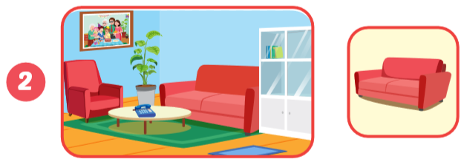
A: Is the table in the kitchen ?
B: Yes, it is .
sofa
living room
A: Is the in the ?
B: Yes, .
it is

Slide 17
the picture
A: Is in ?
B:
the bedroom
Yes, it is.
A:
B:
Is the mirror in the living room?
No, it isn’t.

Slide 18
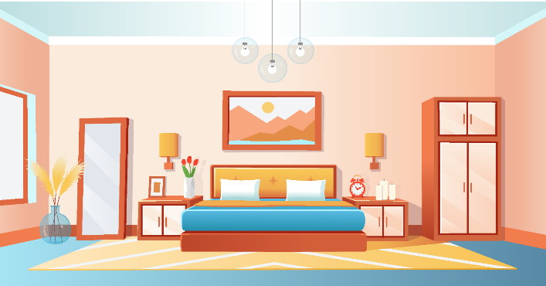
Ask and answer.
Is the picture in the bedroom?
Yes, it is.

Slide 19
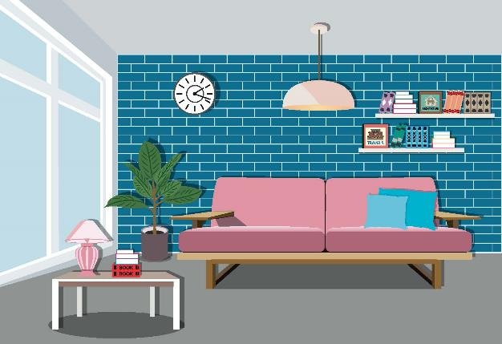
Ask and answer.
Is the mirror in the living room?
No, it isn’t.

Slide 20
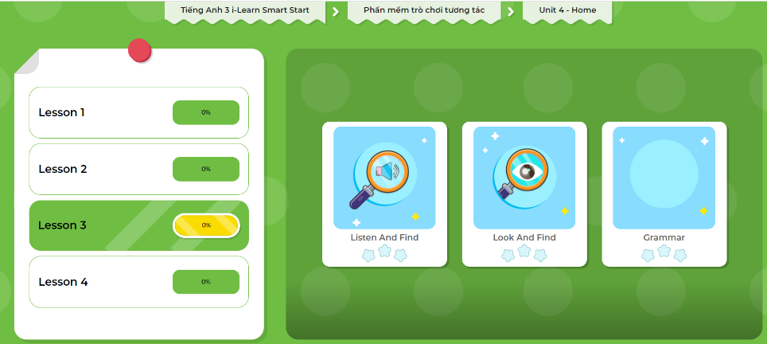
LET’S PLAY!
Click here to play the games!

Slide 21
Lesson 3
Today’s lesson
Vocabularies
Revision (bedroom, bathroom, living room, kitchen, yard).
Structures/ Sentence patterns
Is the picture in the bedroom?
Yes, it is.
Is the mirror in the living room?
No, it isn’t.

