Slide 1
Unit 6: Clothes
Lesson 2.1
Page 85
Notes:
By the end of this lesson, students will be able to talk about what they are wearing.
Vocabulary: skirt, jacket, jeans, boots, T-shirt.
Structure: - What are you wearing?
- I’m wearing blue jeans/
I’m wearing a red jacket.

Slide 2
Unscramble the letters
dress
d
s
e
r
s
pants
t
p
n
s
a
shorts
h
o
r
s
t
s
socks
c
o
s
k
s
shirt
h
r
i
t
s

Slide 3
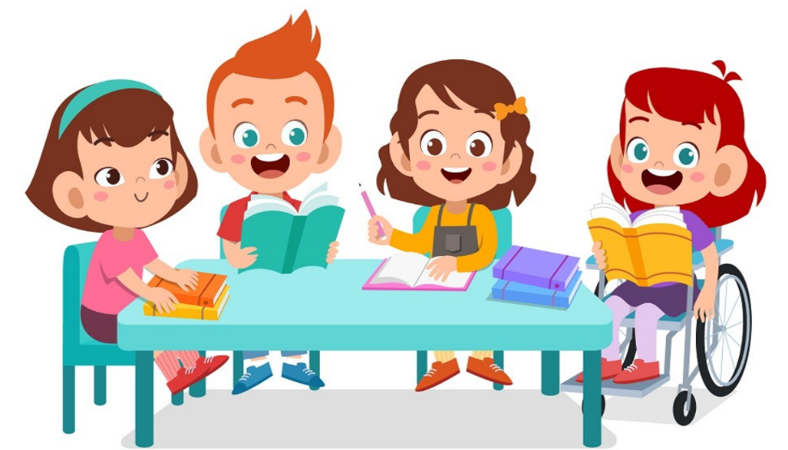
It’s time to learn …

Slide 4
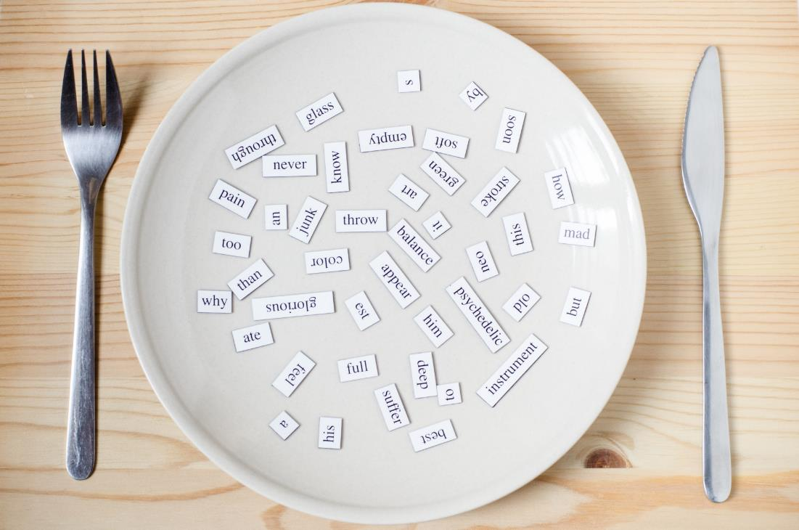
New words

Slide 5
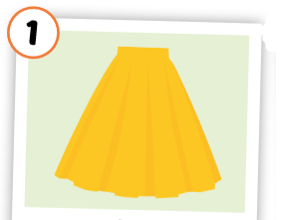
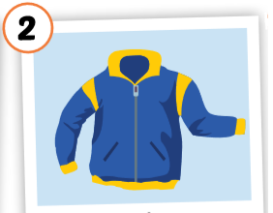
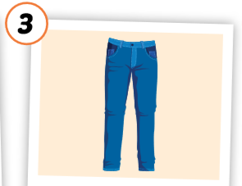
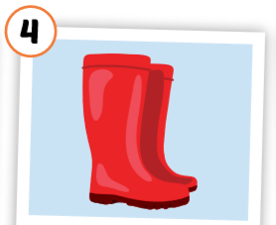
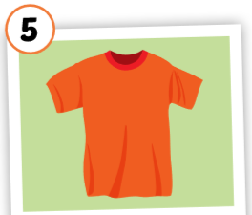
Click each English word to hear the sound.
skirt
jacket
jeans
boots
T-shirt
/skɜːrt/
váy
/ˈdʒækɪt/ áo khoác
/dʒiːnz/
quần jean, quần bò
/buːts/ đôi ủng
/ˈtiː ʃɜːrt/
áo thun
Notes:
GV giới thiệu từ vựng, CCQ

Slide 6
Put the pictures in the right group.
1. a …
2. some … / …s

Slide 7
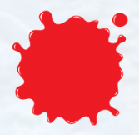
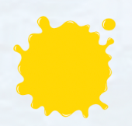
What color …?
green
orange
pink
red
blue
yellow

Slide 8
a / an ____ …
___ … s
yellow
blue
blue
red
orange

Slide 10
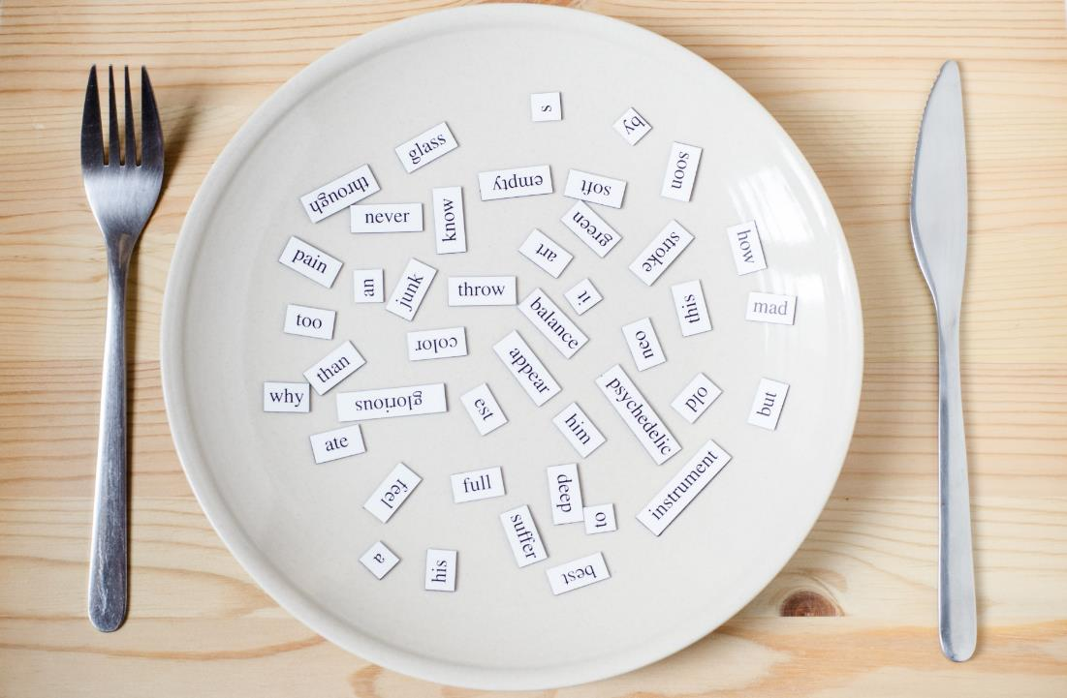
Structures
What are you wearing?
I’m wearing blue jeans.
What are you wearing?
I’m wearing a red jacket.

Slide 11
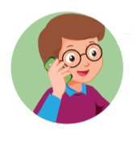
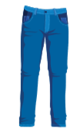
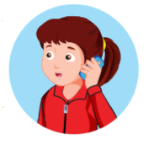

Slide 12
What are you wearing?
I’m wearing red boots.

Slide 13
What are you wearing?
I’m wearing a yellow skirt.

Slide 14
What are you wearing?
I’m wearing blue jeans.

Slide 15
What are you wearing?
I’m wearing an orange T-shirt.

Slide 16
What are you wearing?
I’m wearing a blue jacket.

Slide 17
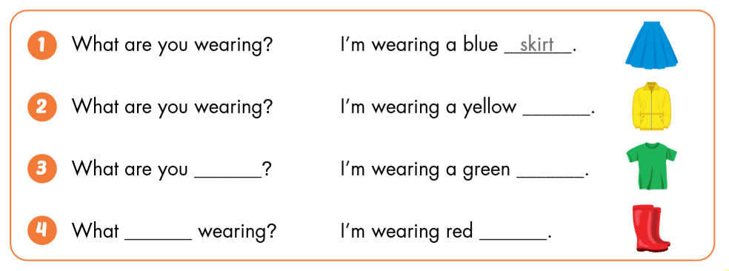
skirt.
jacket.
wearing?
T- shirt.
are you
wearing?
boots.

Slide 18
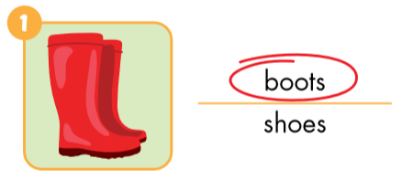
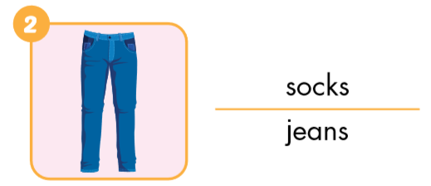
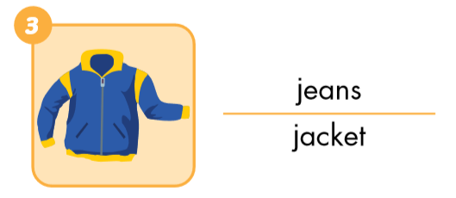
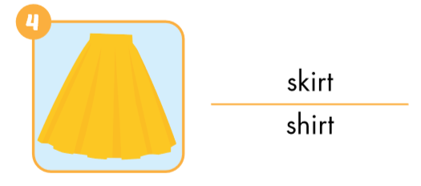
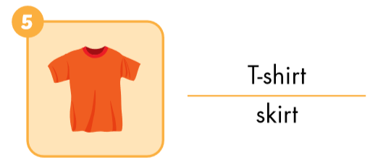
A. Look and circle.

Slide 19
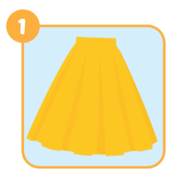
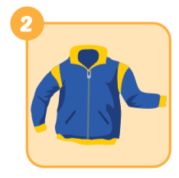
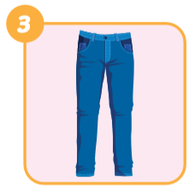
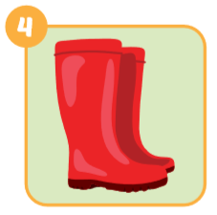
B. Look and write
skirt
jacket
jeans
boots

Slide 20
Today’s lesson
Vocabularies
skirt
jacket
jeans
boots
T-shirt
Structures/ Sentence patterns
What are you wearing?
I’m wearing a red jacket.
What are you wearing?
I’m wearing blue jeans.

