Slide 1
Review
Units 5-8
Page 124

Slide 2
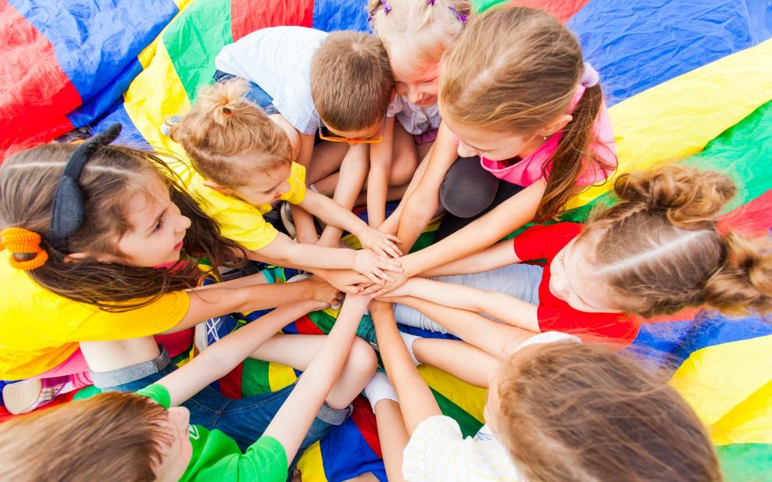
WARM UP

Slide 3
Look and write.
sweatertyhfhsfgchickenqwbnvcwardrobezxsbfriptennisptfgddolllsds
1.________
2.________
3.________
sweater
chicken
wardrobe
4.________
5.________
tennis
doll
KEYS

Slide 4
It’s time to learn …

Slide 5
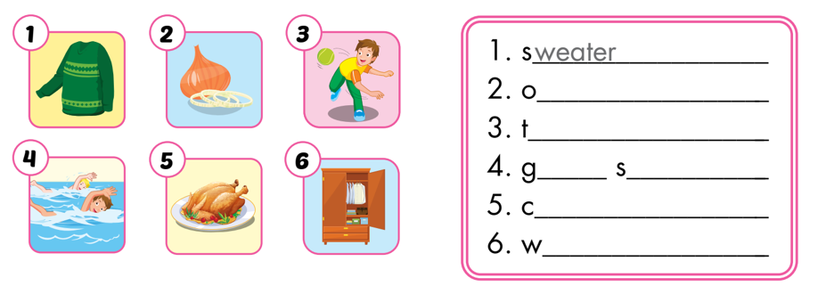
1. Look and write. The first letters are given.
nion
hrowing
o
wimming
hicken
ardrobe

Slide 6
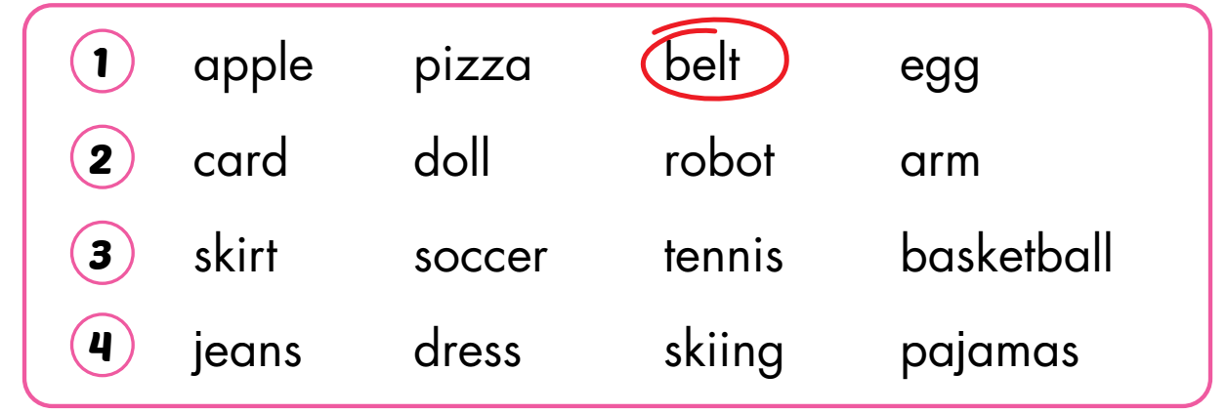
2. Read and circle the odd one out.

Slide 7
3. Unscramble and write.
Would you like some fish?

Slide 8
3. Unscramble and write.
We eat noodles with chopsticks.
I can’t kick the ball in basketball.

Slide 9
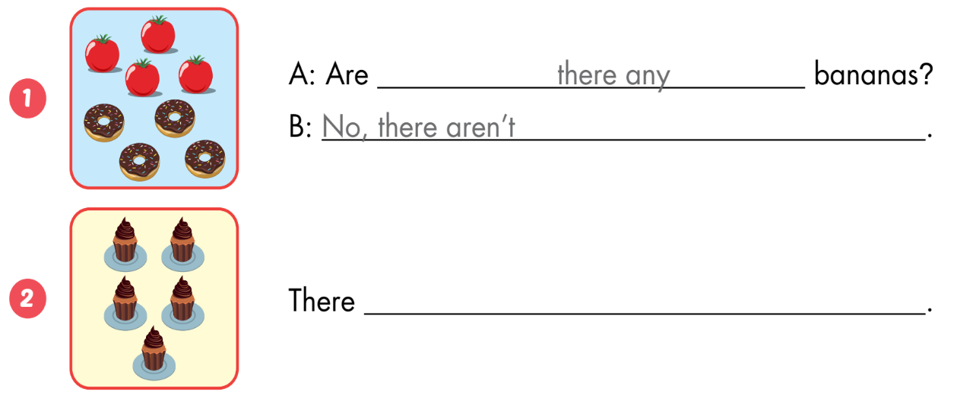
A
Look and write.
are five cupcakes

Slide 10
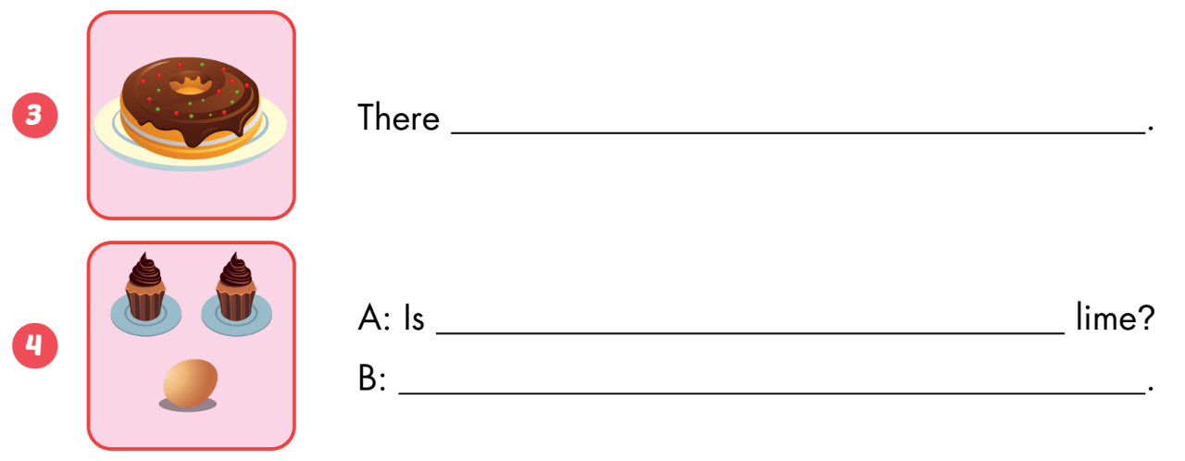
A
Look and write.
is a donut
there a
No, there isn’t

Slide 11
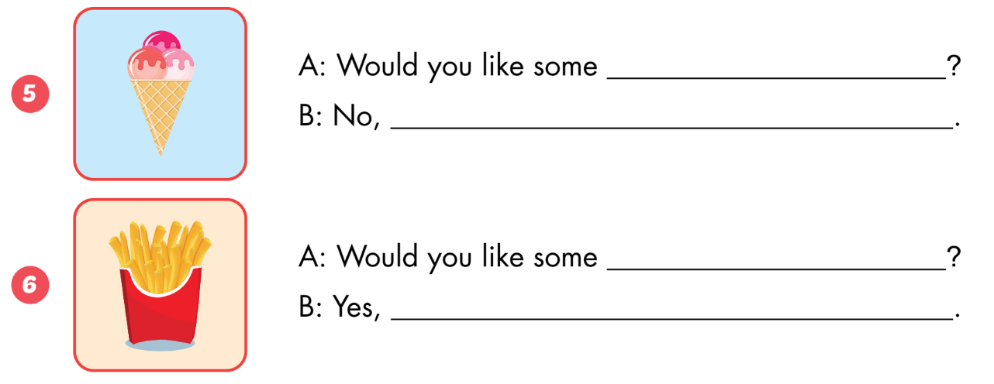
A
Look and write.
ice cream
thank you
fries
please

Slide 12
1
4
6
1
SPIN
2
5
2
5
4
3
3
6
Next Part

Slide 13
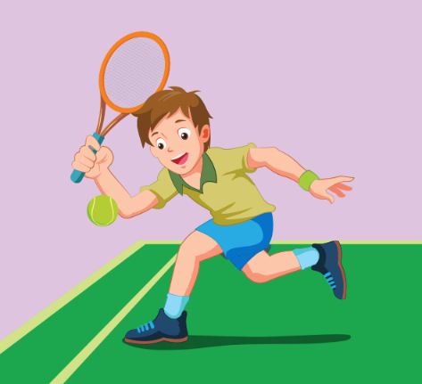
Look and say.
Go back

Slide 14
Look and say.
Go back

Slide 15
Look and say.
Go back

Slide 16
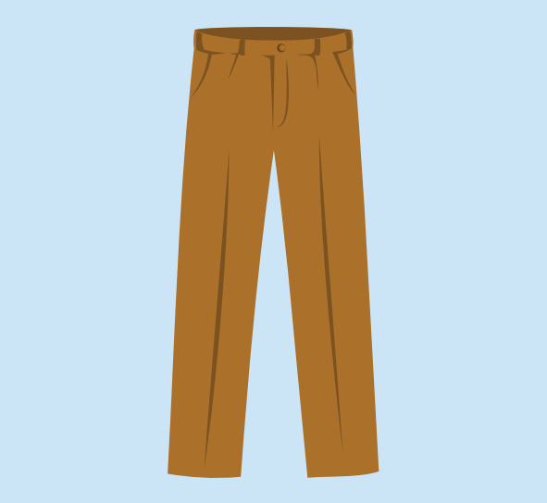
Look and say.
Go back

Slide 17
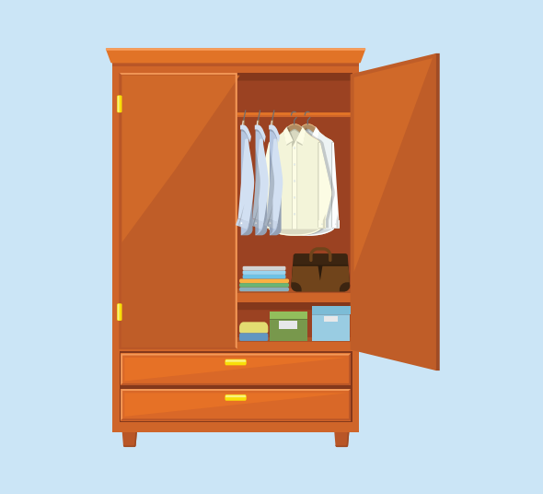
Look and say.
Go back

Slide 18
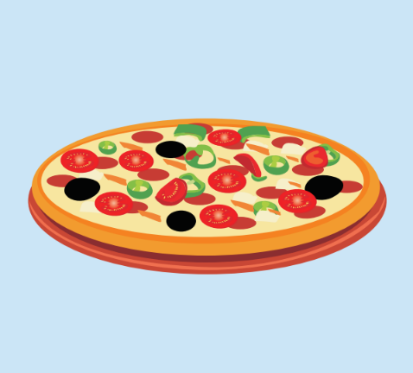
Look and say.
Go back

Slide 19
Today’s lesson
Vocabulary:
sweater, onion, throw, go swimming, chicken, wardrobe, arm, tennis, pajamas, doll
Structures:
We eat noodles with chopsticks./ I’m wearing brown boots./ Would you like some fish?

