Slide 2
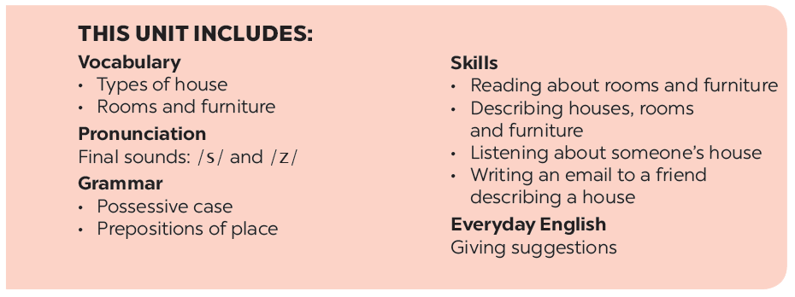

Slide 3
Grammar
Possessive case
Prepositions of place
Choose the correct answer.
Write the correct preposition in the box under each picture. Say a sentence to describe the picture.
Complete the sentences with the correct possessive forms.
Look at the picture and write T (true) or F (False) for each sentence. correct the false ones.
Memory challenge

Slide 4
Grammar
Possessive case
We use ’s after a proper name.
Example: This is Elena’s room.
We use ’s after a singular noun.
Example: This is my mum’s book.

Slide 5
Choose the correct answer.
1.
My (grandmothers / grandmother’s) house is in Ha Noi.
2.
This is my (sister’s / sister’) desk.
3.
My (cousin’s / cousin) dad is my uncle.
4.
(Nam’s / Nam’) house is small.
5.
There are two bedrooms in (Ans / An’s) flat.

Slide 6
Complete the sentences with the correct possessive forms.
Mi’s
1.
Thuc Anh is cousin. (Mi)
This is their chair. (teacher)
2.
teacher’s
3.
Where is computer? (Nick)
Nick’s
4.
My motorbike is in the garden. (father)
father’s
5.
My bedroom is next to the living room. (brother)
brother’s

Slide 7
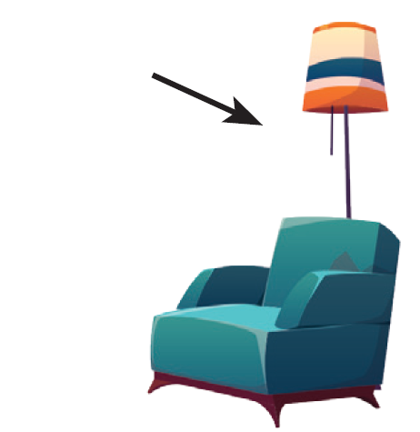
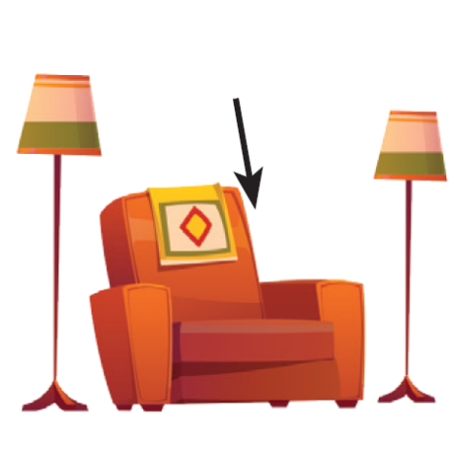
Prepositions of place
Grammar
Prepositions of place describe where people or things are. These are some prepositions of place.
in
on
behind
under
next to
in front of
between

Slide 8
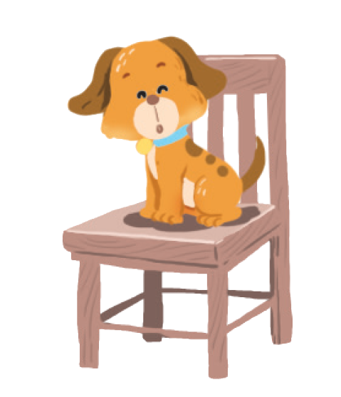
Write the correct preposition in the box under each picture. Say a sentence to describe the picture.
on
behind
in
on
next to
in front of
under
between
Example:
1.
on
The dog is on the chair.

Slide 9
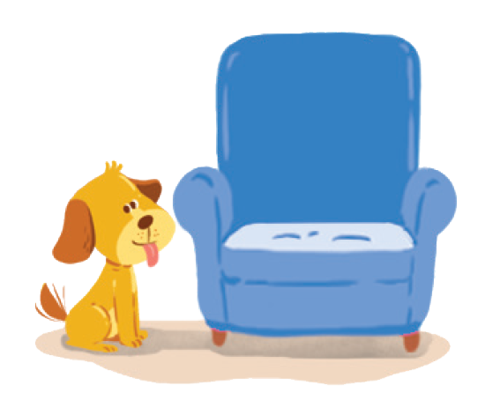
behind
on
next to
behind
in
next to
in front of
under
between
2.
next to
3.
behind
The dog is next to the armchair.
The cat is behind the TV.

Slide 10
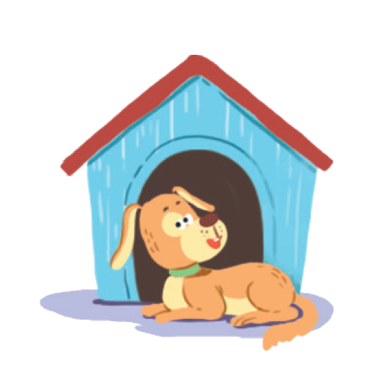
in
on
next to
behind
in
in front of
under
between
in front of
4.
in
5.
in front of
The cat is in the wardrobe.
The dog is in front of the doghouse.

Slide 11
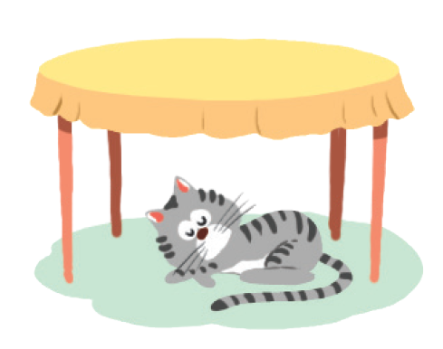
in
on
next to
behind
between
under
between
in front of
under
6.
between
7.
under
The cat is between
the lamp and the armchair.
The cat is under the table.

Slide 12
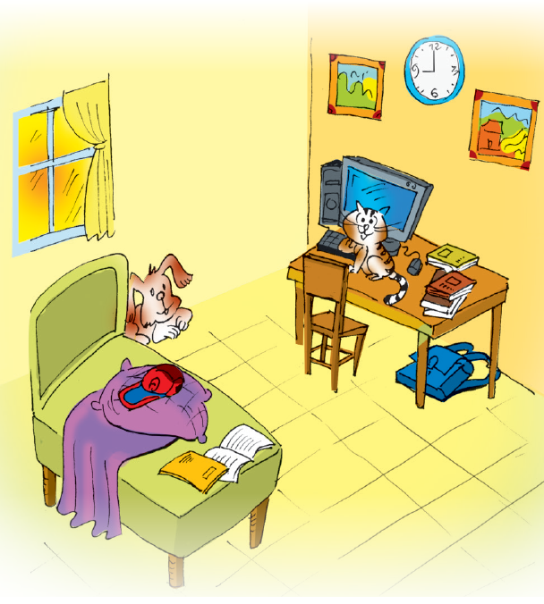
Look at the picture and write T (true) or F (False) for each sentence. Correct the false ones.
Example:
The books are under the table.
F
The books are on the table.

Slide 13
1.
The dog is behind the bed.
T
2.
The school bag is on the table.
F
The school bag is under the table.
3.
The picture is between the clocks.
F
The clock is between the two pictures.
4.
T
The cat is in front of the computer.
F
5.
The cap is under the pillow.
The cap is on the pillow.

Slide 14
Memory challenge
Work in pairs. Look at the picture in 4 carefully, and then cover it. Ask and answer questions about the position of things in the picture.
Example:
A: Where are the books?
B: They’re on the table.

