Slide 1
Unit 5: Wonders of Viet Nam
Lesson 5: Skills 1
TEACHER: NGUYEN THU HANG

Slide 2
WARM UP

Slide 3
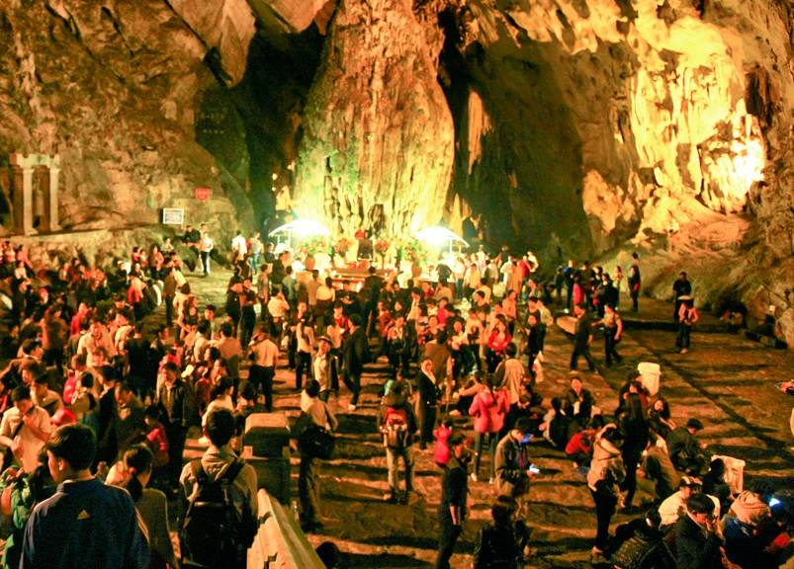
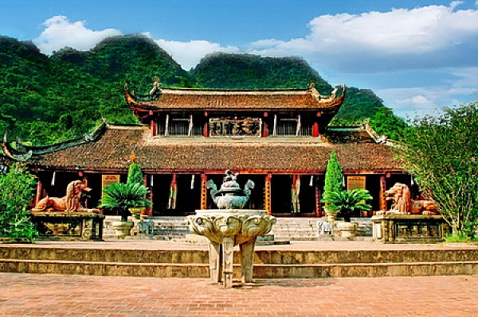
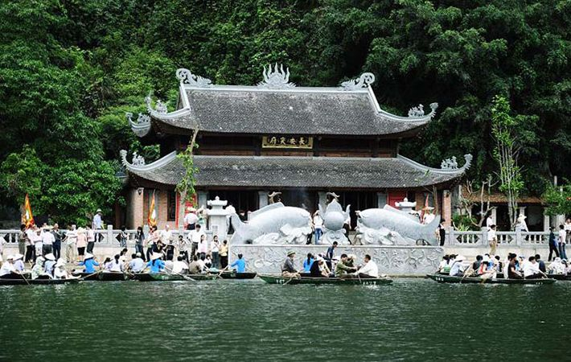
Match the name with the correct picture.
Den Trinh (Presentation Shrine)
Thien Tru (Heaven Kitchen)
Perfume Temple (Inner Temple)
Perfume Temple (Inner Temple)
Den Trinh (Presentation Shrine)
Thien Tru (Heaven Kitchen)

Slide 4
VOCABULARY

Slide 5
- vast /vɑːst/ (adj) :rộng lớn
- backdrop /ˈbækdrɒp/ (n) : nền
- pilgrim /ˈpɪlɡrɪm/ (n): người hành hương
- theme /θiːm/ (n) : chủ đề, đề tài
- reign /reɪn/ (n) : triều đại

Slide 6
1. Read an article about the Perfume Pagoda. Look at the words in the box, then find them in the text and underline them. What do they mean?
vast pilgrims theme backdrops reign
Perfume pagoda is a religious site as well as being a great sight-seeing spot in Viet Nam. It is situated in Huong Son Commune, My Duc District, Ha Noi. It is a vast complex of Buddhist temples and shrines, including Den Trinh (Presentation Shrine) and Thien Tru (Heaven Kitchen) Pagoda, in the limestone Huong Tich mountains. The centre of this complex is the Perfume Temple, also called Chua Trong (Inner Temple), located in Huong Tich Cavern. It is thought that the first temple was built on the current site of Thien Tru in the 15th century during the reign of Le Thanh Tong. Over the years some of its structures which were in ruins have been restored or replaced.
Many Vietnamese works of literature, both old and modern, have made Perfume Pagoda their focus. It has also provided backdrops for many famous paintings. Its beauty has been used as a theme of many famous songs and a topic of lyric poetry. Nowadays during its festival (from the middle of January to the middle of March on the lunar calendar), Perfume Pagoda attracts large numbers of pilgrims from all over Viet Nam.

Slide 7
1. Read an article about the Perfume Pagoda. Look at the words in the box, then find them in the text and underline them. What do they mean?
vast pilgrims theme backdrops reign
Words | Their definitions
vast /vɑːst/ | the period during which a king, queen, emperor, etc. rules
pilgrim /ˈpɪlɡrɪm/ | extremely large in area, size, amount, etc.
theme /θiːm/ | a person who travels to a holy place for religious reasons
backdrop /ˈbækdrɒp/ | the subject or main idea in a talk, piece of writing, or work of art
reign /reɪn/ | the general scene in which an event takes place

Slide 8
Read the statements and decide True or False.
Statements | T | F
1. Perfume Pagoda is not only a religious site but also a great sight-seeing spot in Viet Nam.
2. Perfume Pagoda includes Den Trinh (Presentation Shrine), Thien Tru (Heaven Kitchen) Pagoda, and the Perfume Temple.
3. The Perfume Temple is located in Huong Tich Cavern.
4. The first temple is thought to have been built on the current site of Thien Tru in the 1500s.
5. The beauty of the Perfume Pagoda has been the subject of many famous songs and poems.
6. Pilgrims from all over the world visit the Perfume Pagoda during its festival.
√
√
√
√
√
√

Slide 9
2. Read the article again and answer the questions.
Where is the Perfume Pagoda located? ______________________________________________
2.What does the complex of the Perfume Pagoda include? ______________________________________________
3.Where is the centre of this complex located? ______________________________________________
What is special about the beauty of the Perfume Pagoda? ______________________________________________
Who visits the Perfume Pagoda during its religious festival? ______________________________________________
It is located in Huong Son Commune, My Duc District, Ha Noi.
It includes Den Trinh (Presentation Shrine), Thien Tru (Heaven Kitchen)
Pagoda, and the Perfume Temple.
The centre of this complex, the Perfume Temple, also known as Chua
Trong (Inner Temple), is located in Huong Tich Cavern.
Its beauty has been used as a theme of many famous songs and
a topic of lyric poetry.
Pilgrims from all over Viet Nam do.

Slide 10
3. Work in pairs. Below are some of the things that have caused damage to the man-made wonders of Viet Nam. Put them in order of seriousness. Give your reasons. Can you add anymore?
□ | a. Many roads, hotels, factories, etc, have been built around man-made wonders.
□ | b. Too many tourists visit man-made wonders every day.
□ | c. Local governments don’t have long term measures to protect man-made wonders from severe weather conditions.
□ | d. Recent restorations have changed the original structure of some man-made wonders.
□ | e. Many valuable things have been stolen from man-made wonders.

Slide 11
4a. Work in pairs. Use the ideas in to suggest ways to protect and preserve the man-made wonders of Viet Nam.
It is reported that many of our man-made wonders have been damaged. What should we do to protect and preserve them?
I suggest that we should limit the number of tourists visiting them every day.
That's a good idea. I'd like to suggest raisingmoney to restore and preserve them...

Slide 12
4b. Report your best ideas to the class.
Example:
We suggested limiting the number of tourists who can visit these important sites per day.

Slide 13
REMEMBER WHAT HAVE YOU LEARNT TODAY!

Slide 14
HOME WORK
Learn by heart the new words
Read the passage and answer the questions.
Prepare: Skills 2

Slide 15
Thanks!

