Slide 1
TRƯỜNG THCS LONG BIÊN
BÀI GIẢNG ĐIỆN TỬ MÔN TIẾNG ANH 7
UNIT 7. TRAFFIC
GV: Lê Hà Chi
Tổ Ngoại ngữ - Năng khiếu

Slide 2
Objectives
Have an overview of the unit topic: Traffic
Listen to a short dialogue for gist
Read a short dialogue for specific details

Slide 3
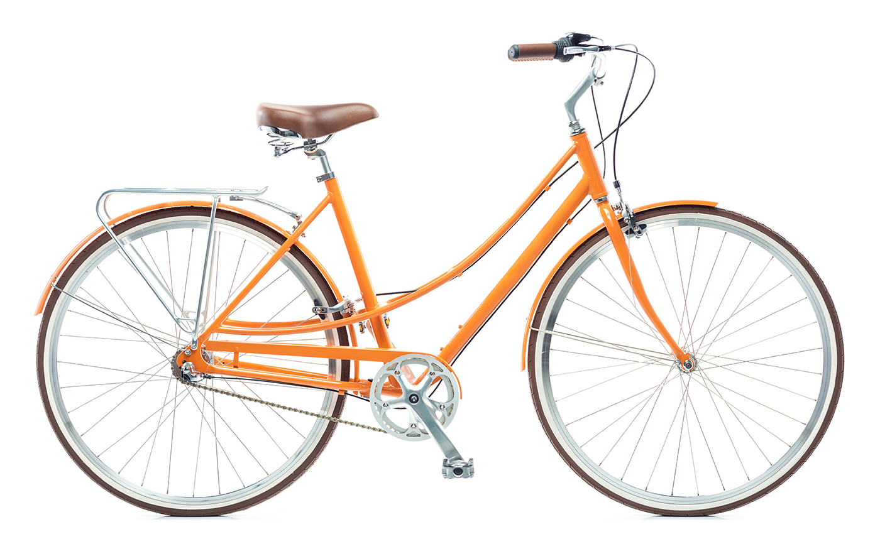
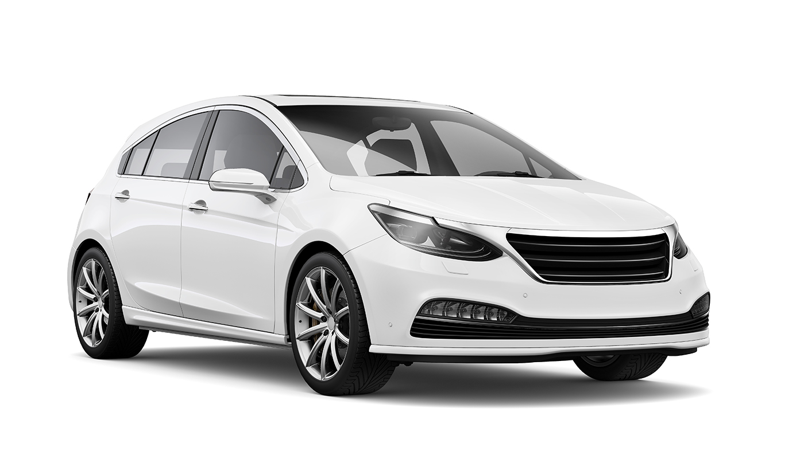
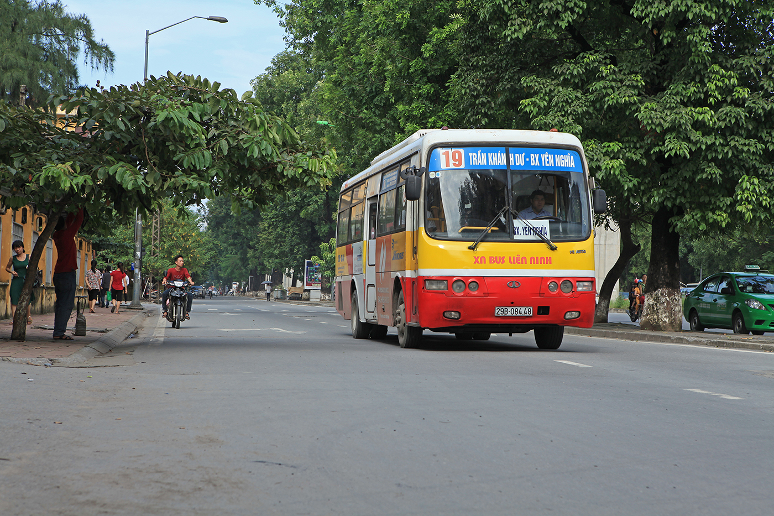
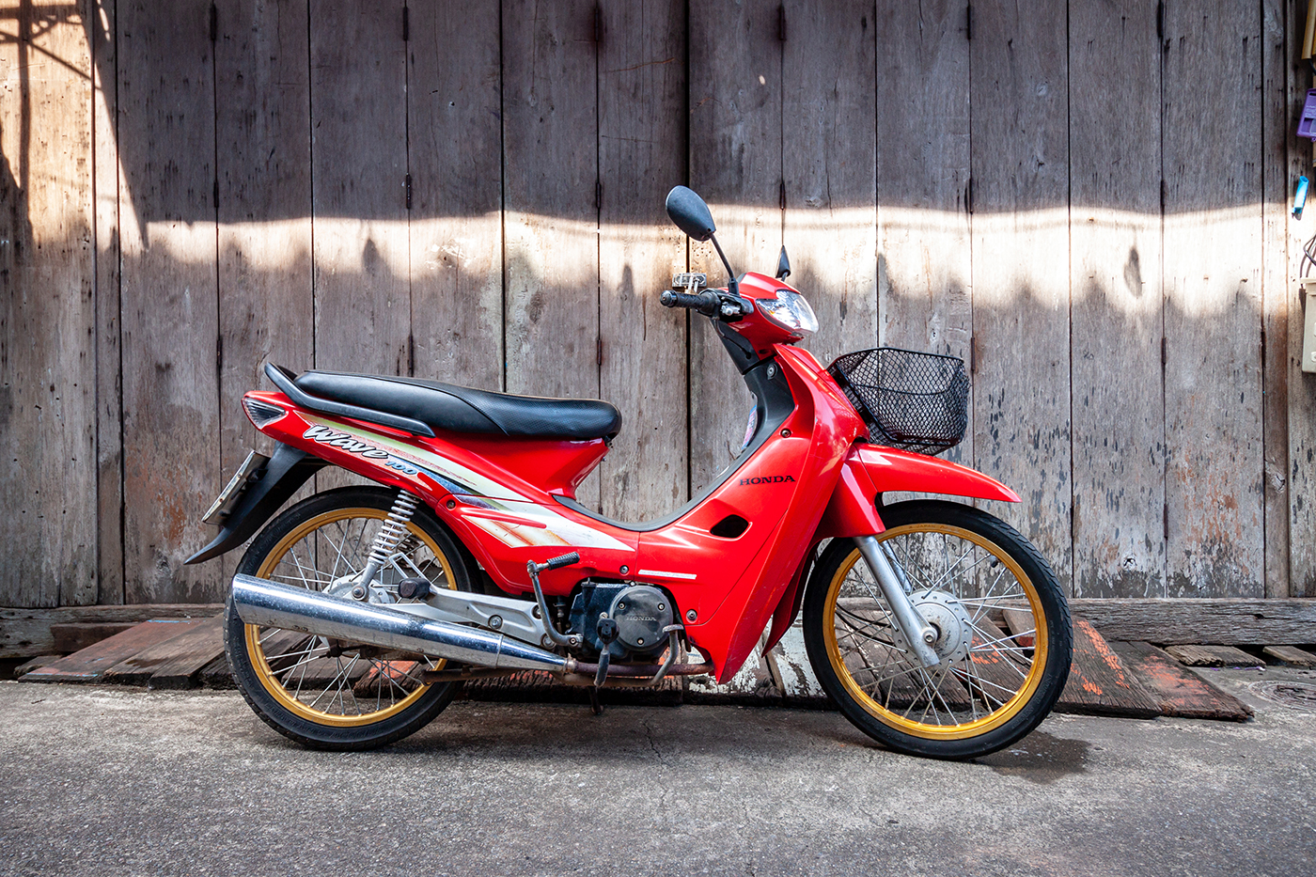
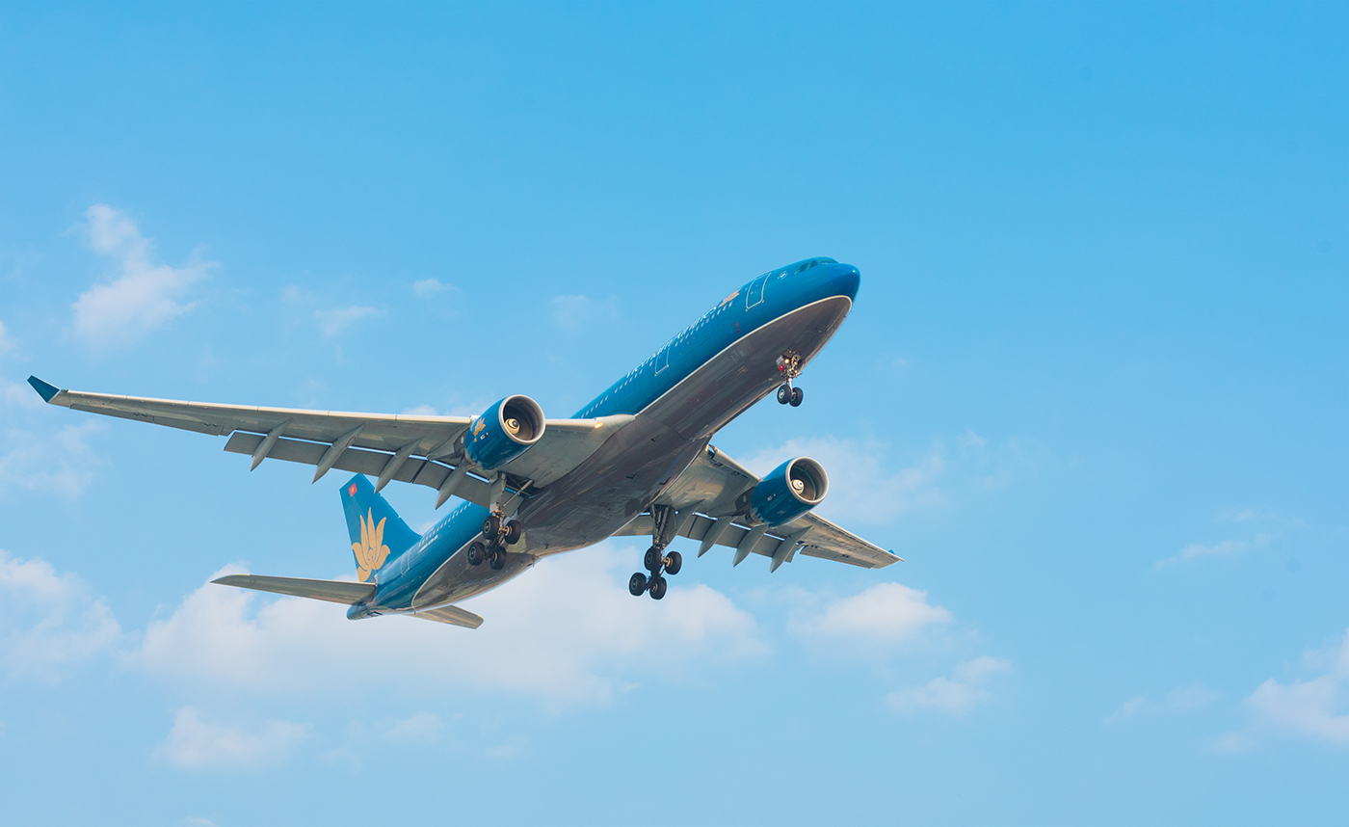
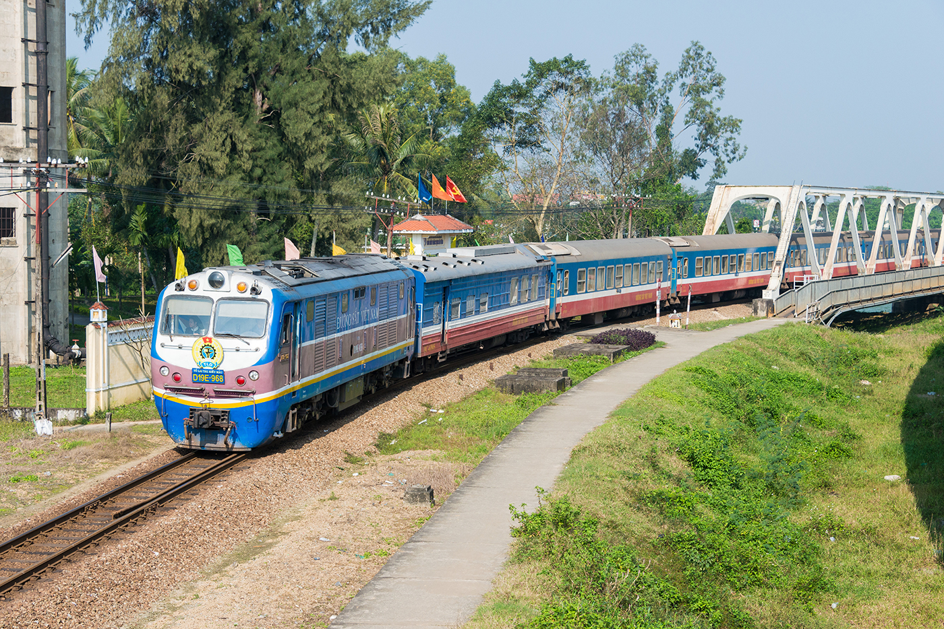
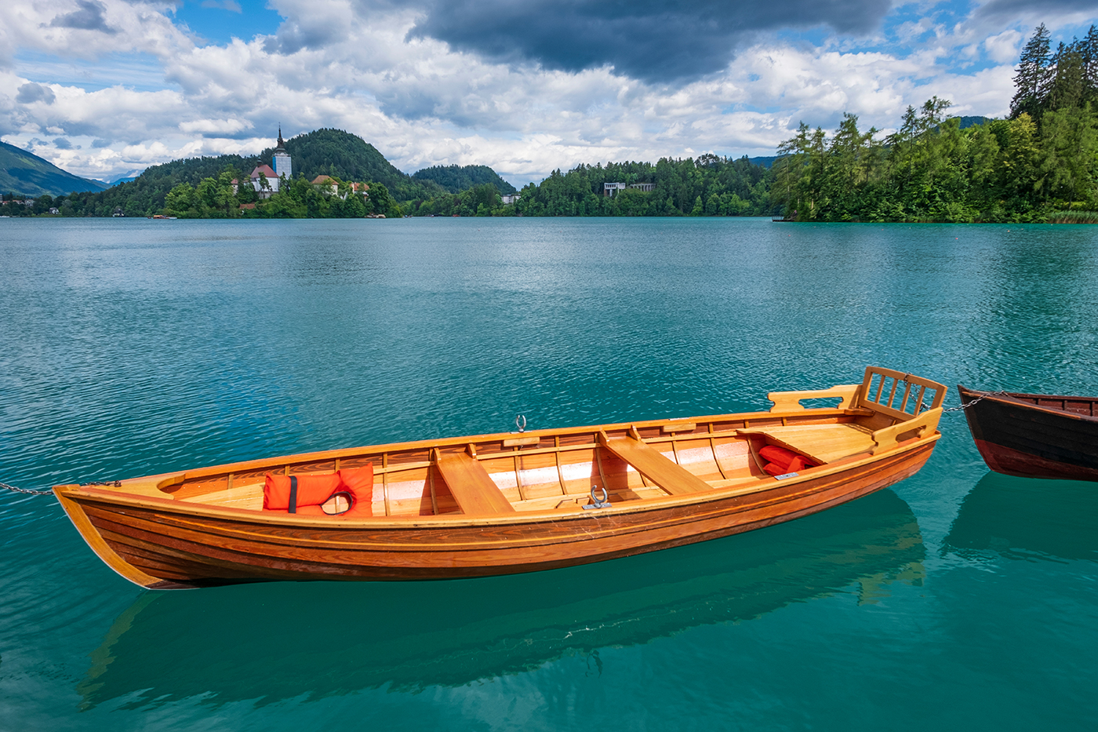
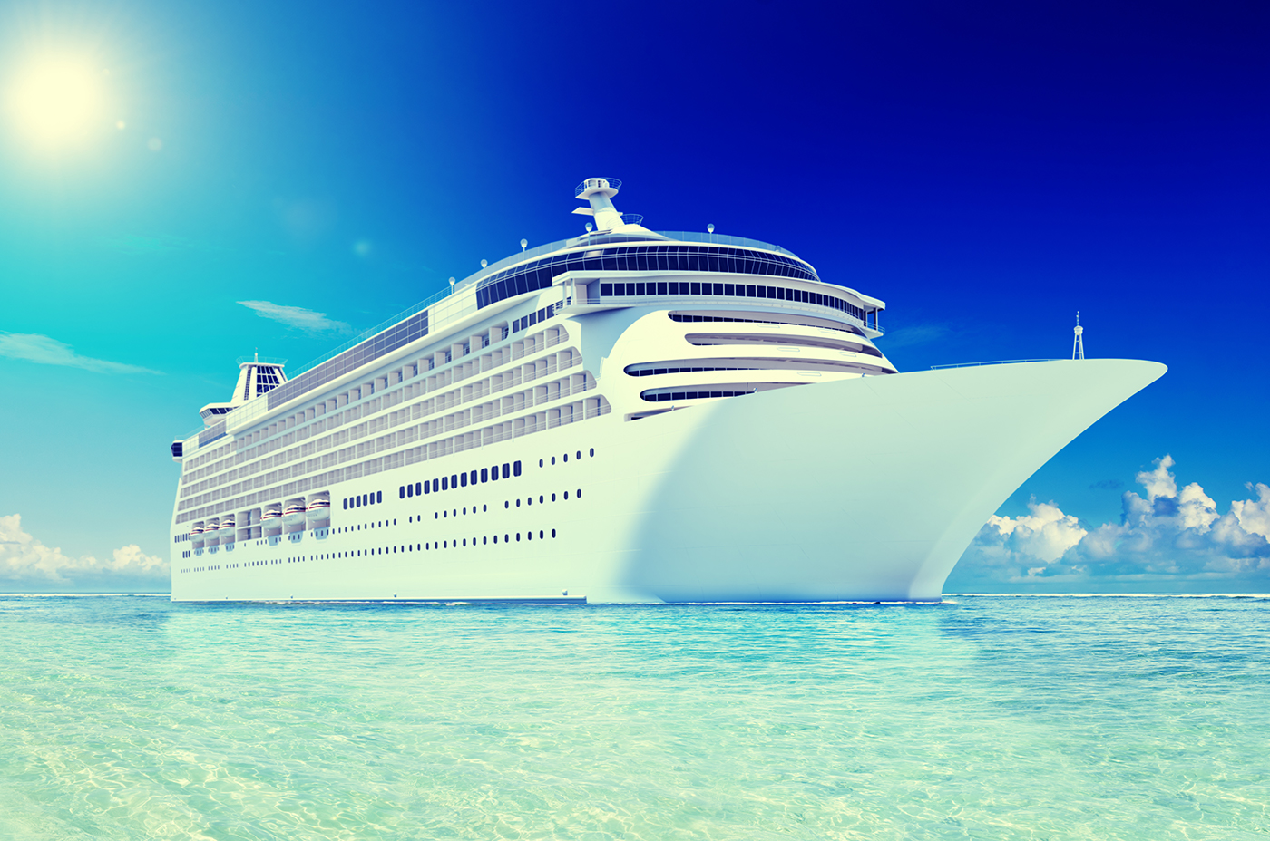
4. Look at pictures and write the words
bicycle
car
bus
motorbike
plane/ airplane
train
boat
ship

Slide 4
I. NEW WORDS

Slide 5
I. NEW WORDS
cycle (v)
/ˈsaɪ.kəl/
đạp xe

Slide 6
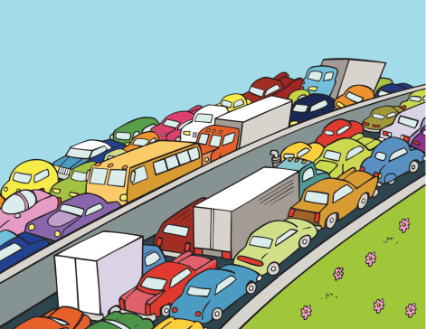
NEW WORDS
traffic jam (n.phr.)
/ˈtræf.ɪk ˌdʒæm/
tắc đường

Slide 7
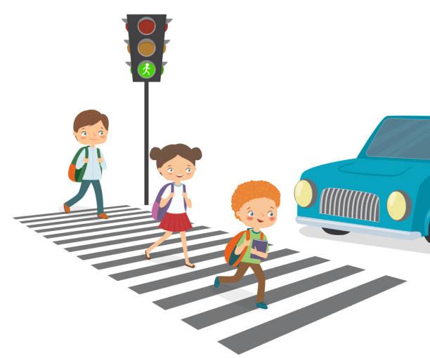
NEW WORDS
cross the road
/krɒs ðə rəʊd/
băng qua đường

Slide 8
NEW WORDS
rush hour
(n. phr.)
/ˈrʌʃ aʊə(r/
giờ cao điểm

Slide 9
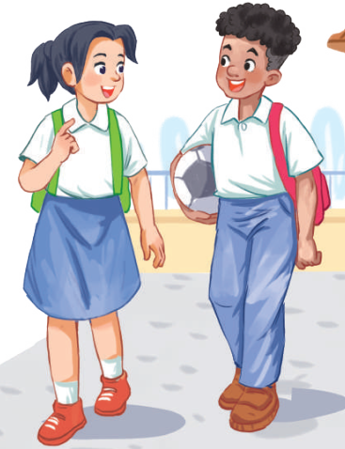
Look at the picture and answer.
1. Who are they?
They are Lan and Mark.
2. Where are they?
They are in the school yard.
3. What are they talking about?
sports
traffic
films

Slide 10
Look at the picture and answer.
3. What are they talking about?
sports
traffic
films
Lan: About 10 minutes. Sometimes,
when there are traffic jams, it takes
longer.
Mark: You should be careful, especially
when you cross the road.
Lan: Right. The roads get really crowded.
By the way, do you often cycle to
school too?

Slide 11
1. Listen and read
Lan: Hi, Mark. How are you?
Mark: Good, thanks. And you? What did you do last Sunday?
Lan: I’m fine. Last Sunday afternoon, I cycled round the lake near my home.
Mark: That sounds really healthy. By the way, do you often cycle to school too?
Lan: Yes, but sometimes my mum takes me on her motorbike.
Mark: How far is it from your home to school?
Lan: It’s about two kilometres.
Mark: How long does it take you to cycle there?
Lan: About 10 minutes. Sometimes, when there are traffic jams, it takes longer.
Mark: You should be careful, especially when you cross the road.
Lan: Right. The roads get really crowded.
Mark: Hey, how about going cycling round the lake this Sunday?
Lan: Great! Can you come to my house at 3 p.m.?
Mark: OK, Lan. See you then.

Slide 12
Ex 2. Read and choose the correct answers.
1. How does Lan often go to school?
A. By bicycle. B. By motorbike. C. On foot.
2. It normally takes Lan ___ to get to school.
A. two minutes B. ten minutes C. twenty minutes
3. Lan and Mark agree to go cycling ______.
A. tomorrow B. every day C. at the weekend

Slide 13
Underline key words
1. How does Lan often go to school?
A. By bicycle. B. By motorbike. C. On foot.
2. It normally takes Lan ___ to get to school.
A. two minutes B. ten minutes C. twenty minutes
3. Lan and Mark agree to go cycling ______.
A. tomorrow B. every day C. at the weekend

Slide 14
Silent read and do Exercise 2
Lan: Hi, Mark. How are you?
Mark: Good, thanks. And you? What did you do last Sunday?
Lan: I’m fine. Last Sunday afternoon, I cycled round the lake near my home.
Mark: That sounds really healthy. By the way, do you often cycle to school too?
Lan: Yes, but sometimes my mum takes me on her motorbike.
Mark: How far is it from your home to school?
Lan: It’s about two kilometres.
Mark: How long does it take you to cycle there?
Lan: About 10 minutes. Sometimes, when there are traffic jams, it takes longer.
Mark: You should be careful, especially when you cross the road.
Lan: Right. The roads get really crowded.
Mark: Hey, how about going cycling round the lake this Sunday?
Lan: Great! Can you come to my house at 3 p.m.?
Mark: OK, Lan. See you then.

Slide 15
Let’s check!
1. How does Lan often go to school?
A. By bicycle. B. By motorbike. C. On foot.
Mark: … By the way, do you often cycle to school too?
Lan: Yes, but sometimes my mum takes me on her motorbike.

Slide 16
Let’s check!
2. It normally takes Lan ___ to get to school.
A. two minutes B. ten minutes C. twenty minutes
Mark: How far is it from your home to school?
Lan: It’s about two kilometres.
Mark: How long does it take you to cycle there?
Lan: About 10 minutes. Sometimes, when there are traffic jams, it takes longer.

Slide 17
Let’s check!
3. Lan and Mark agree to go cycling ______.
A. tomorrow B. every day C. at the weekend
Mark: Hey, how about going cycling round the lake this Sunday?
Lan: Great! Can you come to my house at 3 p.m.?
Mark: OK, Lan. See you then.

Slide 18
Ex 3. Write one word from the conversation to complete each sentence.
1. Last Sunday afternoon, Lan ______ round the lake near her home.
2. Mark says to Lan: “You ______ be careful, especially when you cross the road.
3. Traffic ______ are a problem in big cities.
4. – ______ does your mum go shopping?
– She often walks.
5. This road is very __________ during the rush hours.

Slide 19
Ex 3. Write one word from the conversation to complete each sentence.
1. Last Sunday afternoon, Lan ______ round the lake near her home.
2. Mark says to Lan: “You ______ be careful, especially when you cross the road.
3. Traffic ______ are a problem in big cities.
4. – ______ does your mum go shopping?
– She often walks.
5. This road is very __________ during the rush hours.
cycled
Lan: I’m fine. Last Sunday afternoon, I cycled round the lake near my home.

Slide 20
Ex 3. Write one word from the conversation to complete each sentence.
1. Last Sunday afternoon, Lan ______ round the lake near her home.
2. Mark says to Lan: “You ______ be careful, especially when you cross the road.”
3. Traffic ______ are a problem in big cities.
4. – ______ does your mum go shopping?
– She often walks.
5. This road is very __________ during the rush hours.
cycled
Mark: You should be careful, especially when you cross the road.
should

Slide 21
Ex 3. Write one word from the conversation to complete each sentence.
1. Last Sunday afternoon, Lan ______ round the lake near her home.
2. Mark says to Lan: “You ______ be careful, especially when you cross the road.”
3. Traffic ______ are a problem in big cities.
4. – ______ does your mum go shopping?
– She often walks.
5. This road is very __________ during the rush hours.
cycled
should
About 10 minutes. Sometimes, when there are traffic jams, it takes longer.
jams

Slide 22
Ex 3. Write one word from the conversation to complete each sentence.
1. Last Sunday afternoon, Lan ______ round the lake near her home.
2. Mark says to Lan: “You ______ be careful, especially when you cross the road.”
3. Traffic ______ are a problem in big cities.
4. – ______ does your mum go shopping?
– She often walks.
5. This road is very __________ during the rush hours.
cycled
should
jams
How
crowded

Slide 23
FIND SOMEONE WHO
GAME

Slide 24
FIND SOMEONE WHO …
Activities | Name
usually walks to school | _____________
never goes to school by bus | _____________
cycles for exercise everyday | _____________
never travels by plane | _____________
sometimes go to school in a car | _____________
Do you usually walk to school?
Yes, I do. / No, I don’t.

Slide 25
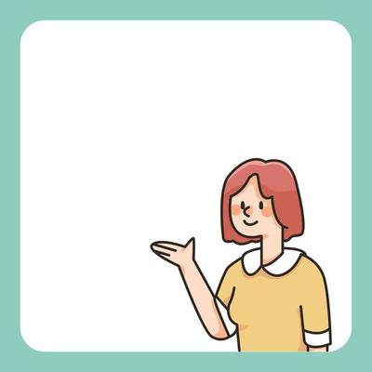
Presentation
Nam usually walks to school. He never goes to school by bus.
Tam usually cycles for exercise everyday.
…

Slide 26
WRAP-UP
What have you done today?
School activities
Means of transportation
Traffic accidents


Slide 27
HOMEWORK
Write new words (5 times/ 1 word)
Prepare for: Do Ex 1, 2 (page…)

Slide 28
Thanks!
Do you have any questions?

