Slide 1
UNIT 2: MY HOUSE
LESSON 3: A CLOSER LOOK 2
English 6

Slide 2
Grammar
Possessive case
1
Choose the correct answer.
2
Complete the sentences with the correct possessive forms.
Prepositions of place
3
Write the correct preposition in the box under each picture. Say a sentence to describe the picture.
4
Look at the picture and write T (true) or F (False) for each sentence. correct the false ones.
5
Memory challenge

Slide 3
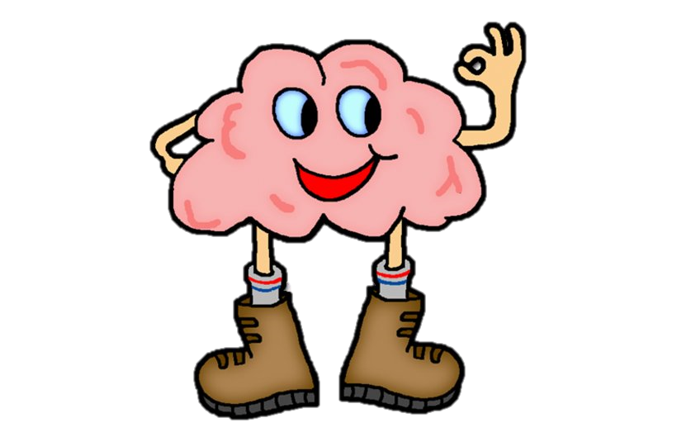

Slide 4
Instructions
Students have to study the picture about 3 people (Jack, Polly and Greg) and try to remember the things belong to each person in 30 seconds without writing down on their notebooks.
After the time, teacher will show the things of Jack, Polly and Greg and a member of each team has to answer quickly the question “Whose is it?”
The group with more correct sentences will be the winner.

Slide 5
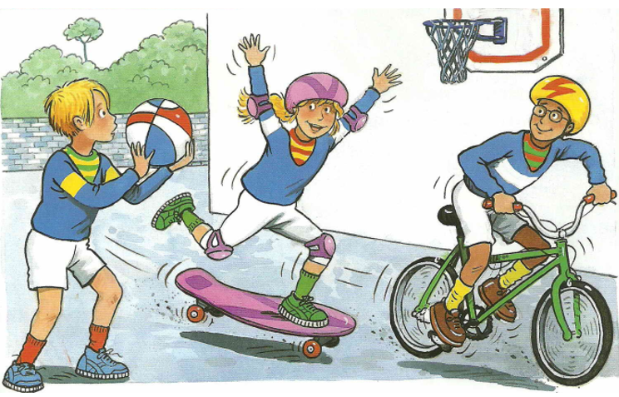
Polly
Greg
Jack
Whose ______ is it?

Slide 6
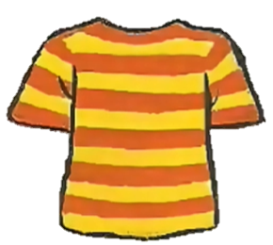
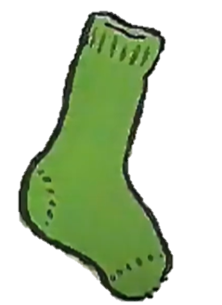
____ball
Jack’s
____T shirt
_________ jumper
Polly’s
Polly’s , Greg’s
Polly’s , Greg’s
1
____T shirt
Greg’s
Jack
3
2
Polly
4
Greg
____sock
Polly’s
____sock
Jack’s
____shoes
Greg’s
6
5
7
Whose ______ is it?

Slide 7
Grammar
Possessive case
We use ’s after a proper name.
Example: This is Elena’s room.
We use ’s after a singular noun.
Example: This is my mum’s book.
proper name's + noun = Nam's pen
singular noun's + noun = teacher's book

Slide 8
Choose the correct answer.
1
1.
My (grandmothers / grandmother’s) house is in Ha Noi.
2.
This is my (sister’s / sister’) desk.
3.
My (cousin’s / cousin) dad is my uncle.
4.
(Nam’s / Nam’) house is small.
5.
There are two bedrooms in (Ans / An’s) flat.

Slide 9
2
Complete the sentences with the correct possessive forms.
Mi’s
1.
Thuc Anh is cousin. (Mi)
This is their chair. (teacher)
2.
teacher’s
3.
Where is computer? (Nick)
Nick’s
4.
My motorbike is in the garden. (father)
father’s
5.
My bedroom is next to the living room. (brother)
brother’s

Slide 10
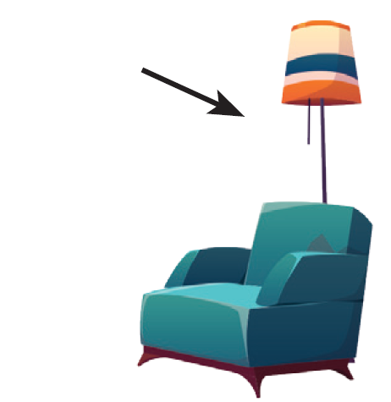
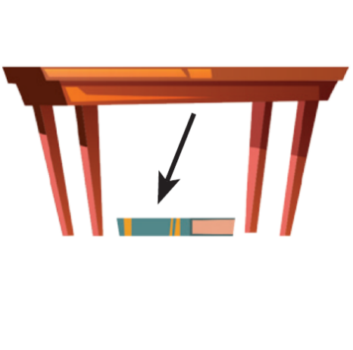
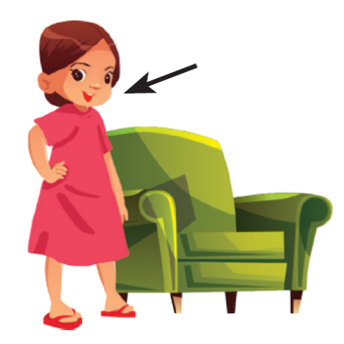
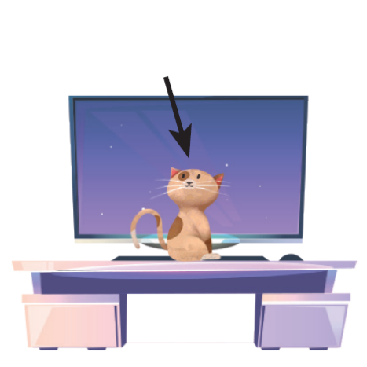
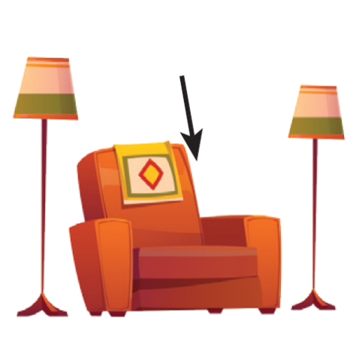
Prepositions of place
Grammar
Prepositions of place describe where people or things are. These are some prepositions of place.
in
on
behind
under
next to
in front of
between

Slide 11
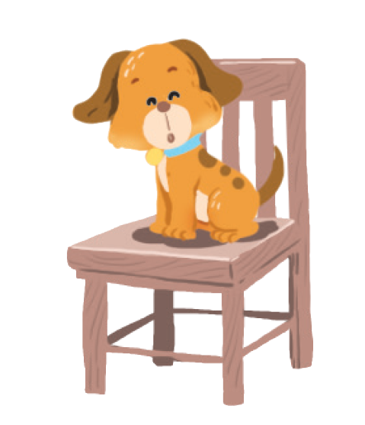
3
Write the correct preposition in the box under each picture. Say a sentence to describe the picture.
on
behind
in
on
next to
in front of
under
between
Example:
1.
on
The dog is on the chair.

Slide 12
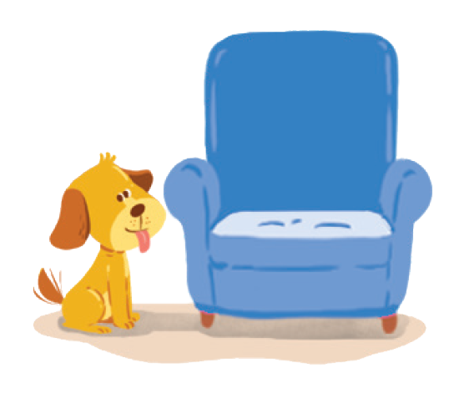
behind
on
next to
behind
in
next to
in front of
under
between
2.
next to
3.
behind
The dog is next to the armchair.
The cat is behind the TV.

Slide 13
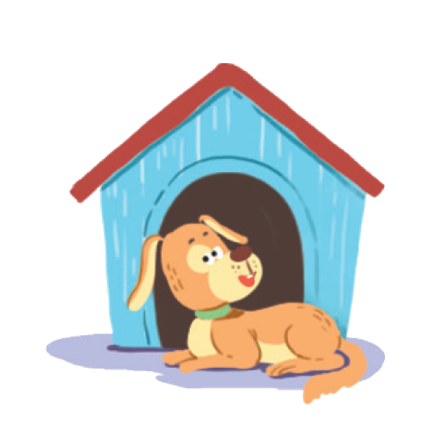
in
on
next to
behind
in
in front of
under
between
in front of
4.
in
5.
in front of
The cat is in the wardrobe.
The dog is in front of the doghouse.

Slide 14
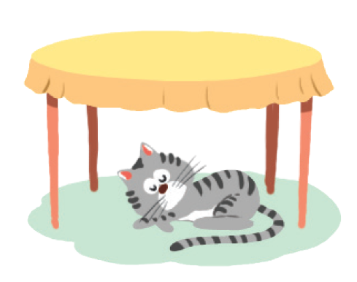
in
on
next to
behind
under
between
in front of
under
between
6.
between
7.
under
The cat is between
the lamp and the armchair.
The cat is under the table.

Slide 15
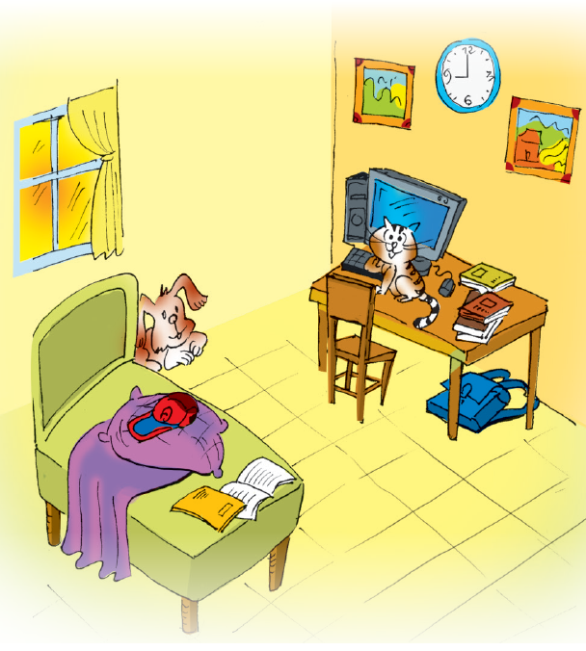
Look at the picture and write T (true) or F (False) for each sentence. Correct the false ones.
4
Example:
The books are under the table.
F
The books are on the table.

Slide 16
1.
T
The dog is behind the bed.
2.
The school bag is on the table.
F
The school bag is under the table.
3.
F
The picture is between the clocks.
The clock is between the two pictures.
4.
T
The cat is in front of the computer.
5.
F
The cap is under the pillow.
The cap is on the pillow.

Slide 17
5
Memory challenge
Work in pairs. Look at the picture in 4 carefully, and then cover it. Ask and answer questions about the position of things in the picture.
Example:
A: Where are the books?
B: They’re on the table.

Slide 19
WHERE ARE
?
PREPOSITIONS OF PLACE

Slide 20
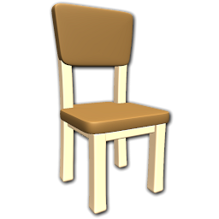
TIME’S UP
NEXT
A
Bart is under the chair.
B
Bart is on the chair.
C
Bart is behind the chair.

Slide 21
TIME’S UP
NEXT
A
He is next to the chair.
B
He is under the chair.
C
He is behind the chair.

Slide 22
TIME’S UP
NEXT
A
Bart is in the chair.
B
Bart is under the chair.
C
Bart is behind the chair.

Slide 23
TIME’S UP
NEXT
A
He is under the ladder.
B
He is in front of the ladder.
C
He is opposite the ladder.

Slide 24
TIME’S UP
NEXT
A
He is in the chair.
B
He is in front of the chair.
C
He is opposite the chair.

Slide 25
TIME’S UP
NEXT
A
Lisa is between the chairs.
B
Lisa is in the chairs.
C
Lisa is on the chairs.

Slide 26
TIME’S UP
NEXT
A
Bart is under the box.
B
Bart is in the box.
C
Bart is on the box.

Slide 27
Homework
Do Exercise B4 - p.11 - Workbook.
Prepare the next lesson: Communication

