Slide 1
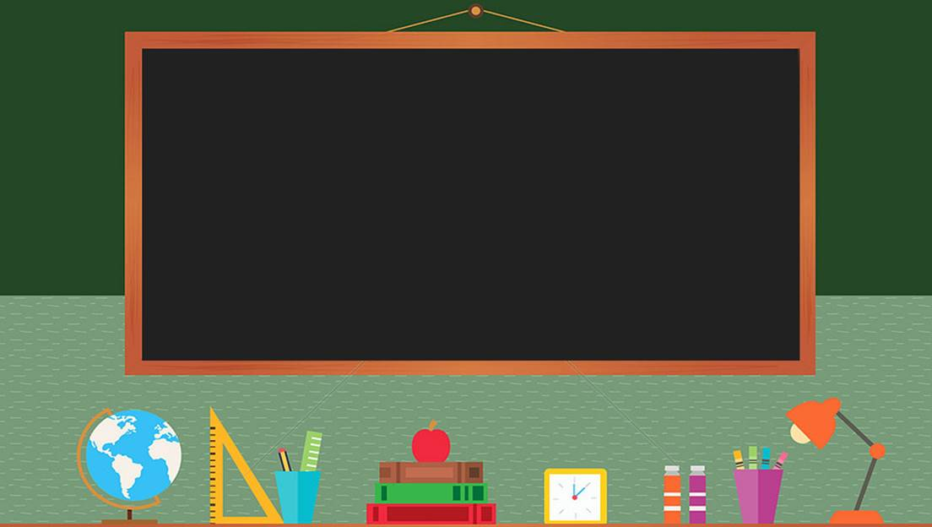

TRƯỜNG THCS LONG BIÊN
BÀI GIẢNG ĐIỆN TỬ MÔN TIẾNG ANH 7
UNIT 1: HOBBIES
LESSON 2: A CLOSER LOOK 2
GV: Trần Thị Liên
Tổ NK-NN

Slide 2

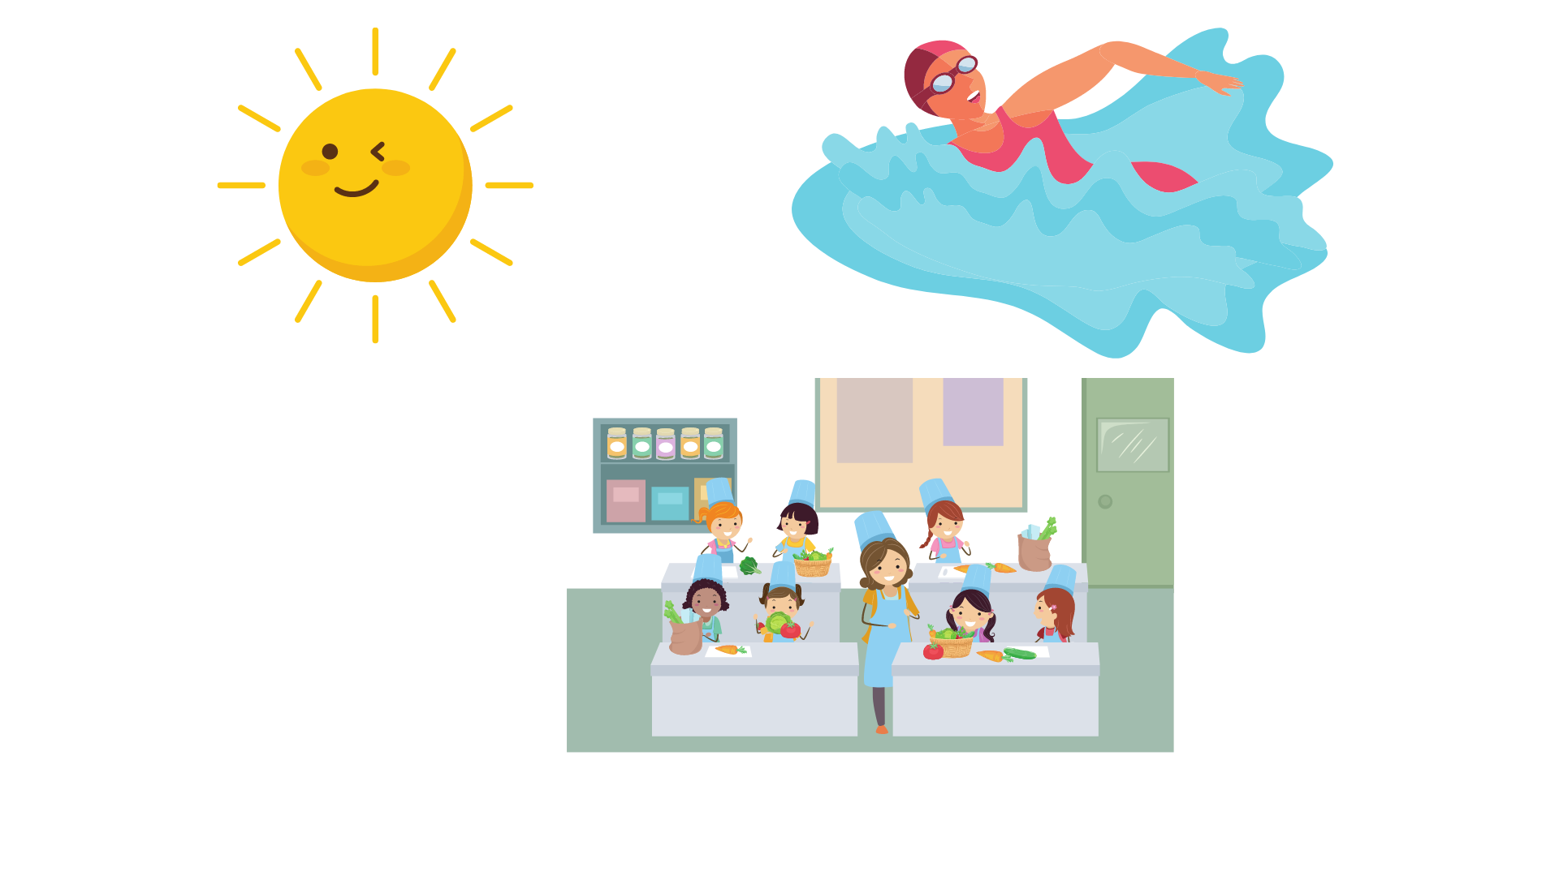
Grammar check
1. The sun ___ every morning.
A. rises B. rise C. risees
A. rises
2. She ___ swimming three times a week.
A. go B. goes C. gos
B. goes
3. The cooking lesson ___ at 9 a.m.
A. startes B. start C. starts
C. starts
What tense?
Present simple

Slide 3







grammar
Unit 1 Hobbies
A closer look 2

Slide 4


objectives
After this lesson, students will be able to
- Identify the correct uses of Present simple
- Use the Present simple correctly in isolation and in context.

Slide 5
Present simple
The sun rises every morning.
The sun rises every morning.
🡪 Something that is a general truth.
She goes swimming three time a week.
She goes swimming three times a week.
🡪 Something that happens regularly in the present.
The cooking lesson starts at 9 a.m.
The cooking lesson starts at 9 a.m.
🡪 Timetables or programmes.

Slide 6
Ex1: (P.11) Match the sentences (1-5)
to the correct uses (a-c).
a. A timetable/ programme
b. A regular action
c. A general truth
1. My sister usually cooks dinner.
b
1. My sister usually cooks dinner.
2. The train leaves at 10 a.m.
a
2. The train leaves at 10 a.m.
3. The Red River flows through Ha Noi.
3. The Red River flows through Ha Noi.
c
4. My yoga class starts at 6 a.m. every Tuesday.
a
4. My yoga class starts at 6 a.m. every Tuesday.
5. We sometimes watch TV on Sundays.
5. We sometimes watch TV on Sundays.
b

Slide 7

Ex2: (P.12) Complete the sentences. Use the
present simple form of the verbs.
make
every month (a regular action)
My brother and I = We
(+) I/ you/ we/ they + V
1. My brother and I (make) _____ a new model every month.
2. What _____ Lan (do) _____ in her free time?
3. I (have) _____ a drawing lesson every Tuesday.
4. Mark (not like) _______ doing judo.
5. _____ your English lesson (start) _____ at 6 p.m.?
does
do
in her free time (a regular action)
Lan = She
(?) Wh- + does + he/she/it + V?
have
every Tuesday (a regular action)
(+) I/ you/ we/ they + V
doesn’t like
Mark = he
(-) He/She/It + doesn’t V
Does
start
start … at … (timetable)
lesson = it
(?) Does + he/she/ it + V?

Slide 8
Ex3: (P.12) Fill in each blank with the correct form of the verb in brackets.
My family members have different hobbies. My dad (1. enjoy) _____ gardening. He (2. spend) _____ two hours in our garden every day. My mum and sister (3. not like) _____ gardening, but they love cooking. They (4. go) _____ to a cooking class every Sunday. Their lesson (5. begin) _____ at 9 a.m. I (6. not enjoy) _______ cooking, and I cannot cook very well.
My dad = He
(+) He/She/ It + Vs/es
enjoys
spends
My mom and sister = they
(-) I/ you/ we/ they + don’t V
don’t like
(+) I/ you/ we/ they + V
go
begins
lesson = it
(+) He/She/ It + Vs/es
don’t enjoy
(-) I/ you/ we/ they + don’t V

Slide 9
Ex4: (P.12) Write complete sentences, using the given words and phrases. You may have to change the words or add some.
sun / set / in / west / every evening.
__________________________________________
2. Trang and Minh / play / basketball / every day / after school?
__________________________________________
3. flight / from / Ho Chi Minh City / not arrive / at 10.30.
__________________________________________
4. our science teacher / start / our lessons / 1 p.m. / on Fridays.
__________________________________________
5. you / make / model / at / weekend?
__________________________________________
The sun sets in the west every morning.
Do Trang and Minh play basketball every day after school?
The flight from Ho Chi Minh City doesn’t arrive at 10.30.
Our Science teacher starts our lesson at 1 p.m. on Fridays.
Do you make model at the weekend?

Slide 10




"
GAME
Sentence race
do
write
have
Work in group. In 5 minutes.
1. Read the verbs on the board.
2. Take turns to make a sentence with the verb, using THE PRESENT SIMPLE.
3. Get 1 point for 1 correct sentence. The group with the most point wins.
play
enjoy
start
spend
like
watch
Example: I play tennis every afternoon.

Slide 11





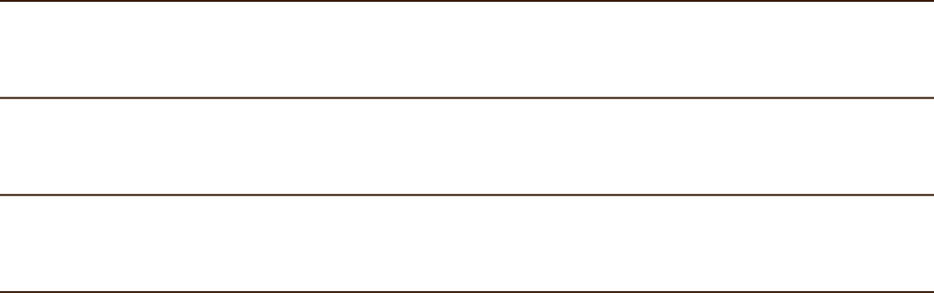
Recap
1. What tense did you learn today?
THE PRESENT SIMPLE
2. Choose the correct uses of THE PRESENT SIMPLE.
A. Timetable/ Programme B. Past action
C. Regular action D. General truth

Slide 12
Homework
- Practise the exercises again.
- Do exercises in workbook.
- Prepare communication.

Slide 13

great work
SEE YOU NEXT TIME

