Slide 1
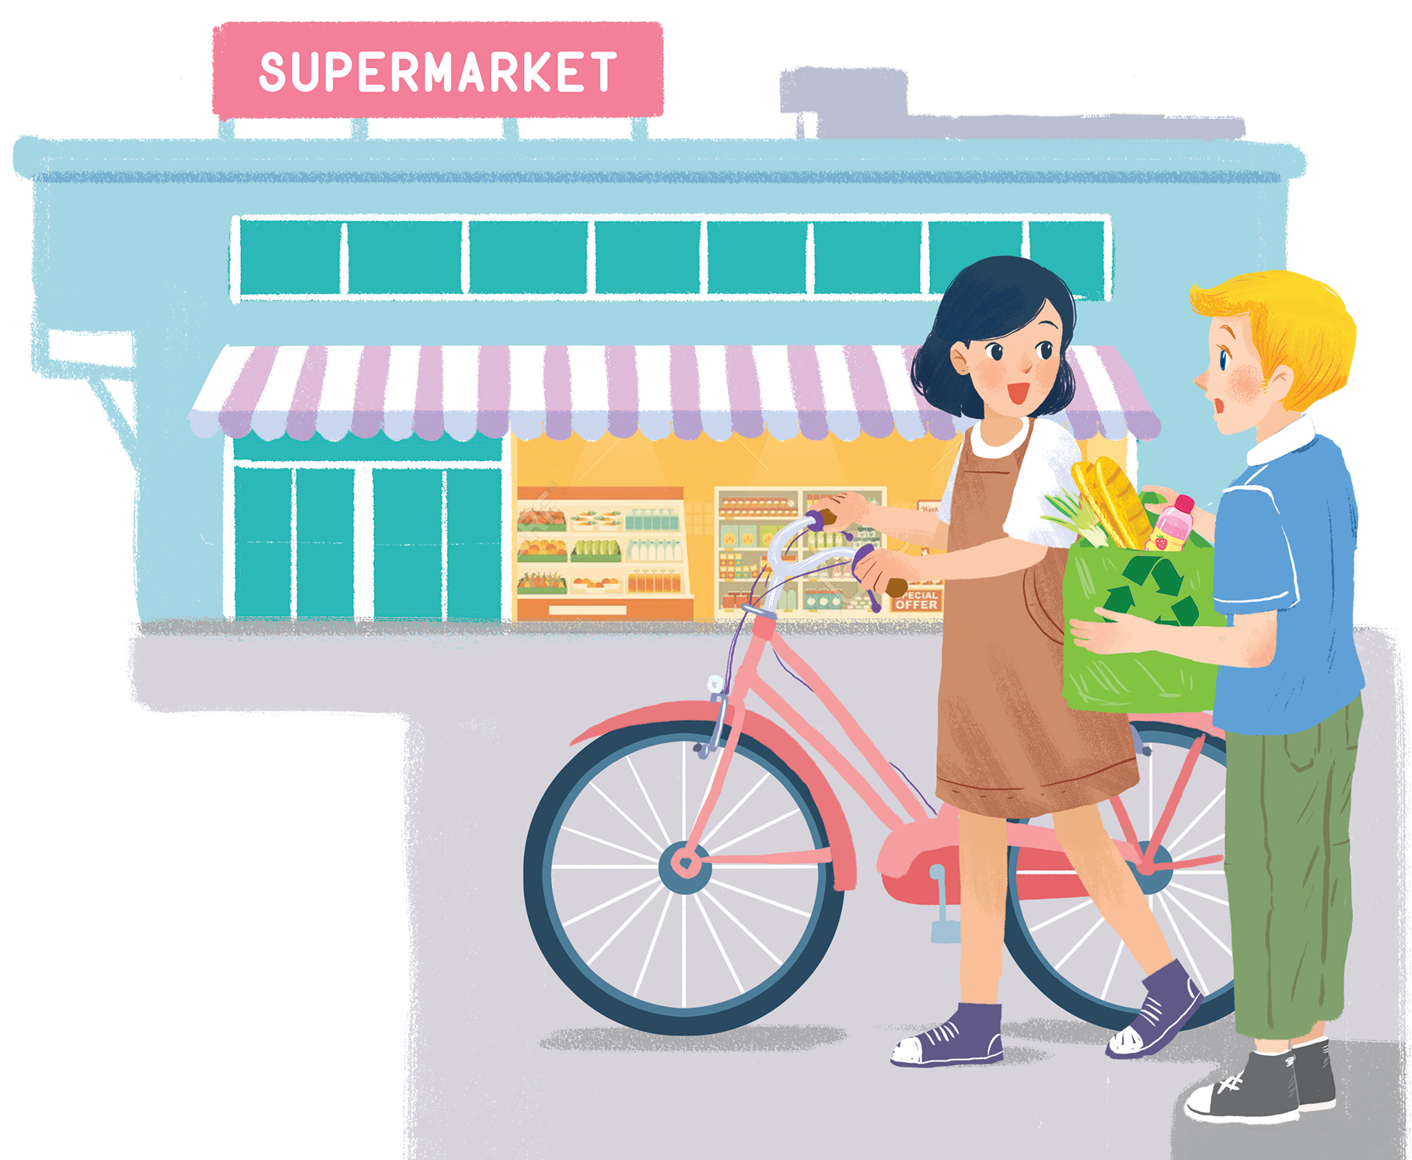
      UNIT 11: OUR GREENER WORLD
      LESSON 5: SKILLS 1
English 6

Slide 2


Reading
1
A reporter is interviewing Nam, a member of the 3Rs Club. Read the interview. Find these words or phrases and underline them.
2
Match the words / phrases with their meanings.
3
Read the text again. Answer the questions.
Speaking
4
Nam mentions the following tips in the interview. Work in groups and discuss to put the tips in order from the easiest to the most diff icult.
5
Tip f tells you to find creative ways to reuse old items. Can you think of any ways to reuse

Slide 3
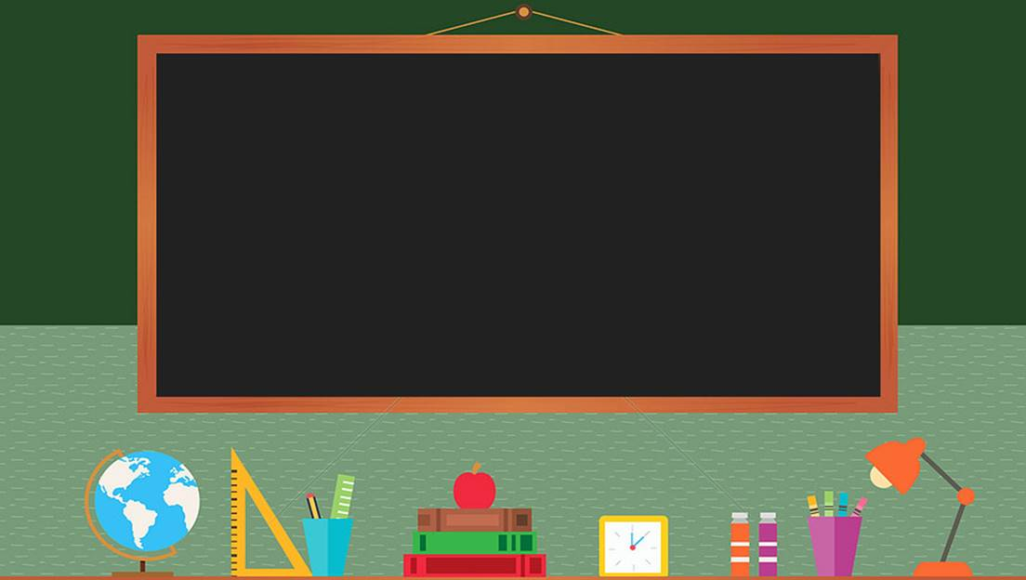

TRƯỜNG THCS LONG BIÊN
BÀI GIẢNG ĐIỆN TỬ MÔN TIẾNG ANH 6
UNIT 11: OUR GREENER WORLD
LESSON 5: Skills 1
GV: Trần Thị Liên
Tổ NK-NN

Slide 4


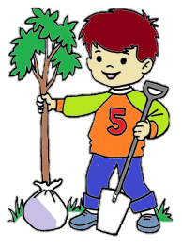





Don’t litter
Unplug plug
Plant trees
What can children do to protect the environment?
Turn off lights, water
Ride a bike
Reuse a bag
Recycle plastic, paper, glass, cans

Slide 5
Reading

Slide 6


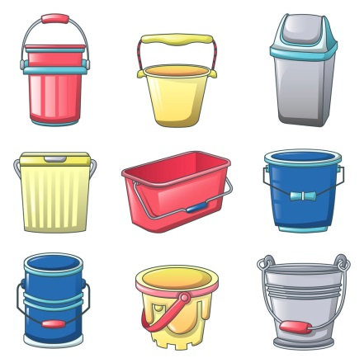

Vocabulary
re‘cycling bin(n)
thùng rác
ex‘change (v)
trao đổi
‘charity (n)
từ thiện
in‘stead of (adv)
thay vì
re‘usable (a)
có thể dùng lại
tip
mẹo
con‘tainer (n)
đồ đựng

Slide 7
What and Where
recycling bin(n)
instead of (adv)
exchange (v)
reusable (a)
container
tip
charity (n)

Slide 8
1
A reporter is interviewing Nam, a member of the 3Rs Club. Read the interview. Find these words or phrases and underline them.
instead of
exchange
recycling bins
reusable
charity

Slide 9
instead of
exchange
recycling bins
reusable
charity
Reporter: Can you share with us some tips to make your school greener?
Nam: Sure. Firstly, we put recycling bins in every classroom.
Reporter: What about old books and uniforms?
Nam: We exchange them with our friends or give them to charity. We don’t throw them away.
Reporter: Anything else?
Nam: We borrow books from the school library instead of buying new ones.
Reporter: Great! You can save much paper.
Nam: And there’s another tip. We bring reusable water bottles to school. Reporter: I see lots of trees in your school. Is planting trees a good tip?
Nam: Yeah. It makes our school greener.
Reporter: Thanks for sharing. Do you want to add anything?
Nam: Finally, we usually find creative ways to reuse old items before throwing them away.

Slide 10
2
Match the words / phrases with their meanings.
e. in the place of somebody or something
a. give something to a person and receive something from him / her
1. instead of
d. giving things to people in need
b. can be used again
2. charity
a. give something to a person and receive something from him / her
c. containers for things that can be recycled
3. exchange
b. can be used again
4. reusable
d. giving things to people in need
c. containers for things that can be recycled
5. recycling bins
e. in the place of somebody or something

Slide 11




100 (4)
100 (1)
200 (5)
200 (2)
300 (6)
300 (3)
Finish
Spin

Slide 12

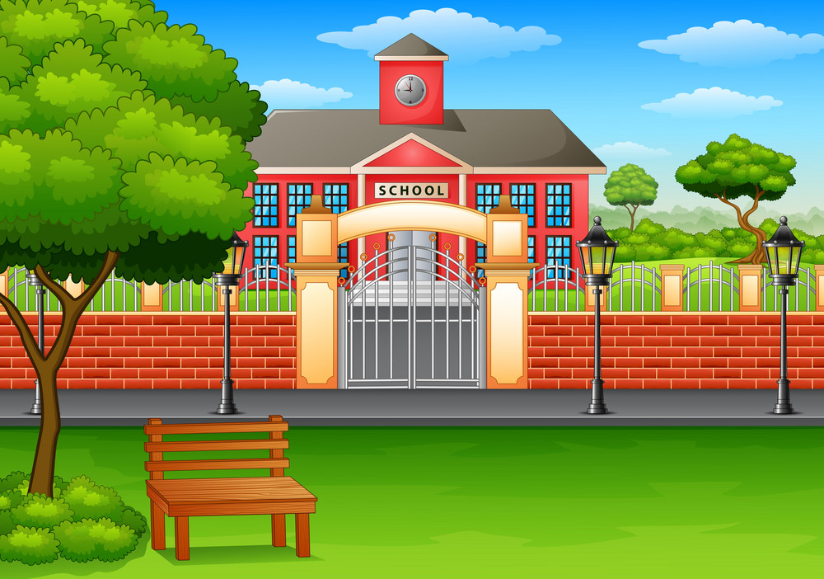
ou
What is the interview about?
Ways to become greener at school.

Slide 13
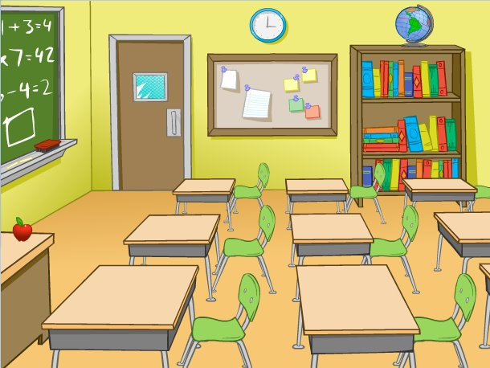
What will they put in every classroom?
Recycling bins.

Slide 14
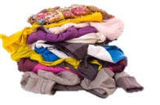
What can they do with their old uniforms?
Exchange old uniforms with friends or give them to charity

Slide 15

What do they do instead of buying new books?
Borrow books from library

Slide 16
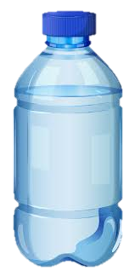
What type of water bottles do they bring to school?
Reusable water bottles.

Slide 17

What should you do when you go out of the room ?
Turn off the lights

Slide 18
3
Read the text again. Answer the questions.
1.
What is the interview about?
Ways to become greener at school
2.
What will they put in every classroom?
Recycing bins
3.
What can they do with their old uniforms?
Exchange old uniforms with friends or give them to charity
4.
What do they do instead of buying new books?
Borrow books from the library
5.
What type of water bottles do they bring to school?
Reusable water bottles

Slide 19
Speaking

Slide 20
Nam mentions the following tips in the interview. Work in groups and discuss to put the tips in order from the easiest to the most difficult.
4
a.
Putting recycling bins in every classroom.
b.
Exchanging old books and uniforms with friends or giving them to charity.
c.
Borrowing books from the school library instead of buying new ones.
d.
Bringing reusable water bottles to school.
e.
Planting trees at school.
f.
Finding creative ways to reuse old items before throwing them away.
Can you add more tips to the list?

Slide 21
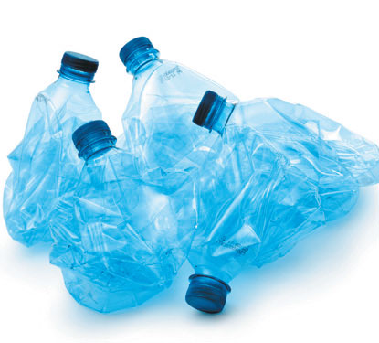

5
Tip f tells you to find creative ways to reuse old items. Can you think of any ways to reuse
a.
used gift wrap?
b.
used water bottles?
c.
used books?

Slide 22
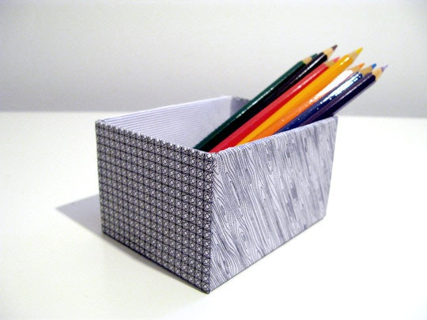
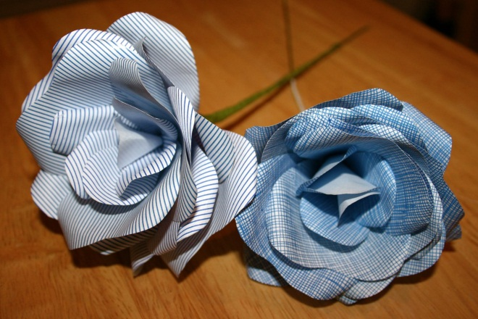
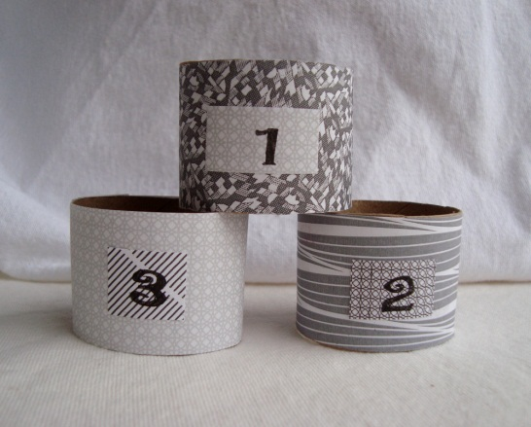
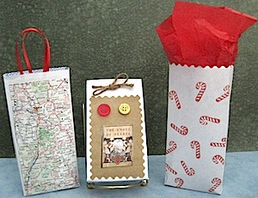
Creative ways to reuse old envelopes
Storage box
Flower
Napkin rings
envelope gift bags

Slide 23
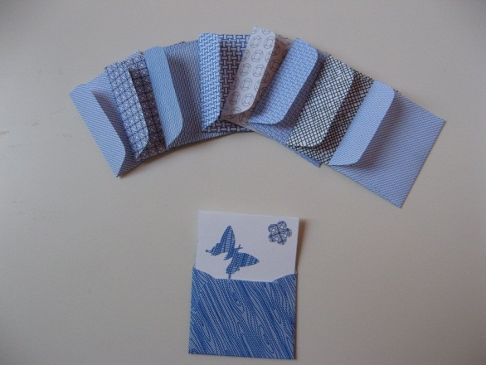
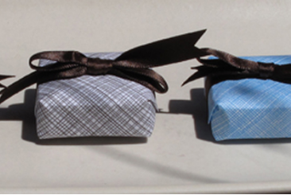
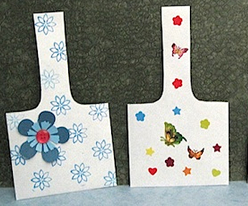
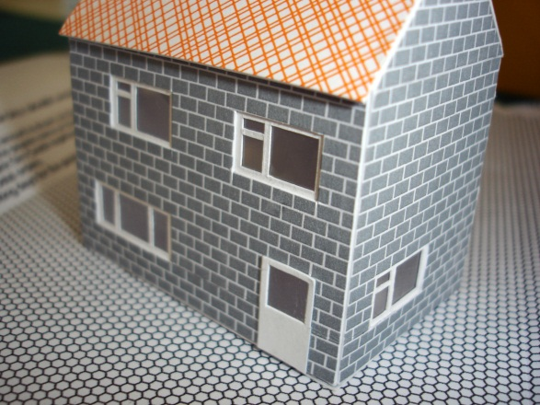
Creative ways to reuse old envelopes
Mini envelopes
Gift wrap
Gift baskets
Tiny house

Slide 24
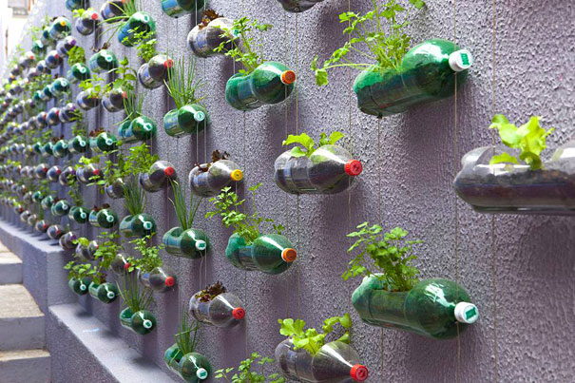
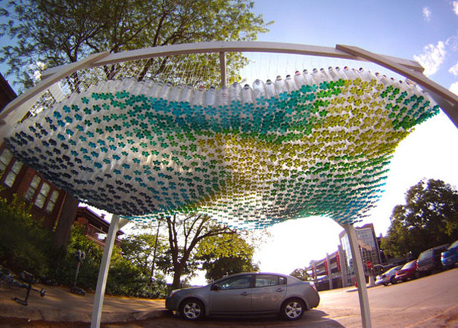
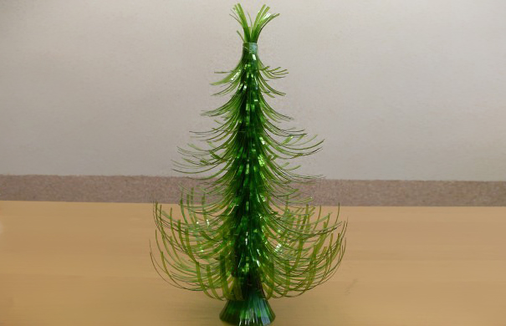
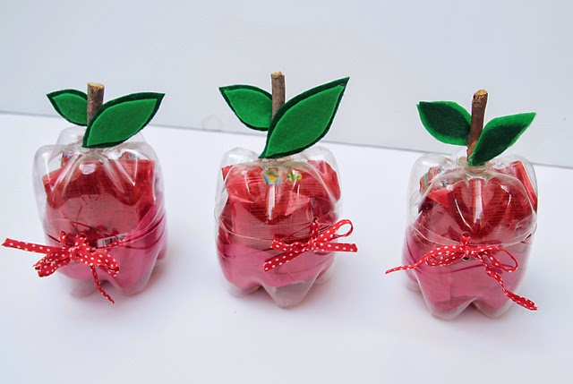
Creative ways to reuse used water bottles
Vertical Garden
Parking Canopy
Christmas Tree
Cute containers

Slide 25
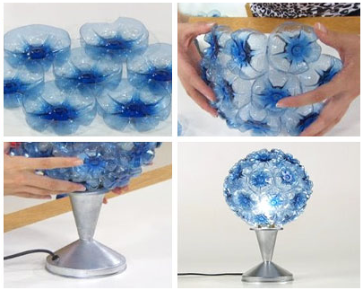
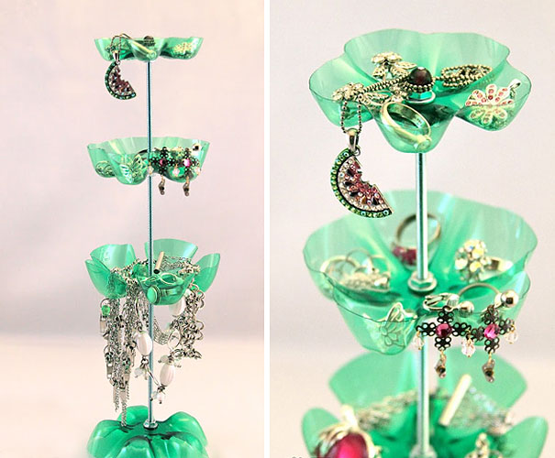
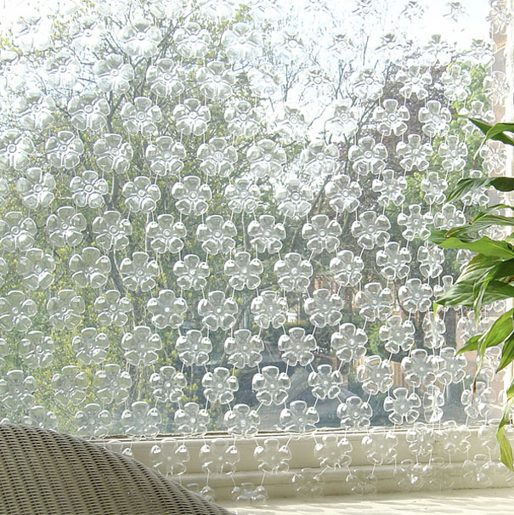
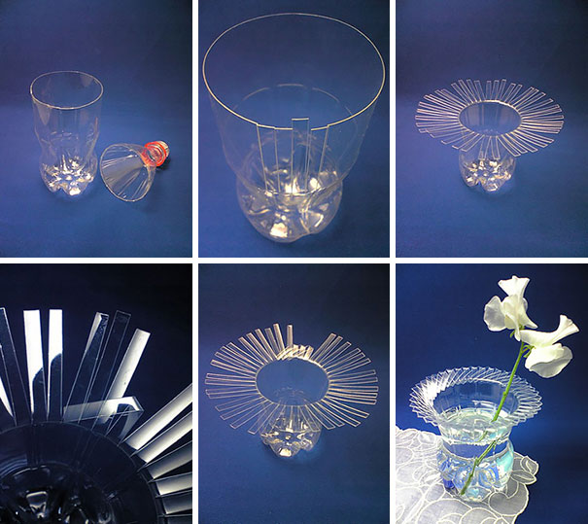
Creative ways to reuse used water bottles
Lamp
Jewelry Stand
Curtain
Bottle Vase

Slide 26
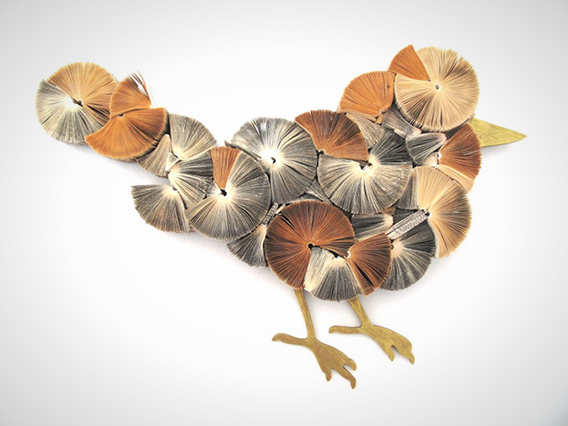
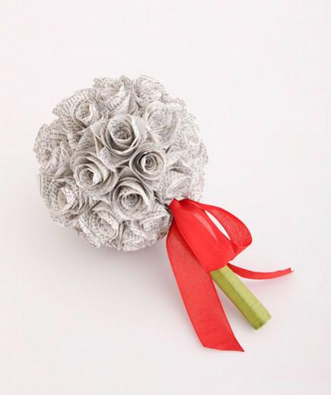
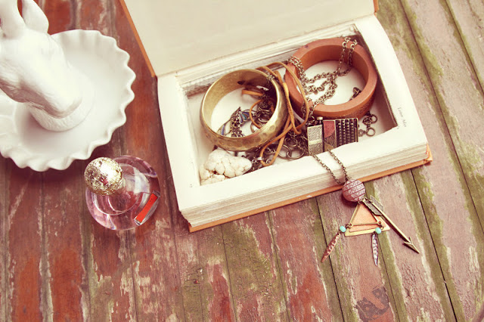
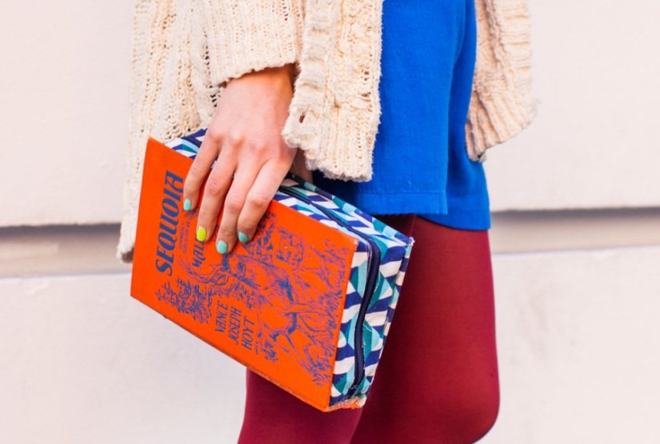
Creative ways to reuse used books
Fanned wall art
Wedding bouquet
Jewelry box
Book cover clutch

Slide 27
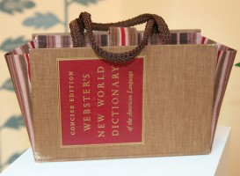
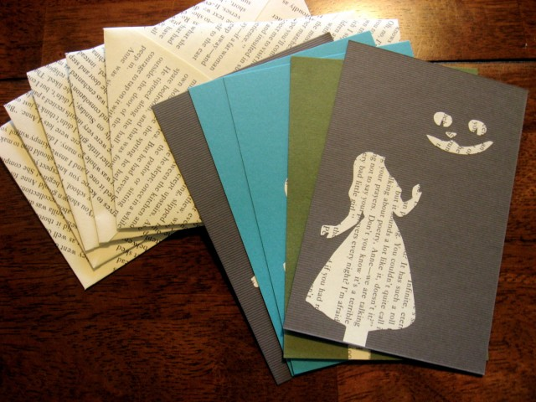
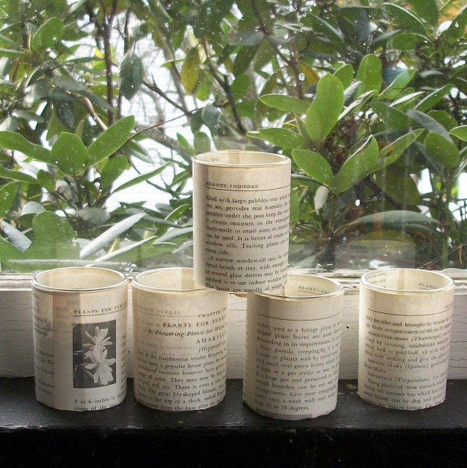
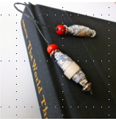
Creative ways to reuse used books
book purse
Greeting Cards
Candleholders
Paper Bead Bookmark

Slide 28

Homework
  Learn vocabulary and the structure by heart.
  Do exercise in your work book
  Prepare the next lesson: Skills 2

