Slide 1

TRƯỜNG THCS LONG BIÊN
BÀI GIẢNG ĐIỆN TỬ MÔN TIẾNG ANH 7
UNIT 4: MUSIC AND ARTS
Peroid 32 : Skills 1
GV: Trần Thị Thu Trang
Tổ Ngoại Ngữ - Năng khiếu

Slide 2



Unit
4
MUSIC AND ARTS
LESSON 5: SKILLS 1
READING
SPEAKING
Unit

Slide 3

OBJECTIVES
By the end of the lesson, students will be able to:
+ Reading:
- read for specific information about traditional art.
+ Speaking:
talk about a musical performance at their school.

Slide 4
LESSON 5: SKILLS 1
Game: Face to face
WARM-UP
* Vocabulary
* Discussion
Task 1: Read the email and match the highlighted words with their meanings.
Task 2: Read the passage again and decide these statements are True (T) or False (F).
Task 3: Read the email again and answer the questions.
READING
Task 4: Ask and answer about Mark’s school musical performance last year.
Task 5: Make a plan for the performance and talk about the items you will contribute.
SPEAKING
POST-READING
& SPEAKING
Evaluation
CONSOLIDATION
Wrap-up
Home work

Slide 5


LESSON 5: SKILLS 1
WARM-UP
Game: Face to face
Aims of the stage:
to introduce the topic of reading

Slide 6
WARM-UP
TRADITIONAL PERFORMANCES

Slide 7

LESSON 5: SKILLS 1
Game: Face to face
WARM-UP
* Vocabulary
* Discussion
Task 1: Read the email and match the highlighted words with their meanings.
Task 2: Read the passage again and decide these statements are True (T) or False (F).
Task 3: Read the email again and answer the questions.
READING
Aims of the stage:
to provide students with some lexical items before reading the text

Slide 8
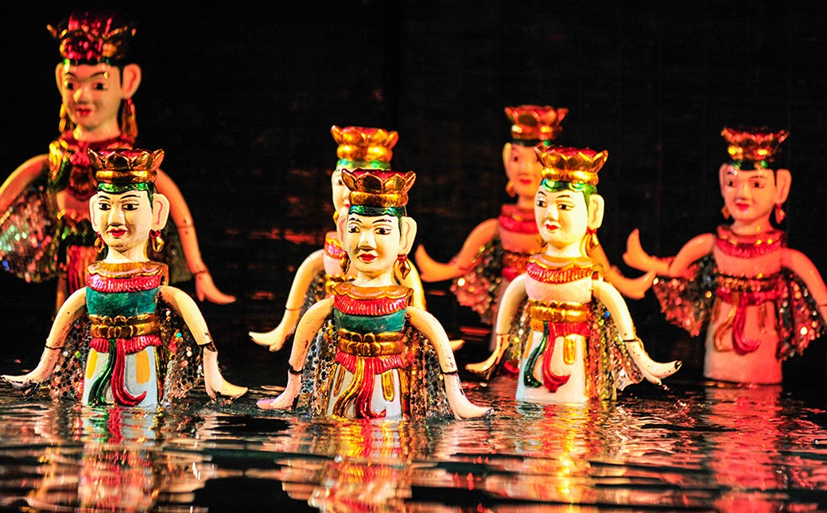
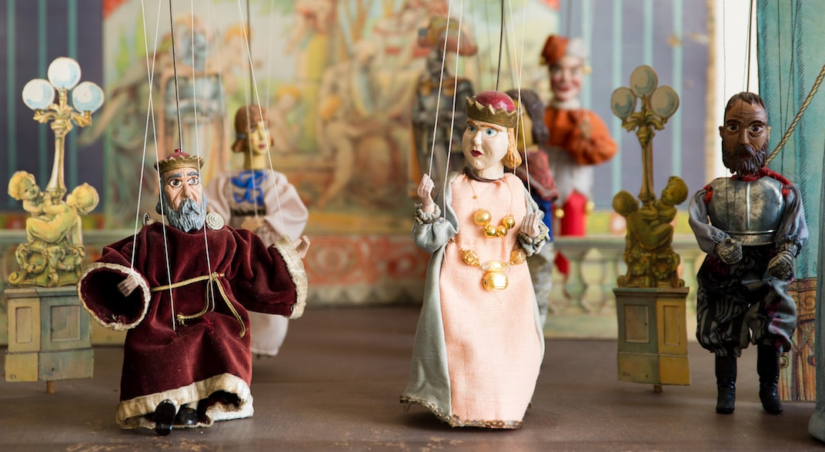
PRE-READING - VOCABULARY
puppetry (n)
/ˈpʌpɪtri/
nghệ thuật múa rối

Slide 9
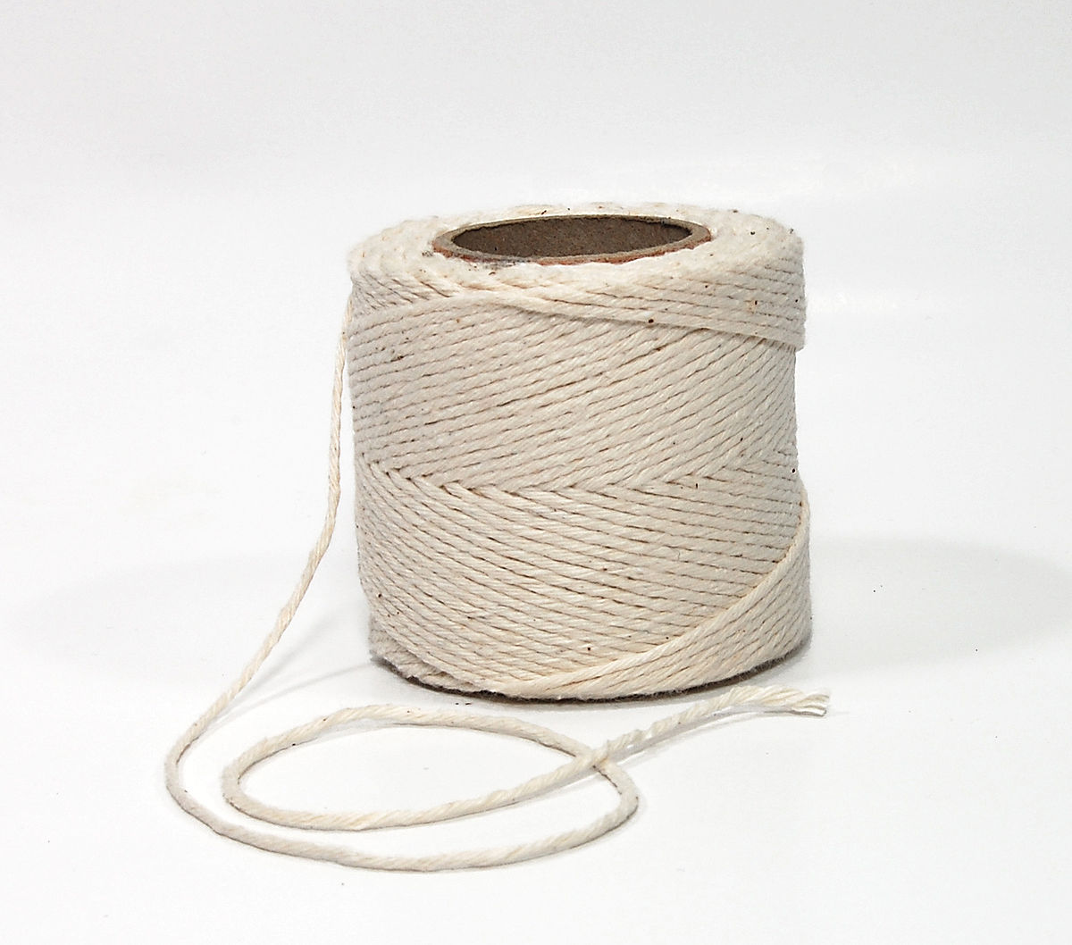
PRE-READING - VOCABULARY
string (n)
/strɪŋ/
sợi dây

Slide 10
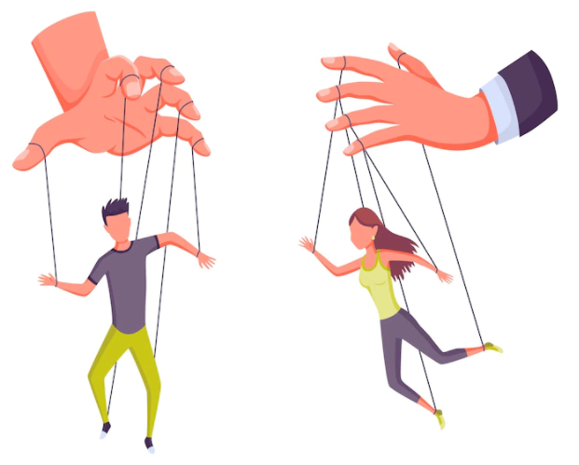
PRE-READING - VOCABULARY
control (v)
/kənˈtrəʊl/
kiểm soát, điều khiển

Slide 11
PRE-READING - VOCABULARY
New words | Pronunciation | Meaning
puppetry (n) | /ˈpʌpɪtri/ | nghệ thuật múa rối
string (n) | /strɪŋ/ | sợi dây
control (v) | /kənˈtrəʊl/ | kiểm soát, điều khiển

Slide 12
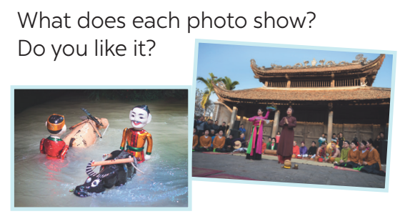

PRE-READING - DISCUSSION

Slide 13
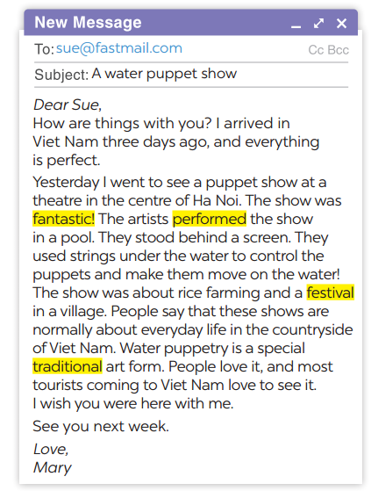
WHILE-READING
1
Read the email and match the highlighted words with their meanings.
1. showed or presented
2. following tradition
3. nice, interesting
4. event or celebration
→ performed
→ traditional
→ fantastic
→ festival

Slide 14

WHILE-READING
2
Read the passage again and decide these statements are True or False.
Statements | True | False
1. Mary went to see a puppet show in an art museum in the centre of Ha Noi.
2. The show was presented by the artists stood behind a screen in a pool.
3. These shows are normally about everyday life in the countryside and in the city of Viet Nam.
4. Tourists come to Viet Nam love to see it because it is a special traditional art form.

Slide 15
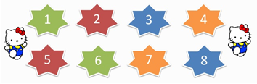
POST-READING
3
Read the email again and answer the questions.
1. Who went to see a water puppet show yesterday?
2. Where did the artists perform the show?
3. Who controlled the puppets?
4. What are water puppet shows normally about?
5. Is water puppetry a traditional Vietnamese art form?
LUCKY NUMBER
Notes:
Lucky numbers: 1,4,8
Number 2: Question 1
Number 3: Question 2
Number 5: Question 3
Number 6: Question 4
Number 7: Question 5

Slide 16
POST-READING
1. Who went to see a water puppet show yesterday?
2. Where did the artists perform the show?
3. Who controlled the puppets?
4. What are water puppet shows normally about?
5. Is water puppetry a traditional Vietnamese art form?
Mary did.
In a pool.
The artists did.
About everyday life in the countryside of Viet Nam.
Yes, it is.

Slide 17
LESSON 5: SKILLS 1
Game: Face to face
WARM-UP
* Vocabulary
* Discussion
Task 1: Read the email and match the highlighted words with their meanings.
Task 2: Read the passage again and decide these statements are True (T) or False (F).
Task 3: Read the email again and answer the questions.
READING
Task 4: Ask and answer about Mark’s school musical performance last year.
Task 5: Make a plan for the performance and talk about the items you will contribute.
SPEAKING

Slide 18
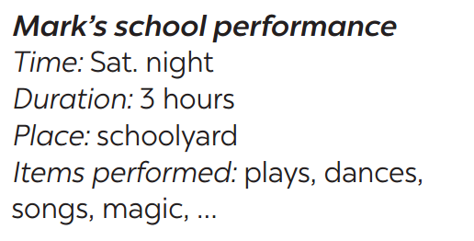

PRE-SPEAKING
4
Ask and answer about Mark’s school musical performance last year.

Slide 19

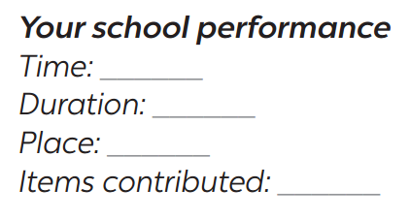
WHILE-SPEAKING
5
Make a plan for the performance and talk about the items you will contribute.
Your school is going to have a musical performance to celebrate Teachers’ Day.

Slide 20
LESSON 5: SKILLS 1
Game: Face to face
WARM-UP
* Vocabulary
* Discussion
Task 1: Read the email and match the highlighted words with their meanings.
Task 2: Read the passage again and decide these statements are True (T) or False (F).
Task 3: Read the email again and answer the questions.
READING
Task 4: Ask and answer about Mark’s school musical performance last year.
Task 5: Make a plan for the performance and talk about the items you will contribute.
SPEAKING
POST-READING
& SPEAKING
Evaluation

Slide 21

POST-READING & SPEAKING
- Students give comments on their friends and vote for the most interesting and informative presentation.
- Teacher gives feedback and comments.

Slide 22
LESSON 5: SKILLS 1
Game: Face to face
WARM-UP
* Vocabulary
* Discussion
Task 1: Read the email and match the highlighted words with their meanings.
Task 2: Read the passage again and decide these statements are True (T) or False (F).
Task 3: Read the email again and answer the questions.
READING
Task 4: Ask and answer about Mark’s school musical performance last year.
Task 5: Make a plan for the performance and talk about the items you will contribute.
SPEAKING
POST-READING
& SPEAKING
Evaluation
CONSOLIDATION
Wrap-up
Homework

Slide 23
CONSOLIDATION
1
WRAP-UP
READING
SPEAKING

Slide 24

CONSOLIDATION
2
HOMEWORK
Do exercises in the workbook.
Prepare for the next lesson: Skills 2.

Slide 25

Website: sachmem.vn
Fanpage: facebook.com/sachmem.vn/

