Slide 1
TRƯỜNG THCS LONG BIÊN
BÀI GIẢNG ĐIỆN TỬ MÔN TIẾNG ANH 8
UNIT 3: TEENAGERS
Peroid 16 : Closer Look 1
GV: Trần Thị Thu Trang
Tổ Ngoại Ngữ - Năng khiếu

Slide 2
Unit
3
TEENAGERS
LESSON 2: A CLOSER LOOK 1

Slide 3
LESSON 2: A CLOSER LOOK 1
WARM-UP
Game: Word puzzles
Task 1: Circle the correct options to complete the phrases.
Task 2: Use the correct form of the verbs in 1 to complete the sentences.
Task 3: Choose the correct answer A, B, or C.
VOCABULARY
Task 4: Listen and repeat the words. Pay attention to the sounds /ʊə/ and /ɔɪ/.
Task 5: Listen and practise the sentences. Underline the words with /ʊə/ and circle the words with /ɔɪ/.
PRONUNCIATION
FURTHER PRACTICE
Game: Slap the board
CONSOLIDATION
Wrap-up
Homework

Slide 4
Find 6 meaningful words in the puzzle.
WARM-UP
A | N | C | H | E | C | K | E
P | P | O | S | T | O | S | E
I | E | N | A | C | U | U | B
C | O | N | M | U | A | T | E
T | W | E | B | S | I | T | E
U | A | C | L | I | P | D | I
R | S | T | D | Y | F | K | L
E | R | P | Q | E | A | O | V

Slide 5
VOCABULARY
1
Circle the correct options to complete the phrases.

Slide 6
VOCABULARY
1

Slide 7
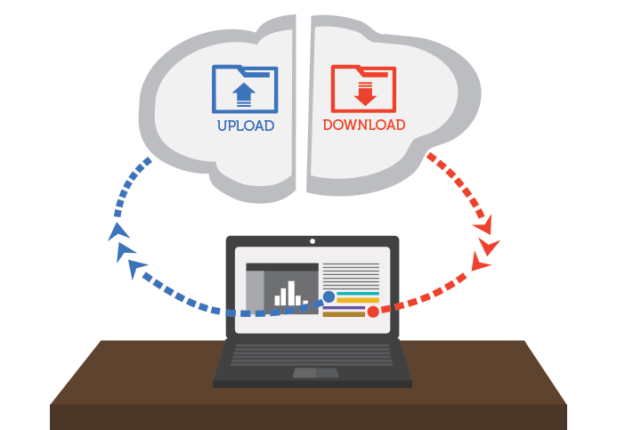
VOCABULARY
upload (v)
/ˌʌpˈləʊd/
tải lên

Slide 8
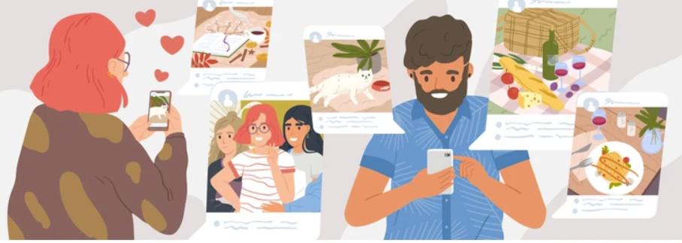
VOCABULARY
browse (v)
/braʊz/
đọc lướt, tìm
(trên mạng)

Slide 9
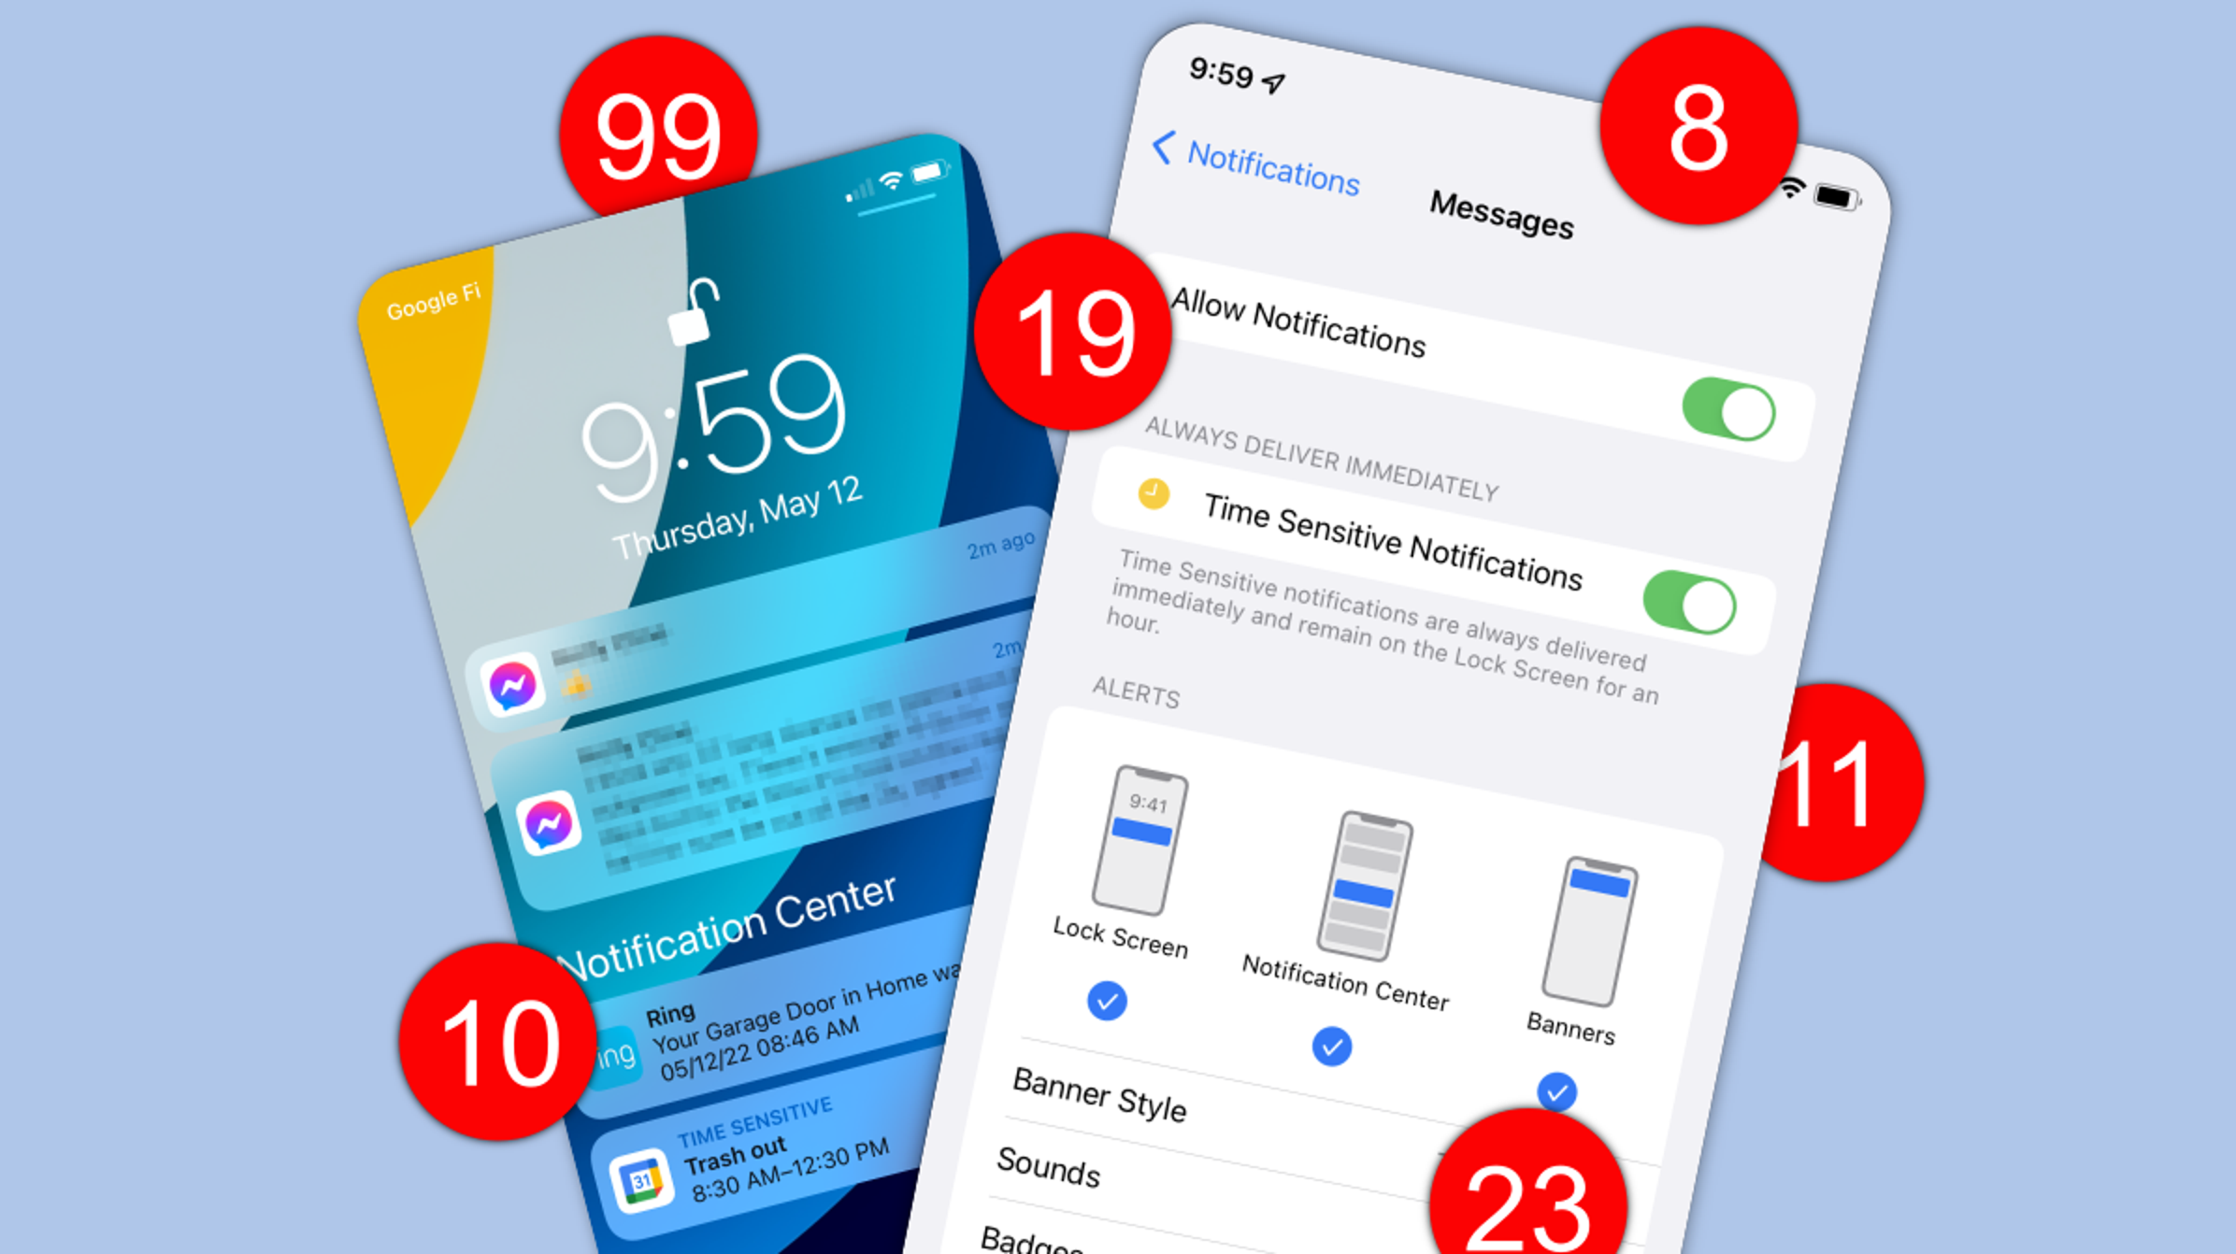
VOCABULARY
notification (n)
/ˌnəʊtɪfɪˈkeɪʃn/
thông báo

Slide 10
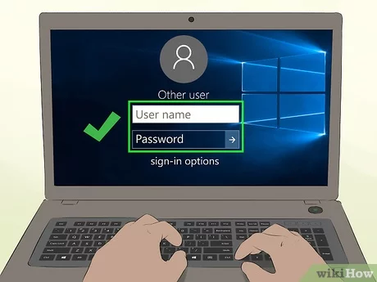
VOCABULARY
log on to (v)
/lɒɡ ɒn tə/
đăng nhập

Slide 11
VOCABULARY
check (v)
/tʃek/
kiểm tra

Slide 12
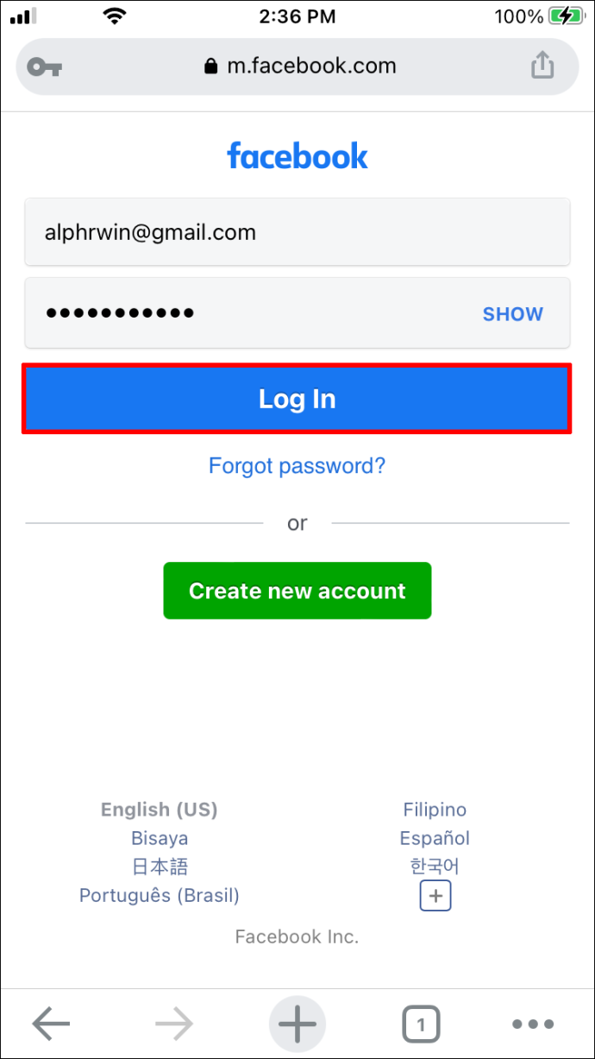
VOCABULARY
account (n)
/əˈkaʊnt/
tài khoản

Slide 13
VOCABULARY
New words | Pronunciation | Meaning
1. upload (v) | /ˌʌpˈləʊd/ | tải lên
2. browse (v) | /braʊz/ | đọc lướt, tìm (trên mạng)
3. notification (n) | /ˌnəʊtɪfɪˈkeɪʃn/ | thông báo
4. log on to (v) | /lɒɡ ɒn tə/ | đăng nhập
5. check (v) | /tʃek/ | kiểm tra
6. account (n) | /əˈkaʊnt/ | tài khoản

Slide 14
VOCABULARY
2
Use the correct forms of the verbs in 1 to complete the sentences.
1. I________ the school website and found pictures of school activities.
2. Our teacher ________ a video of our last meeting in our forum for everyone to see.
3. She ________ with some old friends at the English club.
4. Tom ________ the notifications and saw some new posts.
5. Mi often ________ to her Instagram account to chat with her friends.
browsed
uploaded
connects
checked
logs on

Slide 15
VOCABULARY
3
Choose the correct answer A, B, or C.
1. Our class has a(n)______, and we often post questions there to discuss.
A. office B. forum C. club
2. We try to meet our parents’ ______, but it is hard.
A. dreams B. interests C. expectations

Slide 16
VOCABULARY
3. He is a big ______ and scares his weaker classmates.
A. bully B. forum C. pressure
4. She was chatting with her friends, so she couldn’t ______ on the lesson.
A. concentrate B. coach C. advise
5. We have ______ from our exams, peers, and parents. This makes us feel very stressed.
A. interests B. pressure C. friends

Slide 17
PRONUNCIATION
4
Listen and repeat the words. Pay attention to the sound /ʊə/ and /ɔɪ/. Then put the words into the correct columns
boy tourist toy ensure
avoid choice sure tournament
/ʊə/ | /ɔɪ/
tourist
boy
ensure
toy
sure
avoid
tournament
choice

Slide 18
PRONUNCIATION
5
Listen and practice the sentences. Underline the words with /ʊə/ and circle the words /ɔɪ/.
She is a noisy and curious girl.
They joined a full-day city tour.
I found it enjoyable to watch the tournament.
She’ll record our voices during the interview.
He is not acting very mature and is starting to annoy me.

Slide 19
FURTHER PRACTICE
RULE:
Work in 2 teams.
T reads out word by word, one student will run to the board and slap on the correct word with the correct sound.
The team with more correct answers will be the winner.

Slide 20
FURTHER PRACTICE
toy
noisy
annoy
sure
boy
voice
soil
tour
tourist
enjoy
ensure
tournament
choice
mature
avoid
Notes:
* Teacher should prepare these words to stick on the board.

Slide 21
CONSOLIDATION
1
Wrap-up
List some verb phrases learned in the lesson.
List some other learned words / phrases related to teenagers’ activities or pressure.
Give 2 sounds learned in the lessons and give examples.

Slide 22
CONSOLIDATION
2
Homework
- Do exercises in the workbook.

Slide 23
Website: hoclieu.vn
Fanpage: facebook.com/www.tienganhglobalsuccess.vn/

