Slide 2
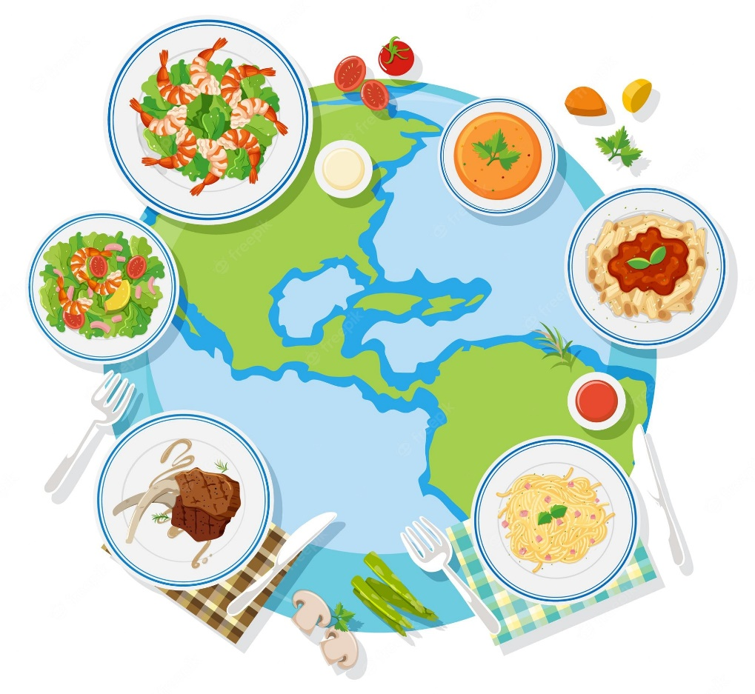
Unit
6
LIFESTYLES
LESSON 4: COMMUNICATION
1

Slide 3
LESSON 4: COMMUNICATION
WARM-UP
Jumbled conversation
﻿Expressing certainty
Task 1: ﻿Listen and read the conversations. Pay attention to the highlighted sentences.
Task 2: ﻿Work in pairs. Make similar conversations to express certainty in the following situations.
EVERYDAY ENGLISH
Task 3: QUIZ: ﻿How much do you know about the cuisines of different countries?
Task 4: ﻿Work in groups. Read the two passages and discuss the questions below.
Task 5: ﻿Work in groups. Talk about the typical food in your area.
﻿CUISINES AROUND THE WORLD
CONSOLIDATION
Wrap-up
Homework

Slide 4
WARM-UP
1. Sure. What do you want to drink?
2. Mom, could you make me a sandwich for breakfast tomorrow?
3. I’m thinking, Mom.
4. Yes, certainly. I’ll have some milk
5. How about a glass of milk? It’s your favorite drink, right?
JUMBLED
CONVERSATION

Slide 5
WARM-UP
2. Mom, could you make me a sandwich for breakfast tomorrow?
1. Sure. What do you want to drink?
3. I’m thinking, Mom.
5. How about a glass of milk? It’s your favorite drink, right?
4. Yes, certainly. I’ll have some milk.
JUMBLED
CONVERSATION

Slide 6
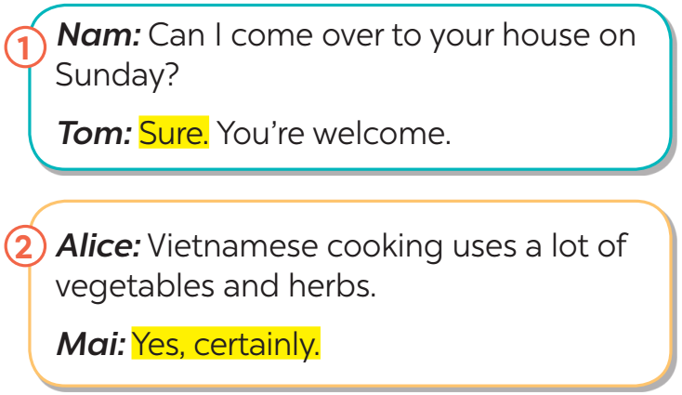
EVERYDAY ENGLISH
1
Listen and read the conversations. Pay attention to the highlighted sentences.
Structure | Examples
How to express certainty | Sure. Yes, certainly.

Slide 7
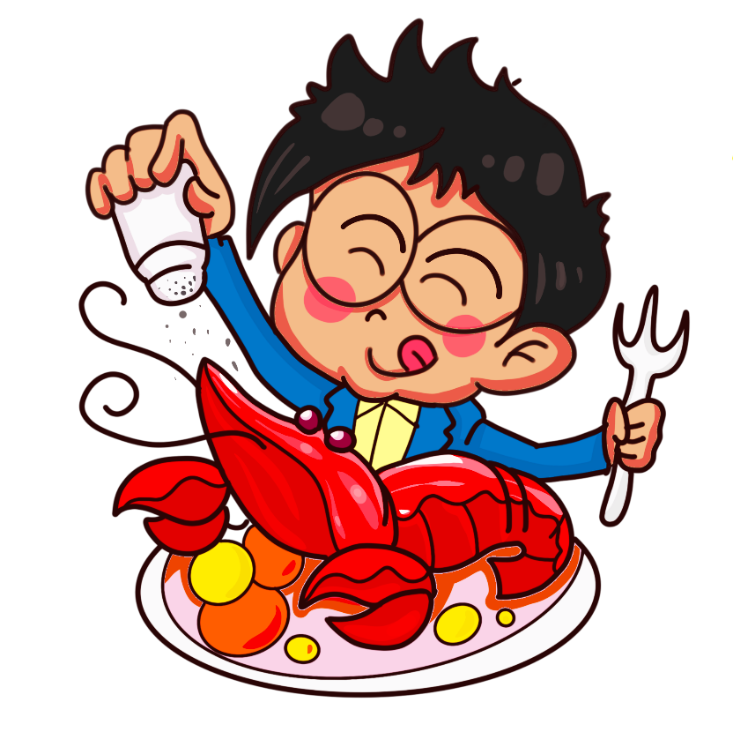
EVERYDAY ENGLISH
2
Work in pairs. Make similar conversations to express certainty in the following situations.
1. You ask your friend to help you with your maths homework.
﻿2. You say that Vietnamese love seafood.

Slide 8
﻿CUISINES AROUND THE WORLD
3
How much do you know about the cuisines of different countries?
Do the quiz to find out.
1. Which country is famous for pasta and pizza?
A. Thailand B. Italy C. Brazil
2. Which country is famous for kimchi?
A. Korea B. Portugal C. Australia
3. England is well-known for ______.
A. dim sum B. spaghetti C. fish and chips
4. Sushi comes from ______.
A. Japan B. Korea C. Taiwan
5. In which country do you think kangaroo steak is common?
A. China B. Australia C. The USA

Slide 9
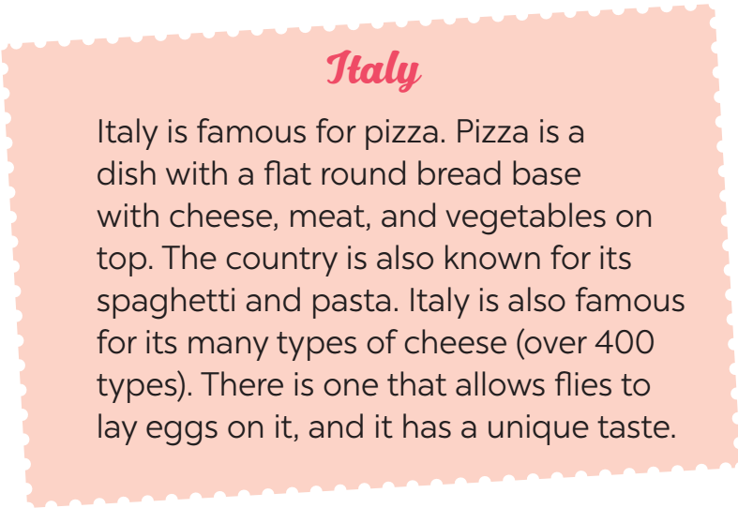
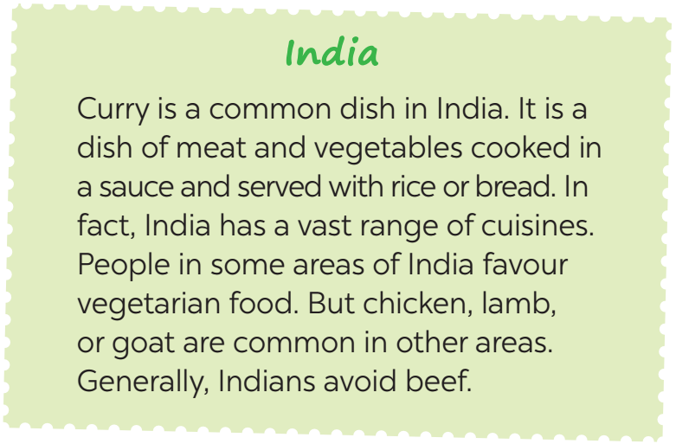
﻿CUISINES AROUND THE WORLD
4
Work in groups. Read the two passages and discuss the questions below:
Do you prefer Italian or Indian food? Why / Why not?

Slide 10
﻿CUISINES AROUND THE WORLD
5
Work in groups. Talk about the typical food in your area. Discuss the following:
﻿– staple food
– favourite food
– foods eaten on special occasions
Example:﻿
A: What is the staple food in your area?
B: It’s rice.
C: Yes. We have rice with most of our meals.
…

Slide 11
CONSOLIDATION
1
Wrap-up
What have we learnt in this lesson?
How to express certainty

Slide 12
CONSOLIDATION
2
Homework
Students’ workbook.
Make a list of 10 popular street food in Asian.

Slide 13
Website: hoclieu.vn
Fanpage: facebook.com/www.tienganhglobalsuccess.vn/

