Slide 2


Unit
3
MY FRIENDS
LESSON 3: A CLOSER LOOK 2
The present continuous
1

Slide 3
LESSON 3: A CLOSER LOOK 2
LESSON 1: GETTING STARTED
WARM-UP
Sentence puzzling
PRESENTATION
The present continuous
Task 1: Put the verbs in brackets in the present continuous.
Task 2: Look at the pictures. Write sentences like the example. Use positive or negative present continuous verbs.
Task 3: Work in pairs. Look at the pictures. Ask and answer.
Task 4: Put the verbs in brackets in the present simple or present continuous.
PRACTICE
PRODUCTION
Task 5: Game: Charades
CONSOLIDATION
Wrap-up
Homework

Slide 4
WARM-UP
RULE:
Work in 4 groups.
Create as many correct sentences from the word cards as possible.
The group with more correct sentences will be the winner.
Sentence puzzling

Slide 5
WARM-UP
1. now / learning / she / English / is.
2. walk / park / he / dog / for / taking / the / his / in / a / is.
3. Trang / friends / about / talking / new / Phong / their / and / are.
4. isn’t / piano / Susan / playing / the.
5. Me / parents / my / visiting / my
 She is learning English now.
 He is taking his dog for a walk in the park.
 Phong and Trang are talking about their new friends.
 Susan isn’t playing the piano.
 My parents are visiting me.

Slide 6

PRESENTATION
Grammar
The present continuous
We use the present continuous for actions happening now.
Example: - She’s talking.
- They’re not talking.
We can use the present continuous with now, at present, or at the moment.
Example: - I’m doing my homework at present.
- A: Are you reading now?
B: Yes, I am.

Slide 7
PRESENTATION
Grammar
The present continuous
Form | Example
S + am/ is/ are + V-ing | She is playing basketball in the garden.
S + am not/ isn’t/ aren’t + V-ing | They are not going to school at the moment.
Am/ Is/ Are + S + V-ing? | Are you having lunch?
Wh + am/ is/ are + S + V-ing? | Why is he standing over there?

Slide 8
PRACTICE
1
Put the verbs in brackets in the present continuous.
1. Nam (read) __________ a book now.
2. They (play) ___________ football at the moment.
3. My sister (not make) ___________ a sandwich at present.
4. I (go) __________ to the supermarket at the moment.
5. _____ they (talk) __________ about their new friends?
is reading
are playing
isn’t making
am going
Are
talking

Slide 9
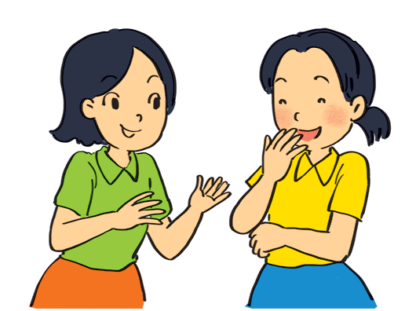
PRACTICE
2
Look at the pictures. Write sentences like the example. Use positive or negative present continuous verbs.
Example:
She’s talking to Mai. (talk)

Slide 10
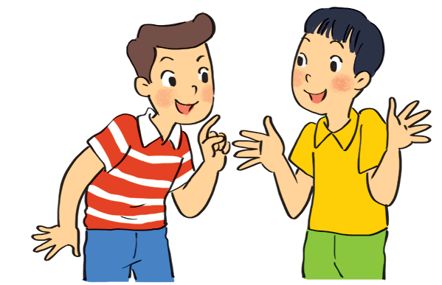
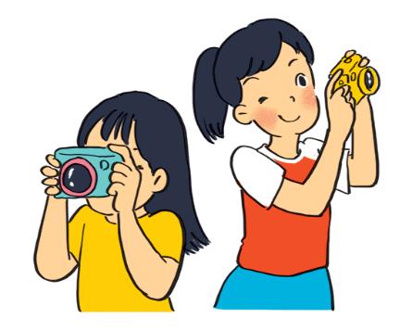
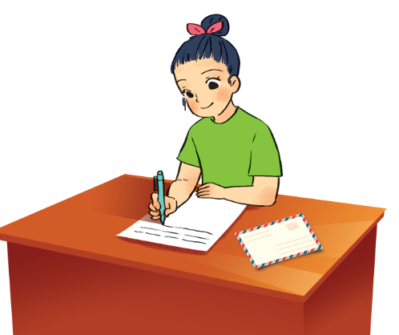
PRACTICE
2
Look at the pictures. Write sentences like the example. Use positive or negative present continuous verbs.
1. Nam and Ba ___________________________.
(eat ice cream)
2. Lan and Trang _______________.
(take photos)
3. Ha ___________________.
(write a letter)
are not / aren’t eating ice cream
are taking photos
is / ’s writing a letter

Slide 11
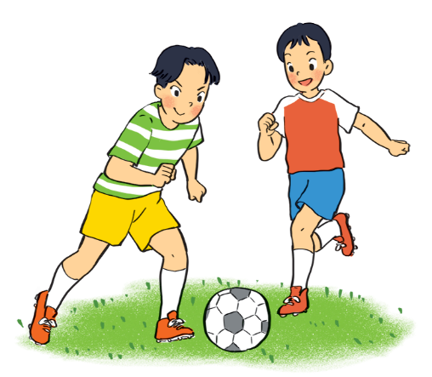
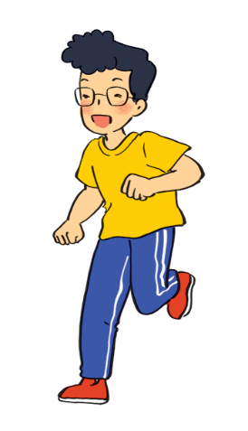
PRACTICE
2
Look at the pictures. Write sentences like the example. Use positive or negative present continuous verbs.
4. Duong and Hung ______________________________.
(play badminton)
5. Phong _________________________.
(draw a picture)
are not / aren’t playing badminton
is not / isn’t drawing a picture

Slide 12
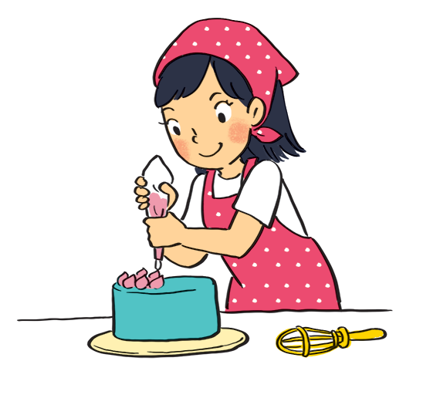
PRACTICE
3
Work in pairs. Look at the pictures. Ask and answer.
Example:
A: your sister / make a cake?
Is your sister making a cake?
B: Yes, she is.

Slide 13
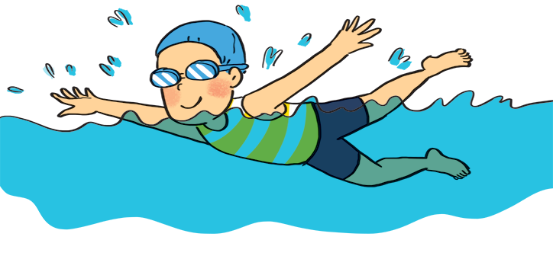
PRACTICE
3
Work in pairs. Look at the pictures. Ask and answer.
1. A: your friend / swim?
______________________
B: __________
Is your friend swimming?
Yes, he is.

Slide 14
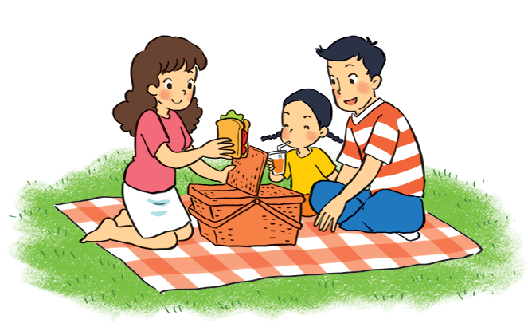
PRACTICE
3
Work in pairs. Look at the pictures. Ask and answer.
2. A: they / listen to music?
_______________________
B: _____________
Are they listening to music?
No, they aren’t.
(They are having a picnic.)

Slide 15
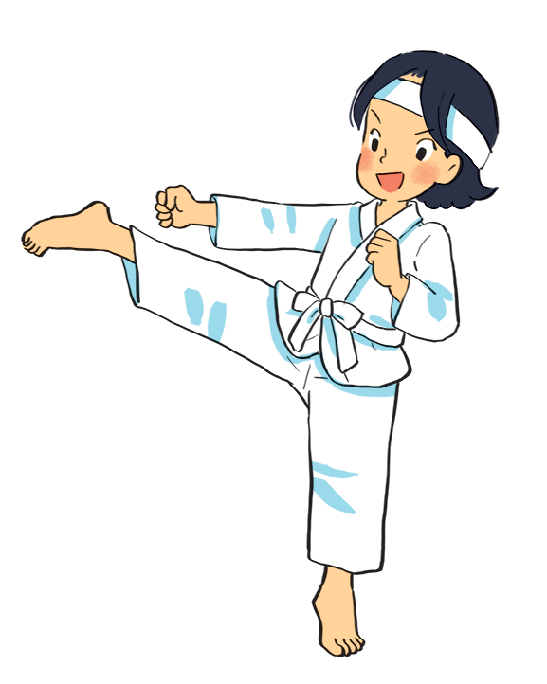
PRACTICE
3
Work in pairs. Look at the pictures. Ask and answer.
3. A: Mi / play the piano?
______________________
B: _____________
Is Mi playing the piano?
No, she isn’t.
(She is doing karate.)

Slide 16
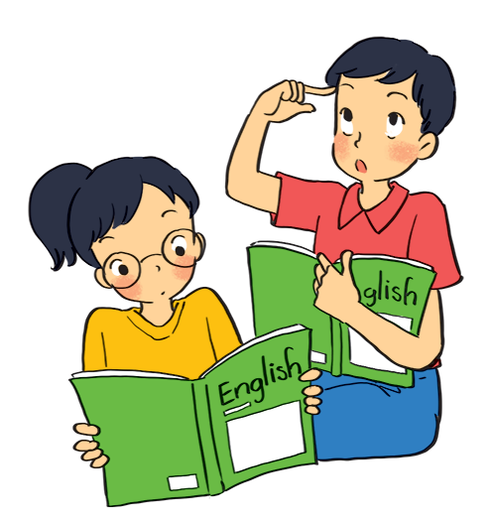
PRACTICE
3
Work in pairs. Look at the pictures. Ask and answer.
4. A: they / learn English?
______________________
B: _____________
Are they learning English?
Yes, they are.

Slide 17
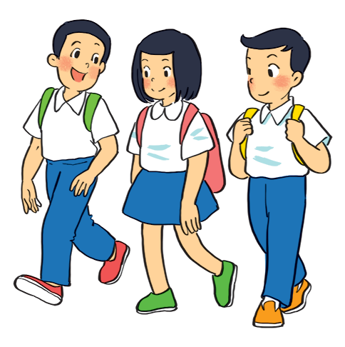
PRACTICE
3
Work in pairs. Look at the pictures. Ask and answer.
5. A: your friends / cycle to school?
____________________________
B: _____________
Are your friends cycling to school?
No, they aren’t.
(They are walking to school.)

Slide 18
PRACTICE
Grammar
The present continuous
When something often happens or is fixed, we use the present simple.
When something is happening now, we use the present continuous.

Slide 19
PRACTICE
4
Put the verbs in brackets in the present simple or present continuous.
1. My best friend (not walk) _______________________ to school every day. Sometimes she (cycle) _______.
2. Look! What _______ he (play) _______?
3. _______ your friends (study) _______ in the library every
afternoon?
4. I (write) ________________ an email to my friend now.
5. He (not do) ________________ his homework now. He (read) ____________.
does not / doesn’t walk
cycles
is
playing
Do
study
am / ‘m writing
is not / isn‘t doing
is / ‘s reading

Slide 20

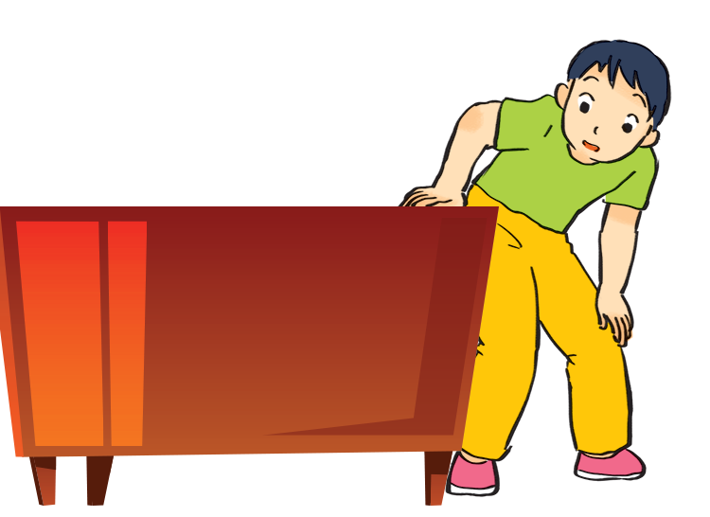
PRODUCTION
5
Charades. Take turns to mime different actions.
Others guess what you are doing.
Example:
A: Are you dancing?
B: No, I’m not.
C: Are you looking for something?
B: Yes, I am.

Slide 21

CONSOLIDATION
1
Wrap-up
What have we learnt in this lesson?
Use the present continuous to talk about things happening now;
Ask about appearance and personality

Slide 22

CONSOLIDATION
2
Homework
Do exercises in the Workbook.

Slide 23






Website: hoclieu.vn
Fanpage: facebook.com/www.tienganhglobalsuccess.vn/

