Slide 1

Saturday, October 17, 2020
ENGLISH 8

Slide 2
WARM UP
Fill each blank with the correct form of the word in the box.
country
colour
expensive
exciting
fast
1. He is a famous athletic so of course he runs ___________ me.
2. My pen pal friend says he would like to visit my ___________ at harvest time to see what farmers do.
3. The cost of living in my town is _________________ in this area.
4. Our garden is __________ in spring when almost flowers bloom.
5. City children have ____________ life than the country children.
faster than
countryside
the most expensive
colourful
more exciting

Slide 3



Saturday, October 17, 2020
New lesson
UNIT 2: LIFE IN THE COUNTRYSIDE
LESSON 7: LOOKING BACK
& PROJECT

Slide 4
Saturday, October 17, 2020
VOCABULARY

Slide 5
1. Use the words and phrases in the box to describe the pictures. Some words / phrases may be used for more than one picture.
colourful
peaceful
peaceful
peaceful
nomadic life
vast
vast
quiet
quiet
quiet
inconvenient
ger
pasture
pasture
cattle
rice
horses
paddy fields
paddy fields
harvest time

Slide 6
* Describe the pictures.
Saturday, October 17, 2020
peaceful, vast, quiet, pasture, paddy field
The scenery is so peaceful and quiet. There are vast lands, vast pasture and vast paddy fields. There are few people. It’s really a typical view of the countryside.

Slide 7
* Describe the pictures.
Saturday, October 17, 2020
quiet, peaceful, colourful, paddy field, rice, harvest time
It’s harvest time now. There are many colourful rice paddy fields in the picture. The country looks so picturesque. Some people are working on the fields. Their work is hard and their lives may be uncomfortable. However, life in the country is very quiet and peaceful. After a hard day, they can relax without thinking so much about other complex problems as people in the city do.

Slide 8
* Describe the pictures.
peaceful, vast, quiet, nomadic life, pasture, inconvenient, ger, cattle, horses
There are a lot of cattle on the pasture. Nomadic life is hard and inconvenient. They put up some tents to stay in. They usually move to look for grasslands for their cattle. These cattle are very important to them because they provide them with many necessary things. Nomadic children can ride horses and help their parents a lot. It’s a hard but interesting life.

Slide 9
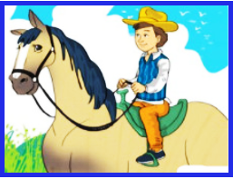
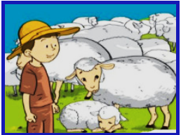
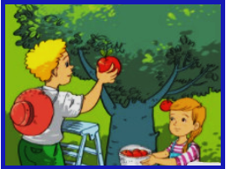
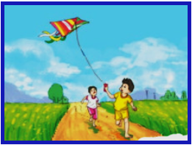
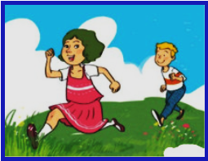
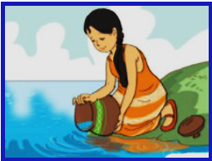
2. Look at each picture and write a sentence describing what each person is doing. Use the verbs in brackets.
1. (ride)
2. (herd)
3. (pick)
A boy is riding a horse.
A man is herding his cattle.
A boy and a girl are picking apples.
4. (fly)
5. (un around)
6. (collect)
The children are flying a kite on the fields.
The children are running around in the fields.
A woman is collecting water from the river.

Slide 10
GRAMMAR

Slide 11
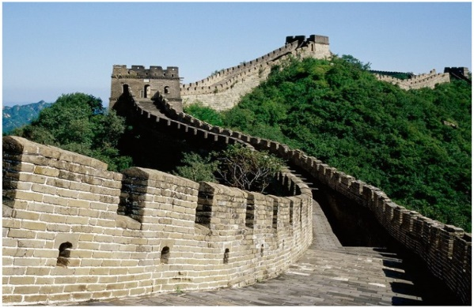
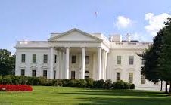
3. Look at the pictures and complete the sentences, using suitable comparative forms of the adverbs in brackets.
faster
1. A lion runs ________ than a horse. (fast)
earlier
2. The Great Wall was built _______ than the White House. (early)

Slide 12
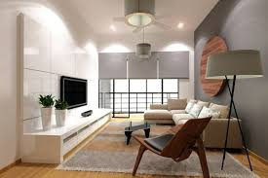
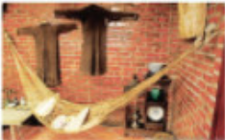
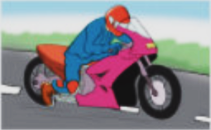
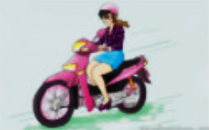
3. Look at the pictures and complete the sentences, using suitable comparative forms of the adverbs in brackets.
better
3. Homes in the city are often _______ furnished ______ those in the countryside. (well)
than
more skillfully than
4. A racing driver drives ___________________ a normal motorist. (skillfully)

Slide 13
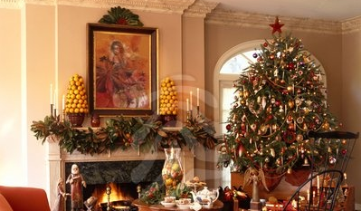
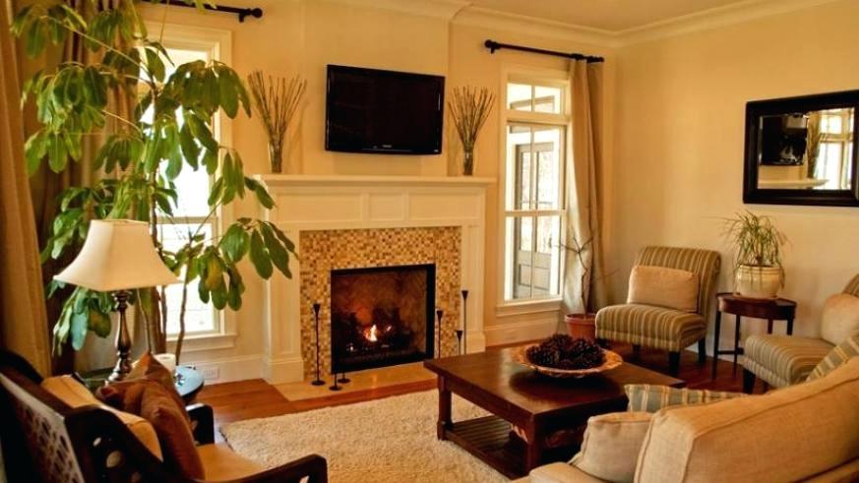
3. Look at the pictures and complete the sentences, using suitable comparative forms of the adverbs in brackets.
5. A house is ________________ decorated at New Year _________ during the year.
more beautifully
than

Slide 14
4. Read the situations and complete the sentences with suitable forms of the adverbs in brackets.
1. A horse can run 80km/hr while a camel can only run 12km/hr. (fast)
→ A horse can run _________________________
2. According to a survey, 75% of the population
in the countryside are happy with their life. This rate in the city is only 47%. (happily)
→ People in the countryside live _______________
_________________________________________
3. Unlike many other jobs, farmers depend heavily on the weather. (heavily)
→ Farmers depend ____________________________
_________________________________________
4. We are both bad at swimming but I’m better
than my sister. (badly)
→ My sister swims _________________________
faster than a camel.
more happily than
those in the city.
more heavily on the weather
than people in many other jobs.
worse than I do.

Slide 15
Communication

Slide 16
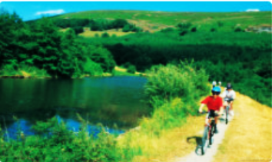
5. Work in groups.
You are planning a trip to the countryside. Work together and answer the question:
What will you do during the trip to the countryside?
Write the answers in the table below.
Person’s name | Activity
1.
2.
3.
4.
Tuan
climb the tree
Nga
go fishing
Nam
swim in the river
Lan
ride a bike around the village
Report your findings to the class.

Slide 17
Model report to the class:
Hi. I am Lý Lệ Lan. I am the representative of the group Lovely Tiger. Our group includes Tuan, Nga, Nam and me - Lan. After our ardent discussion about What we will do during the trip to the countryside, I would like to report it to you as follows:
Tuan will climb the trees to find bird nests. He wants to know how the birds lay eggs. Nga will go fishing. She has bought her fishing rod already. She hopes to catch a lot of fish. Nam wants to swim in the river there. He can swim very well in the swimming pool, but he has never swum in a river. I am the last person in my group. I will ride a bike around the village to go sight-seeing. I will take a camera with me. I hope I will take a lot of beautiful pictures there.

Slide 18
Now. It’s time you conduct the discussion. And each group nominates the representative to report the results to the class.

Slide 19


Work in groups of four or five. Take turns to
draw a group picture of a place you would like to live in the countryside. Then make a list of:
1. the things you have in your picture
2. the activities you can do there
Show your drawing to the class and talk about it.

Slide 20
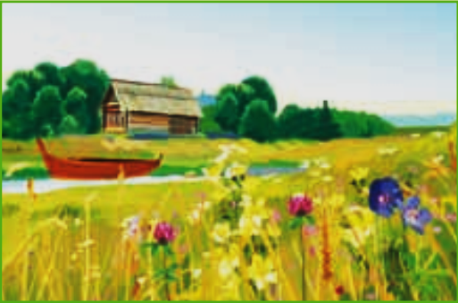
Model Project:
1. the things we have in the picture
▪ a wooden house
▪ a beautiful river
▪ a boat
▪ a field of wild ﬂowers
2. the activities we can do there
▪ biking along the river
▪ picking wild ﬂowers
▪ swimming in the river
▪ boating on the river

Slide 21
Report to the class:
Saturday, October 17, 2020
This is our home village in the countryside. It has a wooden house in the middle. The house is near the river. There is a boat on the river. There is also a field of wild flowers nearby. We will bike along the river and swim in the river. We will go boating on the river. In the morning we will go picking the wild flowers. We love our place very much.

Slide 22


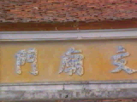
HOMEWORK
- Review all the new words again.
- Review the grammar point: Comparatives.
- Do the project. Report to the class in the next period.
- Prepare for : Unit 3 – Getting started
Listen and read
+

Slide 23
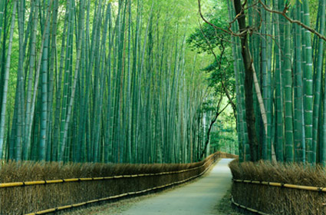
THANKS FOR YOUR ATTENTION!
Goodbye!
See you again!

