Slide 1
Hello everyone !!!
MRS THU BA

Slide 2
* WARM-UP
* Work in groups
1. Sure. What do you want to drink?
2. Mom, could you make me a sandwich for breakfast tomorrow?
3. I’m thinking, Mom.
4. Yes, certainly. I’ll have some milk
5. How about a glass of milk? It’s your favorite drink, right?
JUMBLED
CONVERSATION

Slide 3
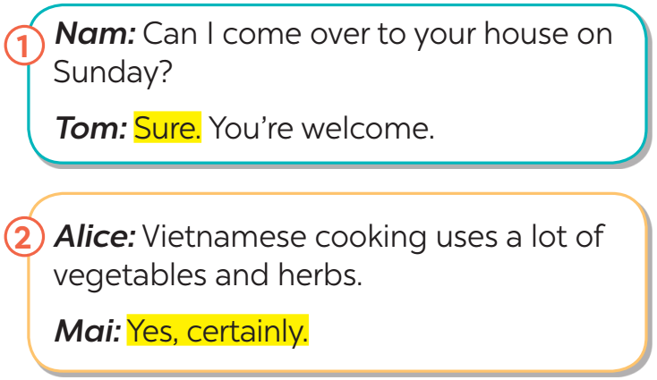
* EVERYDAY ENGLISH
1
Listen and read the conversations. Pay attention to the highlighted sentences.
Structure | Examples
How to express certainty | - Sure. - Yes, certainly.

Slide 4
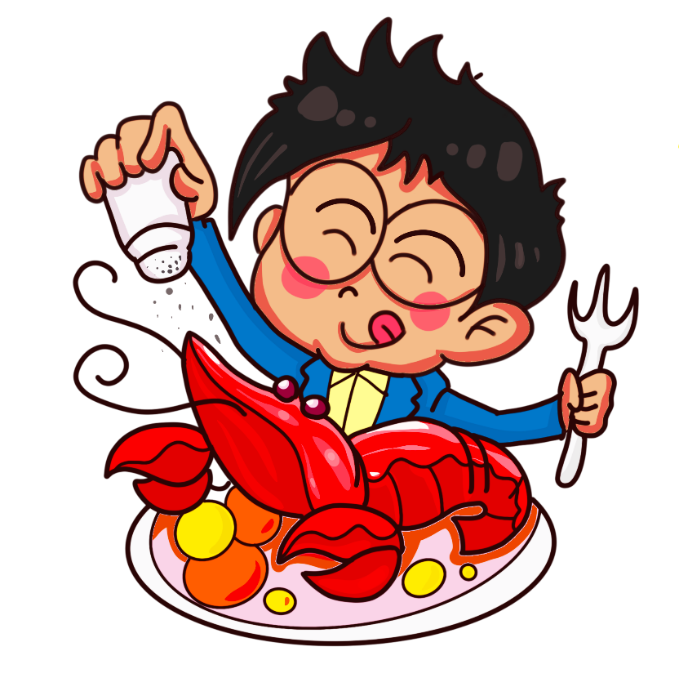
* EVERYDAY ENGLISH
2
Work in pairs. Make similar conversations to express certainty in the following situations.
1. You ask your friend to help you with your maths homework.
﻿2. You say that Vietnamese love seafood.

Slide 5
﻿CUISINES AROUND THE WORLD
3
How much do you know about the cuisines of different countries?
Do the quiz to find out.
1. Which country is famous for pasta and pizza?
A. Thailand B. Italy C. Brazil
2. Which country is famous for kimchi?
A. Korea B. Portugal C. Australia
3. England is well-known for ______.
A. dim sum B. spaghetti C. fish and chips
4. Sushi comes from ______.
A. Japan B. Korea C. Taiwan
5. In which country do you think kangaroo steak is common?
A. China B. Australia C. The USA

Slide 6
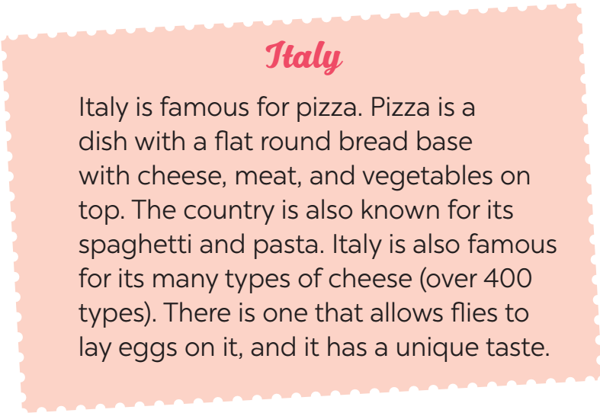
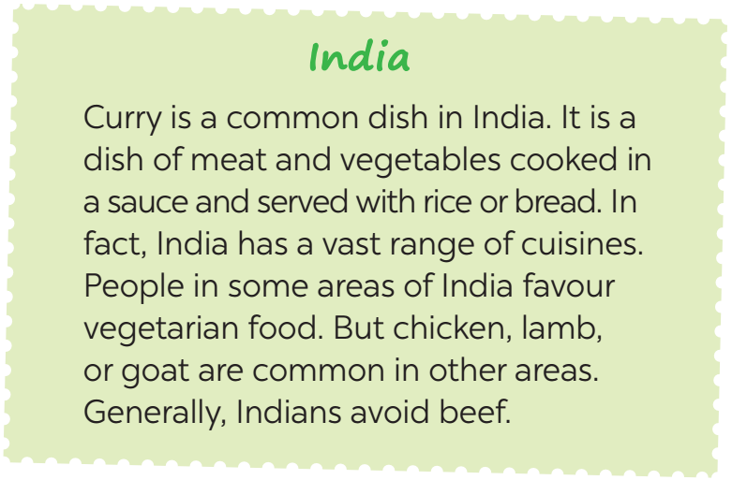
﻿CUISINES AROUND THE WORLD
4
Work in groups. Read the two passages and discuss the questions below:
Do you prefer Italian or Indian food? Why / Why not?

Slide 7
4
Work in groups. Read the two passages and discuss the questions below:
Do you prefer Italian or Indian food? Why / Why not?
→ I prefer Italian food to Indian food. It’s because I love pizza. Spaghetti and pasta are really delicious too.
→ I like the Indian cusine because I enjoy the favour of curry. It’s savory and delicious. I hope one day I well have the chance to try Italian cusine.

Slide 8
﻿CUISINES AROUND THE WORLD
5
Work in groups. Talk about the typical food in your area. Discuss the following:
﻿– staple food (lương thực)
– favourite food
– foods eaten on special occasions
* Example:﻿
A: What is the staple food in your area?
B: It’s rice.
C: Yes. We have rice with most of our meals.
…

Slide 9
* Example:
* staple food
A: What is the staple food in your area?
B: It's rice.
C: Yes. We have rice with most of our meals.
* favourite food
A: What is your favourite food in your country?
B: People in my country love all kinds of noodles and banh mi
C: They also eat a lot of seafood.
* foods eaten on special occasions
A: What do people in your area eat on special occasions?
B: We usually have banh chung, banh tet.
C: Yes. I see people eat them on Tet holiday.

Slide 10
* CONSOLIDATION
What have we learnt in this lesson?
How to express certainty
Examples
- Sure. - Yes, certainly.

Slide 11
* Homework
Students’ workbook.
Make a list of 10 popular street food in Asian.
Prepare lesson 5: Skills 1

Slide 12
Thank you!
Have a nice day!

