Slide 1
TRƯỜNG THCS THANH AM
TIẾNG ANH 8
UNIT 2: LIFE IN THE COUNTRYSIDE
– LESSON 2: A CLOSER LOOK 1

Slide 2
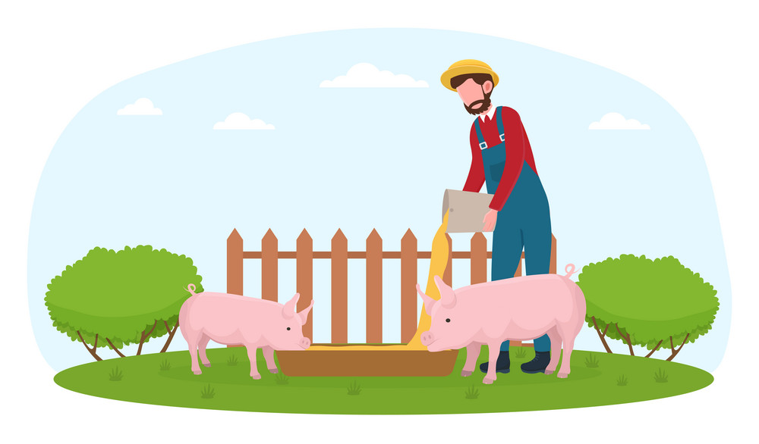
Unit
2
LIFE IN THE COUNTRYSIDE
LESSON 2: A CLOSER LOOK 1

Slide 3
LESSON 2: A CLOSER LOOK 1
WARM-UP
Matching game
Vocabulary
Task 1: Circle the correct words to complete the sentences.
Task 2: Match the following adjectives with their definitions.
Task 3: Complete the sentences with the words from 2.
VOCABULARY
Task 4: Listen and repeat the words. Pay attention to the sounds /ə/ and /ɪ/.
Task 5: Listen and practise the sentences. Underline the bold words with /ə/, and circle the bold words with /ɪ/.
PRONUNCIATION
Wrap-up
Homework
CONSOLIDATION

Slide 4
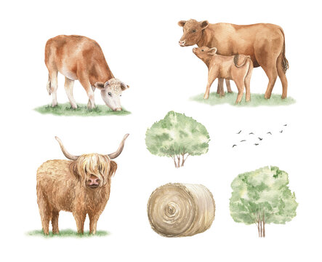
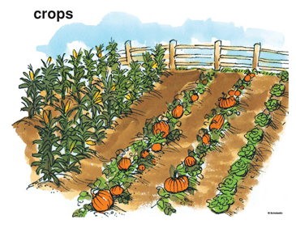
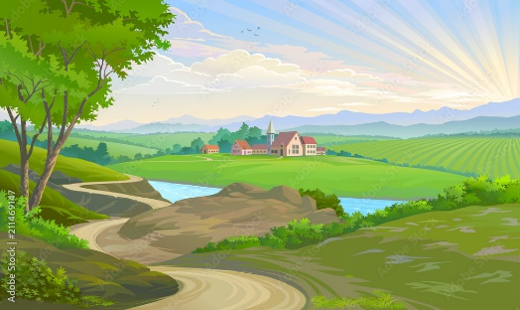
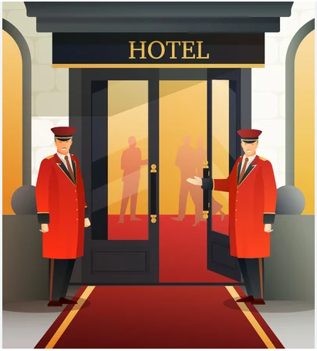
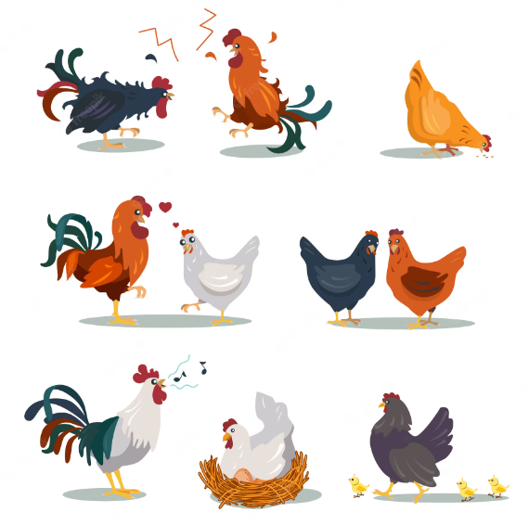
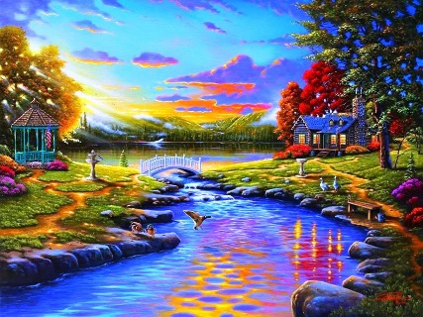
WARM-UP
MATCHING
GAME
Match the words to the suitable pictures.
CATTLE
CROP
1.
CATTLE
2.
VAST
3.
CROP
HOSPITABLE
POULTRY
VAST
PICTURESQUE
4.
HOSPITABLE
5.
POULTRY
6.
PICTURESQUE

Slide 5
VOCABULARY
cattle (n)
/ˈkætl/
cows and bulls kept by farmers for their milk or meat

Slide 6
VOCABULARY
poultry (n)
/ˈpəʊltri/
birds such as chickens that are used for meat or eggs
a poultry farm.

Slide 7
VOCABULARY
crop (n)
/krɒp/
a plant grown for food, usually on a farm

Slide 8
VOCABULARY
vast (adj)
/vɑːst/
extremely large

Slide 9
VOCABULARY
hospitable (adj)
/hɒˈspɪtəbl/
/ˈhɒspɪtəbl/
generous towards visitors and guests

Slide 10
VOCABULARY
picturesque (adj)
/ˌpɪktʃəˈresk/
attractive, beautiful

Slide 11
VOCABULARY
New words | Pronunciation | Vietnamese equivalent
1. cattle (n) | /ˈkæt(ə)l/ | gia súc
2. poultry (n) | /ˈpəʊltri/ | gia cầm
3. crop (n) | /krɒp/ | hoa màu
4. vast (adj) | /vɑːst/ | mênh mông
5. hospitable (adj) | /hɒˈspɪtəbl/ /ˈhɒspɪtəbl/ | hiếu khách
6. picturesque (adj) | /ˌpɪktʃəˈresk/ | đẹp như tranh vẽ

Slide 12
VOCABULARY
1
Circle the correct words to complete the sentences.
1. We helped the farmers herd cattle / poultry.
2. They are helping their parents pick plants / fruit in the orchard.
3. At harvest time farmers are busy cutting and collecting food / crops.
4. The driver loaded / unloaded the rice from the back of the truck.
5. People here live by catching / holding fish from nearby lakes
and ponds.

Slide 13
VOCABULARY
2
Match the following adjectives with their definitions.
a. pretty, especially in a way that looks old-fashioned
b. having something near or around
c. extremely large in area, size, amount, etc.
d. pleased to welcome guests; generous and friendly to visitors
e. having received good or thorough training

Slide 14
VOCABULARY
3
Complete the sentences with the words from 2.
1. The local people are kind and __________ to visitors.
2. Our factory needs a lot of ____________ workers.
3. While travelling up the mountain, people always stop and take photos of the ___________ scenery.
4. The Sahara is a ______ desert that covers parts of eleven countries in Northern Africa.
5. The lake is _____________ by a lot of trees.
hospitable
well-trained
picturesque
vast
surrounded

Slide 15
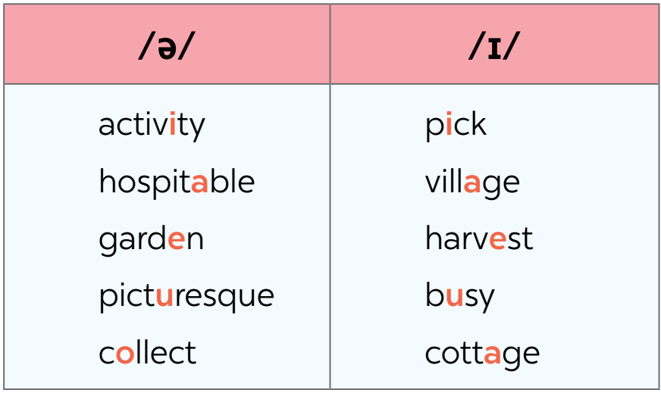
PRONUNCIATION
4
Listen and repeat the words. Pay attention to the sounds /ə/ and /ɪ/.

Slide 16
PRONUNCIATION
5
Listen and practise the sentences. Underline the bold words with /ə/, and circle the bold words with /ɪ/.
1. There is a lot of water in the bottle.
2. The farmers here are hard-working.
3. They are picking fruits in the orchard.
4. People in my village usually gather at weekends.
5. Please buy some milk and pasta at the supermarket.

Slide 17
CONSOLIDATION
1
Wrap-up
What have we learnt in this lesson?
Vocabulary: The lexical items related to Life in the countryside
Pronunciation: The sounds /ə/ and /ɪ/ in words and sentences

Slide 18
CONSOLIDATION
2
Homework
Do exercises in the workbook.

Slide 19
Website: hoclieu.vn
Fanpage: facebook.com/www.tienganhglobalsuccess.vn/

