Slide 1









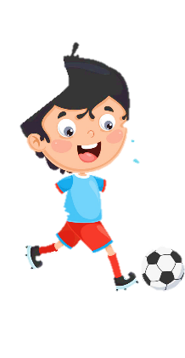
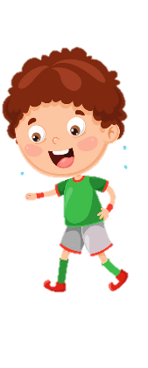











Slide 2




Review 1
Part 1

Slide 3

1. WARM UP
Guess the colours
Notes:
(Teacher shows a black and white picture. Ss have to guess what colour it is.)
- Divide the class into 4 groups
- Set the game rules.
- Ask students to look and guess.
- Award the best groups

Slide 4
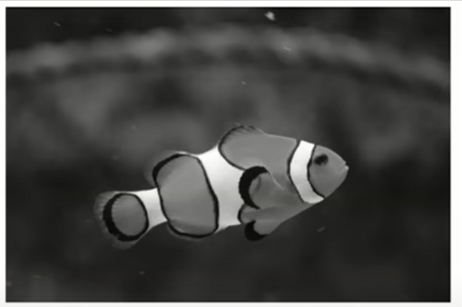
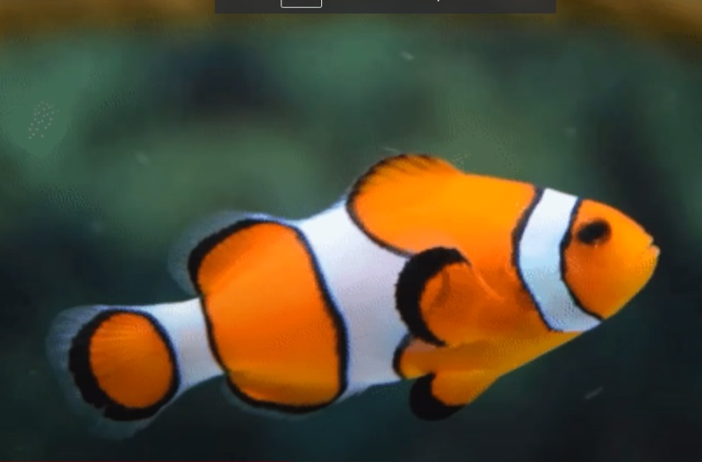
What colour is the fish?
It’s red.
It’s orange.
Notes:
Ấn vào câu để chọn đáp án

Slide 5
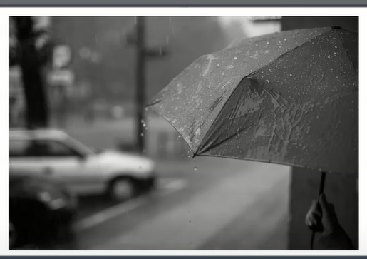
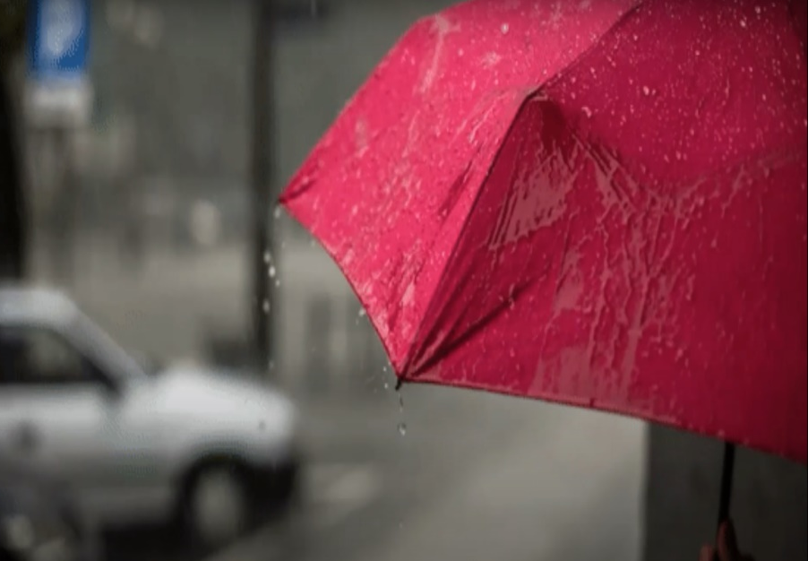
What colour is this umbrella?
It’s pink.
It’s purple.
Notes:
Ấn vào câu để chọn đáp án

Slide 6
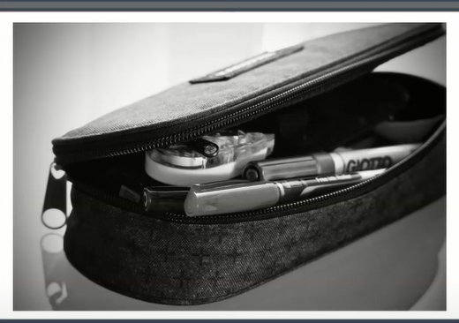
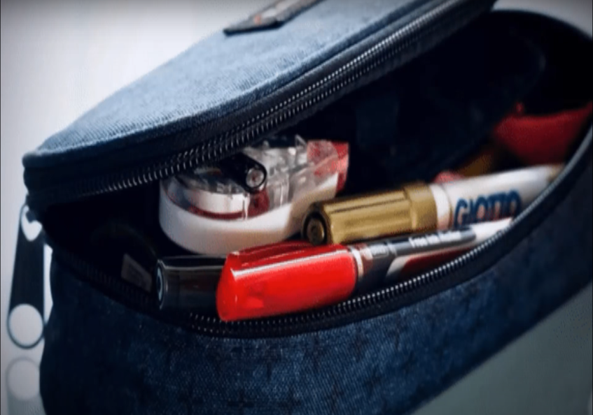
What colour is this pencil case?
It’s blue.
It’s green.
Notes:
Ấn vào câu để chọn đáp án

Slide 7
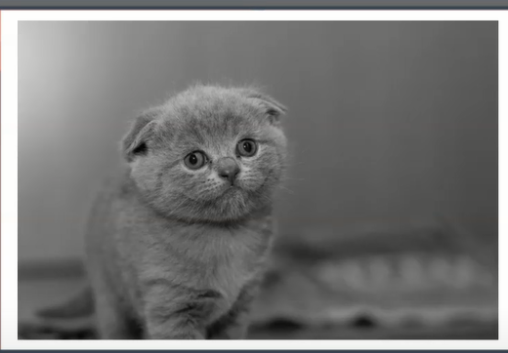
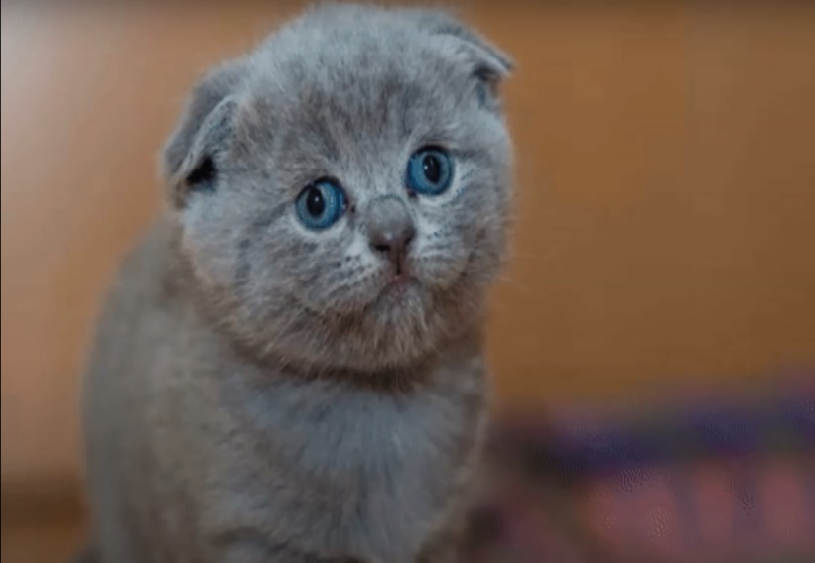
What colour is this cat?
It’s orange.
It’s grey.
Notes:
Ấn vào câu để chọn đáp án

Slide 8


2. REVIEW
Task 1: Count, write and say

Slide 9
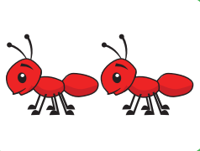
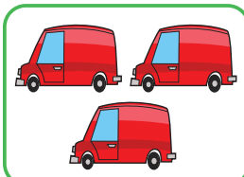

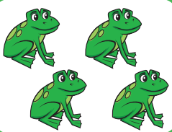

Review
ducks
ants
vans
eggs
frogs
Notes:
- Point to pictures on the book and say one by one.
- Ask students to listen and repeat in chorus, groups.
- Say a word for students to repeat then point.

Slide 10


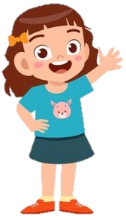

Game “Slap the board”
frogs
Notes:
- Vocabulary checking: Teacher asks students to play a small game to check vocabulary. Students have to slap the picture which teacher calls.

Slide 11
Count, write and say
two
1 _____ red vans
five
3 _____ red ants
three
2 _____ yellow ducks
six
four
4 _____ white eggs
5 _____ green frogs
Notes:
- Ask students to look at the pictures and count, then write numbers.
- Call students to answer.
1. three red vans.
2. five yellow ducks.
3. two red ants.
4. six white eggs.
5. four green frogs.
- Check answers and give feedback.

Slide 12

2. REVIEW
Task 2: Match and say

Slide 13
Match and say
1 Hi. I’m Mai.
a I’m six years old.
2 How are you?
b I’m fine. Thank you.
3 How old are you?
c Hi, Mai. I’m John.
4 Goodbye, Nam.
d Bye, Alex.
Notes:
- Ask students to look at the 4 questions and 4 answers. Then T points and say aloud, students listen and repeat in chorus, groups.
- Ask SS to work in pairs and match the questions.
- Call some pairs to match.
1.c 2.b 3.a 4.d
- Check their answers and give them feedback.

Slide 14
2. REVIEW
Task 3: Write and say

Slide 15



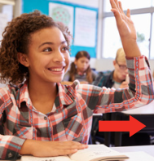
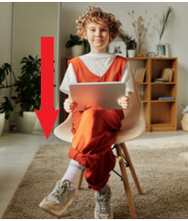

Write and say
1 _____ talk!
in
Don’t
4 May I come ____?
out
5 May I go _____?
2 _____ up!
Stand
Look
3 _____ down!
6 ____ at the board!
Sit
Notes:
- Ask students to look at 6 pictures and call names of the commands.
- Call students to fill in the blanks.
1. Don’t talk!
2. Stand up!
3. Sit down!
4. May I come in?
5. May I go out?
6. Look at the board!
- Check answer and give feedback.

Slide 16
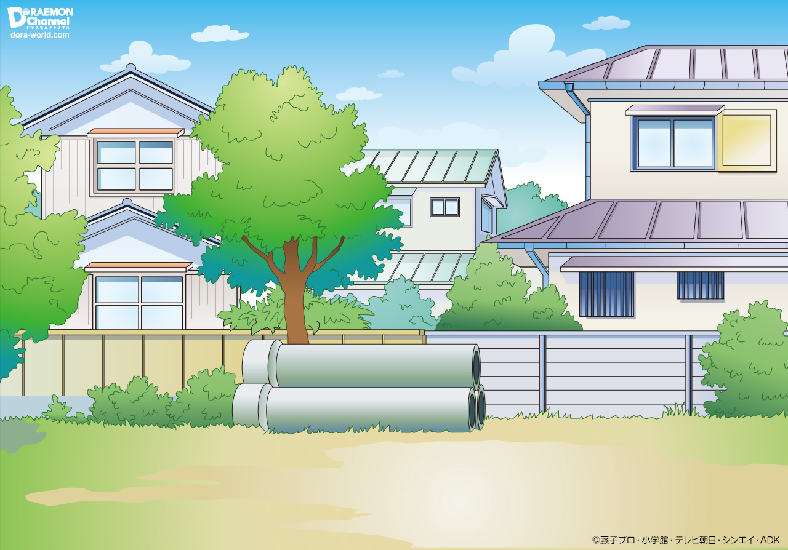


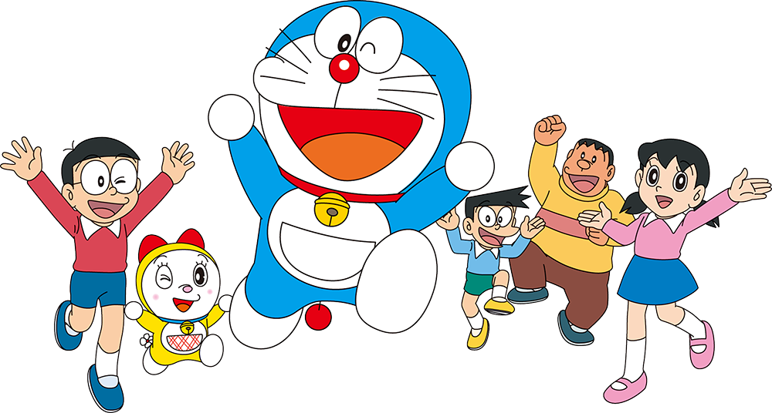
Puzzles

Slide 17
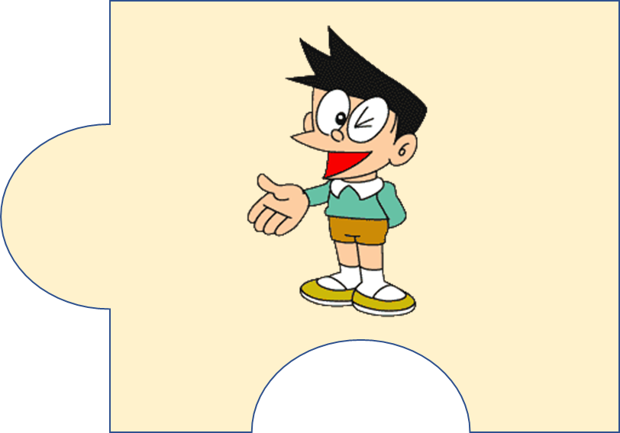
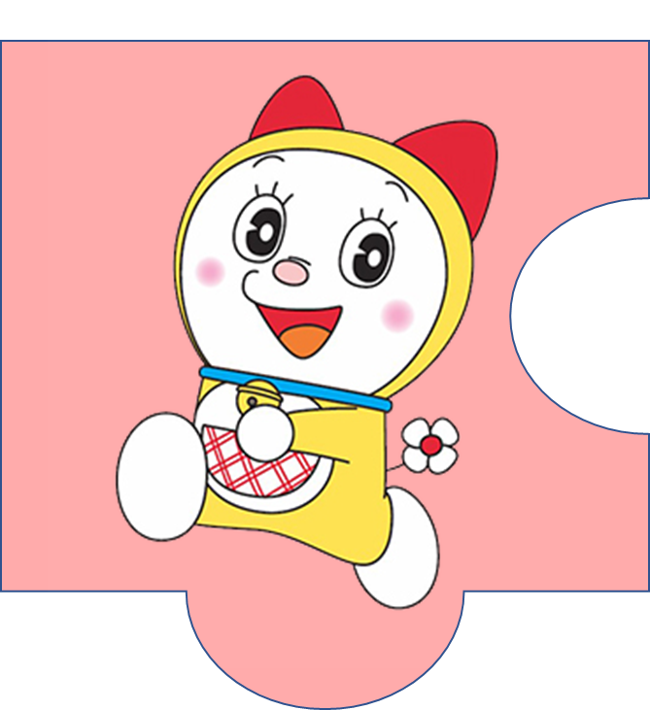
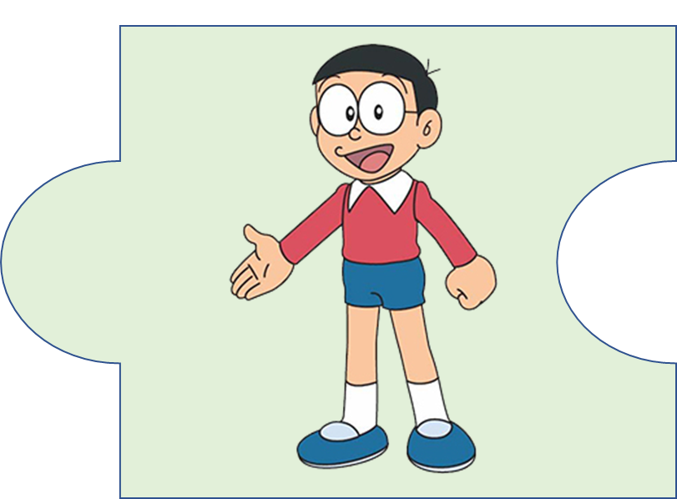
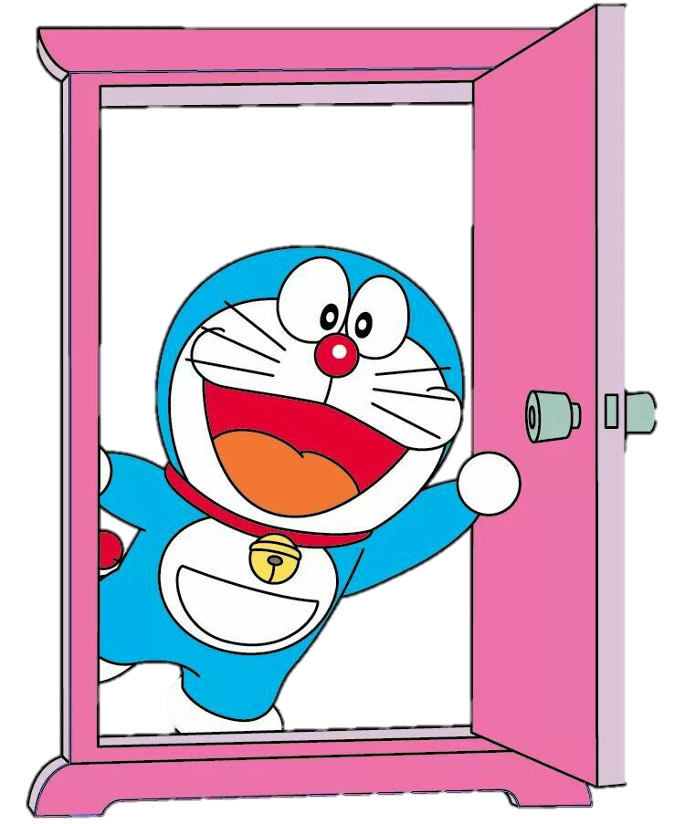


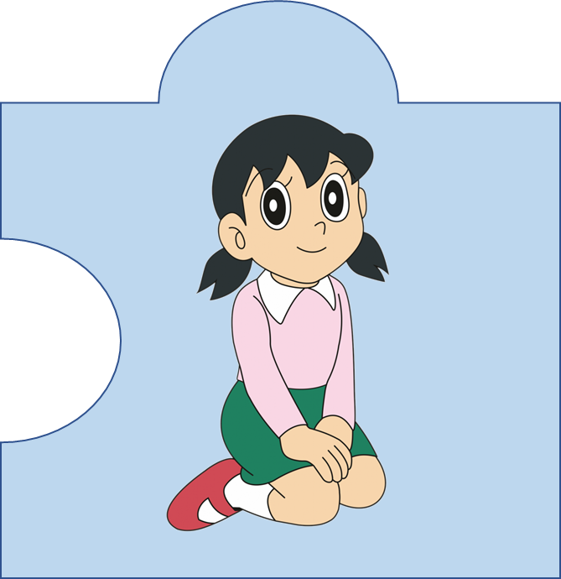
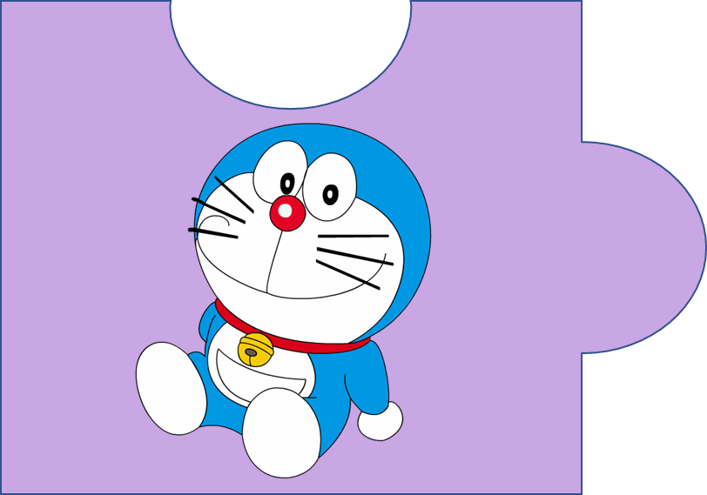
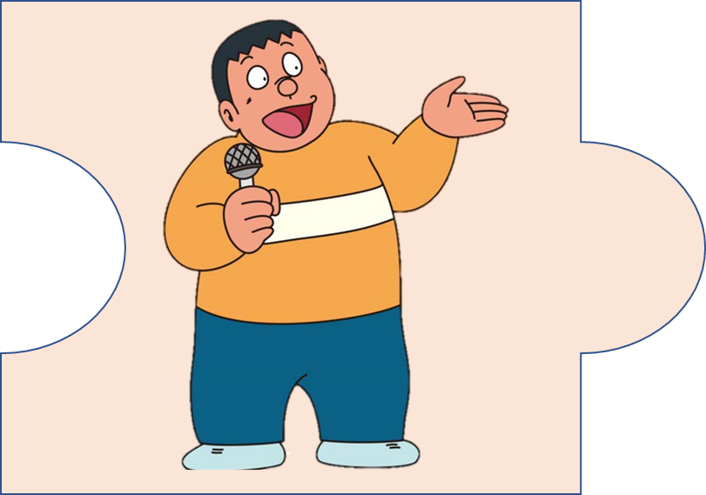

?
20
It’s a magic door.
Notes:
(There are 6 pictures about characters in Doaremon story. Each picture is a puzzle piece. There is 1 treasure behind the puzzle pieces. Students choose one of pictures and answer the questions to open the puzzle pieces. Students guess the name of the treasure after opening all the puzzle pieces.)

Slide 18

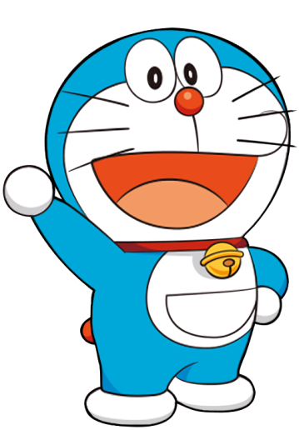
Reorder the word:
“inestc”
  insect

Slide 19

What letters are missing?
“_u_k”
  duck

Slide 20
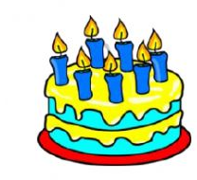
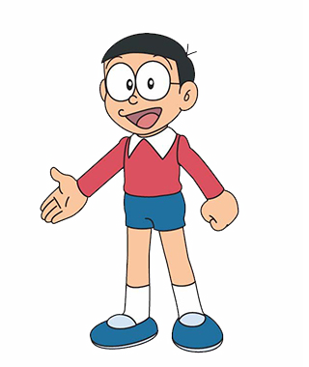
Make a question!
“______________?
I’m seven years old.”
  How old are you?

Slide 21

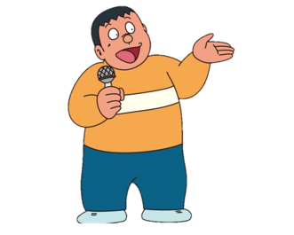
Fill in the blank
“What ______ is it?”
- It’s _______.
  What colour is it?
  - It’s black.

Slide 22

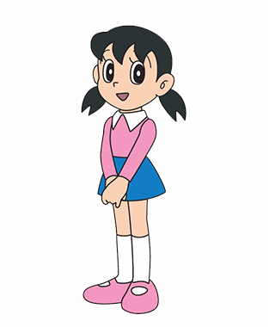
What command is it?
  Sit down!

Slide 23

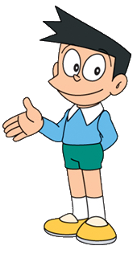
What command is it?
  Look at the board!

Slide 24


3. EXTRA ACTIVITY
Introduce yourself
Notes:
(Teacher calls pairs of SS from the differen groups. One of them chooses a piece of paper and uses their language to describe the word. The other has to guess the word in 20 seconds.)

Slide 25

Hello. My name is Mary.
I’m eight years old. I like red.
Example
Notes:
- Work in pairs and introduce themselves to their friends.
- Call some students to present in front of the class.
- Give feedback for them.

Slide 26




Thank you & goodbye!

