Slide 1
Unit 16
WHERE’S THE POST OFFICE?
Lesson 1

Slide 2
VOCABULARY

Slide 3
Vocabulary
pharmacy
/ˈfɑːməsi/

Slide 4
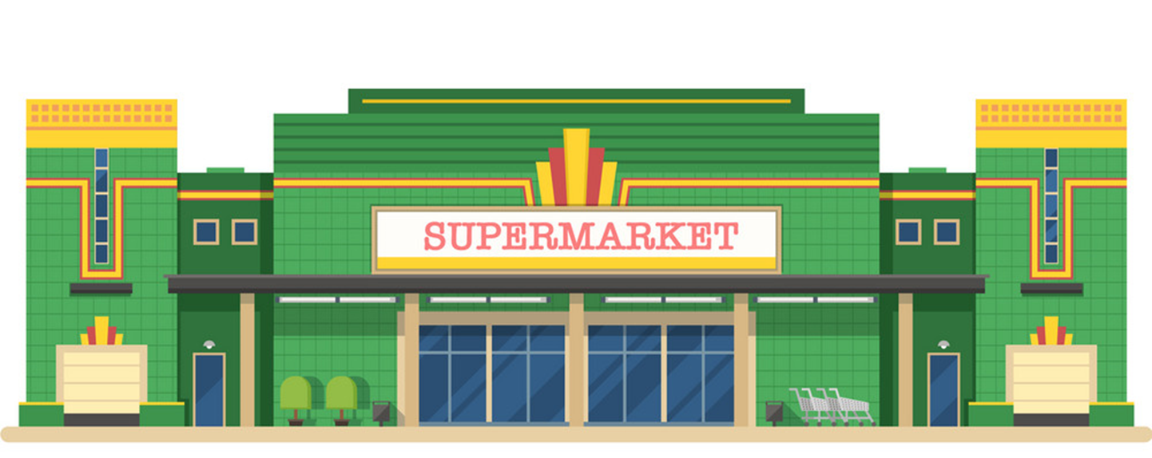
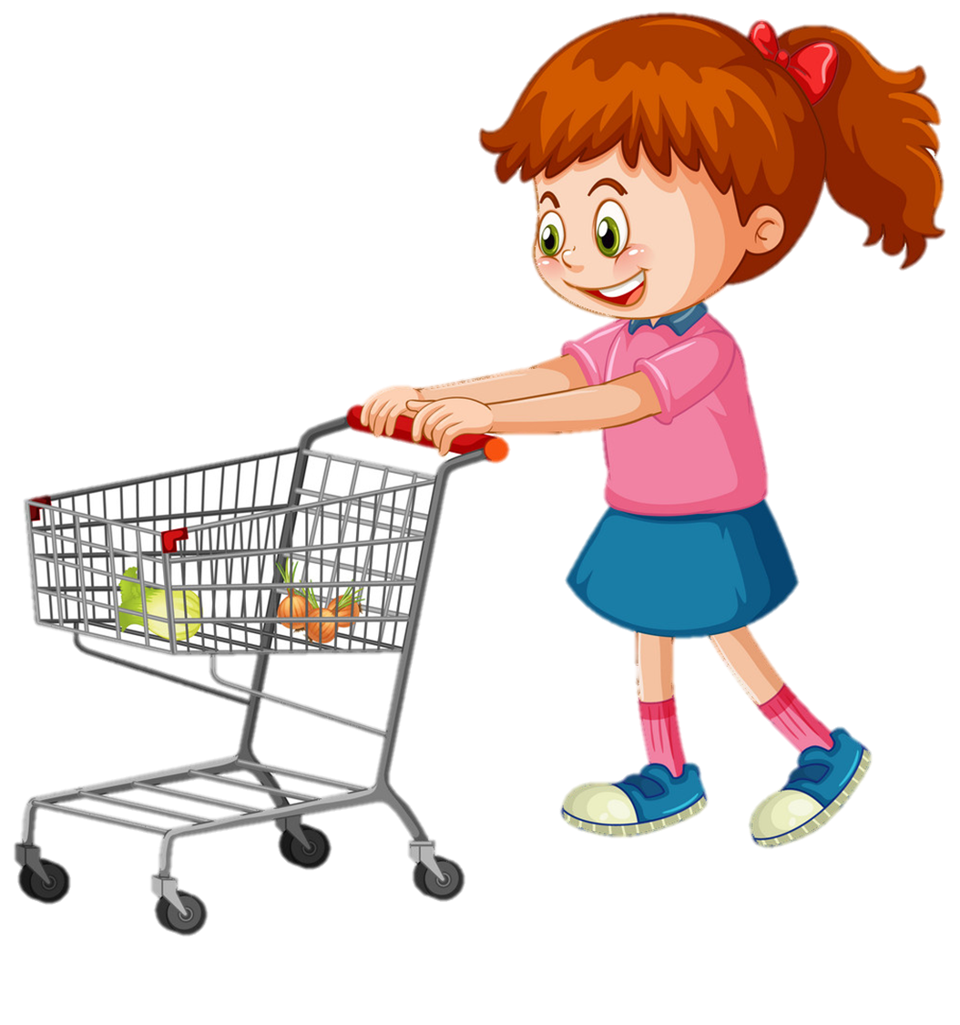
supermarket
/ˈsuːpəmɑːkɪt/

Slide 5
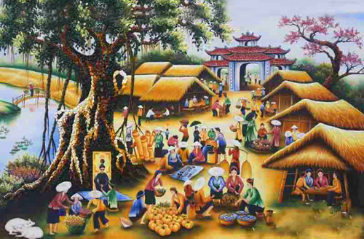
Vocabulary
market
/ˈmɑːrkɪt/

Slide 6
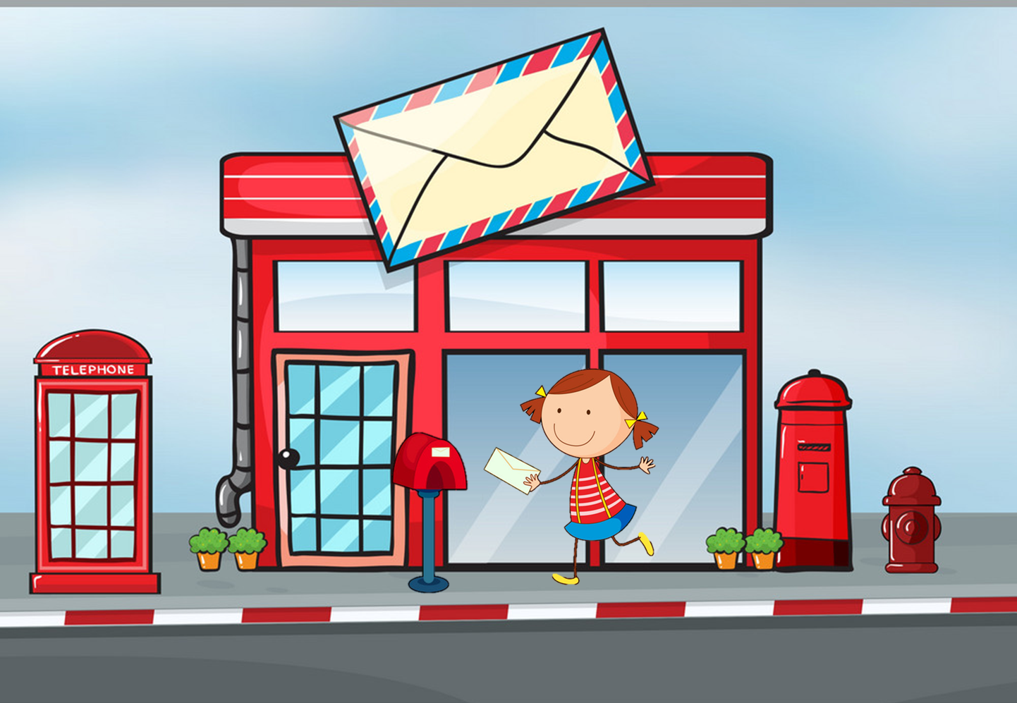
Vocabulary
Post office
/ˈpəʊst ɑːfɪs/

Slide 7
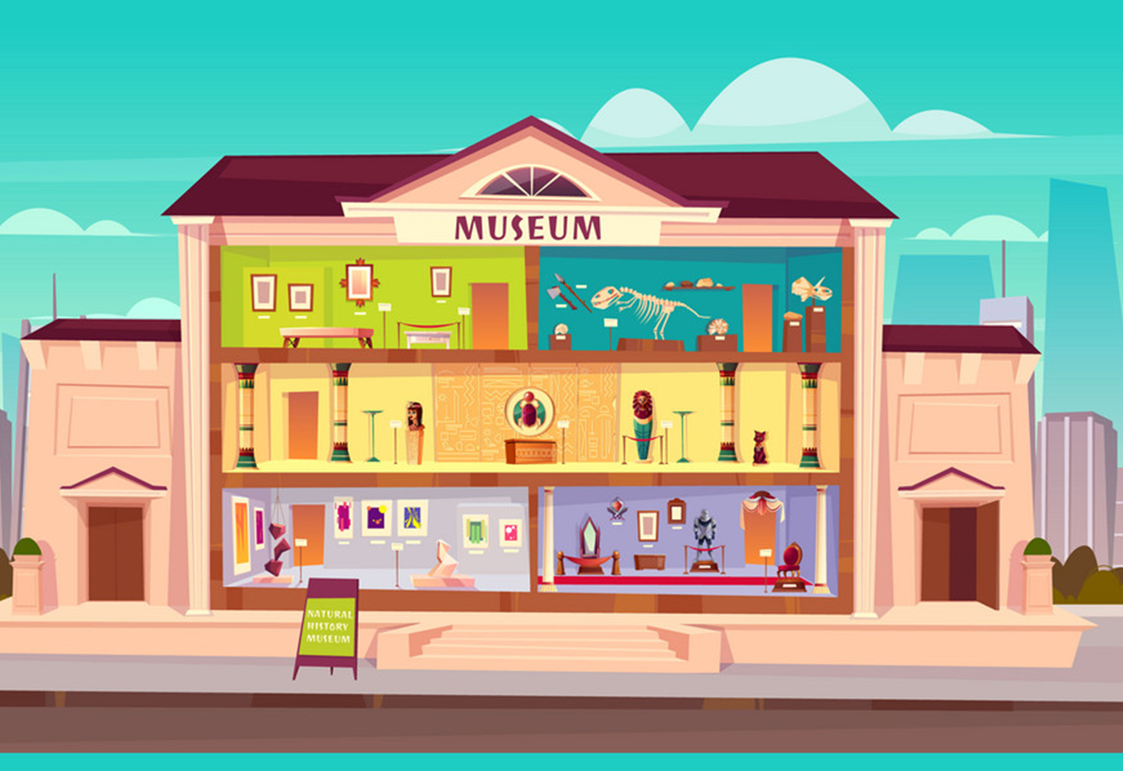
Vocabulary
Museum
/mjuˈziːəm/

Slide 8
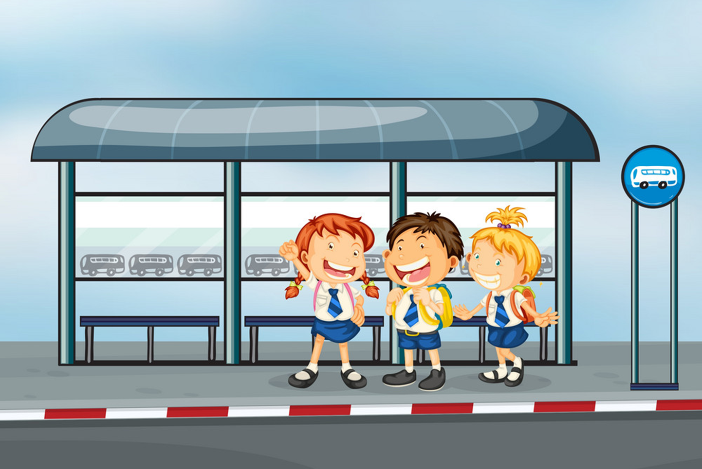
Vocabulary
Bus stop
/ˈbʌs stɑːp/

Slide 9
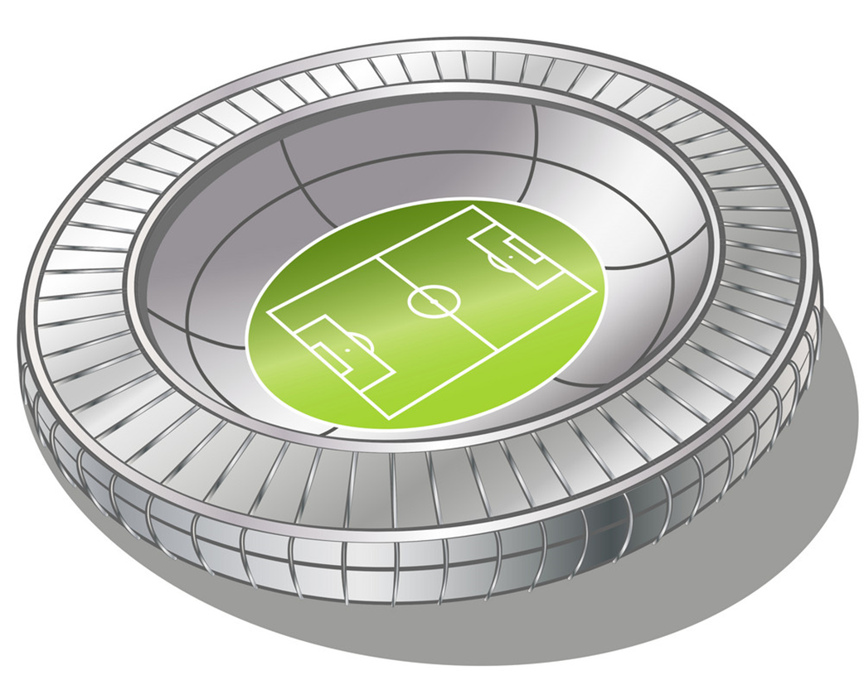
Vocabulary
Stadium
/ˈsteɪdiəm/

Slide 10
Vocabulary
Theatre
/ˈθiːətər/

Slide 11
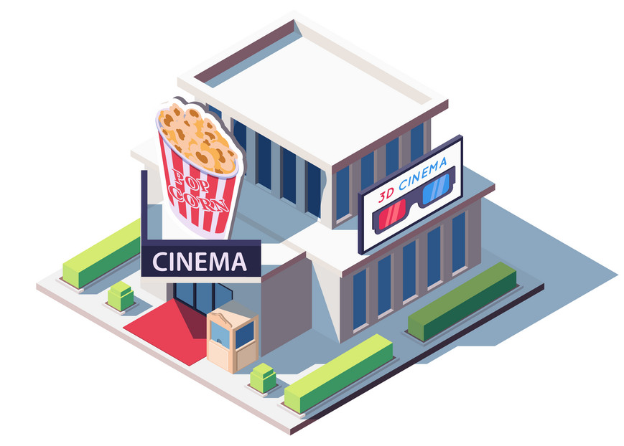
Vocabulary
cinema
/ˈsɪnəmə/

Slide 12
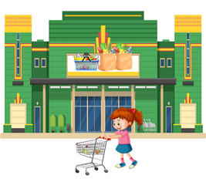
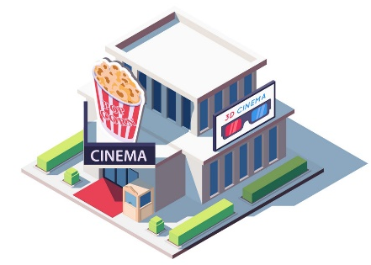
Vocabulary
museum
post office
bus stop
supermarket
market
pharmacy
theatre
cinema
stadium

Slide 13
Vocabulary
Over there
/ˌəʊvər ˈðer/
: Ở đằng kia
Near
/nɪr/
: Ở gần
Opposite
/ˈɑːpəzɪt/
: Đối diện
Between
/bɪˈtwiːn/
: Ở giữa
Next to
/ˈnekst tu/
: Bên cạnh
At the end
/ ət ði end əv/
: Ở cuối
On the corner
/ɒn ðə kɔːrnər əv/
: Ở góc

Slide 14
Look and say
between

Slide 15
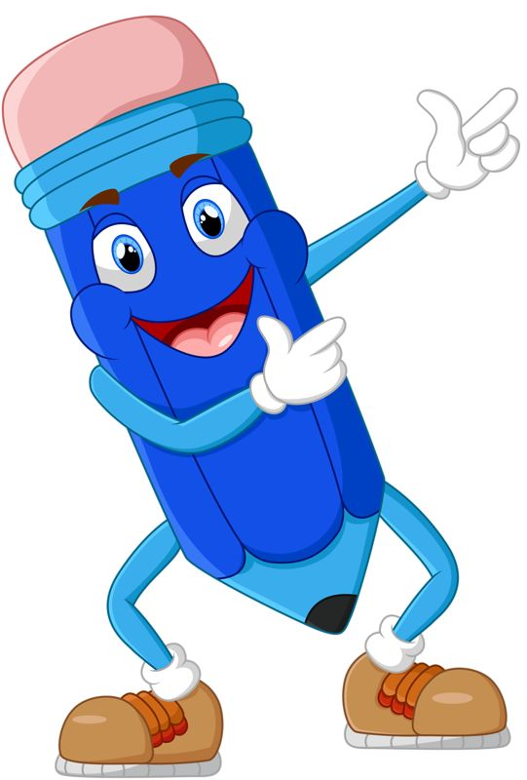
Look and say
over there

Slide 16
Look and say
start
At the end

Slide 17
Look and say
opposite

Slide 18
Look and say
next to

Slide 19
Look and say
On the corner

Slide 20
Look and say
near

Slide 21
Vocabulary
Turn left
/tɜːrn left/
: Rẽ trái
Turn right
/tɜːrn raɪt/
: Rẽ phải
Go straight
/ɡəʊ streɪt/
: Đi thẳng
Go ahead
/ɡəʊ əˈhed/
: Đi về phía trước
Go along
/ɡəʊ əˈlɔːŋ/
: Đi dọc theo

Slide 22
Read and match
Turn right
Đi về phía trước
Go ahead
Rẽ trái
Go along
Rẽ phải
Turn left
Đi thẳng
Go straight
Đi dọc theo

Slide 23
GRAMMAR

Slide 24
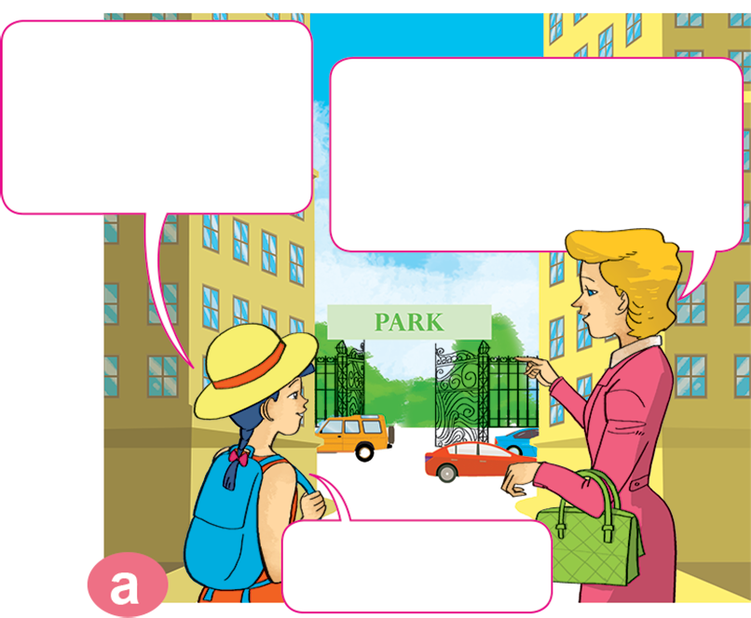
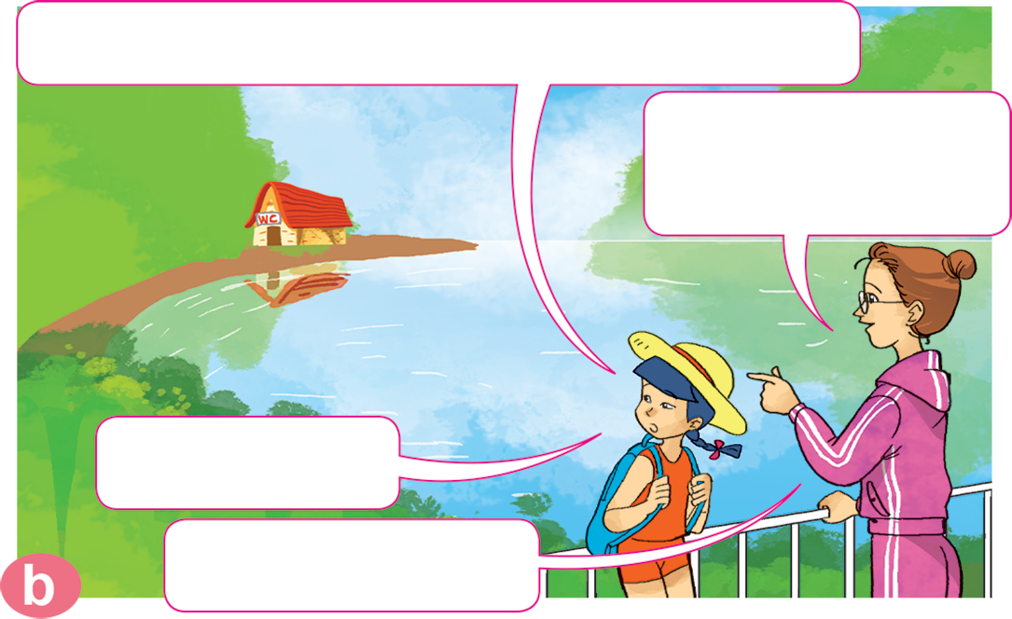
1. Look, listen and repeat.
Excuse me, where's the toilet, please?
Excuse me, where's the park, please?
Go straight ahead. It's at the end of the street.
It's over there, near the lake.
Thanks a lot.
Thank you.
You're welcome.

Slide 25
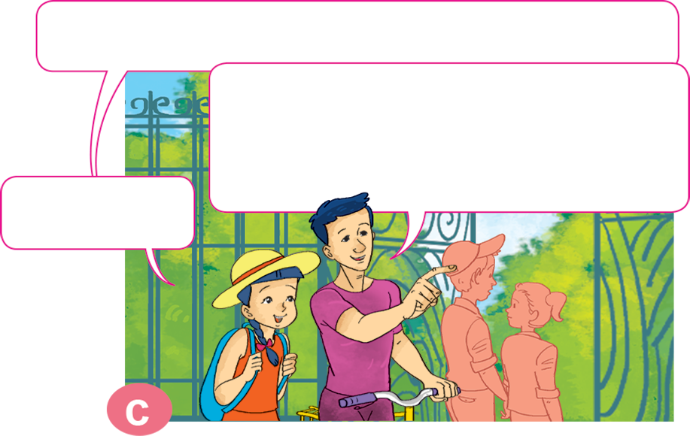
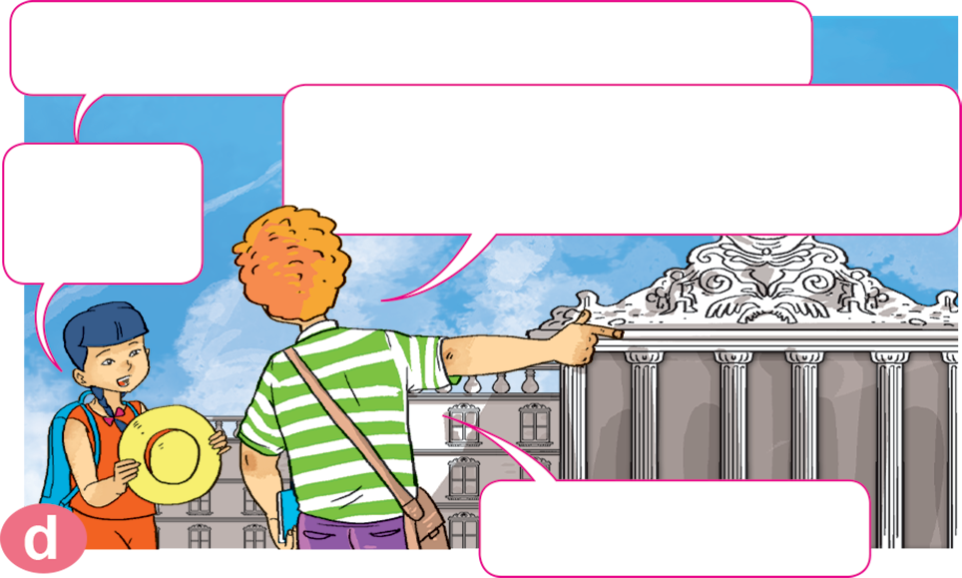
1. Look, listen and repeat.
Excuse me, is the museum near here?
Excuse me, where's the post office?
No, it isn't. Turn left. It's on the corner of the street, next to the theatre.
Turn right. It's between the supermarket and the cinema.
Thanks a lot.
Thank you.
Thank you.
You're welcome.

Slide 26
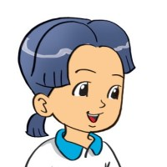
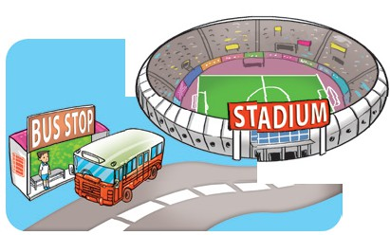
2. Point and say.
Excuse me, where's the ____________?
the bus stop
It's _______ ___________.
next to
the stadium
Excuse me, where's the bus stop?
It's next to the stadium.

Slide 27
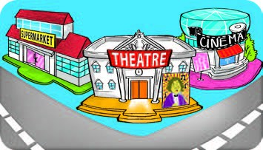
2. Point and say.
Excuse me, where's the ____________?
theatre
It's ________ ______________________.
between
cinema and supermarket
Excuse me, where's the bus stop?
It's next to the stadium.

Slide 28
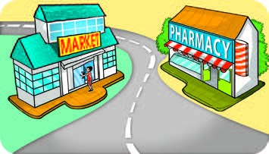
2. Point and say.
Excuse me, where's the ____________?
pharmacy
It's _________ ___________.
opposite
market
Excuse me, where's the bus stop?
It's next to the stadium.

Slide 29
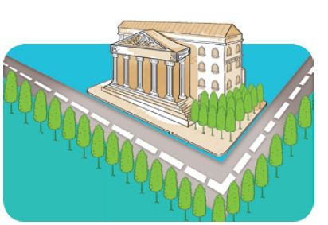
2. Point and say.
Excuse me, where's the ____________?
museum
It's _______________ _________.
on the corner of
the street
Excuse me, where's the bus stop?
It's next to the stadium.

Slide 30
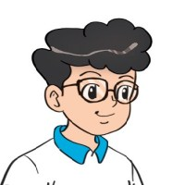
3. Let’s talk.
Where's the _____?
It's next to/opposite _____.
It's between _____and _____.
It's on the corner of _____.
Turn right/left _____.

Slide 31
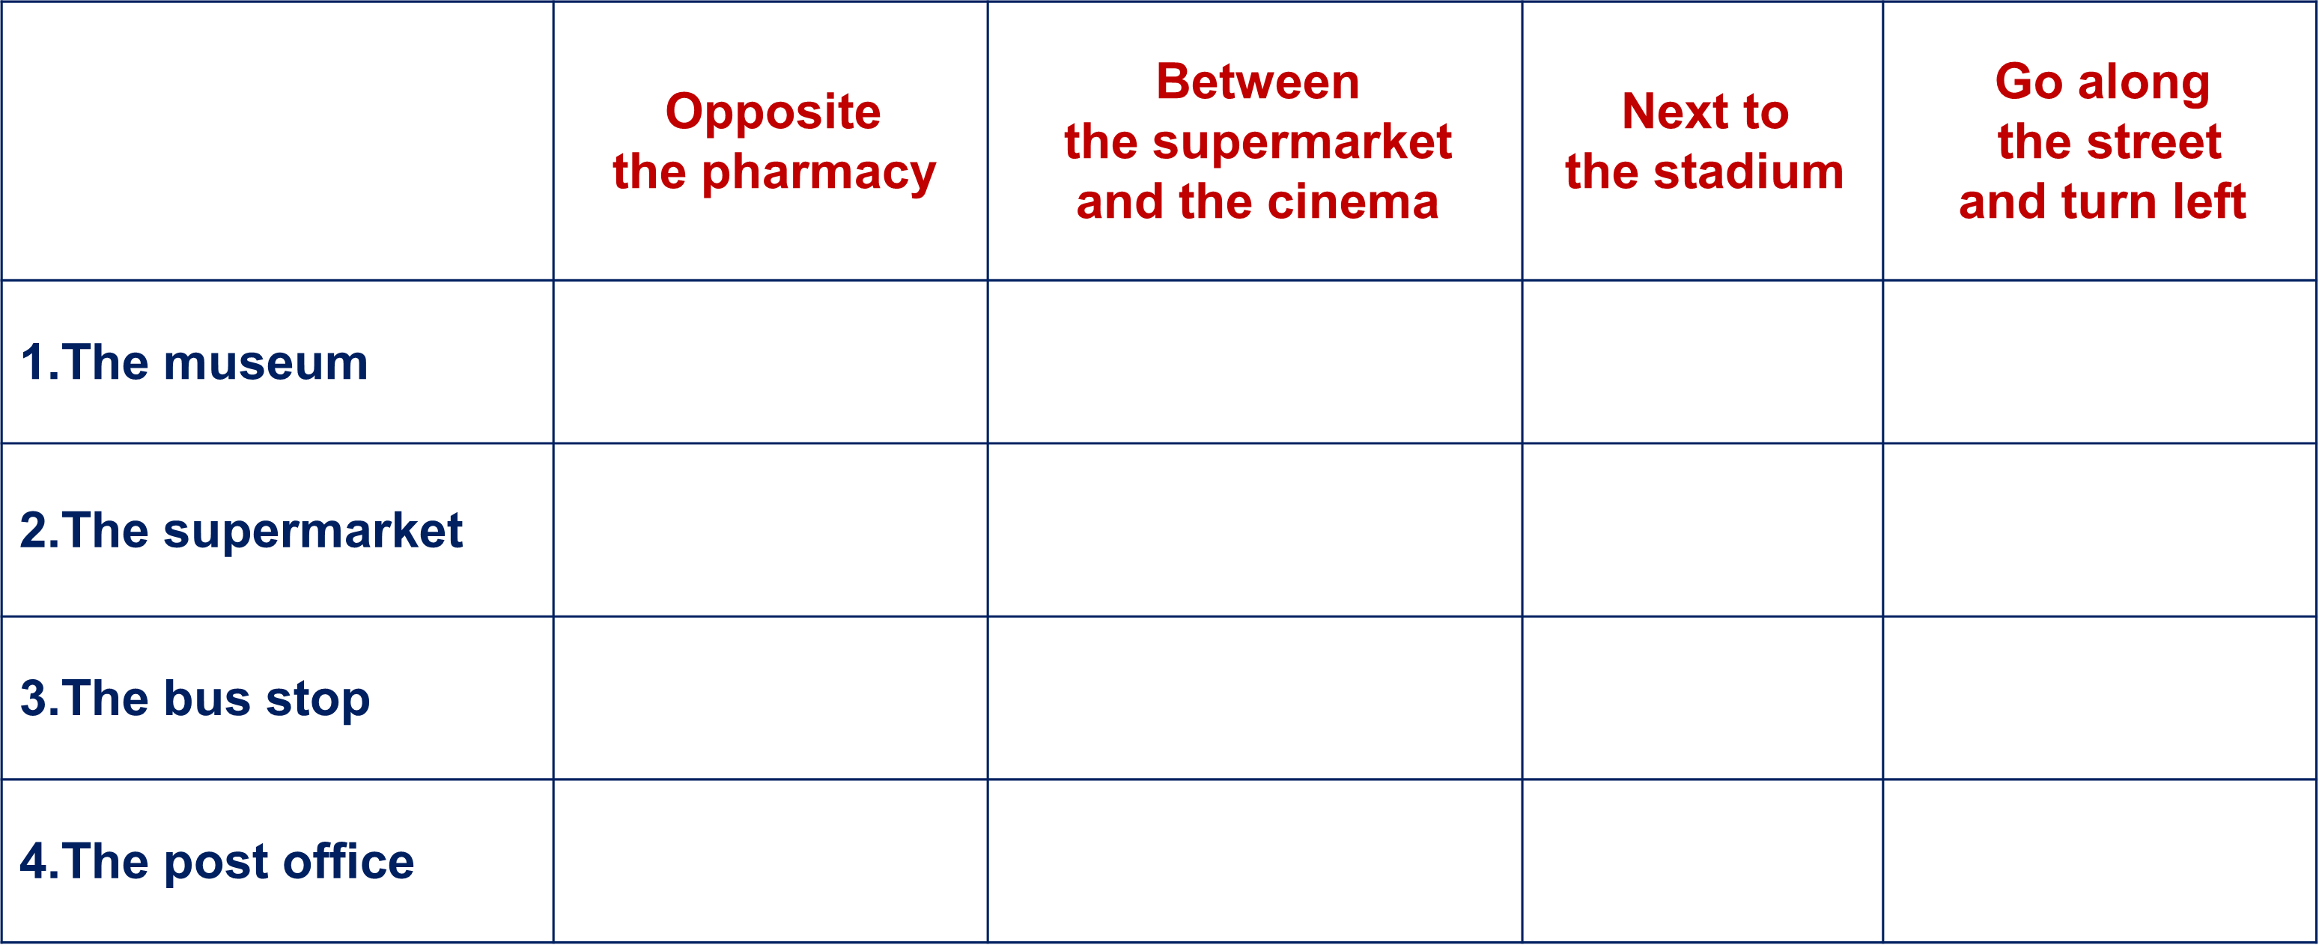
4. Listen and tick.

Slide 32
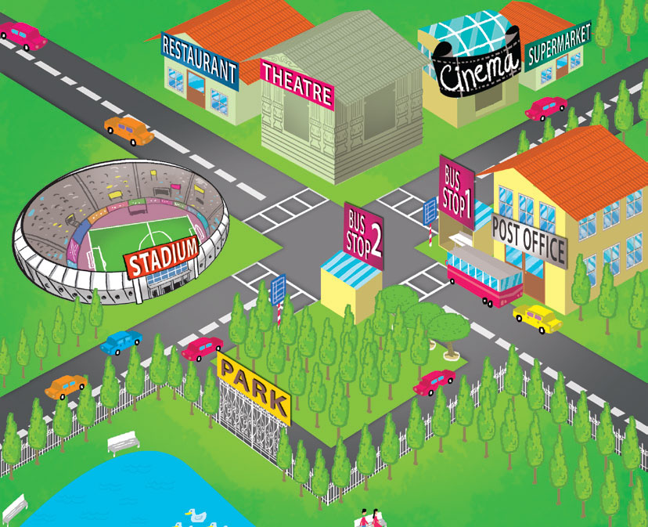
5. Look, read and complete.
1. The theatre is _____________ the stadium.
2. The cinema is __________ the theatre and the supermarket.
3. The stadium is ___________ of the street.
4. Bus stop 1 is _____________ Bus stop 2.
5. The post office is __________ Bus stop 1.
opposite
on the corner
opposite
opposite
next to
between
between
on the corner
opposite
next to

Slide 33
6. Let’s sing.

