Slide 1
Unit 16
WHERE’S THE POST OFFICE?
Lesson 2

Slide 2
VOCABULARY

Slide 3
Vocabulary
take a boat
/teɪk ə bəʊt/

Slide 4
Vocabulary
take a coach
/teɪk ə kəʊtʃ/

Slide 5
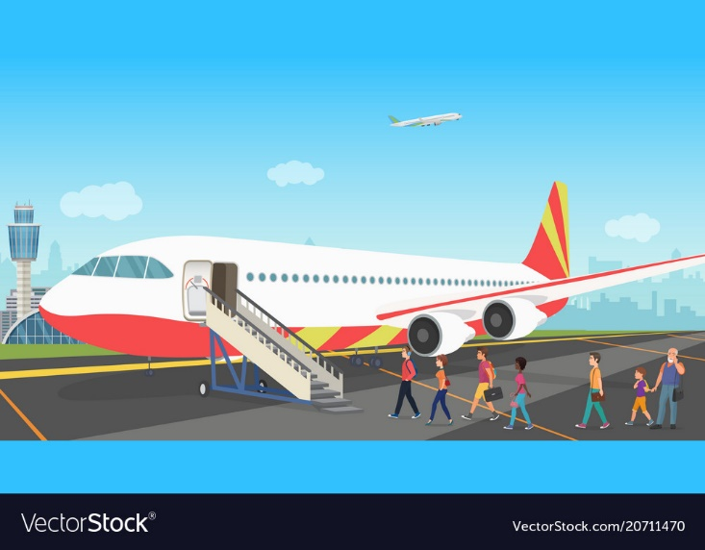
Vocabulary
go by plane
/ ɡəʊ baɪ pleɪn/

Slide 6
Vocabulary
on foot
/ ɒn fʊt /
walk
/wɔːk/

Slide 7
GRAMMAR

Slide 8
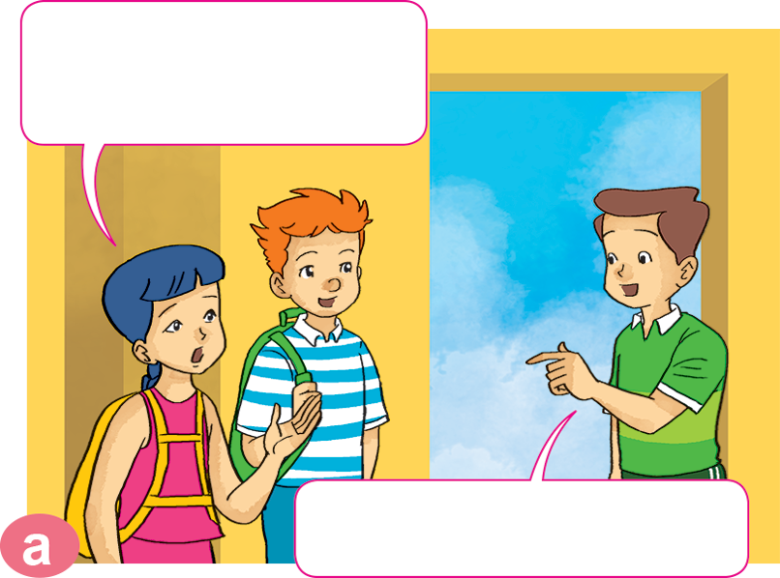
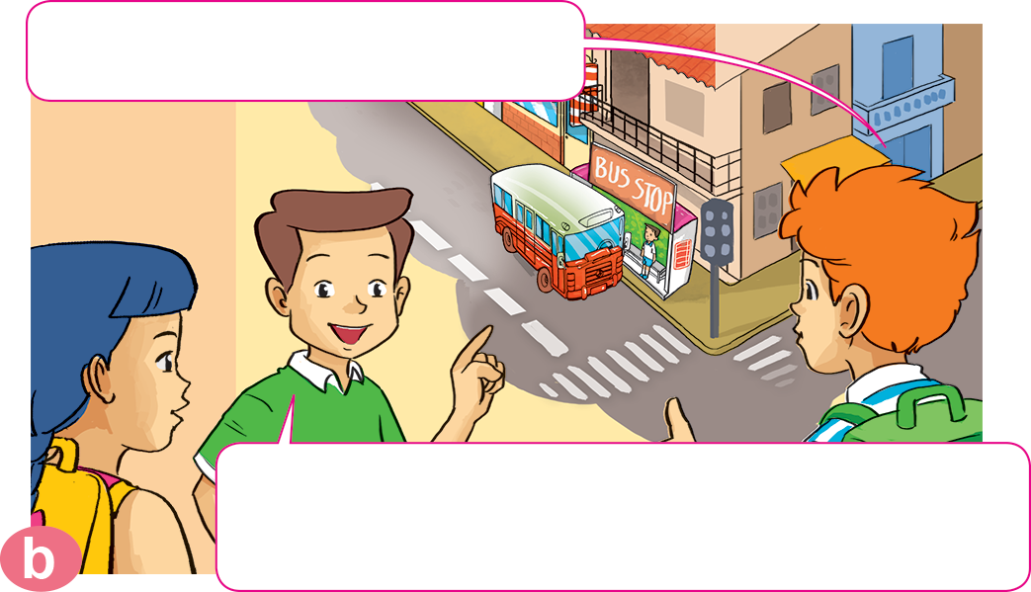
1. Look, listen and repeat.
How can we get to the zoo, Nam?
Where's the bus stop?
Go out of this building. Turn right. It's on the next corner.
You can take a bus.

Slide 9
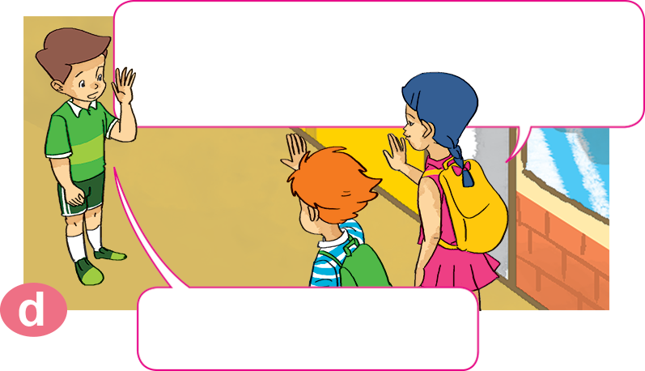
1. Look, listen and repeat.
What bus goes to the zoo?
It's very kind of you, Nam.
Thanks a lot.
You can take bus number 22. It stops right at the zoo entrance.
You're welcome.

Slide 10
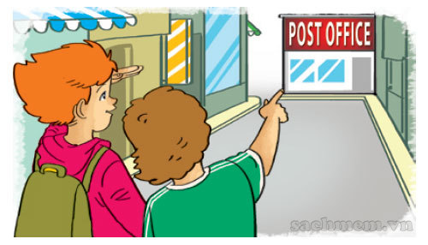
2. Point and say.
How can I get to _________________?
the post office
You can __________________.
walk for five minutes
Excuse me, where's the bus stop?
It's next to the stadium.

Slide 11
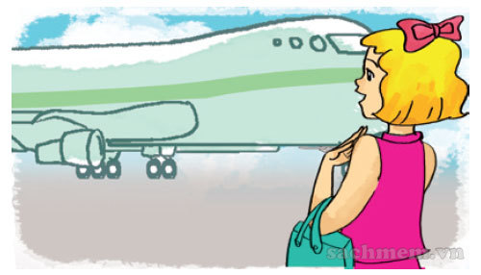
2. Point and say.
How can I get to _________________?
Phu Quoc Island
You can ______________.
take a boat
Excuse me, where's the bus stop?
It's next to the stadium.

Slide 12
2. Point and say.
How can I get to _________________?
Sa Pa
You can ______________.
take a coach
Excuse me, where's the bus stop?
It's next to the stadium.

Slide 13
2. Point and say.
How can I get to _________________?
Ho Chi Minh city
You can ______________.
go by plane
Excuse me, where's the bus stop?
It's next to the stadium.

Slide 14
3. Let’s talk.
the supermarket
How can I get to _____________________?
You can _______________________.

Slide 15
3. Let’s talk.
Ha Noi
How can I get to _____________________?
You can _______________________.

Slide 16
3. Let’s talk.
the cinema
How can I get to _____________________?
You can _______________________.

Slide 17
3. Let’s talk.
How can I get to _____________________?
Ho Chi Minh City
You can _______________________.

Slide 18
3. Let’s talk.
How can I get to _____________________?
the post office
You can _______________________.

Slide 19
3. Let’s talk.
Singapore
How can I get to _____________________?
You can _______________________.

Slide 20
4. Listen and write one word in each box
4
3
How can they get there? | By
1. Akiko
2. Tony
3. Mai
4. Linda
boat
1
2
taxi
coach
plane

Slide 21
5. Read and complete. Then say aloud.
1
trip
Mai: We're going to have a school (1) _______ next weekend.
Akiko: Where are you going?
Mai: We're going to the (2) _______.
Akiko: Is it far from your school?
Mai: No, it isn't.
Akiko: How are you going to get there?
Mai: On (3) _______.
zoo
have
foot
how
welcome
trip
zoo
foot

Slide 22
5. Read and complete. Then say aloud.
2
zoo
have
foot
how
welcome
trip
Tony: I'll go to Ho Chi Minh City tomorrow.
Mai: (4) _______ are you going to get there?
Tony: By plane because I don't have much time.
Mai: (5) _______ a nice trip!
Tony: Thanks a lot, Mai.
Mai: You're (6) _______.
How
Have
welcome

Slide 23
Ms Huyền Phạm
0936.082.789
Ms Huyền Phạm
0936.082.789
Ms Huyền Phạm
0936.082.789
Ms Huyền Phạm - 0936.082.789 – YOUTUBE: MsPham. Facebook: Dạy và học cùng công nghệ.
Ms Huyền Phạm
0936.082.789
Notes:
Ms Huyền Phạm - 0936.082.789 – YOUTUBE: MsPham. Facebook: Dạy và học cùng công nghệ.

Slide 24
How can I get to the post office?
Next
You can walking.
I am walk.
I can walk.
You can walk.
Notes:
Ms Huyền Phạm - 0936.082.789 – YOUTUBE: MsPham. Facebook: Dạy và học cùng công nghệ.

Slide 25
How can I get to Ho Chi Minh city?
Next
You can go
on plane.
You can go
a plane.
You can go
by plane.
You can go
to plane.
Notes:
Ms Huyền Phạm - 0936.082.789 – YOUTUBE: MsPham. Facebook: Dạy và học cùng công nghệ.

Slide 26
You can take a bus.
Next
What can I get to school?
How can I get to school?
Why can I get to school?
When can I get to school?
Notes:
Ms Huyền Phạm - 0936.082.789 – YOUTUBE: MsPham. Facebook: Dạy và học cùng công nghệ.

Slide 27
You can go on foot.
Next
How can I get the museum?
How I get to the museum?
How can I get to the museum?
How can I to the museum?
Notes:
Ms Huyền Phạm - 0936.082.789 – YOUTUBE: MsPham. Facebook: Dạy và học cùng công nghệ.

Slide 28
How can I get ___ Phu Quoc Island?
You can take a boat.
Next
a
the
go
to
Notes:
Ms Huyền Phạm - 0936.082.789 – YOUTUBE: MsPham. Facebook: Dạy và học cùng công nghệ.

Slide 29
Notes:
Ms Huyền Phạm - 0936.082.789 – YOUTUBE: MsPham. Facebook: Dạy và học cùng công nghệ.

