Slide 1

Unit 4: HOME
Lesson 4.1 Review and practice
Page 64

Slide 2
Lesson Outline
Warm-up
Listening
Reading
Consolidation
Wrap-up

Slide 3
Objectives
By the end of this lesson, students will be able to review asking where people are, asking what people are doing, asking where things are and talking about their homes.

Slide 4

WARM UP

Slide 5

Reading

Slide 6

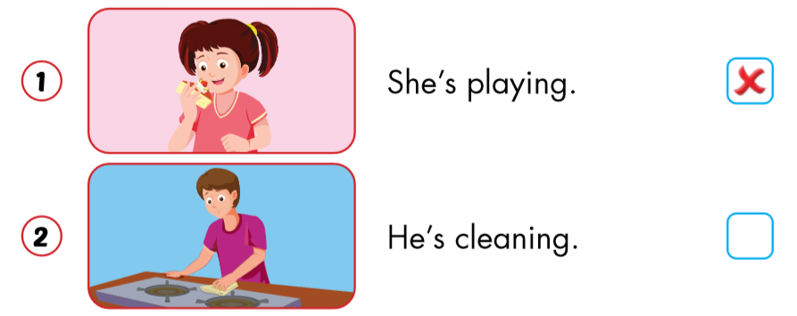


Slide 7
