Slide 1
Unit 10
Where were you yesterday?
Lesson 1

Slide 2
VOCABULARY

Slide 3
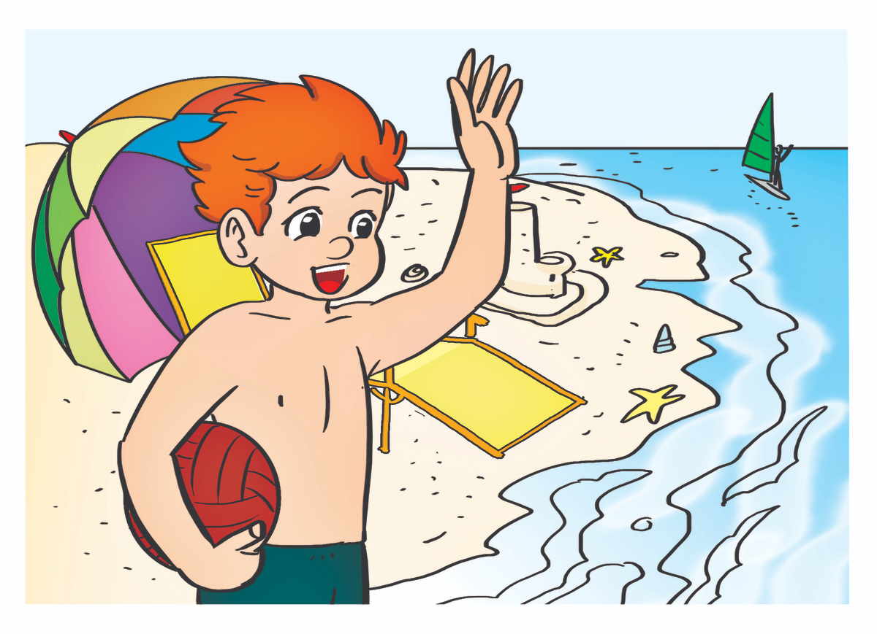
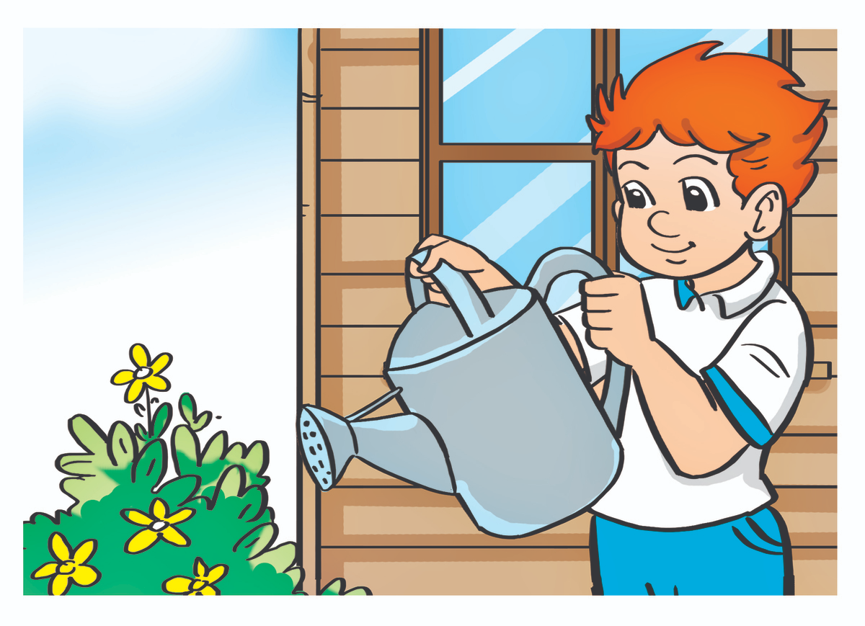
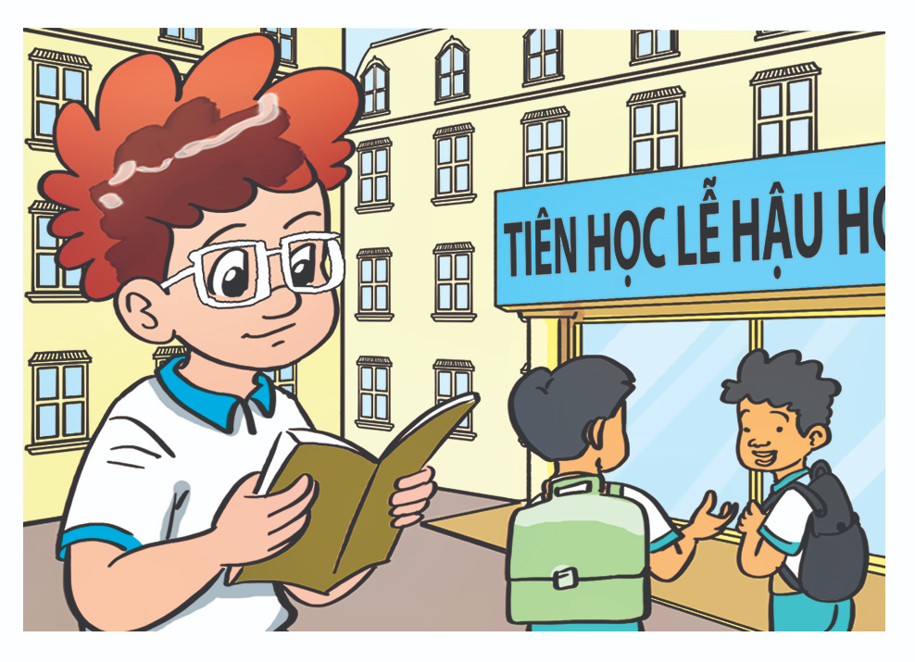
Verd – (v)
A. Vocabulary
at the zoo
on the beach
in the school library
Ở sở thú
Ở bãi biển
Ở thư viện trường
Yesterday
at home
at school
/ˈjestərdeɪ/
Ở nhà
Ở trường
Hôm qua

Slide 4
at
A. Vocabulary
at
at
_____ the zoo
Yesterday
____ school
_________
Ở sở thú
in
on
at
___ the school library
_____ the beach
____ home

Slide 5
GRAMMAR

Slide 6
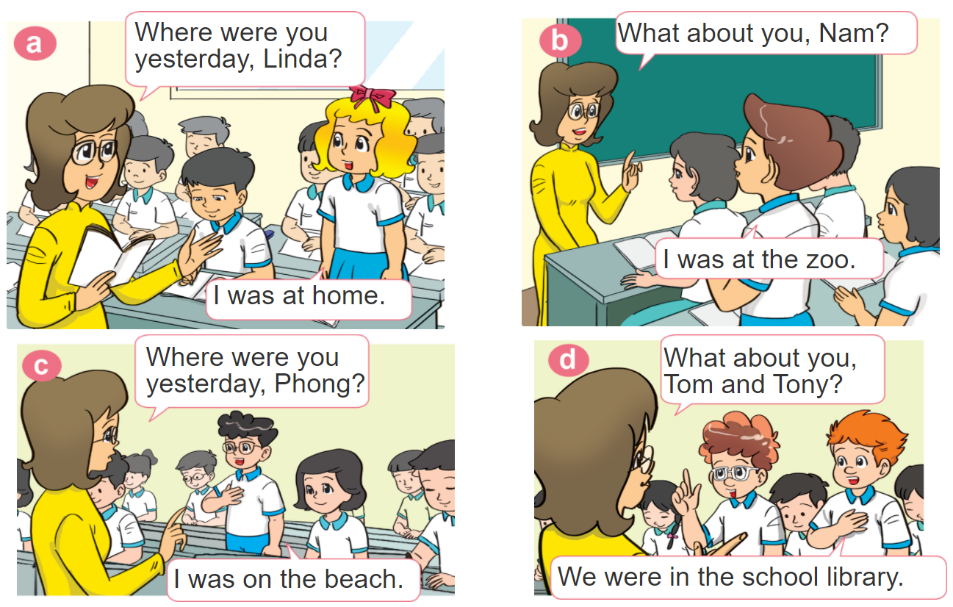
1. Look, listen and repeat.

Slide 7
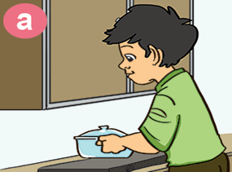
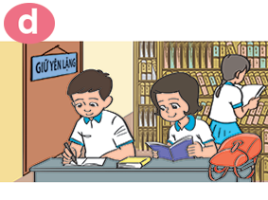
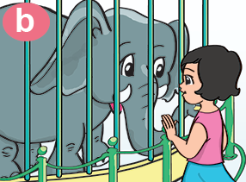
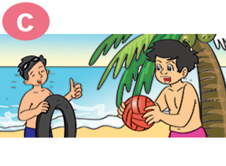
2. Point and say
Where were you yesterday?
I was _________.
at home
in the
school libray
at the zoo
on the beach

Slide 8
B. Grammar
Hỏi và trả lời bạn đã ở đâu:
(Bạn đã ở đâu ngày hôm qua?)
Where were you yesterday?
I was _______________.
+ cụm từ chỉ địa điểm
(Tớ đã ở ___________)

Slide 9
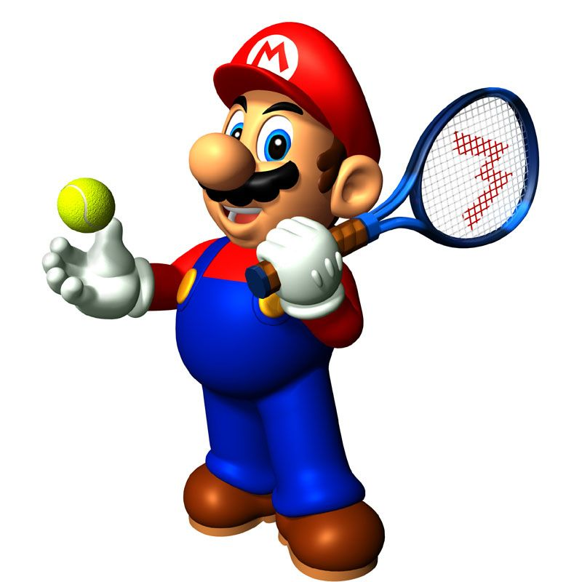

Slide 10
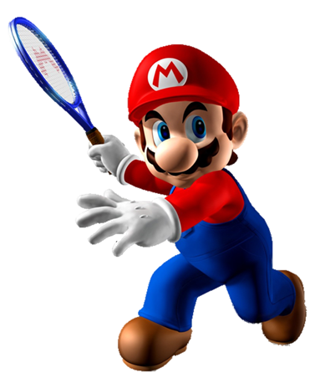
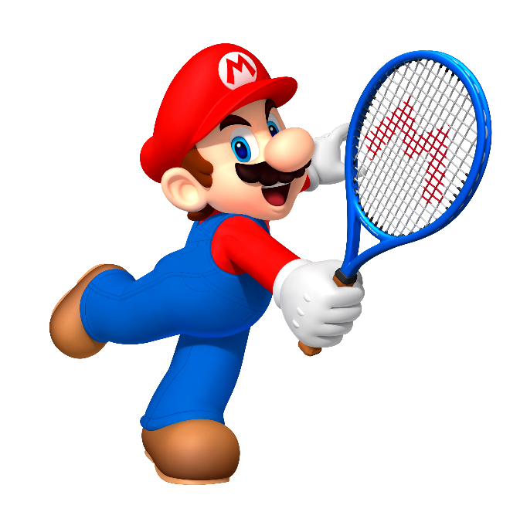
I was at home.
Where were you yesterday?
I was at school.
I wants

Slide 11
I was at school.
Where were you yesterday?
I was at the zoo.
Intelligent

Slide 12
Next
I was on the beach.
Where were you yesterday?
I was in the school library.

Slide 13
I was on the beach.
Where were you yesterday?
do
I was at the zoo.

Slide 14
I was at the zoo.
Where were you yesterday?
I was at home.
cat

Slide 15
at
on
Where were you yesterday?
I was ___ the school library.
in

Slide 16
are
was
Where _____ you yesterday?
I was at school.
were

Slide 17
am
was
Where were you yesterday?
I _____ on the beach.
were

Slide 18
Yesterday
Today
Where were you _________?
Sunday

Slide 19
Time’s up!

Slide 20
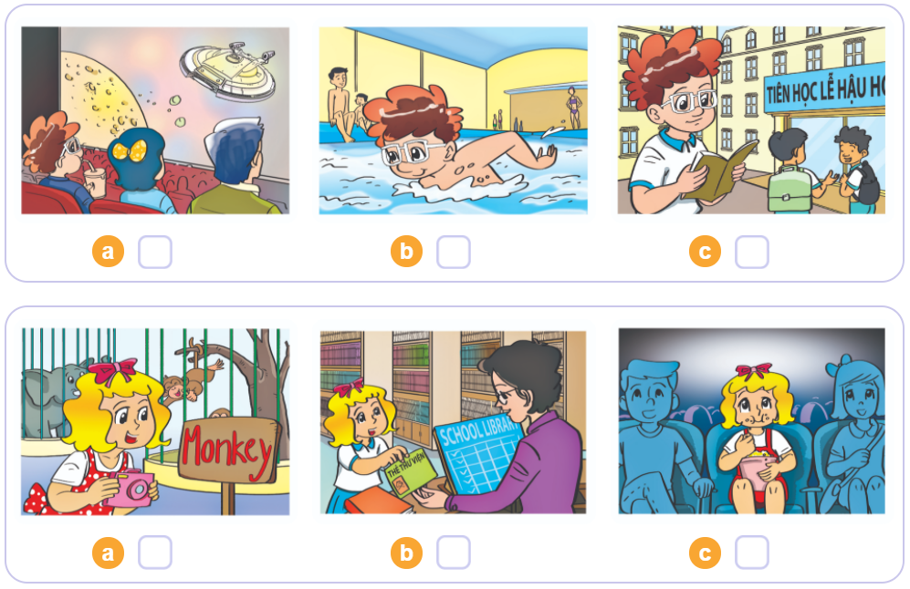
3. Listen and tick
1
2
3

Slide 21
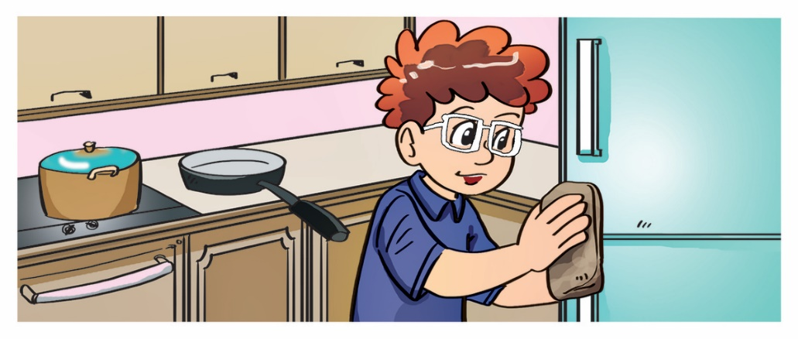
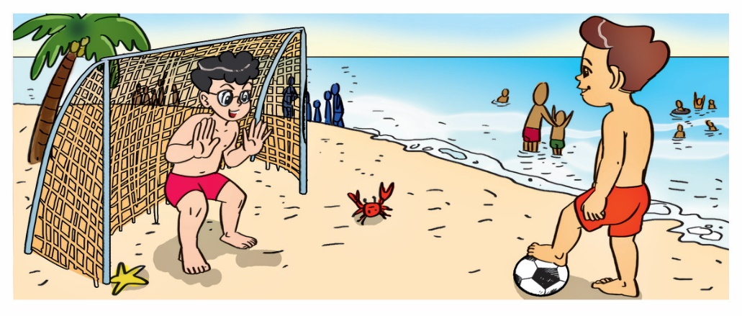
4. Look and write
1. A: Where was Tom yesterday?
B: He was at home. / in the kitchen.
___________.
2. A: Where was Linda yesterday?
B: She was in the library / at school.
_____________.
3. A: Where were Phong and Nam yesterday?
B: They were on the beach.
_________________.

Slide 22
5. Let’s sing

Slide 23
THANK YOU!
Welcome to join with me!
MsPham Powerpoint
Mspham

