Slide 1
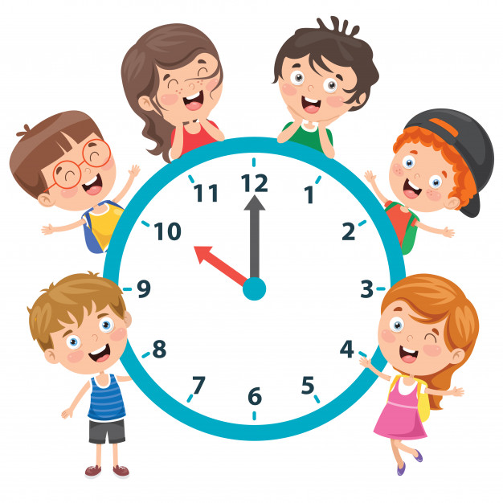
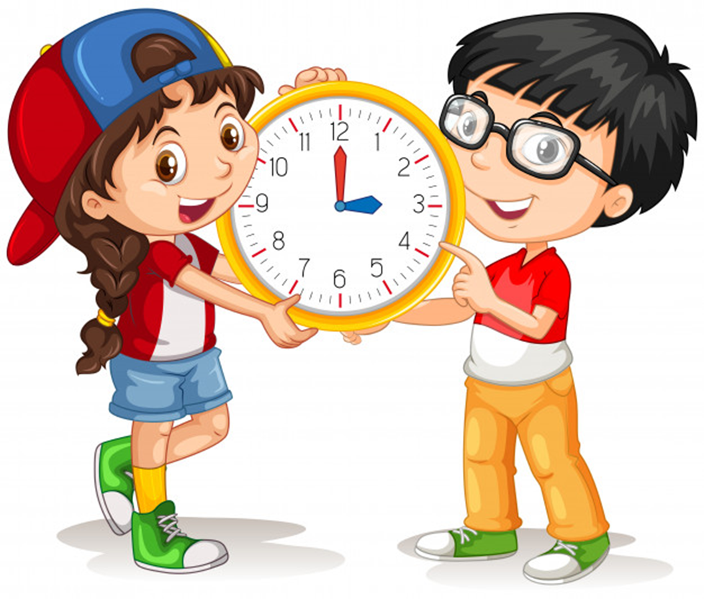
Unit 11
What time is it?
Lesson 1

Slide 2
Past: giờ hơn.
To: giờ kém.
Example:
9h21: nine twenty-one
10h30: half past ten, ten thirty.
2h11: two eleven, eleven past two
4h35: thirty-five past four/ twenty-five to five/ four thirty-five.
7h18: seven eighteen./ eighteen past seven

Slide 3
NUMBER

Slide 4
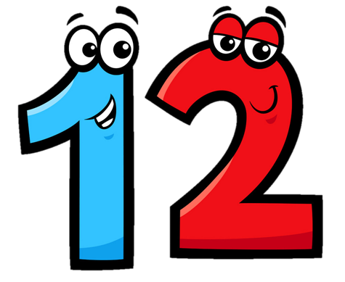
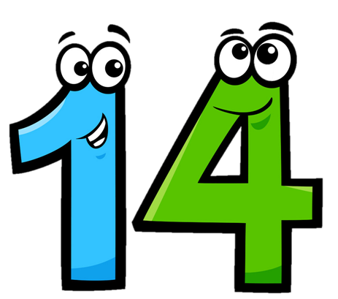
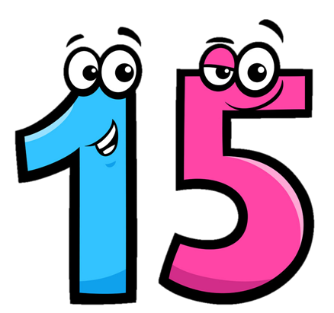
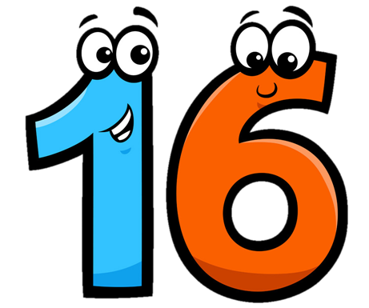
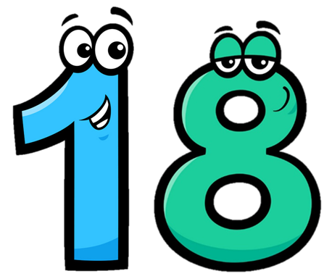
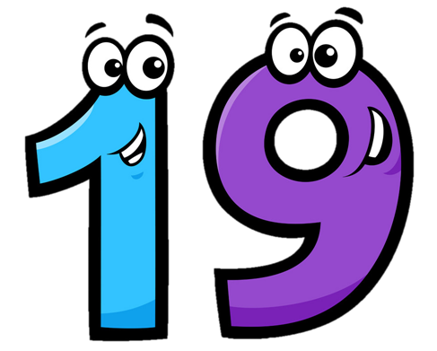
Eleven
/ɪˈlevn/
Twelve
/twelv/
Thirteen
/ˌθɜːˈtiːn/
Fourteen
/ˌfɔːˈtiːn/
Fifteen
/ˌfɪfˈtiːn/
Sixteen
/ˌsɪksˈtiːn/
Seventeen
/ˌsevnˈtiːn/
Eighteen
/ˌeɪˈtiːn/
Nineteen
/ˌnaɪnˈtiːn/

Slide 5
Choose the correct number
a
b
c
Twelve

Slide 6
Choose the correct number
a
b
c
Eleven

Slide 7
Choose the correct number
a
b
c
Fifteen

Slide 8
Choose the correct number
a
b
c
fourteen

Slide 9
Choose the correct number
a
b
c
Thirteen

Slide 10
Choose the correct number
a
b
c
Seventeen

Slide 11
Choose the correct number
a
b
c
Nineteen

Slide 12
Choose the correct number
a
b
c
Eighteen

Slide 13
Choose the correct number
a
b
c
Sixteen

Slide 14
Look read and circle
Fifteen
Sixteen
Seventeen
Eleven
Thirteen
Twelve
Eighteen
Nineteen
Sixteen

Slide 15
Look read and circle
Fifteen
Thirteen
Eighteen
Eleven
Sixteen
Twelve
Fourteen
Fifteen
Sixteen

Slide 16
Look read and circle
Eleven
Nineteen
Eighteen
Twelve
Eleven
Thirteen
Fifteen
Fourteen
Twelve

Slide 17
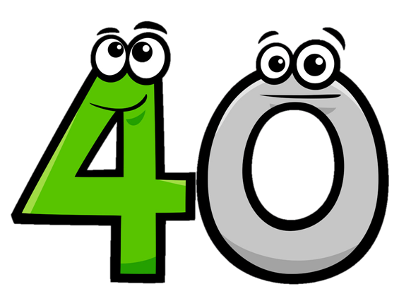
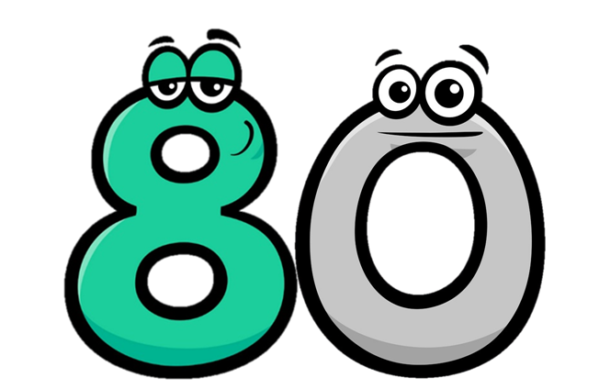
Twenty
/ˈtwenti/
Thirty
/ˈθɜːti/
Forty
/ˈfɔːti/
Fifty
/ˈfɪfti/
Seventy
/ˈsevnti/
Eighty
/ˈeɪti/
Ninety
/ˈnaɪnti/
Sixty
/ˈsɪksti/

Slide 18
Match
Forty
Thirty
Fifty
Twenty

Slide 19
Match
ninety
seventy
eighty
sixty

Slide 20
21
=
20
+
1
twenty-one
twenty
one
22
=
20
+
2
twenty-two
twenty
two

Slide 21
34
=
30
+
4
thirty-four
thirty
four
43
=
40
+
3
forty-three
forty
three

Slide 22
Look and say
15
fifteen
40
forty
20
twenty
45
forty-five
25
twenty-five
50
fifty
30
thirty
55
fifty-five
35
thirty-five

Slide 24
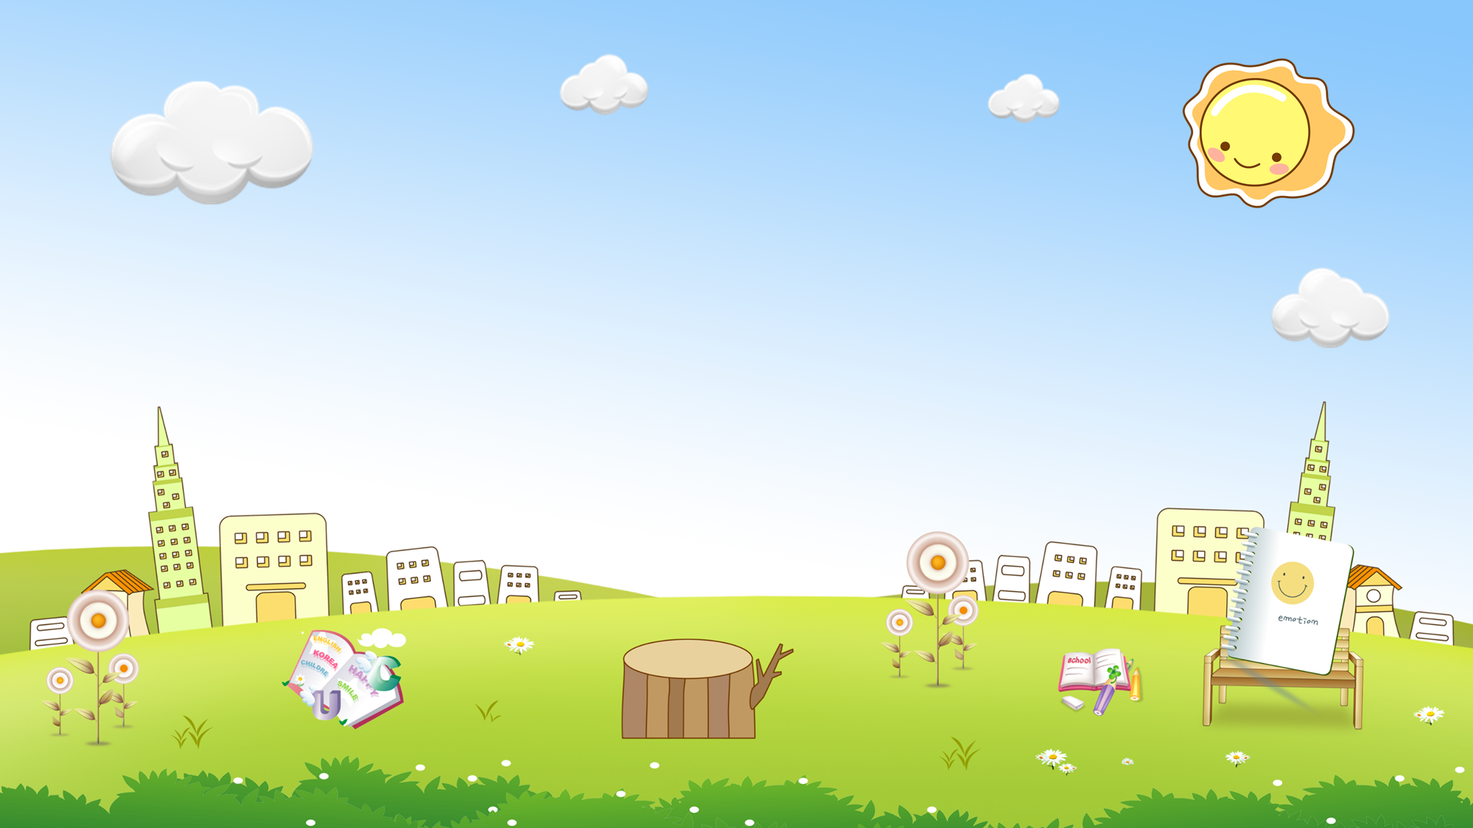
are
a. Thirteen b. Twelve
c. Eleven
a
b
c

Slide 25
old
a. Twoteen b. twenty
c. Twelve
a
b
c

Slide 26
you
a. Fifteen b. Fourteen
c. Fiveteen
a
b
c

Slide 27
old
a. Threeteen b. Thirteen
c. Thirty
a
b
c

Slide 28
are
a. Thirteen b. Twelve
c. Thirty
a
b
c

Slide 29
you
a. Fourteen b. Forteen
c. Fourty
a
b
c

Slide 30
are
a. Twelve b. Twenteen
c. Twenty
a
b
c

Slide 31
old
a. Fourty b. Forty
c. Fourteen
a
b
c

Slide 32
you
a. Fifty b. Fivety
c. Fifteen
a
b
c

Slide 33
are
a. Nine-two b. Nineteen-two
c. Ninety-two
a
b
c

Slide 34
old
a. Fifty b. Fifty-five
c. Fifteen
a
b
c

Slide 35
you
a. Eighty-six b. Sixteen
c. Eight-six
a
b
c

Slide 36
are
a. Seventeen b. Seventy
c. Seventy-three
a
b
c

Slide 37
old
a. Four-two b. Forty-two
c. Fourty-two
a
b
c

Slide 38
you
a. Thirty-one b. Eleven
c. Three-one
a
b
c

Slide 39
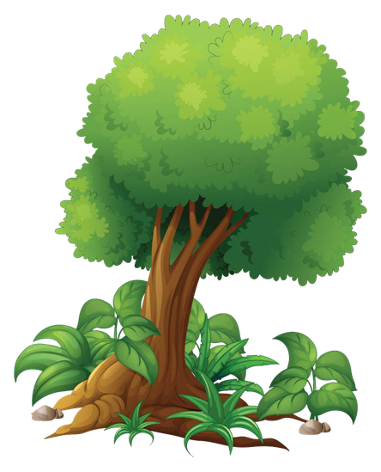
GOOD JOB!
STOP

Slide 40
GRAMMAR

Slide 41
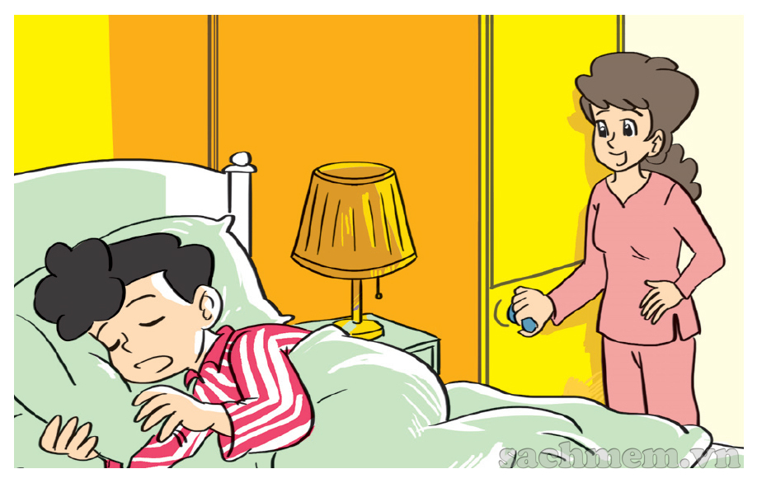
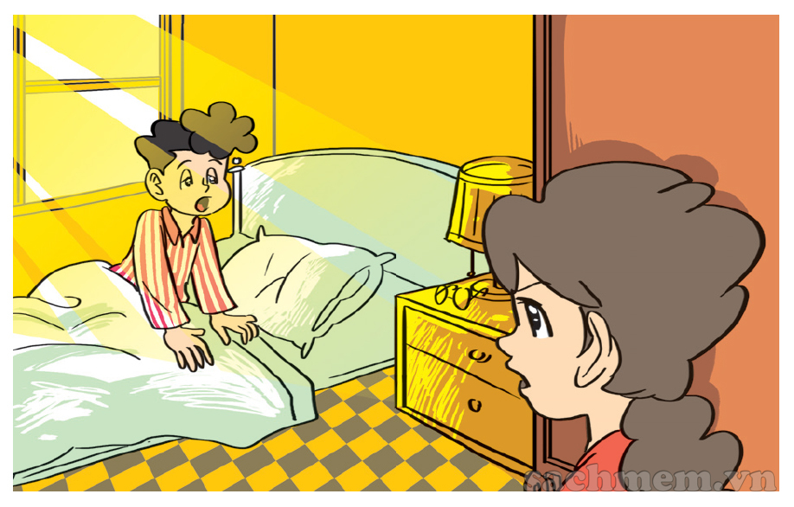
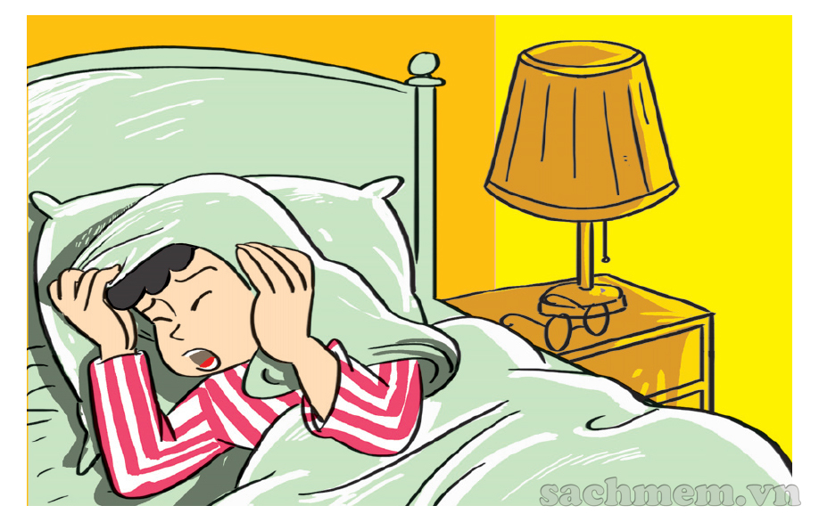
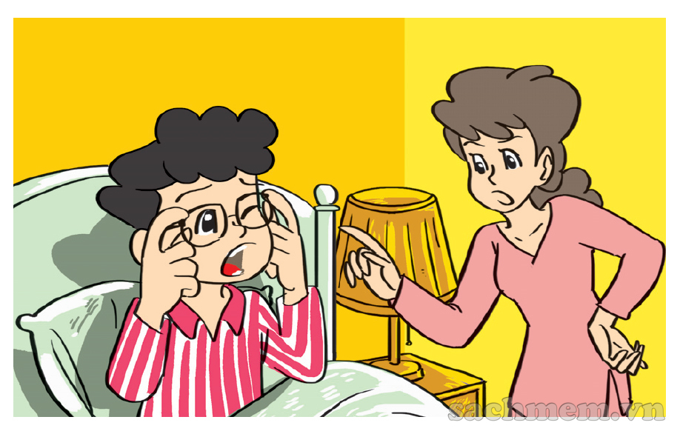
1. Look, listen and repeat.
What time is it, Mum?
It's time to get up, Phong.
It's seven o'clock
Today's Sunday and I
don't have to go to school.
But it's time
for breakfast.
Oh, yes, Mum.

Slide 42
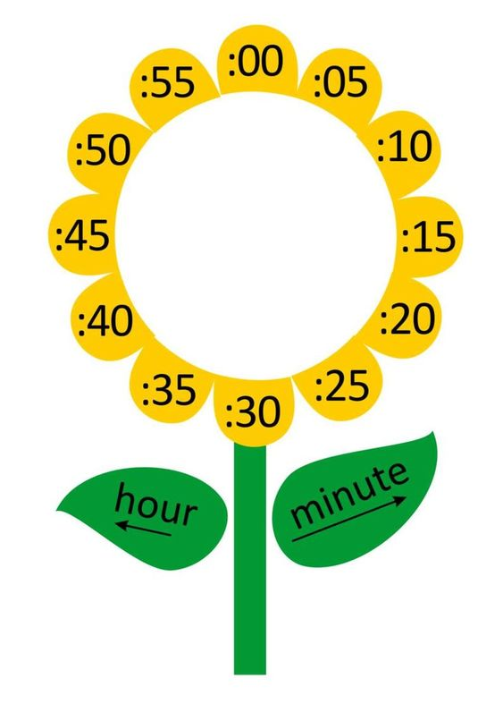
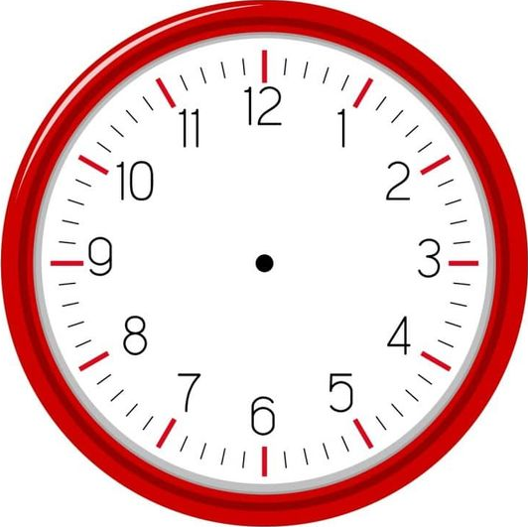
What time is it?
one
It's __________ o’clock.

Slide 43
What time is it?
two
It's __________ o’clock.

Slide 44
What time is it?
three
It's __________ o’clock.

Slide 45
What time is it?
six
It's __________ o’clock.

Slide 46
What time is it?
one
fifteen
It's _________________.

Slide 47
What time is it?
one
thirty
It's _________________.

Slide 48
What time is it?
one
forty
It's _________________.

Slide 49
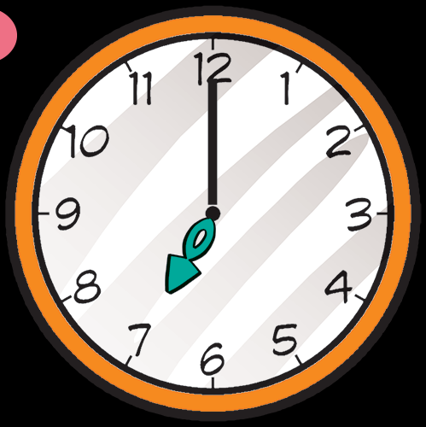
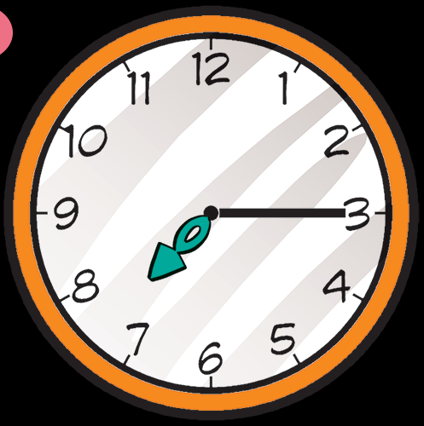
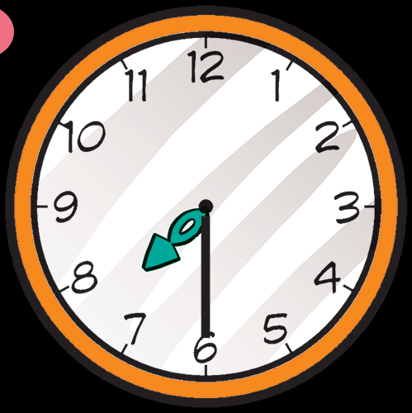
2. Point and say.
What time is it?
It's __________
It's __________
It's __________
seven o’clock.
seven fifteen.
seven thirty.

Slide 50
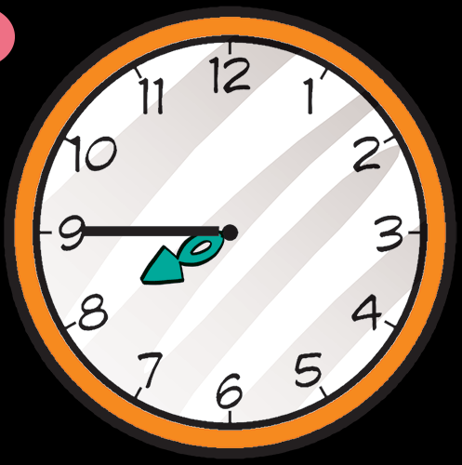
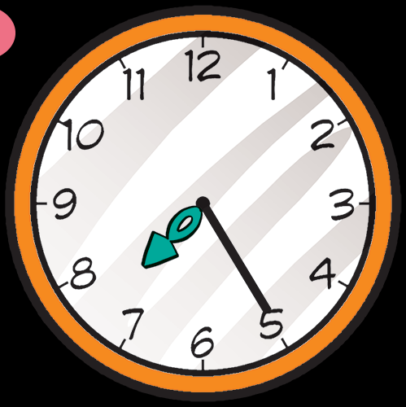
2. Point and say.
What tim is it?
It's ____________.
It's ______________.
seven forty-five
seven twenty-five

Slide 51
3. Listen and tick.
a
b
c
1

Slide 52
3. Listen and tick.
a
b
c
2

Slide 53
3. Listen and tick.
a
b
c
3

Slide 54
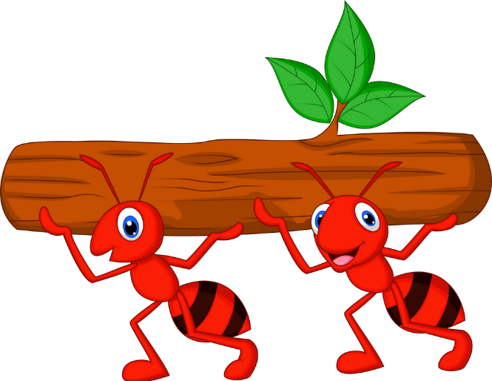
Kiến chăm chỉ
PLAY

Slide 55
____________?
It’s three o’clock.
What time is it?
Next
Notes:
Ms Huyền Phạm - 0936.082.789 – YOUTUBE: MsPham. Facebook: Dạy và học cùng công nghệ.

Slide 56
What time is it?
It’s _________.
ten o’clock.
Next
Notes:
Ms Huyền Phạm - 0936.082.789 – YOUTUBE: MsPham. Facebook: Dạy và học cùng công nghệ.

Slide 57
What time is it?
It’s _________.
Six fifteen
Next
Notes:
Ms Huyền Phạm - 0936.082.789 – YOUTUBE: MsPham. Facebook: Dạy và học cùng công nghệ.

Slide 58
_________ is it?
It’s six fifteen.
What time
Next
Notes:
Ms Huyền Phạm - 0936.082.789 – YOUTUBE: MsPham. Facebook: Dạy và học cùng công nghệ.

Slide 59
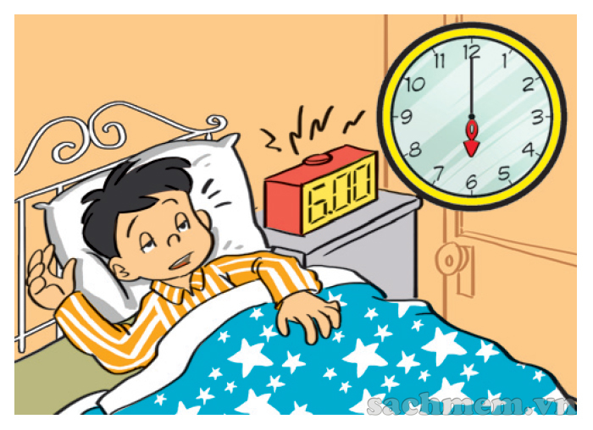
What time is it?
It’s six o’clock.
It’s twelve thirty.
It’s six o’clock.
Next
Notes:
Ms Huyền Phạm - 0936.082.789 – YOUTUBE: MsPham. Facebook: Dạy và học cùng công nghệ.

Slide 60
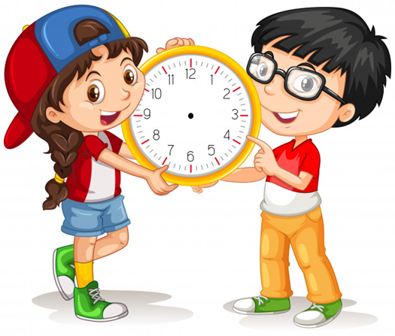
What time is it?
It’s ten thirty.
True
False
True
Next
Notes:
Ms Huyền Phạm - 0936.082.789 – YOUTUBE: MsPham. Facebook: Dạy và học cùng công nghệ.

Slide 61
What time is it?
It’s ten o’clock.
True
False
False
Next
Notes:
Ms Huyền Phạm - 0936.082.789 – YOUTUBE: MsPham. Facebook: Dạy và học cùng công nghệ.

Slide 62
WELL DONE!
EXIT
Notes:
Ms Huyền Phạm - 0936.082.789 – YOUTUBE: MsPham. Facebook: Dạy và học cùng công nghệ.

Slide 63
5. Look and write
What time is it?
What time is it?
It's four o’clock.
It's ten twenty.

Slide 64
5. Look and write
What time is it?
What time is it?
It's ten thirty.
It's eleven fifty.

Slide 65
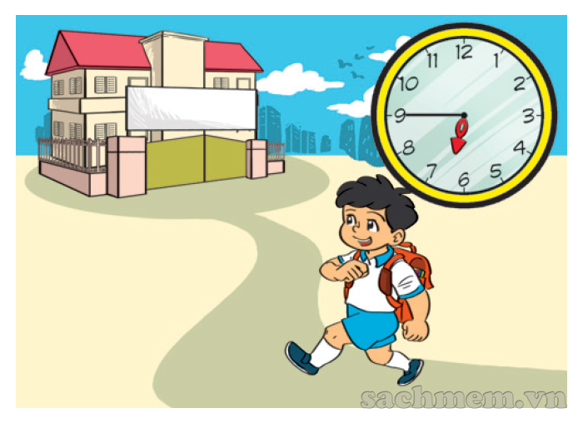
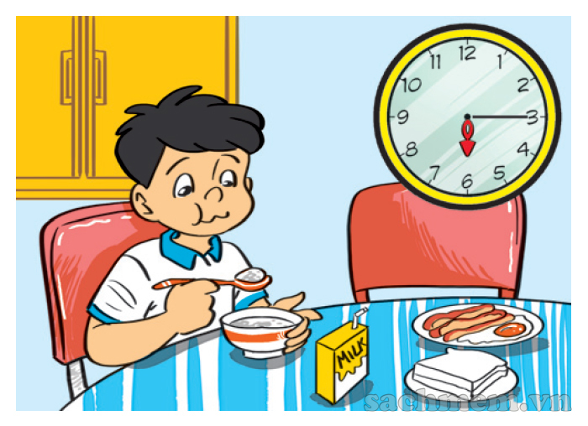
5. Let’s sing
1
2
3
a
b
c
What time is it?
It's six o'clock.
It's time to get up.
What time is it?
It's six fifteen.
It's time for breakfast.
What time is it?
It's six forty-five.
It's time for school.

Slide 66
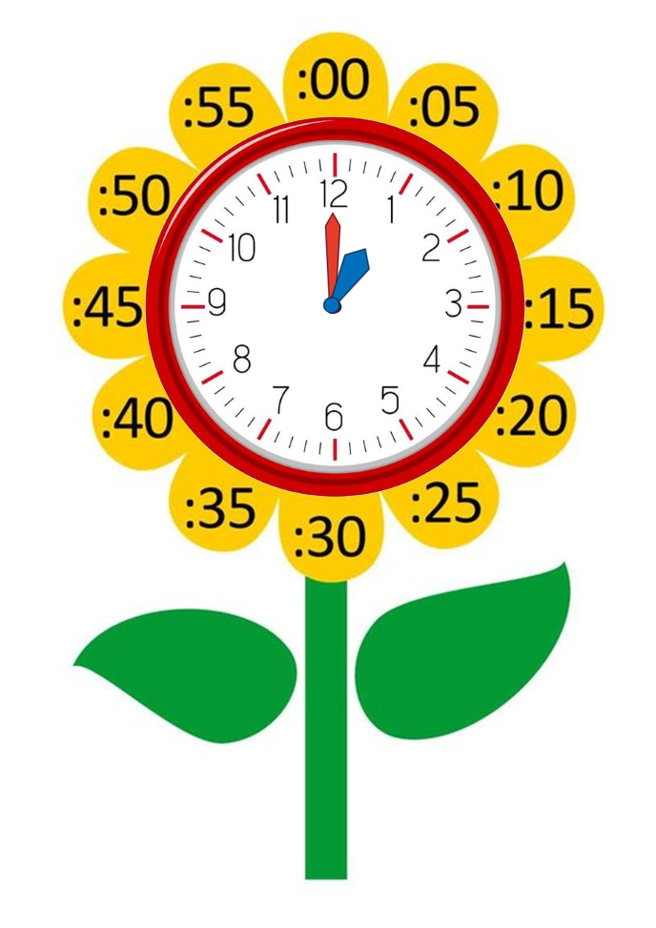
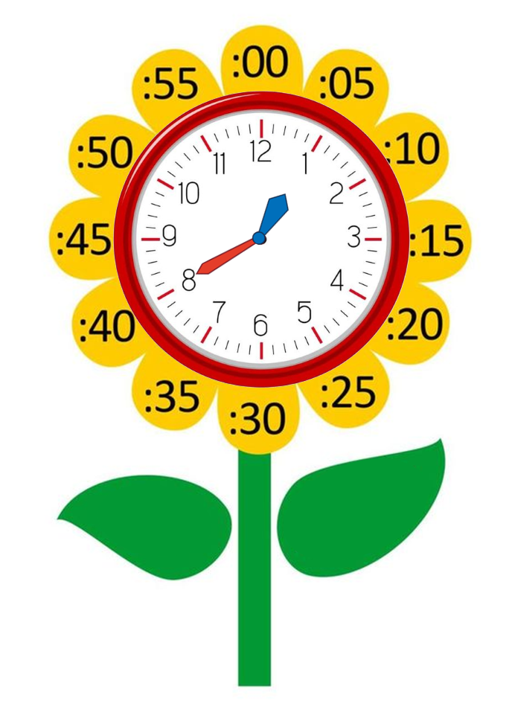
Model sentence
What time is it?
It's + số giờ + o’clock.
It's one o’clock.
It's + số giờ + số phút.
It's one forty.

