Slide 1
UNIT 19. WHICH PLACE
WOULD YOU LIKE TO VISIT?
LESSON 1

Slide 2
Thong nhat park

Slide 3
The museum of history

Slide 4
Trang tien bridge

Slide 5
Thien mu pagoda

Slide 6
Ben thanh market

Slide 7
The city theatre

Slide 8
Bai dinh pagoda

Slide 9
Hoa lu temple

Slide 12
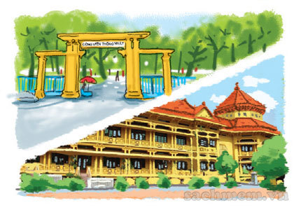
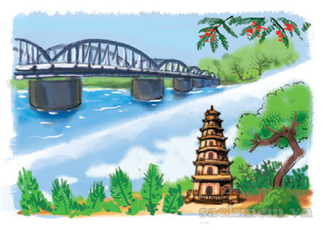
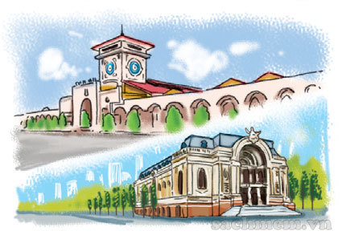
1. Vocabulary
- Thong Nhat Park
- The Museum of History
- Trang Tien Bridge
- Thien Mu Pogoda
- Ben Thanh Market
- Thi City Theatre
- Bai Dinh Pagoda
- Hoa Lu Temple
2. Model sentence
Which place would you like to visit Bai Dinh Pagoda or Hoa Lu Temple?
I’d like to visit Bai Dinh Pagoda .

Slide 13
Which place would you like to visit
or ?
Thong Nhat Park
The Museum of History
I’d like to visit .
Thong Nhat Park

Slide 14
Which place would you like to visit
or ?
Trang Tien Bridge
Thien Mu Pagoda
I’d like to visit .
Thien Mu Pagoda

Slide 15
Which place would you like to visit
or ?
Ben Thanh Market
The City Theatre
I’d like to visit .
The City Theatre

Slide 16
Which place would you like to visit
or ?
Bai Dinh Pagoda
Hoa Lu Temple
I’d like to visit .
Bai Dinh Pagoda

Slide 17
LISTEN AND circle
1
2
3
1.Which place would Mai like to visit?
a.the City Theatre b.Ben Thanh Market
2.Which place would Tom like to visit?
a.Thien Mu Pagoda b.Trang Tien Bridge
3. Which place would Linda like to visit?
a.Bai Dinh Pagoda b.Hoa Lu Temple

Slide 18
READ AND COMPLETE
park
museum
centre
would
somewhere
Tony: It’s Sunday today.
Let’s go (1) in the city.
Phong: Which place (2) you like to visit, Thong Nhat (3) or the History Museum?
Tony: I’d like to visit the (4)
Phong: That’s a good idea!
Tony: Where is it?
Phong: It’s in the (5) of the city.
Tony: OK. Let’s go now.
somewhere
would
park
museum
centre

