Slide 1
Unit 1
What’s your address?
Lesson 2

Slide 2
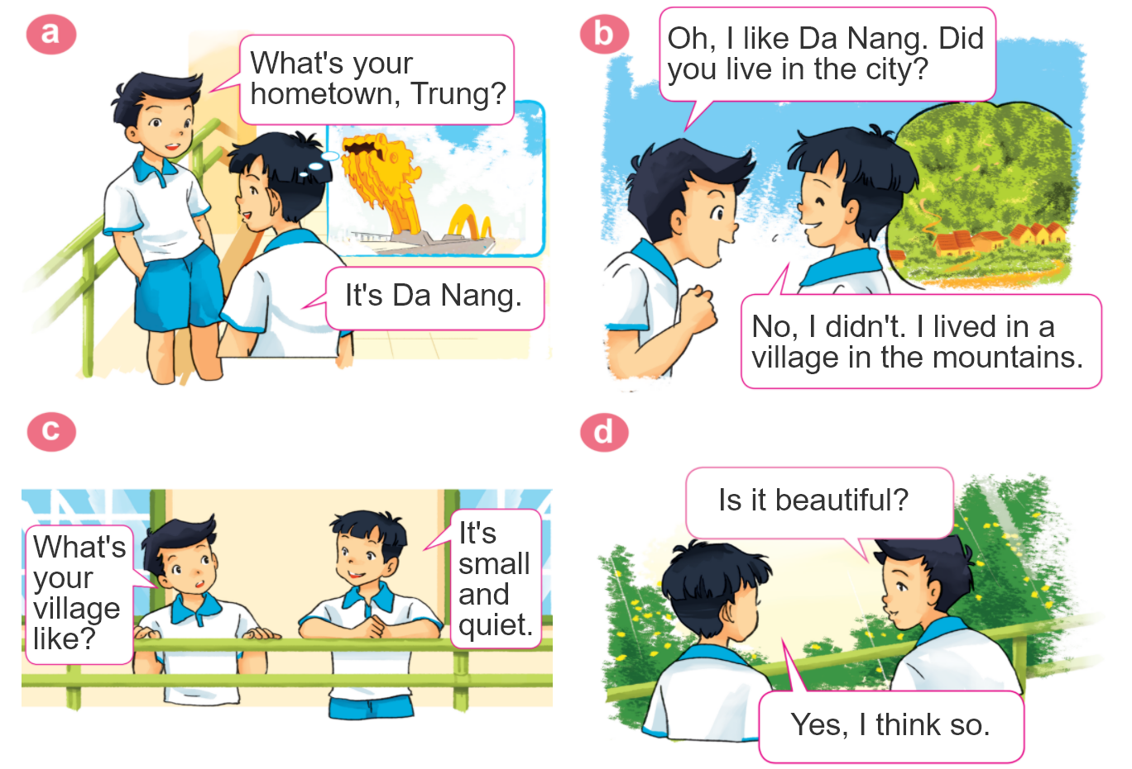
1. Look, listen and repeat.

Slide 3
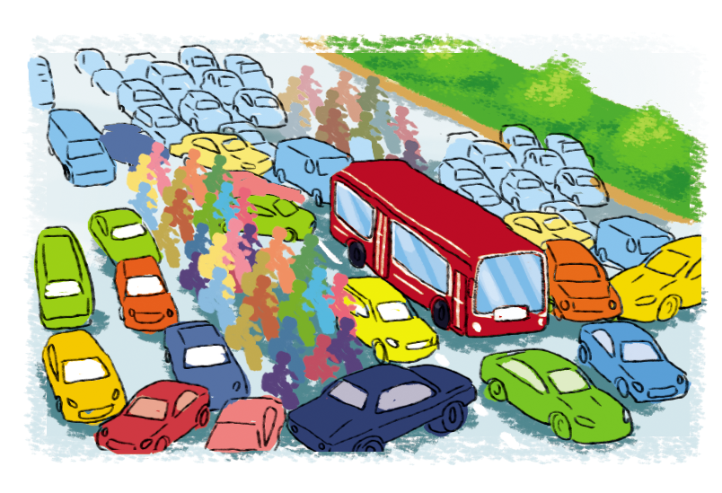
2. Point and say
city,
big and busy
What's the ________ like?
city
It's __________________.
big and busy

Slide 4
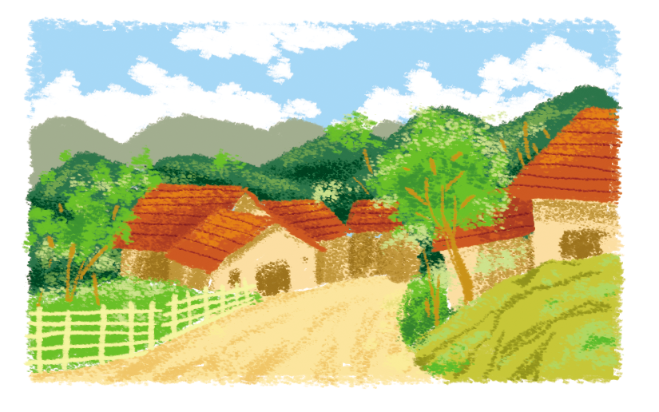
2. Point and say
village,
far and quiet
What's the ________ like?
village
It's __________________.
far and quiet

Slide 5
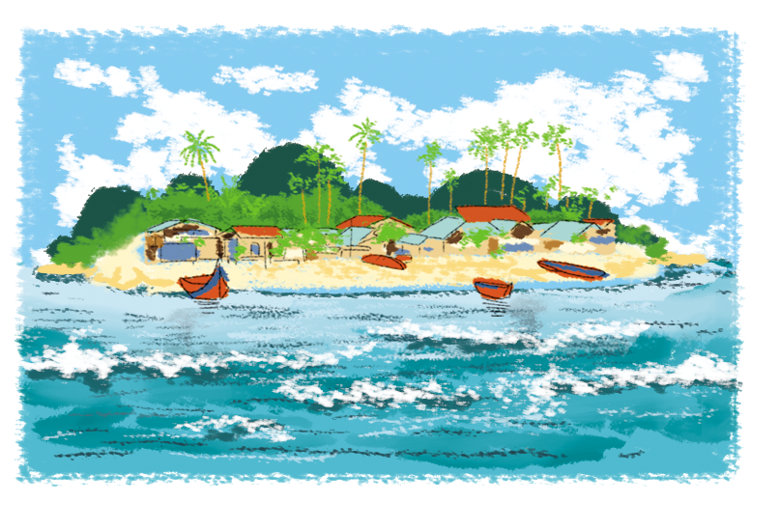
2. Point and say
island,
small and pretty
What's the ________ like?
island
It's __________________.
small and pretty

Slide 6
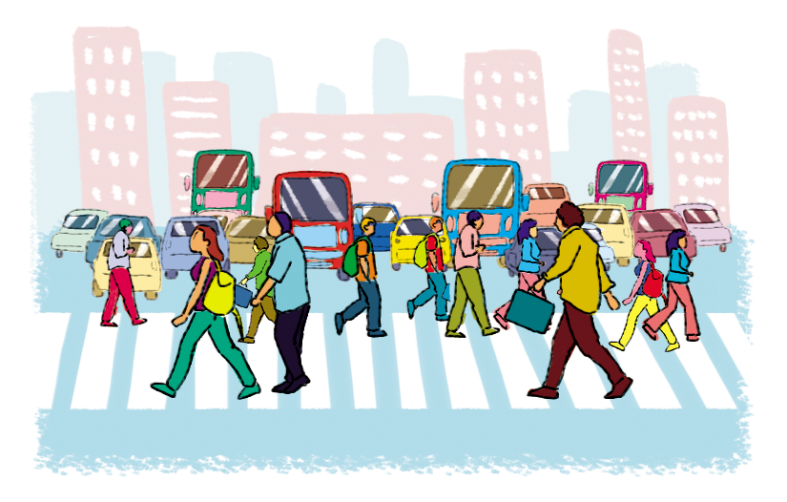
2. Point and say
town,
large and crowded
What's the ________ like?
town
It's __________________.
large and crowded

Slide 7
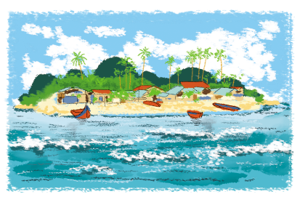
2. Point and say
What's the ________ like?
It's ___________.
city,
big and busy
town,
large and crowded
village,
far and quiet
island,
small and pretty

Slide 8
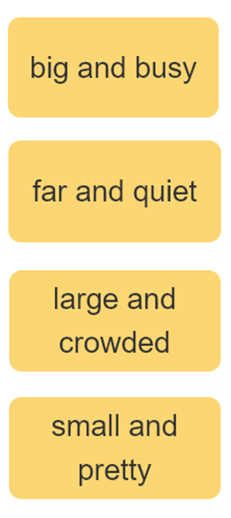
3. Let’s talk
I live ____________.
Where do you live?
What's it like?
It’s ______.
Who do you live with?
I live with ________.
parents
grandparents

Slide 9
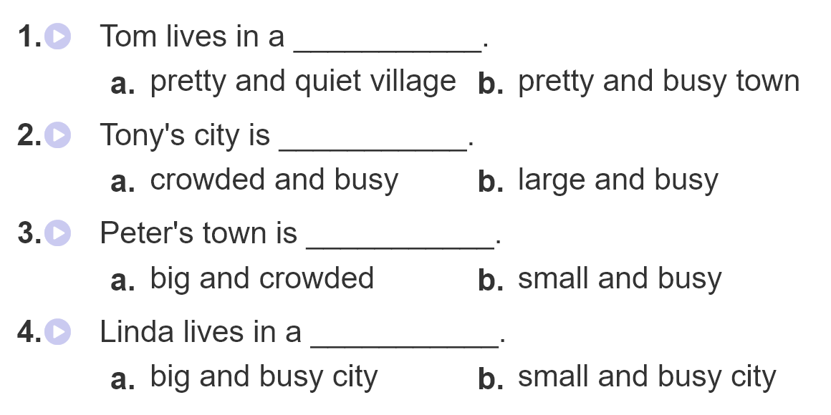
4. Listen and circle

Slide 10
5. Write about you.

Slide 11
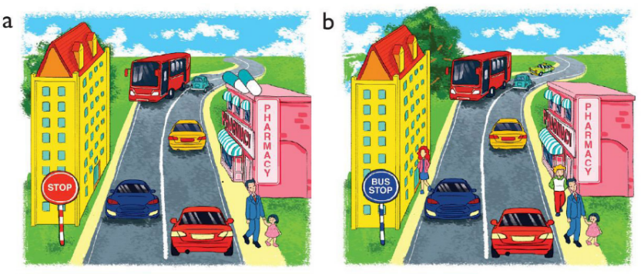
6. Let’s play
Spot the difference
(Click the different spot)

