Slide 1
Unit 3: WEATHER
Lesson 4.1
Page 43

Slide 2
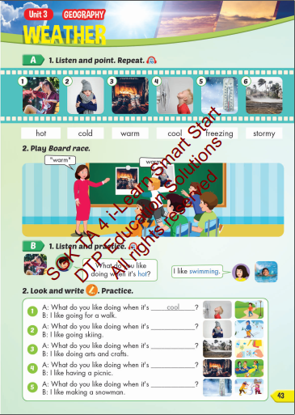
Lesson Outline
Warm-up
Vocabulary
Structure
Consolidation
Wrap-up

Slide 3
Objectives
By the end of this lesson, students will be able to the weather like today.
Vocabulary: Cold, Hot, Warm, Freezing, Cool, Stormy
Structure: What do you like doing when it's hot?
I like swimming.

Slide 4
WARM UP

Slide 5
What is this?
Coat
Gloves
Sunglasses

Slide 6
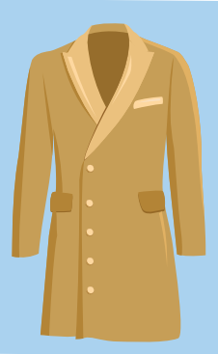
What is this?
Umbrella
Coat
Cap

Slide 7
What is this?
Cap
Raincoat
Gloves

Slide 8
What is this?
Sunglasses
Raincoat
Umbrella

Slide 9
What is this?
Coat
Umbrella
Cap

Slide 10
What is this?
Raincoat
Cap
Gloves

Slide 11
Vocabulary

Slide 13
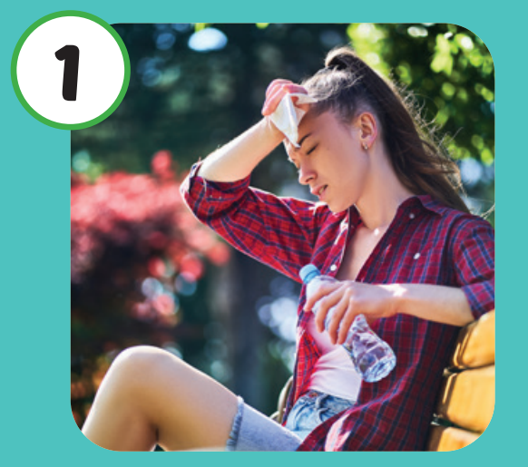
Listen and repeat.
Click each picture to hear the sound.
Hot
/hɑːt/
Nóng

Slide 14
Listen and repeat.
Click each picture to hear the sound.
Cold
/koʊld/
Lạnh

Slide 15
Listen and repeat.
Click each picture to hear the sound.
Warm
/wɔːrm/
Ấm áp

Slide 16
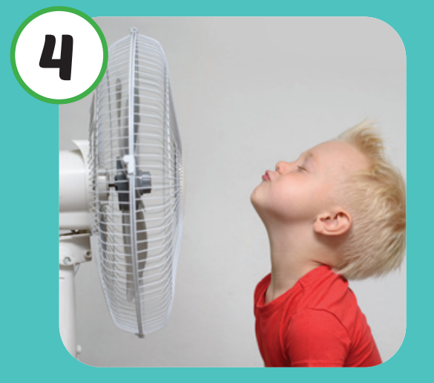
Listen and repeat.
Click each picture to hear the sound.
Cool
/kuːl/
Mát mẻ

Slide 17
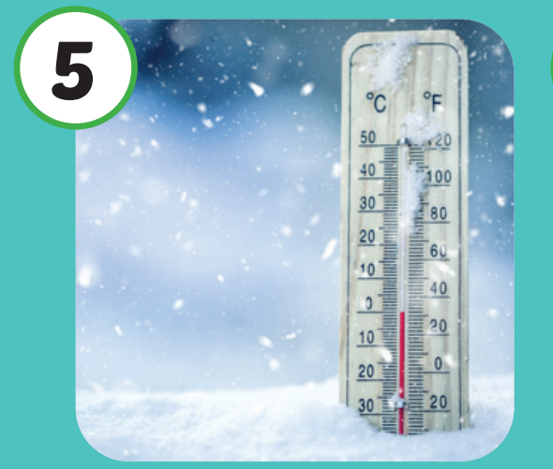
Listen and repeat.
Click each picture to hear the sound.
Freezing
/ˈfriːzɪŋ/
Lạnh cóng

Slide 18
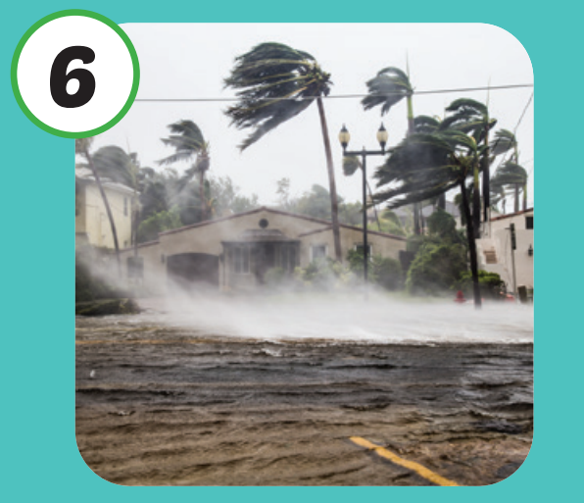
Listen and repeat.
Click each picture to hear the sound.
Stormy
/ˈstɔːrmi/
Có bão

Slide 19
Practice

Slide 21
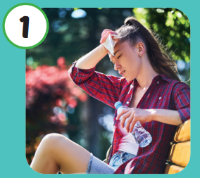
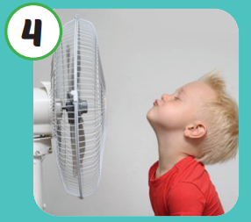
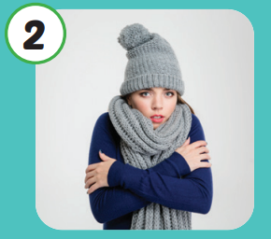
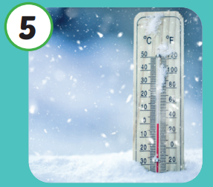
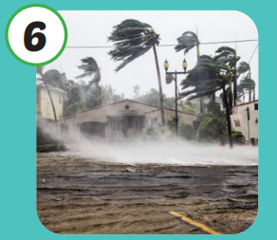
Hot
Cool
Cold
Freezing
Warm
Stormy

Slide 22
Structure

Slide 23
Structures
What do you like
doing when it's hot?
I like swimming.

Slide 24
What do you like doing when it's hot?
I like swimming.

Slide 25
cold
stormy

Slide 26
warm
freezing

Slide 27
CONSOLIDATION

Slide 28
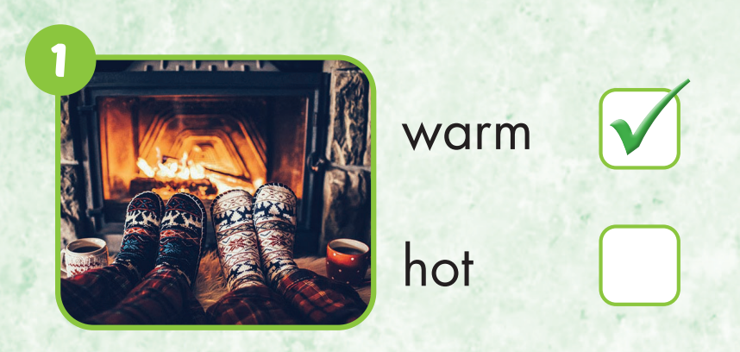

Slide 29
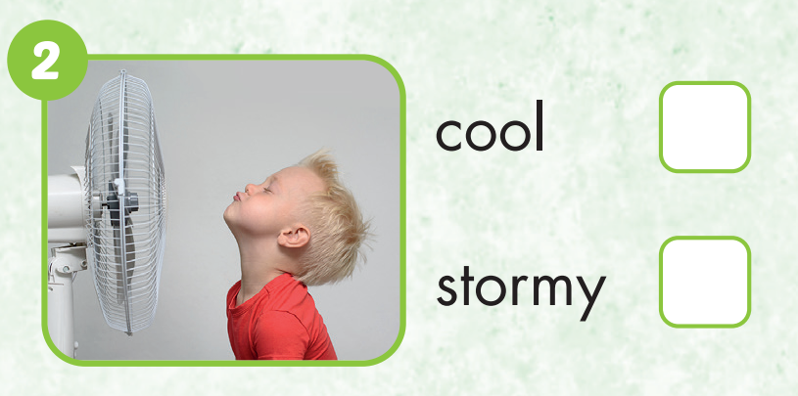

Slide 30
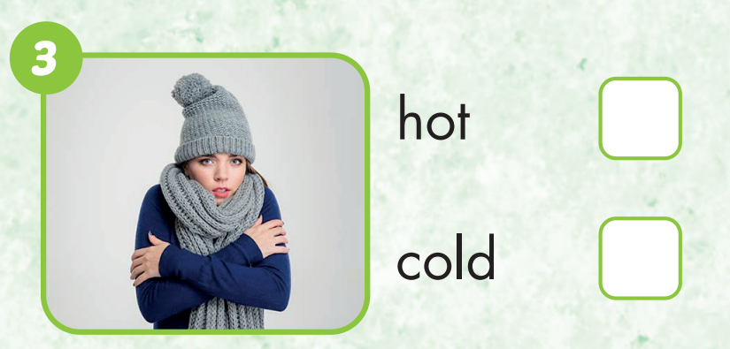

Slide 31
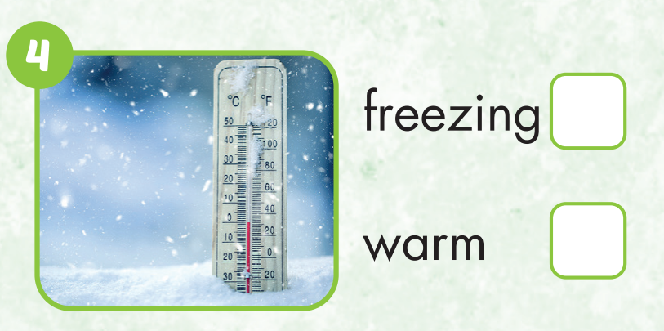

Slide 32
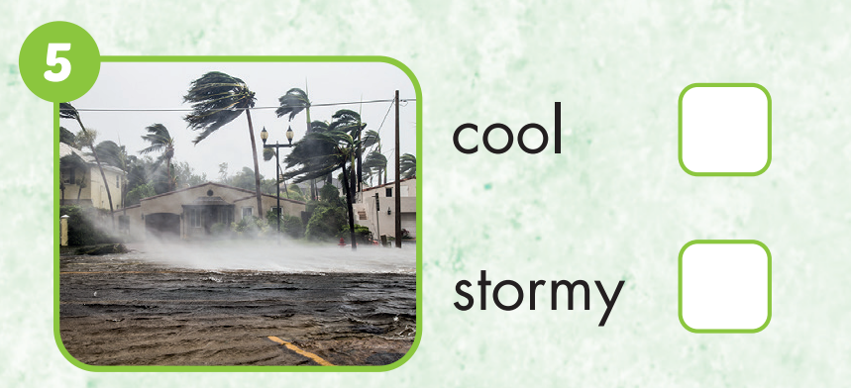

Slide 33
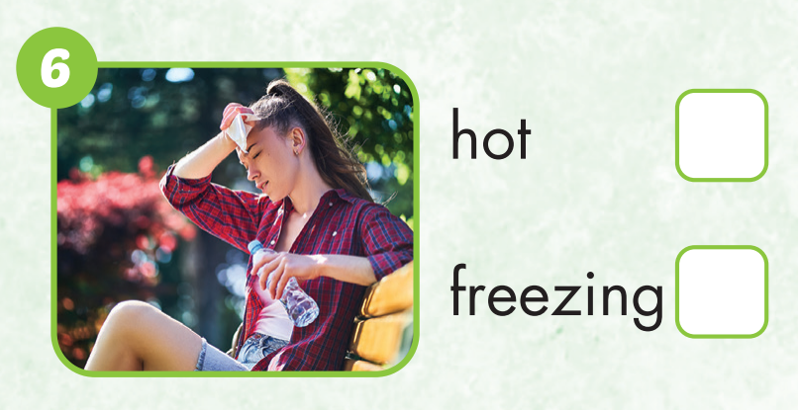

Slide 34
WRAP-UP

Slide 35
Lesson 3
Today’s lesson
Vocabularies
Hot
Cold
Warm
Cool
Freezing
Stormy
Structures/ Sentence patterns
What do you like doing when it's hot?
I like swimming.

Slide 36
Homework
Practice the vocabularies and structure; and make sentences using them.
Do the exercises in Tiếng Anh 4 i-Learn Smart Start WB (page 28).
Do the exercises in Tiếng Anh 4 i-Learn Smart Start Notebook (page 19).
Prepare the next lesson (page 44 SB).
Play the consolidation games in Tiếng Anh 4 i-Learn Smart Start DHA App on www.eduhome.com.vn

Slide 37
Have a nice day!

