Slide 1

Unit 5: Sports and hobbies
Lesson 2.3
Page 72

Slide 2
Lesson Outline
Warm-up
Listening
Consolidation
Wrap-up

Slide 3
Objectives
By the end of this lesson, students will be able to pronounce the sound /θ / and talk about their school timetables.
Phonic: /θ /
Structure: When do you have English?
- I have English on Wednesdays and Fridays.

Slide 4

WARM UP

Slide 5


Choose a number and fill in the blank.
c_tching
thr_w_ng
1
2
a
o
i
k_c_ing
_itting
Click on each word to hear the sound.
3
i k
4
h
Click here to show answers.
1
2
3
4

Slide 6

It’s time to learn …

Slide 7
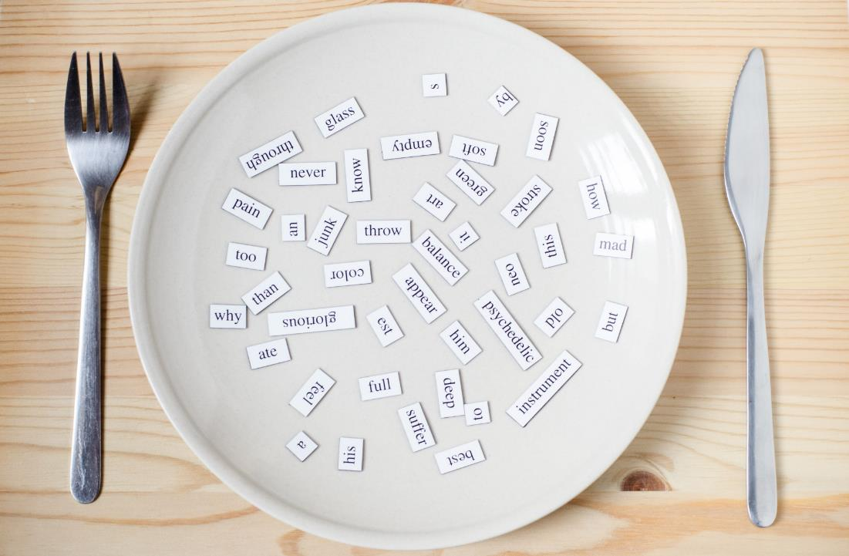
Phonics
/θ/

Slide 8

/θ/
throwing
three
Click on each word to hear the sound.

Slide 9


/ θ /, / θ /, / θ /,
/ θ /, / θ /, / θ /,
throwing, three,
/ θ /, / θ /, / θ /
/ θ /, / θ /, / θ /,
/ θ /, / θ /, / θ /,
throwing, three,
/ θ /, / θ /, / θ /
Click to follow the lyrics.
Notes:
GV click lần 1 để follow lyric 1
Gv click lần 2 để follow lyric 2

Slide 10
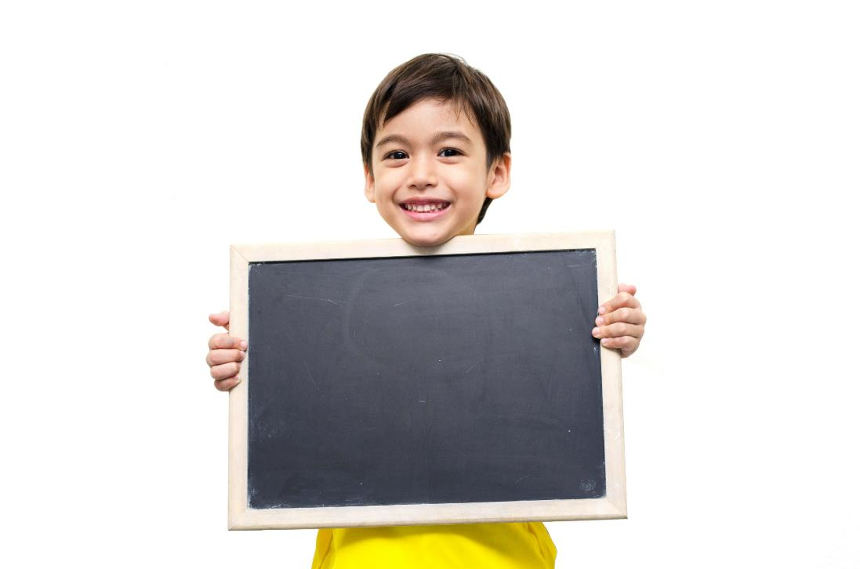
Listening

Slide 11

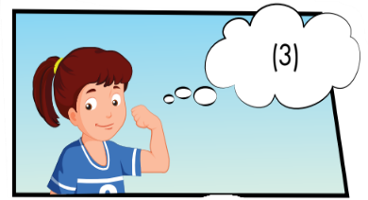
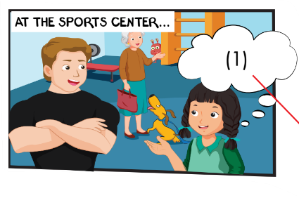
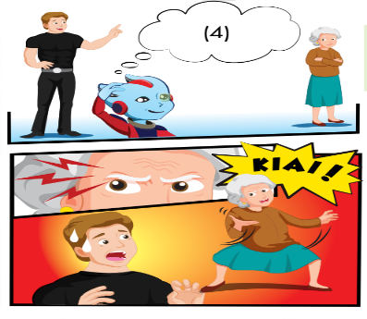
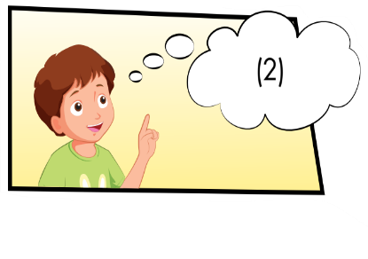
What actions can you see?
Who can you see?
What actions can you see?
How does the man feel?

Slide 12
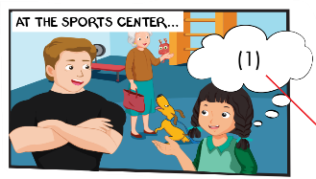

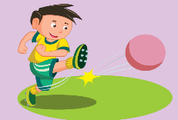
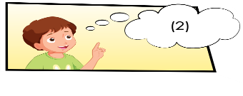
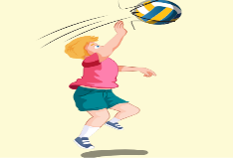
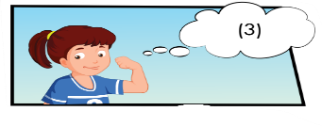
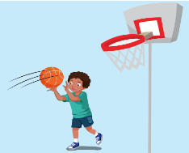
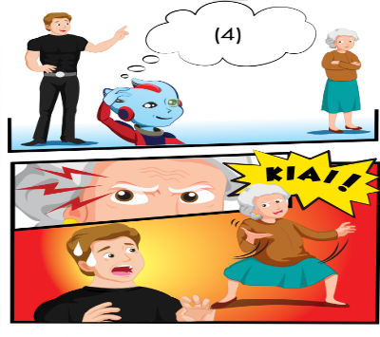
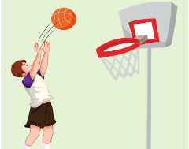
kicking, soccer
hitting balls, volleyball
catching, basketball
throwing,basketball

Slide 13
Click on the number to hear the sound
James: What are you good at, Mai?
Mai: I’m good at
James: Good. You can play with the team
1
Kicking.
soccer
James: What are you good at, Tom?
Tom: I’m good at
James: OK. for you.
2
catching.
Basketball

Slide 14
James: What about you, Lucy?
Lucy: I’m good at .See?
James: Lucy, the team.
3
hitting balls
volleyball
Click on the number to hear the sound

Slide 15
James: Alfie, what are you good at?
Alfie: I’m good at balls.
James: Good. team.
OK, Grandma? What are you good at?
Grandma: I’m good at doing this! Kiai!
Children: Wow!
throwing
Basketball
4
Click on the number to hear the sound

Slide 16
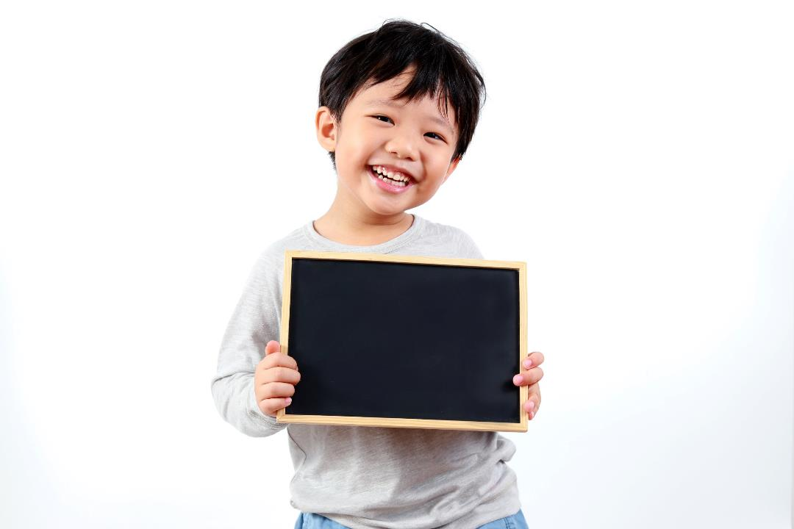
Practice

Slide 17
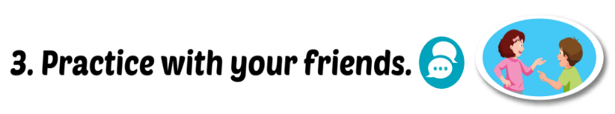
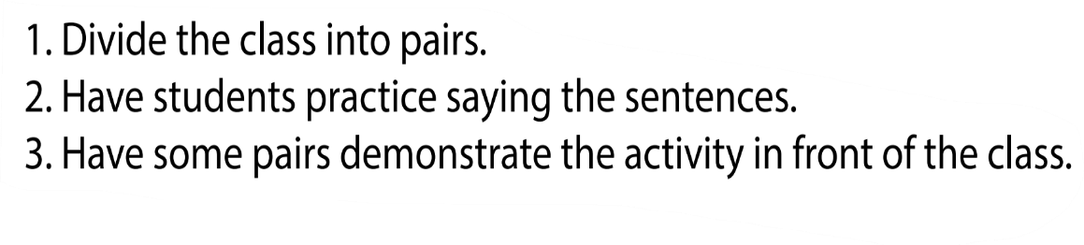


What are you good at?
I’m good at …

Slide 18

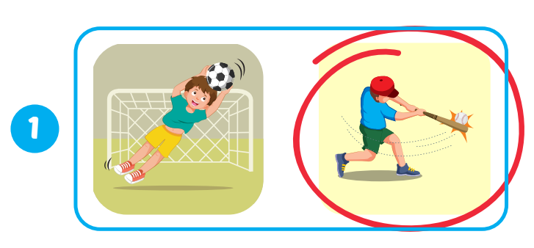
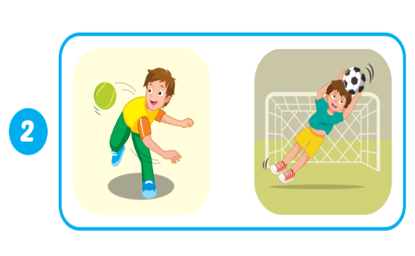
Extra Practice
WB, page 51.
Click on the picture to hear the sound

Slide 19
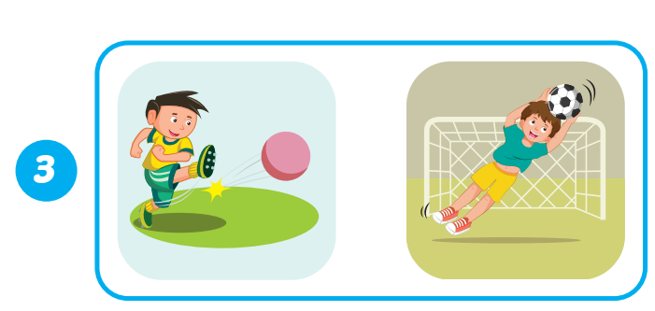
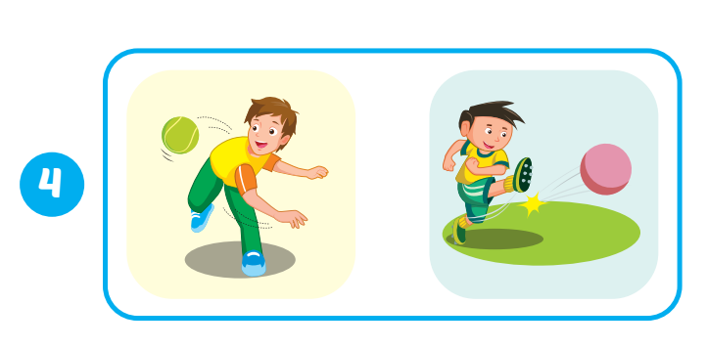
Extra Practice
WB, page 51.
Click on the picture to hear the sound

Slide 20

CONSOLIDATION

Slide 21
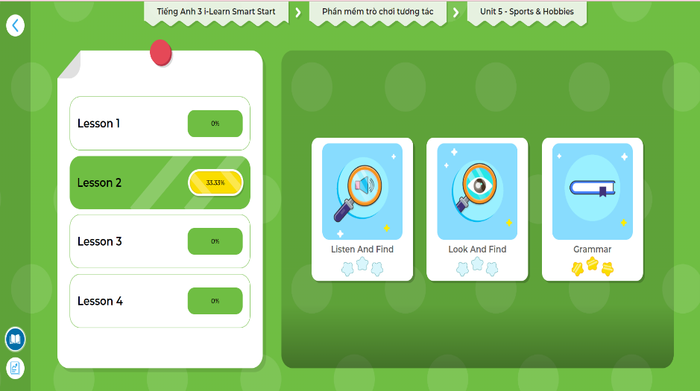
LET’S PLAY!
Click here to play the games.

Slide 22

WRAP-UP

Slide 23

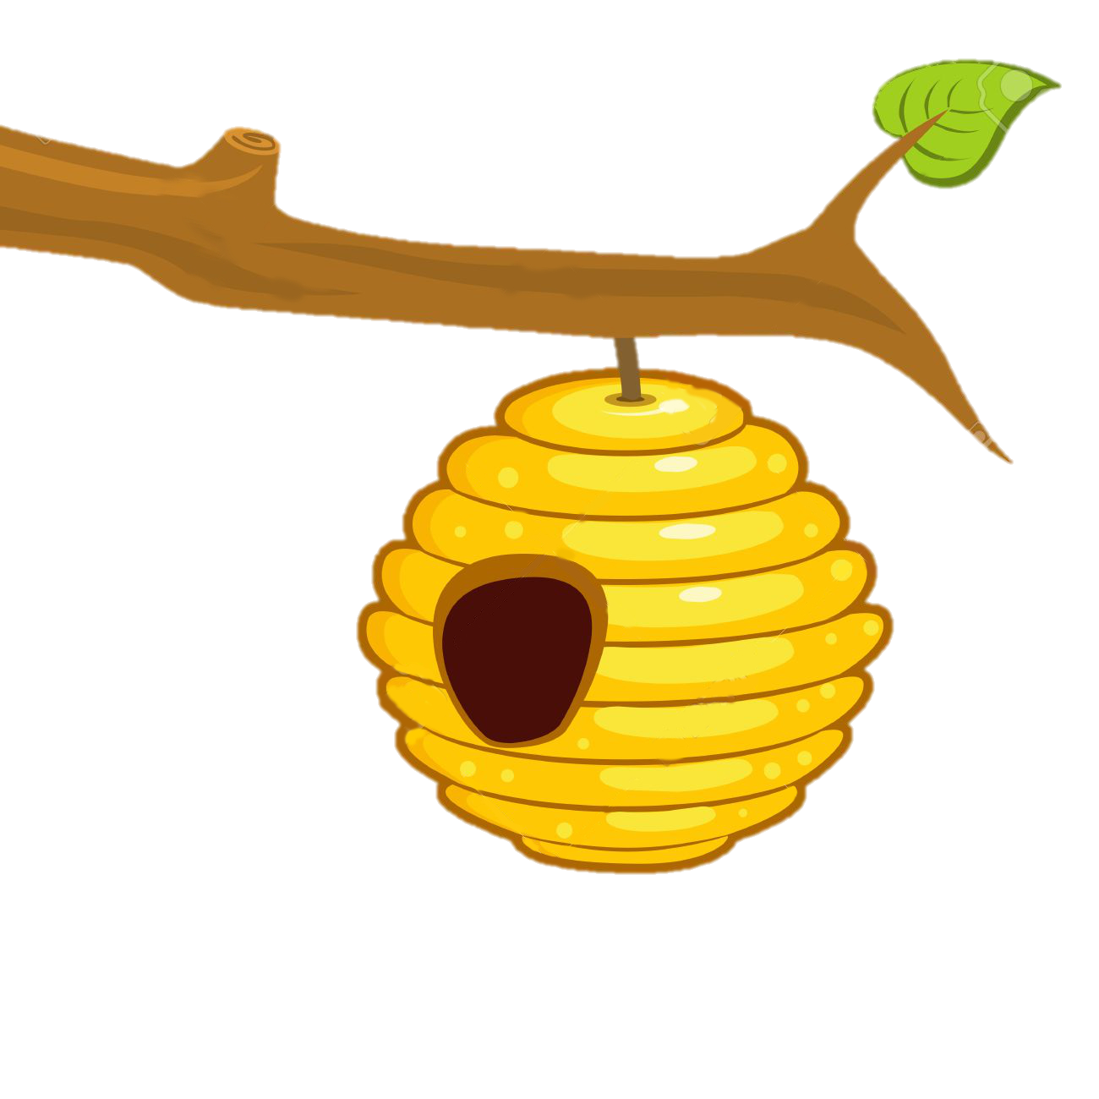




Bees return
to the hive
Play

Slide 24






Click on any bee to open the question.
End

Slide 25

Click the icon to hear the sound
📢
catching
Click to show answer.
Back

Slide 26
Rewrite the word: ihtgint
hitting
Click to show answer.
Back

Slide 27
Rewrite the word: kngckii
kicking
Click to show answer.
Back

Slide 28
Click the icon to hear the sound
📢
throwing
Click to show answer.
Back

Slide 29
Click the icon to hear the sound
📢
hitting
Click to show answer.
Back

Slide 30
Click the icon to hear the sound
📢
I’m good at..
Click to show answer.
Back

Slide 31
Click the icon to hear the sound
📢
kicking
Click to show answer.
Back

Slide 32
Rewrite the word: chatcgni
catching
Click to show answer.
Back

Slide 33
/ˈθrəʊɪŋ/
ném
throwing
Click to show answer.
Back

Slide 34
Today’s lesson
Phonics
/θ/
Structures/ Sentence patterns
What are you good at?
- I’m good at…

Slide 35
Lesson 3
Homework
Practice the vocabularies/ structures and make sentences using them.
Do the exercises on page 51 WB
Do the exercises in Tiếng Anh 3 i-Learn Smart Start Notebook on page 35.
Prepare the next lesson (page 73 SB)
Play the consolidation games in Tiếng Anh 3 i-Learn Smart Start DHA App on www.eduhome.com.vn

Slide 36
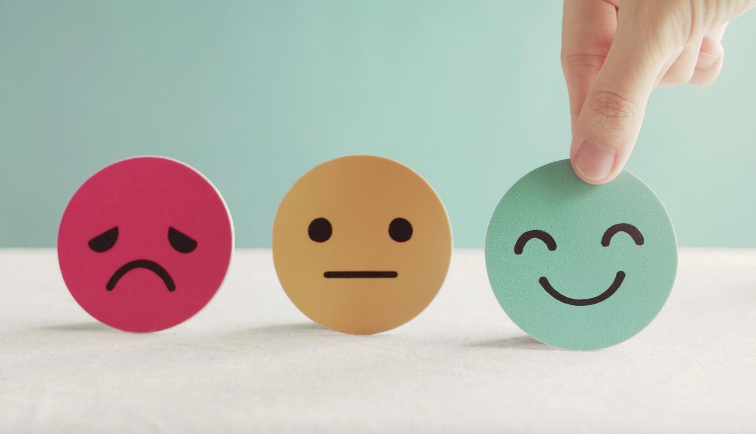
Lesson 3
Stay positive and have a nice day!

