Slide 1

Unit 4: HOME
Lesson 1.2
Page 53

Slide 2
Lesson Outline
Warm-up
Listening
Consolidation
Wrap-up

Slide 3
Objectives
By the end of this lesson, students will be able to ask where people are.
Vocabulary: Revision
(bedroom, bathroom, kitchen, yard).
Structure: Where’s Dad? I think he’s in the kitchen.
Where’s Tom? He’s in the bedroom.
Help!

Slide 4

WARM UP

Slide 5
Unscramble the letters.
living room
1
l
v
i
r
o
m
o
i
g
n
bathroom
2
t
h
r
o
a
b
o
m
bedroom
3
b
e
r
d
m
o
o
r
kitchen
4
c
e
h
k
i
t
n
yard
5
a
r
y
d

Slide 6

It’s time to learn …

Slide 7


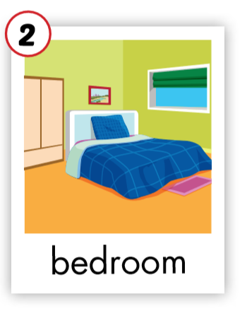
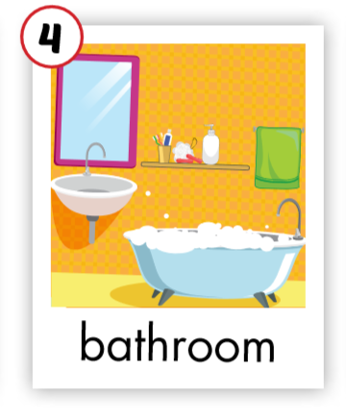
C. 1. Listen and repeat.
Click on the earphone/ each English word to hear the sound.
1
2

Slide 8


C. 2. Chant.
Click on the earphone to practice the chant.
/u:/ /u:/ /u:/
bedroom
bathroom
/u:/ /u:/ /u:/
/u:/ /u:/ /u:/

Slide 9

Listening

Slide 10

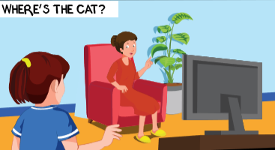
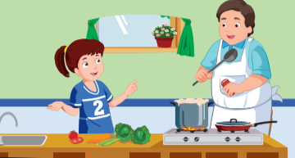
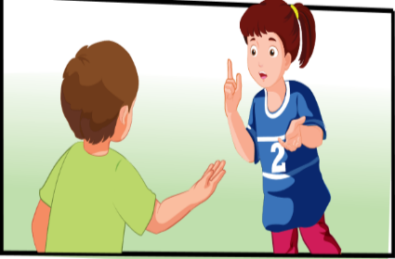
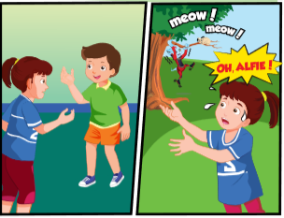
Click on the earphone to listen.

Slide 11



Click on the earphone or each sentence to listen.
Where’s Fluffy, Mom?
She’s with Daddy.
Where’s Dad?
He’s in the
kitchen.

Slide 12
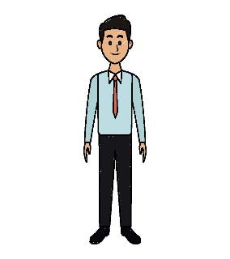
Click the earphone or each sentence to listen.
Dad! Where’s Fluffy?
I think she’s with Tom.
Oh. Where’s Tom?
bedroom.
He’s in the

Slide 13


Click on the earphone or each sentence to listen.
Hi, Tom. Is Fluffy here?
I think Ben has her.
Where’s Ben?
bedroom.
He’s in the

Slide 14

Click the earphone or each sentence to listen.
Hi, Ben. Where’s Fluffy?
She’s with Alfie.
Where’s Alfie?
yard.
He’s in the
Oh, Alfie!
Help! Help!

