Slide 1

Unit 4: HOME
Lesson 2.1
Page 55

Slide 2
Lesson Outline
Warm-up
Vocabulary
Structure
Consolidation
Wrap-up

Slide 3
Objectives
By the end of this lesson, students will be able to ask what people are doing.
Vocabulary: cleaning, playing, eating, sleeping, cooking.
Structure: What’s he doing? He’s sleeping.

Slide 4

WARM UP

Slide 5
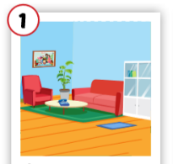
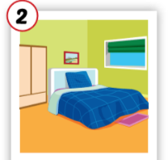
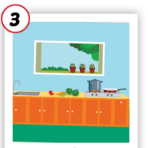
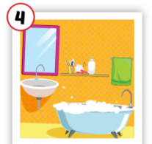
Crossword puzzles
3
k
1
l
i
o
b
r
4
2
e
Notes:
Students play the crossword puzzles. They practice spelling.

Slide 6
Crossword puzzles
3
k
1
l
i
v
i
n
g
r
o
o
m
b
r
4
2
e

Slide 7
Crossword puzzles
3
k
1
l
i
v
i
n
g
r
o
o
m
b
r
4
2
b
e
d
r
o
o
m

Slide 8
Crossword puzzles
3
k
1
l
i
v
i
n
g
r
o
o
m
b
t
r
4
c
h
2
b
e
d
r
o
o
m
n

Slide 9
Crossword puzzles
3
k
1
l
i
v
i
n
g
r
o
o
m
b
a
t
h
r
o
o
m
4
c
h
2
b
e
d
r
o
o
m
n

Slide 10

It’s time to learn …

Slide 11
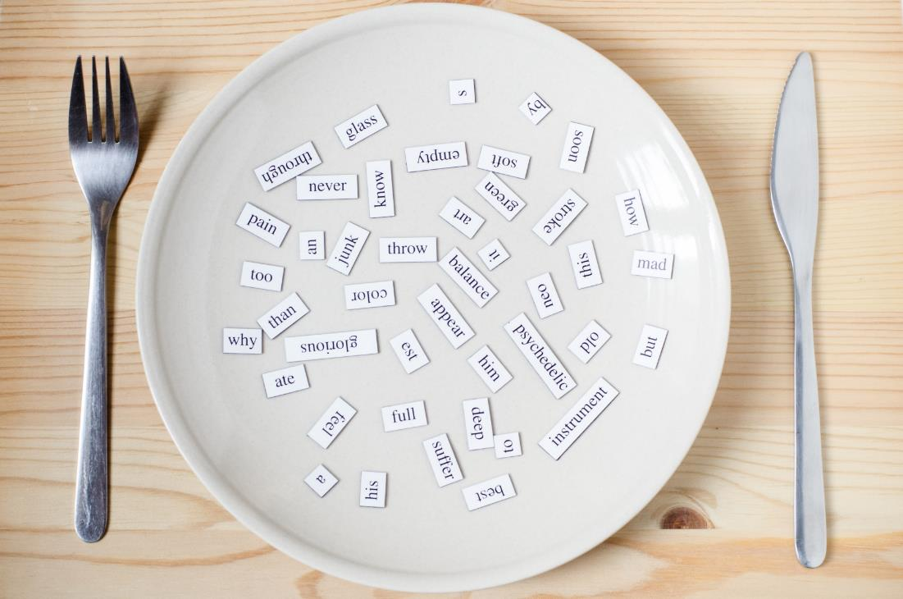
New words
cleaning, playing,
eating,
sleeping, cooking.

